Slide 1
BEAUTY AND THE BELIEVER

Slide 2
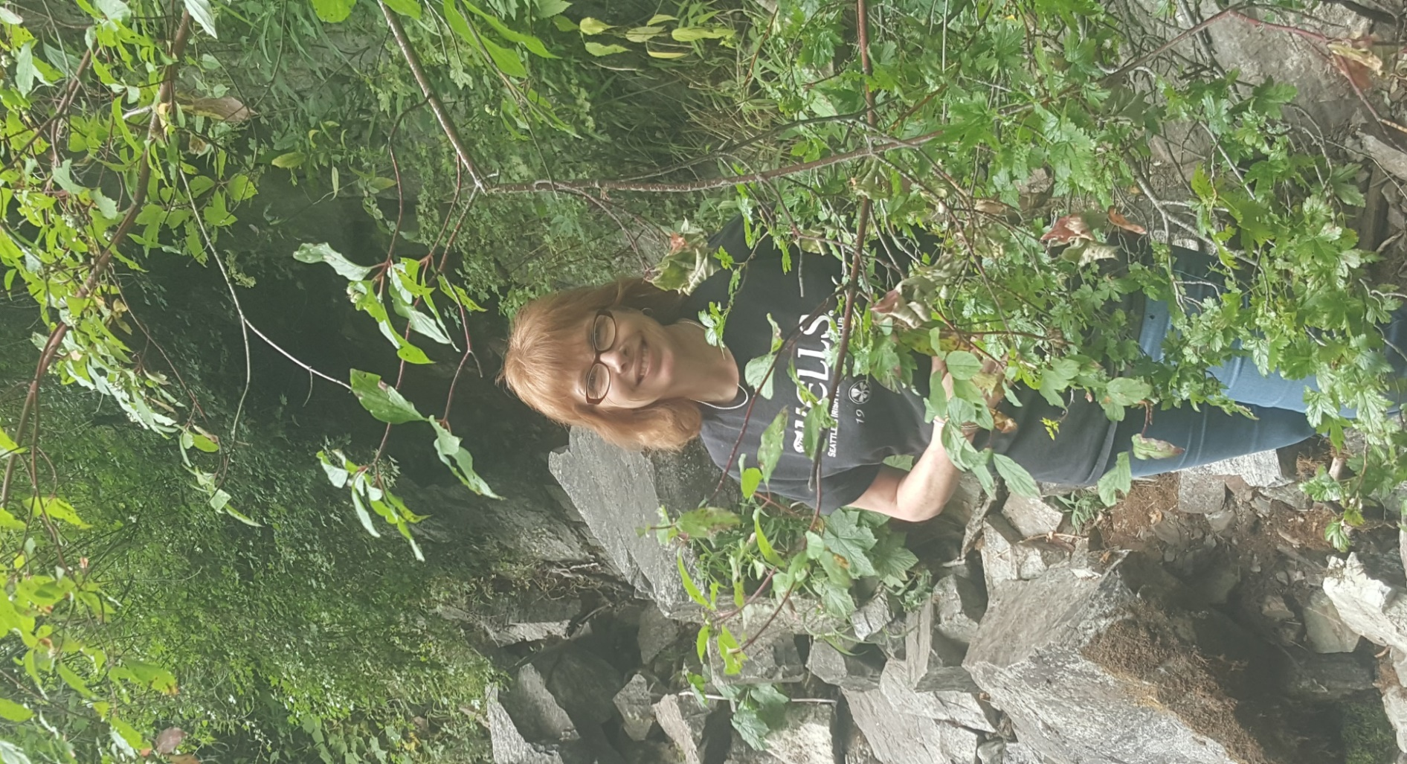

Slide 3
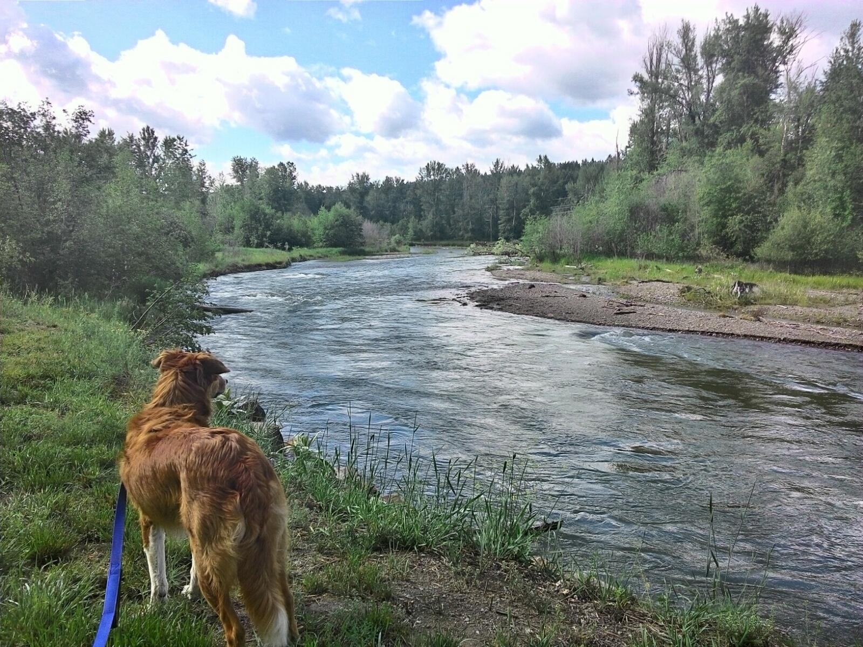

Slide 8
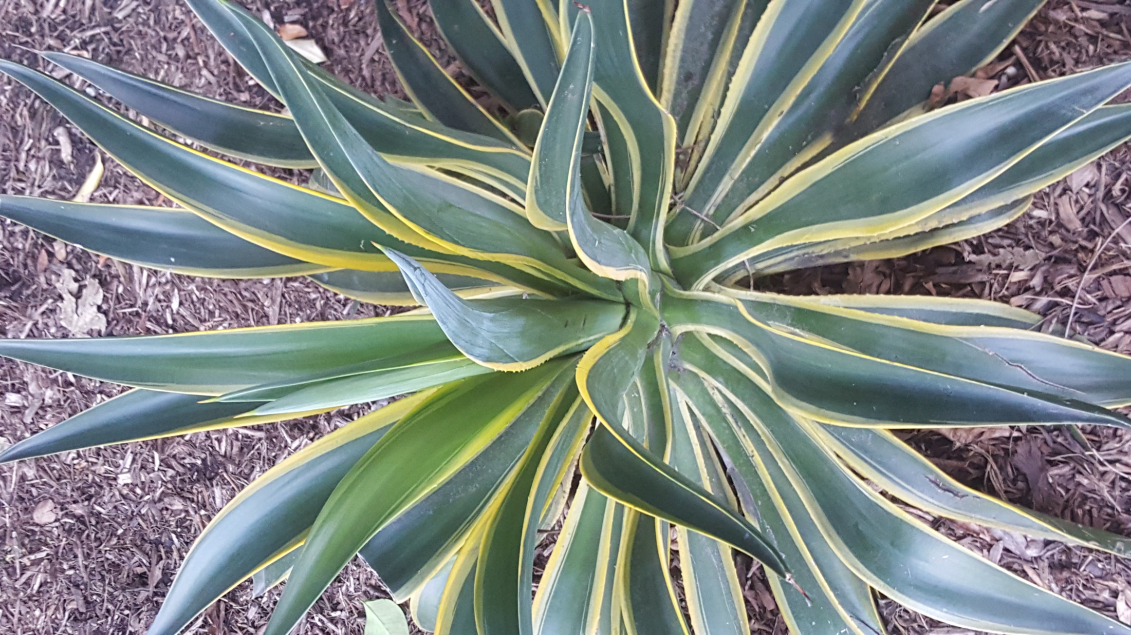

Slide 9
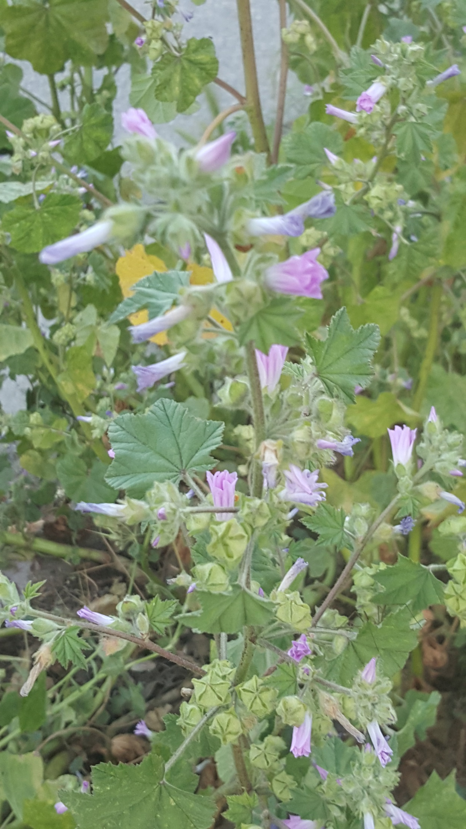

Slide 10
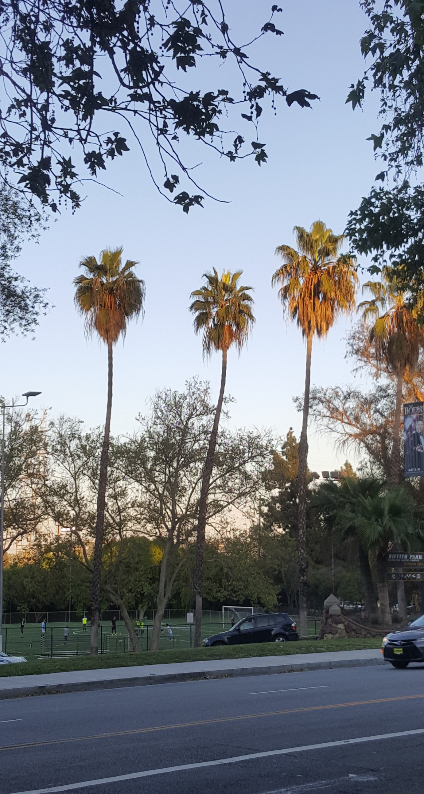

Slide 11
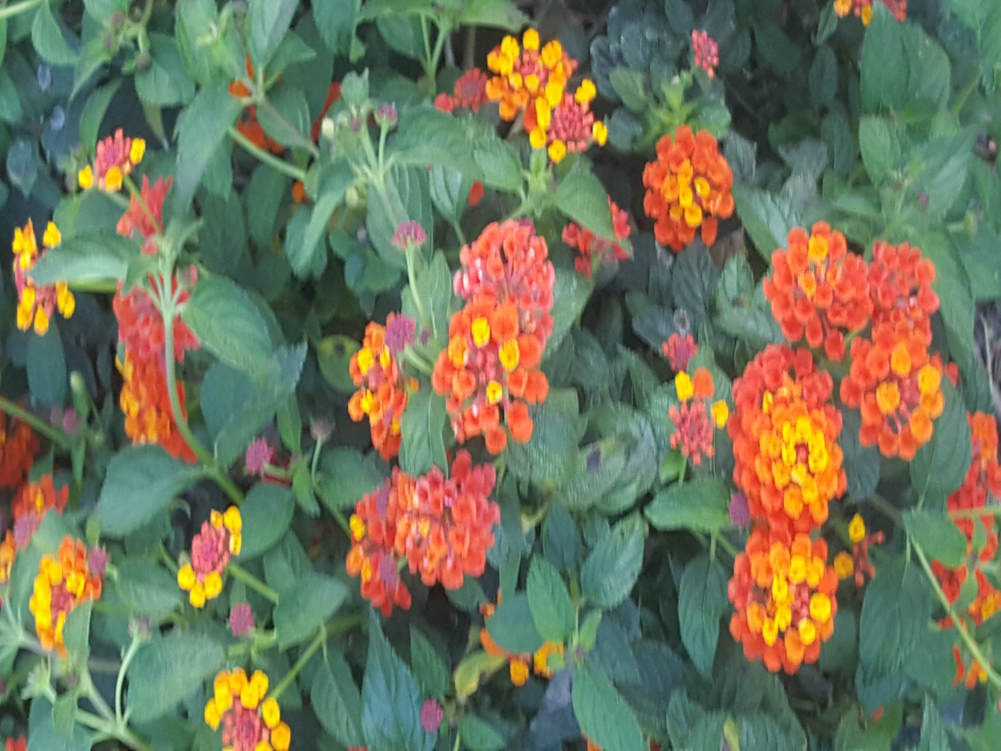

Slide 12
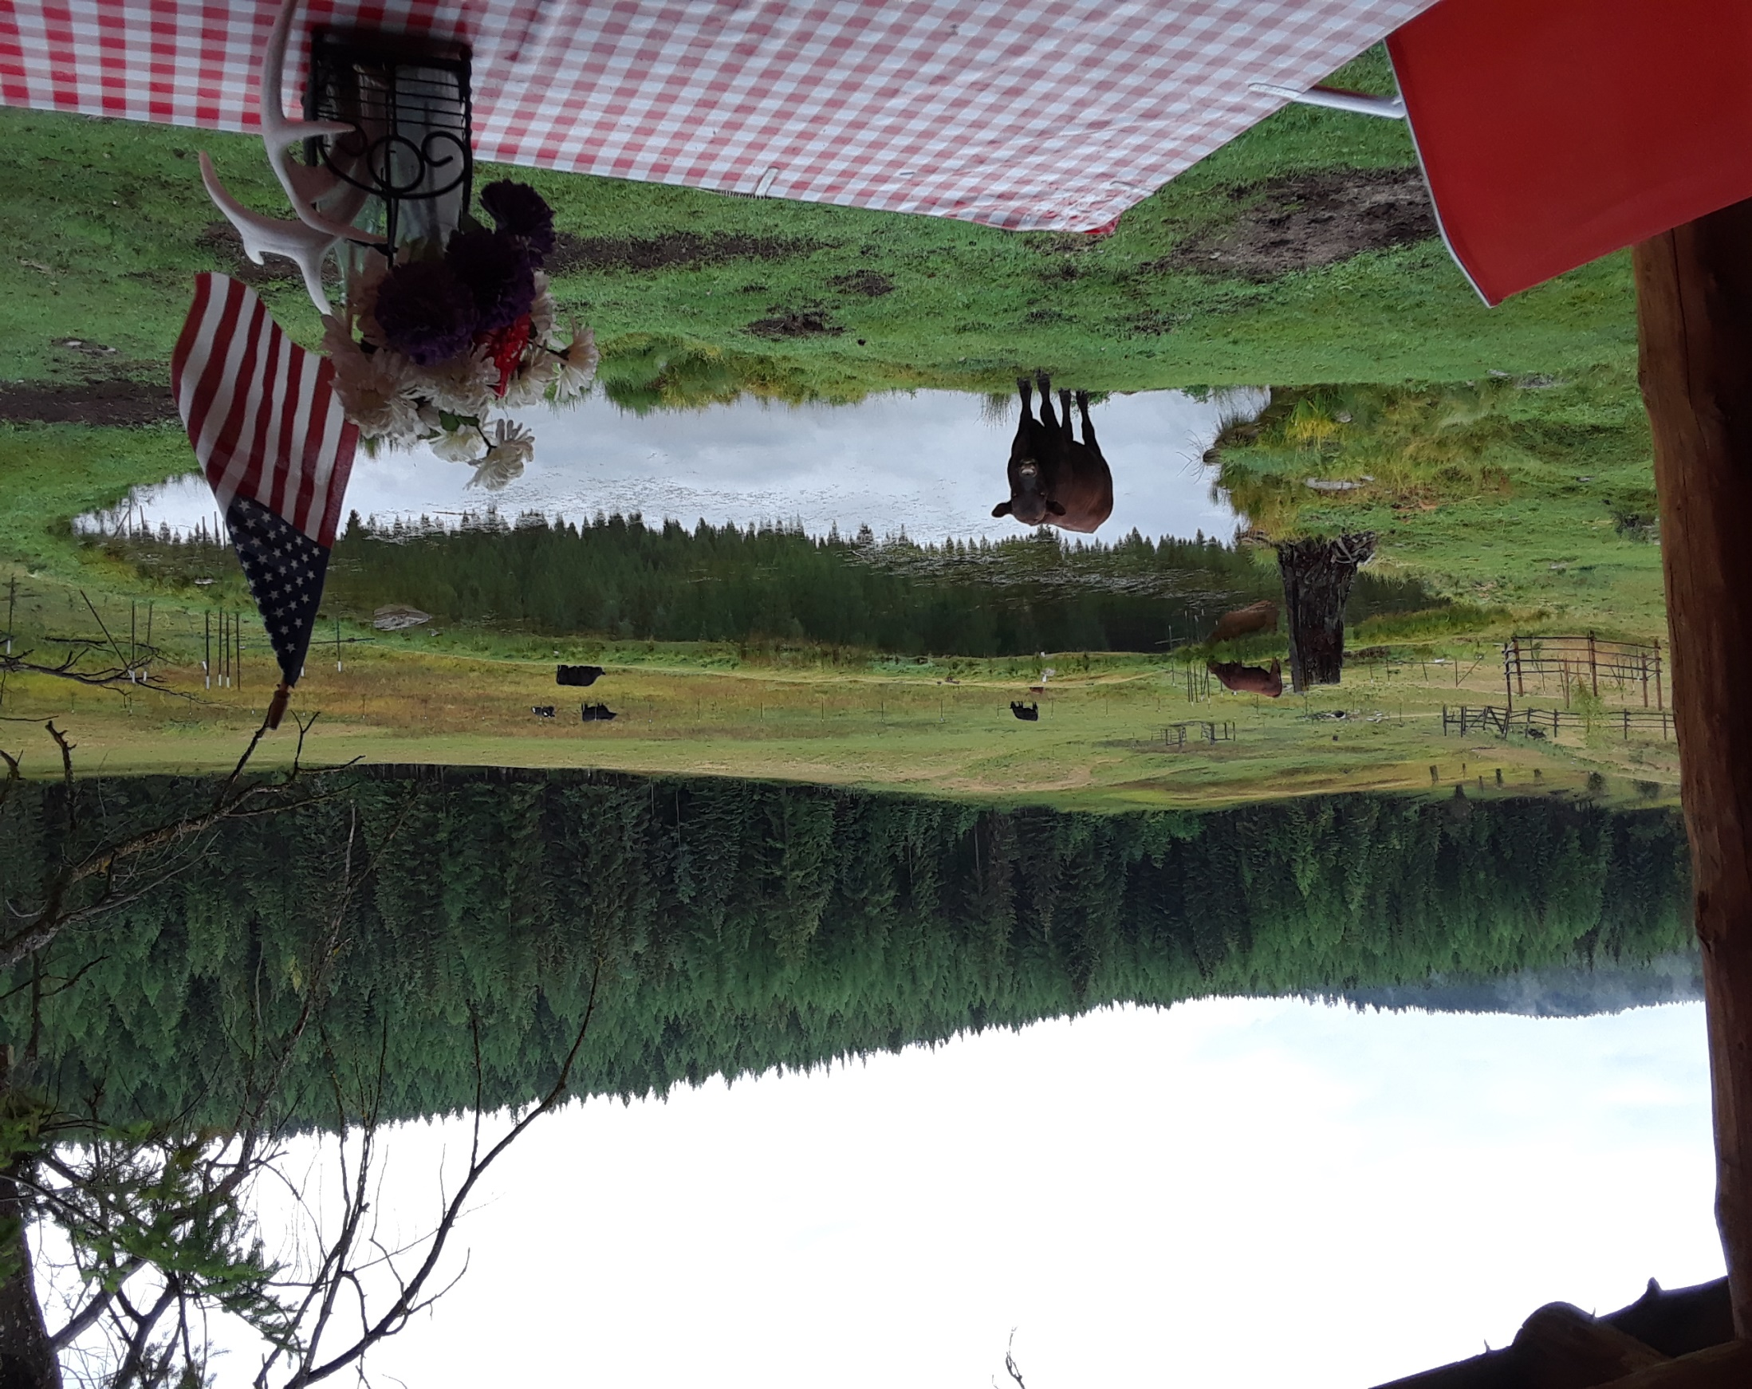

Slide 13
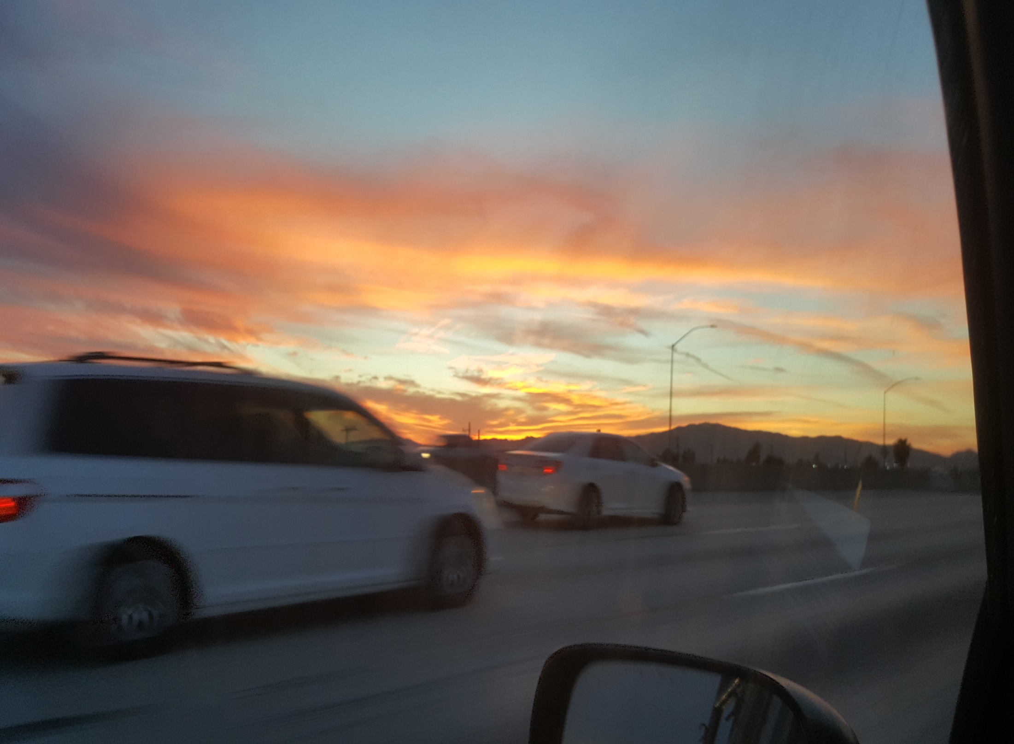

Slide 14
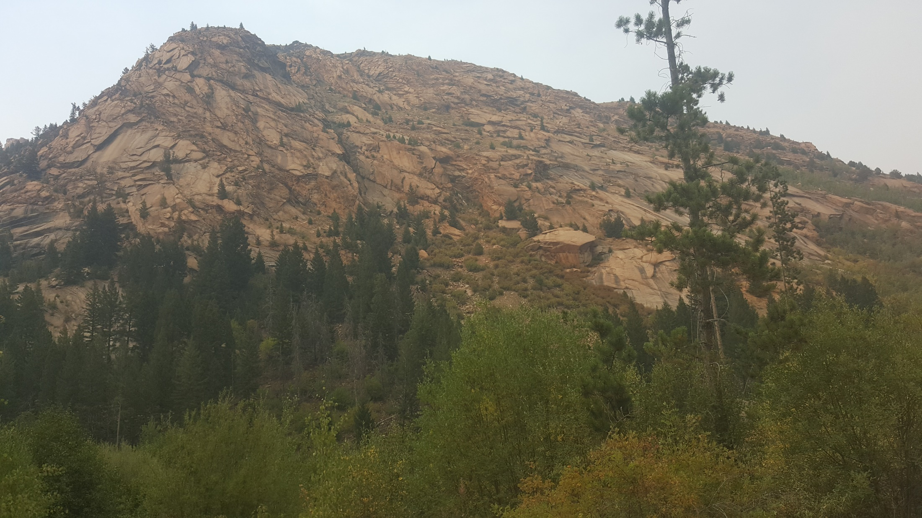

Slide 15
What is beauty?
Why is it part of creation?
What is it’s purpose?
How does it relate to our faith?

Slide 16
Psalms 19:1
The heavens are telling of the glory of God; and their expanse is declaring the work of his hands

Slide 17
Psalms 139:14
I will give thanks to you for I am fearfully and wonderfully made, Wonderful are your works, and my soul knows it very well

Slide 18
Philippians 4:8
…Whatever is true, whatever is honorable, whatever is right, whatever is pure, whatever is lovely, whatever is of good repute, if there is any excellence and if anything worthy of praise, dwell on these things

Slide 19
Zechariah 9:16-17
And the Lord their God will save them in that day as the flock of his people; For they are as the stones of a crown, Sparkling in his hand. For what comeliness and beauty will be theirs

Slide 20
Revelation 21:2
And I saw the holy city, new Jerusalem, coming down out of heaven from God, made ready as a bride adorned for her husband.

Slide 21
Psalms 27:4
One thing that I have asked from the Lord, that I shall seek: That I may dwell in the house of the Lord all the days of my life, To behold the beauty of the Lord.

Slide 22
1 Peter 3:3
Your beauty must not be merely external- braiding the hair, and wearing gold jewelry, or putting on dresses; but let it be the hidden person of the heart, with the imperishable quality of a gentle and quiet spirit, which is precious in the sight of God.

Slide 23
Psalms 8:5
What is man that you take thought of him, And the son of man that you care for him? Yet you have made him a little lower than God, And you crown him with glory and majesty.

Slide 24
What is beauty?
Why is it part of creation?
What is it’s purpose?
How does it relate to our faith?

Slide 25
Building blocks of the faith
Truth
Goodness
Beauty

Slide 26
John 13:34-35
“A new commandment I give to you, that you love one another, even as I have loved you, that you also love one another. By this all men will know that you are my disciples, if you have love for one another”

Slide 27
“Every man is almost always led to believe not through proof, but through that which is attractive….The mind and the heart are like gateways through which truths are received by the soul, but very few enter through the mind….”
Blaise Pascal

Slide 28
How is beauty about God?
Can it change how we live?
Can beauty be an apologetic for God?

Slide 29
Creatures are not born with desires unless satisfaction for those desires exist. A baby feels hunger: well, there is such a thing as food. A duckling wants to swim: well, there is such a thing as water. Men feel sexual desire: well, there is such a thing as sex. If I find in myself a desire which no experience in this world can satisfy, the most probable explanation is that I was made for another world. C. S. Lewis

Slide 30
The existence of beauty is God’s tease: we crave beauty, we always want more, yet it never satisfies. We are seeing through a glass darkly, in our heart we believe in satisfaction, yet our head knows it can’t be had in this lifetime. Beauty is God’s early warning system of the complete and total and permanent satisfaction that we were made for. The satisfaction we can only experience in the presence of Jesus Christ.

Slide 31
BEAUTY AND THE BELIEVER
Or
HOW TO NOT EAT STRAWBERRY PIE LIKE AN ATHEIST

Slide 32
Psalms 19:1
The heavens are telling of the glory of God; and their expanse is declaring the work of his hands

Slide 33
Building blocks of the faith
Truth
Goodness
Beauty

Slide 34
Philippians 4:8
…Whatever is true, whatever is honorable, whatever is right, whatever is pure, whatever is lovely, whatever is of good repute, if there is any excellence and if anything worthy of praise, dwell on these things

Slide 35
John 13:34-35
“A new commandment I give to you, that you love one another, even as I have loved you, that you also love one another. By this all men will know that you are my disciples, if you have love for one another”

Slide 36
“Strawberry pie is eaten around the world every day. Yet if I simply eat and enjoy it for it’s own sake without thought of God as the creator and giver of the pleasure, then I am eating strawberry pie like an atheist. My wonder and delight are being experienced for their own sake. In other words, when we fail to acknowledge God as both the giver of the pleasure and the beauty behind the beauty, we are missing beauty’s intended purpose-to lead us to him.”

Slide 37
One thing I have asked from the LORD, that I shall seek: That I may dwell in the house of the LORD all the days of my life, To behold the beauty of the LORD and to meditate in his temple. Psalms 27:4
On the glorious splendor of your majesty and on your wonderful works, I will meditate. Psalms 145:5

Slide 38
“Beauty must once again play a central role in our understanding of the Christian faith. Without a positive theological evaluation of beauty there is no motive to delight in God and no compelling reason to love him.”
-Author Richard Harries

Slide 39
“Whether, then, you eat or drink or whatever you do, do all to the glory of God.
1 Corinthians 10:31

Slide 40
“Lord, help us eat this meal like Christians”

