Slide 1
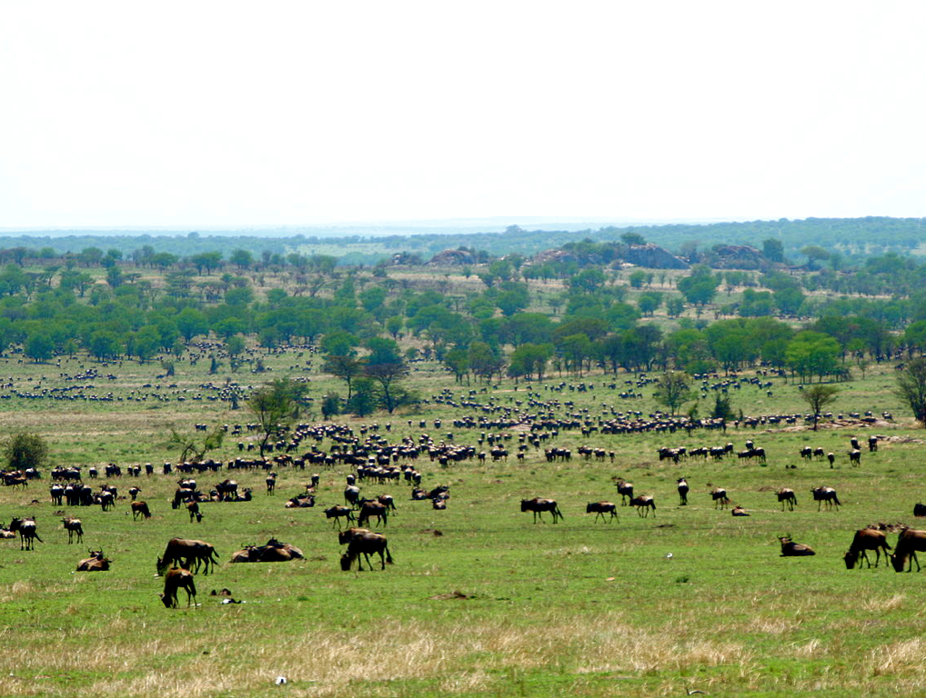
He did not create it [Earth] to be empty; but formed it to be inhabited. Isaiah 45:18
Stefan Swanepoel
Notes:
God takes personal credit for each of Earth’s kinds of creatures. It’s God, not naturalism.

Slide 2
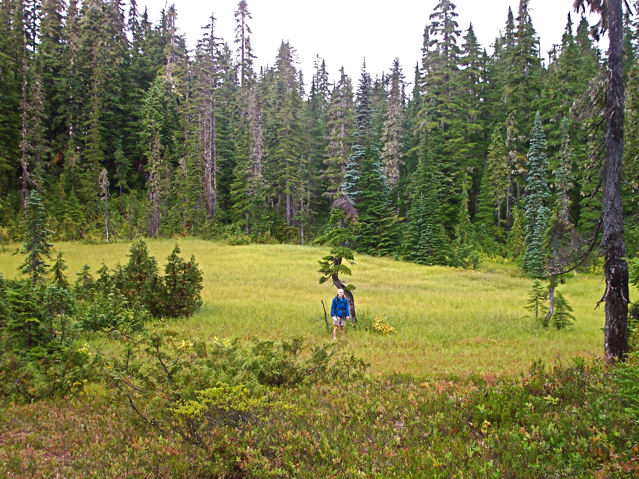

Slide 3
Go to the ant, you sluggard; consider its ways and be wise!
Notes:
Proverbs 6:6-7; 30:25

Slide 4
It has no commander; no overseer or ruler, yet it stores its provisions in summer and gathers its food at harvest.
Notes:
Proverbs 6:6-7; 30:25

Slide 5
How much of the land animal biomass do ants comprise?
Notes:
15–25 percent
Ant diversity and abundance greatly expanded during the Paleogene era.

Slide 7
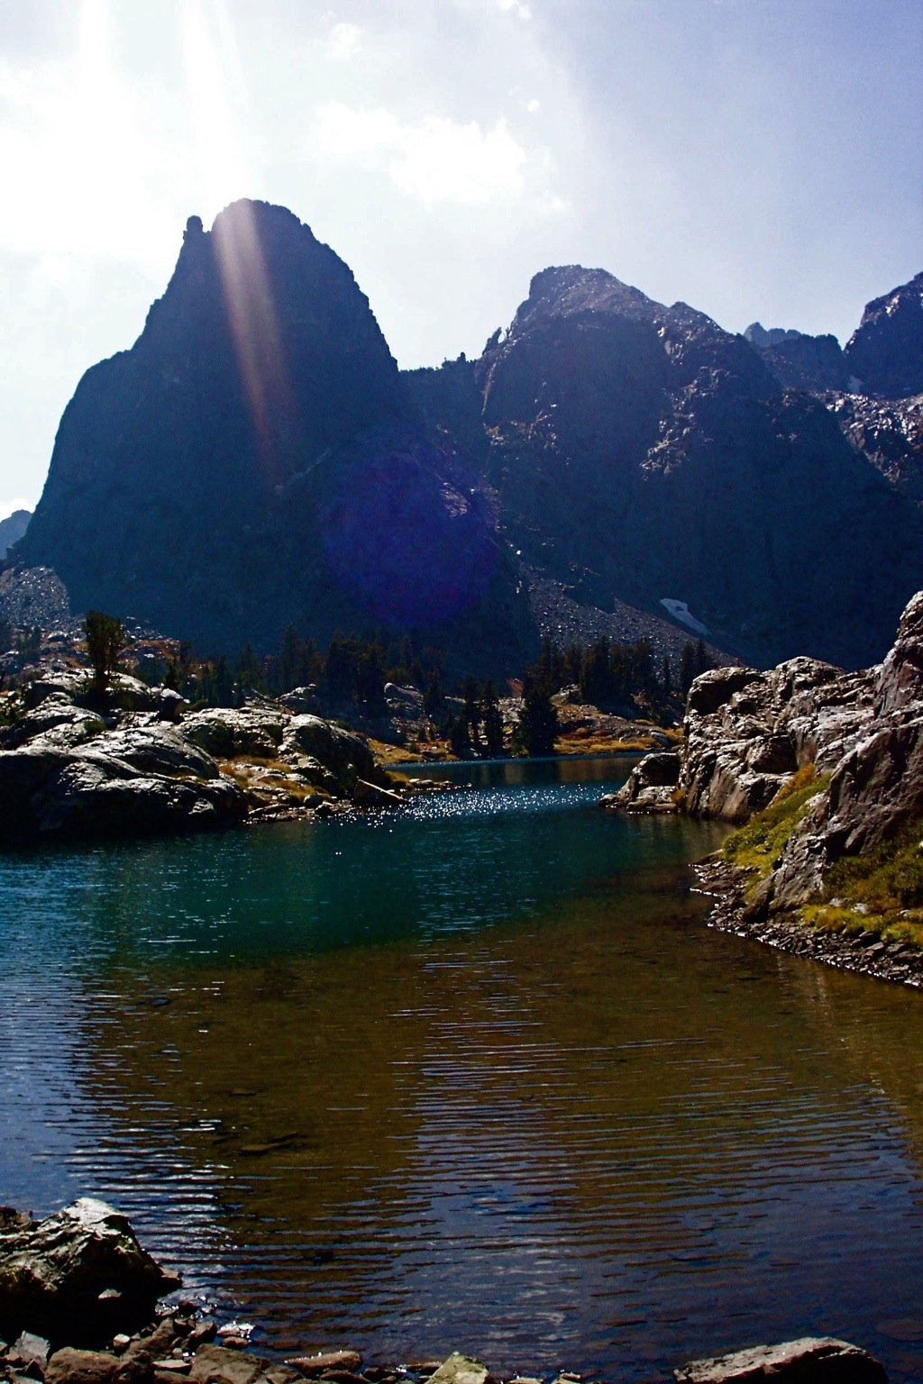
Solar Luminosity
100%
90%
80%
0 1 2 3 4 5 6
Sun’s age (billions of years)
Hugh Ross
Notes:
Advanced life can tolerate only a tiny change in solar luminosity.

Slide 8
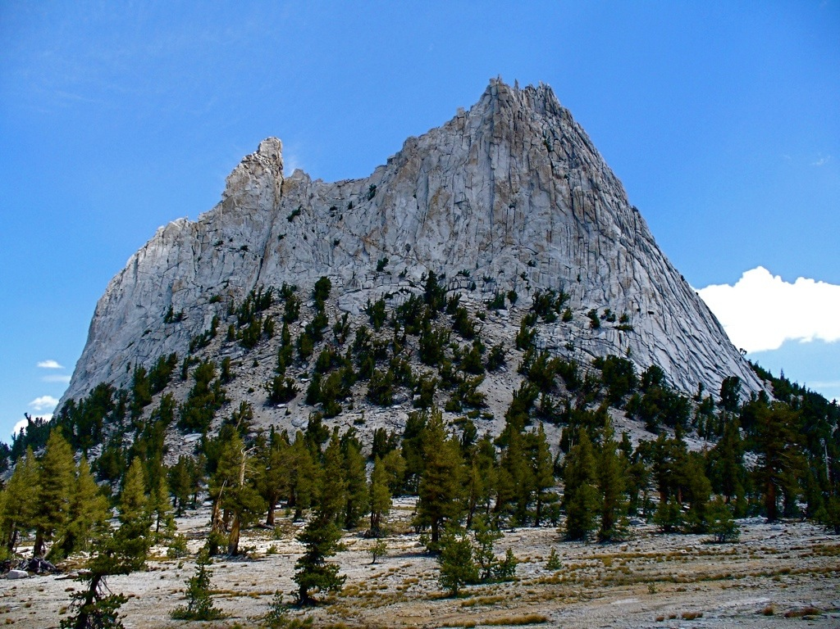
erosion of silicates
Hugh Ross

Slide 9
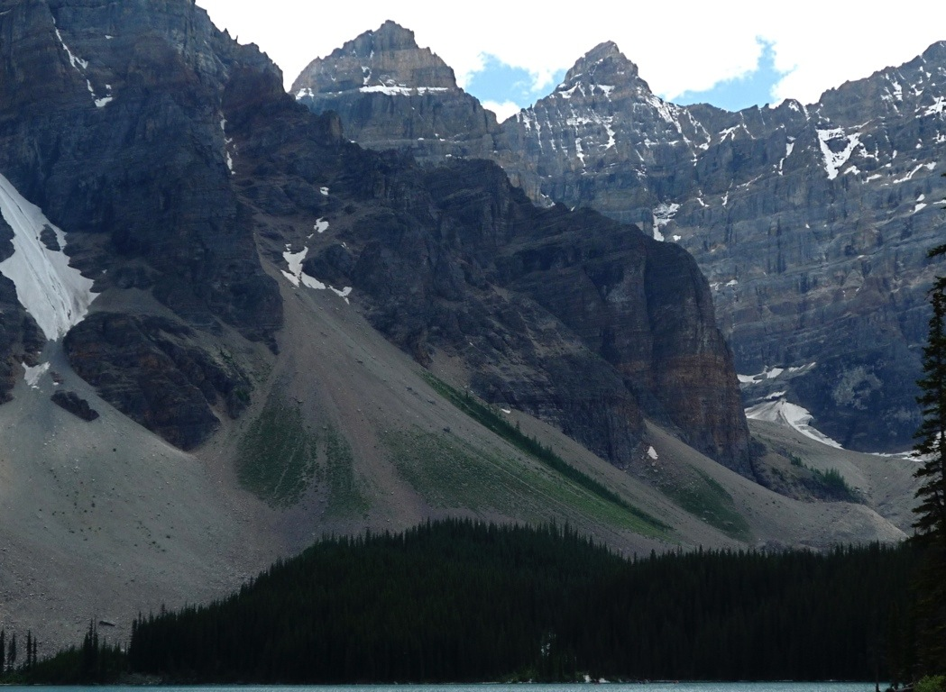
CaSiO3 + 2CO2 + H2O Ca⁺⁺ + 2HCO3 + SiO2
Ca⁺⁺ + 2HCO3 CaCO3 + CO2 + H2O
Net reaction:
CaSiO3 + CO2 CaCO3 + SiO2
MgSiO3 + CO2 MgCO3 + SiO2
Hugh Ross
Notes:
Rain falling upon exposed silicate acts as a catalyst.
Other metal silicates react the same way.
Depending on the existing life forms, life regulates the rate at which erosion forces convert silicates into sand and carbonates.

Slide 10
Hugh Ross

