Slide 1

(Just a Few)
Recent Discoveries in the Lands of the Bible
Mark Durham
Notes:
New Holyland discoveries in support of the Bible are being made at an ever increasing rate. My talk today will be focused mostly on discoveries relating to David.

Slide 2
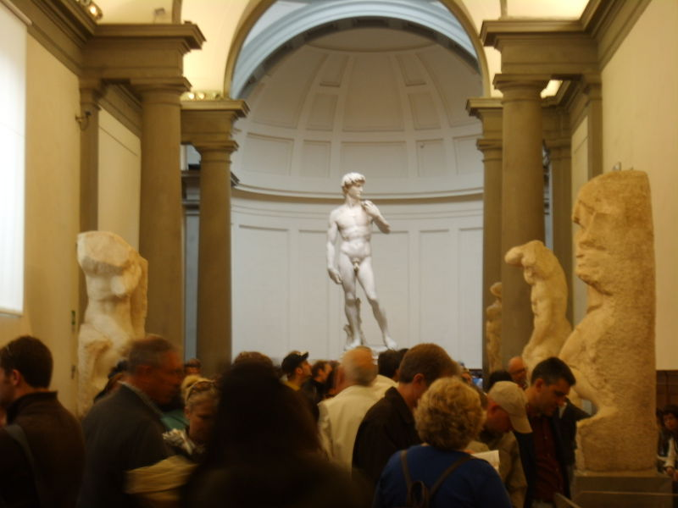
David by Michelangelo
Notes:
Let’s start with David (Michelangelo, David, marble, 1501-04, marble, 517 cm, ~17’. (Galleria dell'Accademia, Florence))

Slide 3
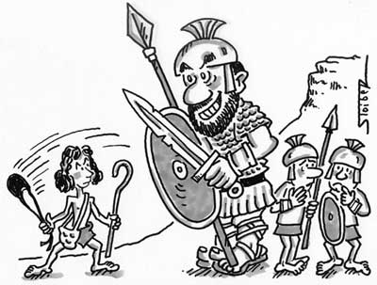
David & Goliath
“Go tell the troops to expect Shepard’s pie tonight.”
Notes:
Just a few reminders of who he was…

Slide 4
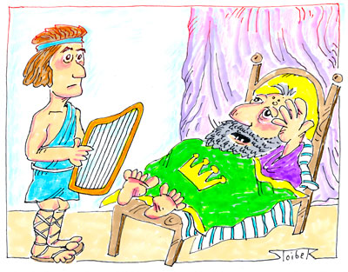
David & Saul…
“Play it again Dave---but softly.”
BAR. Sept-Oct 2010
Notes:
From Biblical Archaeological Review Magazine, Sept-Oct 2010.

Slide 5

Why is David so Important in Archaeology?
1) Bible authenticity largely revolves around David (and Solomon)
2) Minimalists claim he didn’t exist, or
3) Minimalists move him into a low Chronology (more recent)…
4) Believers say David gives credence to the modern claim-to-exist by Israel
Israel Finkelstein
Notes:
“Minimalists” are a group of highly skeptical mid-Eastern scholars beginning in 1990’s that unfairly criticize Bible as being fictional, or mostly fictional, in regard to names, places, occurrences, and dates. Picked up the disbelieving torch from the Higher Critics (Documentary Hypothesis) for 1790-1940.
David’s life is conventionally dated to c. 1040–970 BC, he reigned over Judah c. 1010–1002 BC, and over the United Kingdom c. 1002–970 BC. Low Chronology for David would place him in 10th century BC, which was a time of little growth for the Jews; this would mean that he was more likely the leader of a small-time chiefdom instead of a King of two countries.
Israel Finkelstein—noted minimalist: One of his most controversial theories is his description of 10th century BCE Jerusalem, the period associated with the biblical kings David and Solomon, as a mere 'village' or tribal center.

Slide 6
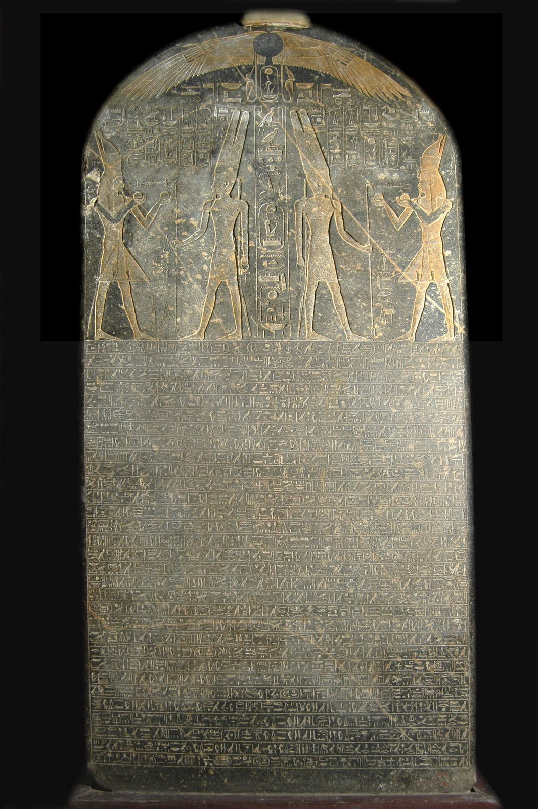
Merneptah
Victory Stele
First mention of “Israel” outside of the Bible: “Israel is laid waste, his seed is not”
This engraved granite slab is more than seven feet tall and was found in Western Thebes, Egypt
It was carved c. 1208 BC and is now in the Egyptian Museum, Cairo.
PHOTO: ©Greg Gulbrandsen
Notes:
Not a new discovery but… Described destruction of Israel by Egyptian forces. Merneptah was the son and successor of Ramesses II. This reference suggest that by 1208 (when inscription carved) the Israelites were already in the land of Canaan. Regarding the Exodus, two possible dates emerge: 1250-1270 BC and 1446/7 BC.

Slide 7
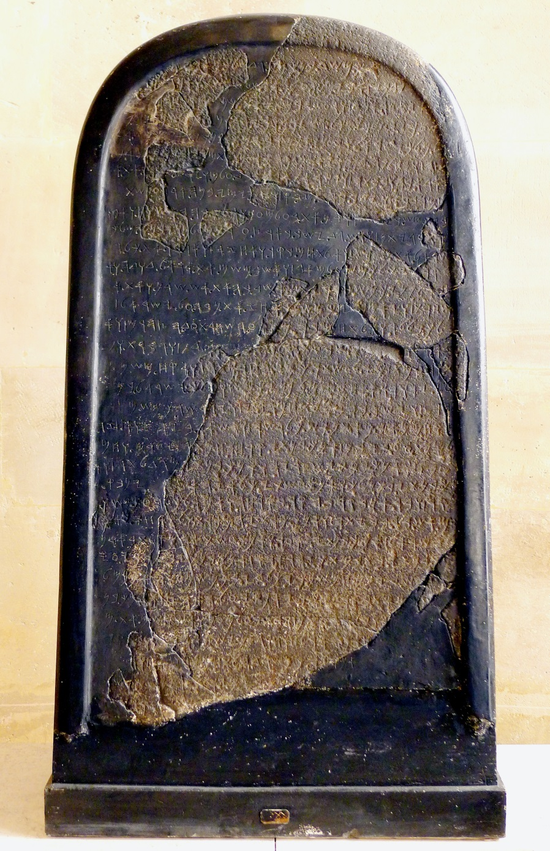
Mesha Stele or Moabite Stele
Discovered by Charles Warren, 1868-70 (100 X 60 X 60 cm basalt) in modern Jordan
Victory stele For King Mesha of Moab,~840 BC, making it the oldest possible reference to David
In Moabite language; Line 12 appears to reference a captured "altar hearth of David" at Ataroth
2 Kings 3 tells how Israel and Judah allied with Edom to fight losing battle against Mesha of Moab
Notes:
Parallel to 2 Kings 3--Inscription similar to. Inscription tells how Jehoram of Israel makes an alliance with Jehoshaphat king of Judah and an unnamed king of Edom (south of Judah) to put down his rebellious Moabite vassal Mesha; the three kings have the best of the campaign until Mesha, in desperation, sacrifices to his god Kemosh either his eldest son or the eldest son of the king of Edom; the sacrifice turns the tide, "there came great wrath against Israel", and Mesha is apparently left victorious.
The shaded area represents pieces of the original stele, whereas the plain white background represents Ganneau's reconstruction from the 1870s based on the squeeze made prior to being damaged by local villagers over ownership.

Slide 8
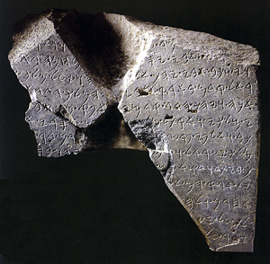
King David in Archaeology
TELL DAN STELA
This Inscribed monument contains the oldest known reference to King "David" outside of the Bible. 800-845 BC
**See Replica**
Notes:
TELL DAN STELA: As stated earlier, Minimalists claimed that if David and Solomon existed, they were simply pastoralist chieftains from the hills of Judea, and thus their military exploits were gross exaggerations from later times (somewhat supported because their names are not found in in Egyptian texts). In 1993 however this view was challenged with this find. This fragment was a statement by court, official Hazael for unnamed king of Damascus, Syria. Claims to have defeated “Jehoram king of Israel and killed Ahaz son of /// I overthrew the house of David.” These two ruled from 852 to 841BC, and 841 BC. Both killed by usurper general Jehu, who became king of Israel.

Slide 9
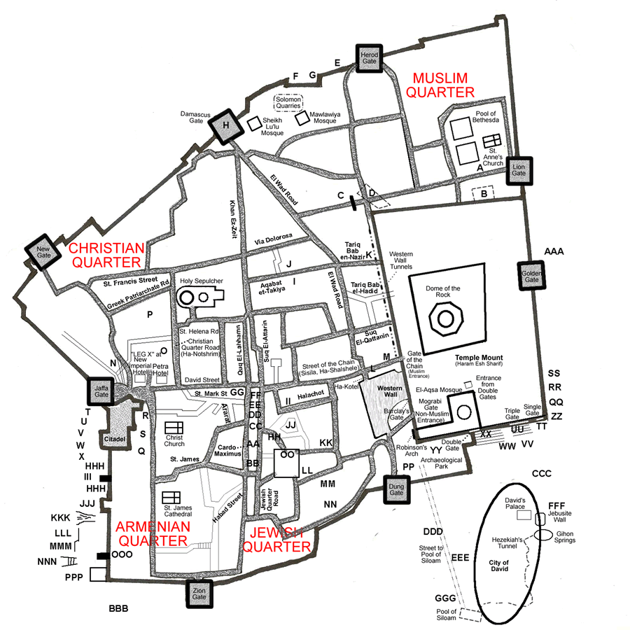
David’s Palace Confirmed!
Jerusalem: Historical Section
David's Palace is located in the bottom right of this map in the City of David.
Notes:
The next several slides refer to David’s newly confirmed Palace.
Also of significance is the Temple Mount with the Dome of the Rock and Al Aqsa Mosque (Masjid). The four “Quarters” developed after David’s time, and into the Byzantine and Islamic eras.

Slide 10
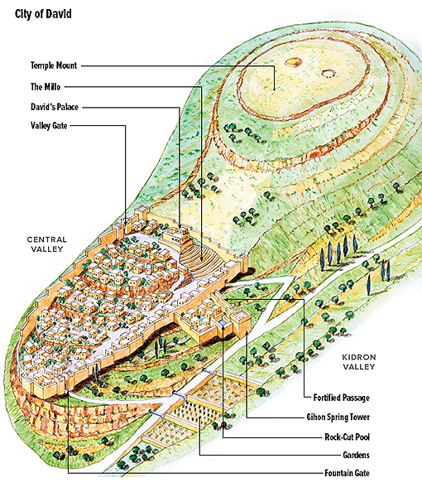
City of David with Millo & Palace
Notes:
Located in the oldest part of Jerusalem, the City of David sits on a 12 acre rocky spur that extends south of the Temple Mount. David built his palace (Large Stone Structure—LSS), which is supported by the Millo (Stepped Stone Structure—SSS) extending down the slope. Also, here too is evidence of the rebuilding of the city wall when Nehemiah returned from the Babylonian exile.

Slide 11
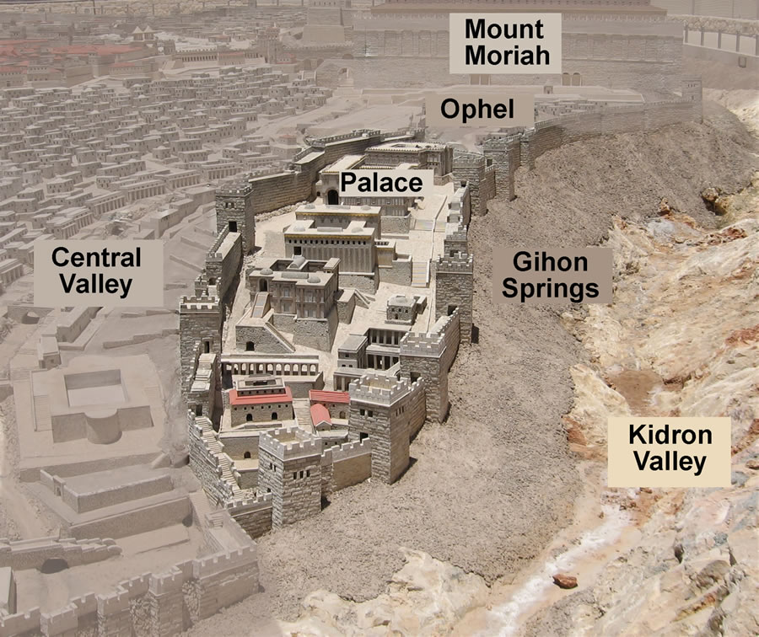
King David in Archaeology: City of David
Notes:
City of David, from Holyland Model of Jerusalem. (Ophel = meaning fortified hill or risen area). Mount Moriah = Temple Mount area, and site where Abraham went to sacrifice his son Isaac, also know as Mount Zion, and where Solomon would build the First Temple. Note that the newly excavated Millo (Stepped Stone Structure) is NOT depicted…

Slide 12
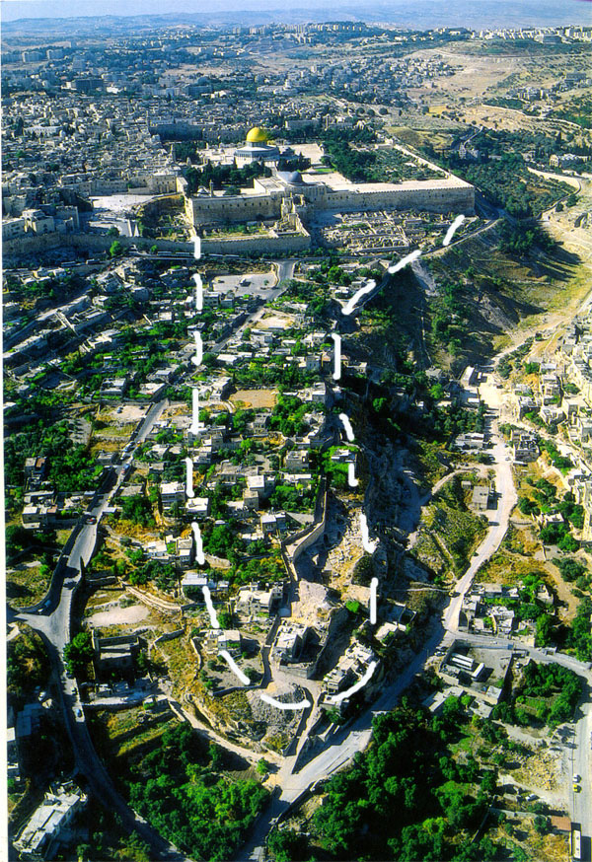
City of David, now
Notes:
Contemporary aerial view of City of David. Note Dome of Rock, and Al Aqsa Mosque (Masjid) with blue roof.
Side Note on Islam: The Isra is the part of the journey of Muhammad from Mecca to Jerusalem whick began at a time when Muhammad was in the Masjid al-Haram, when the archangel Gabriel came to him, and brought Buraq, the traditional heavenly steed of the prophets. Buraq carries Muhammad to the Masjid Al Aqsa, the "Farthest Mosque", in Jerusalem. Muhammad alights, tethers Buraq to the Western Wall and performs prayer, where on God's command he is tested by Jibriel.

Slide 13
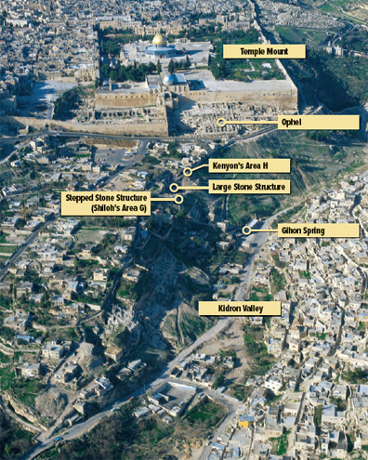
City of David now
See David’s Palace (Large Stone Structure)
See Millo (Stepped Stone Structure)
Notes:
Contemporary photo of City of David. Note position of LSS (David’s Palace) and SSS (Millo, steps)

Slide 14

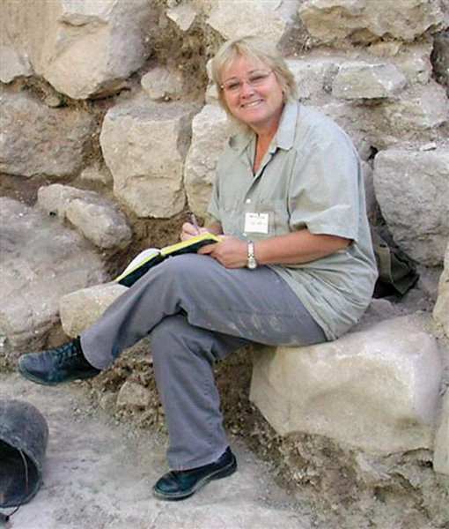
City of David
Research Archaeologists
Eilat Mazar
Kathleen Kenyon
Notes:
In the years 1961-7, Kathleen Kenyon excavated under Jordanian rule. She dug a large cross-section on the eastern slope of the City of David from the top of the hill downwards. She exposed numerous sections of residential buildings from various time periods. Along the cross-section, two fortress walls from different time periods were discovered, the oldest of the two from the Middle Bronze Age (18th century BCE) and the second from the First Temple period. Additionally, she discovered sections of the main street of the city of Jerusalem from the Second Temple period in the Tyropoeon Valley and parts of buildings in other places throughout the City of David.
Eilat Mazar Israeli archaeologist Eilat Mazar (daughter of Benjamin Mazar’s, “Dean” of Israel archaeology) believes the evidence she has uncovered during months of excavation and biblical comparison points to an extraordinary discovery: She believes she has found the palace of King David, the poet-warrior who the Bible says consolidated the ancient Jewish kingdom around the 10th century B.C. and expanded its borders to encompass the Land of Israel. Only a small fraction of the structure has been exposed. Some archaeologists believe Jerusalem was no more than a tiny hilltop village when it served as David's capital. The discovery of a palace or other large public building from David's time would strengthen the opposing view that he and his son, Solomon, presided over a civilization grander than the collection of rural clans some historians say made up the Jewish kingdom. Whether David was a tribal chieftain or visionary monarch matters deeply to the Jewish historical narrative. Why would confirmation of a discovery of this magnitude be so politically important?

Slide 15
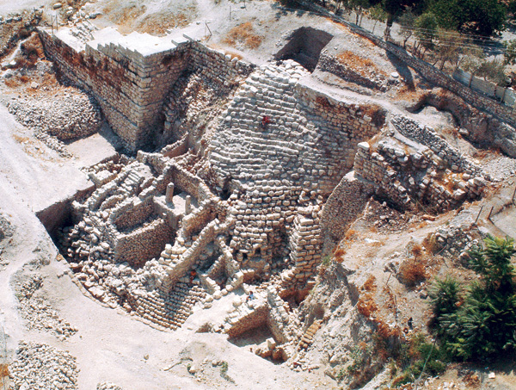
Millo, or Stepped Stone Structure
These support steps lead directly up to David’s Palace, which had yet to be excavated when this photograph was taken
Notes:
Most recently excavated by Eilat Mazar. Mazar believes the Stepped Stone Structure once helped to support a huge palace complex built into the hillside.

Slide 16
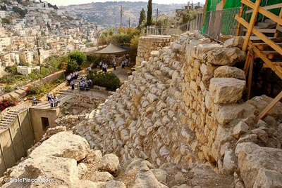
Millo, or Stepped Stone Structure
Notes:
A view from David's Palace of the Millo, or the Stepped Stone Structure, that supported part of the fortress and David's Palace known as the Large Stone Structure.

Slide 17
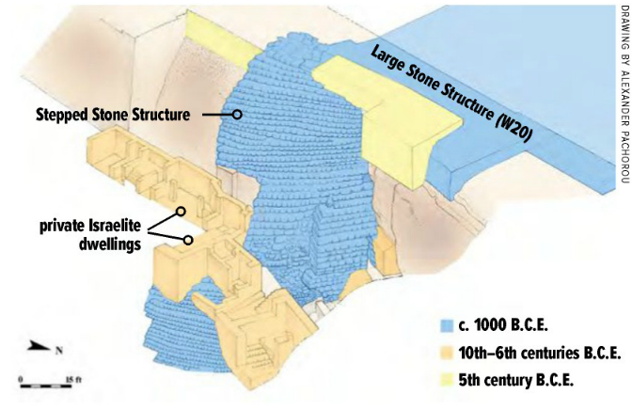
Millo or Stepped Stone Structure
Notes:
Here we see a diagrammatic depiction of the Millo or Stepped Stone Structure.
Building on previous textual and archaeological evidence identifies these monuments as, respectively, the remains of King David’s palace (not excavated) and the Millo; i.e., Large Stone Structure and Stepped Stone Structure, resp.

Slide 18
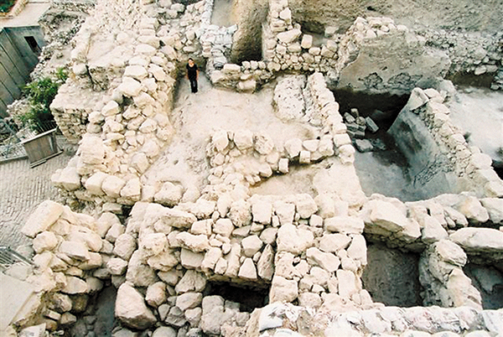
King David’s Palace-Unearthed
City of David (Jerusalem)
Aka Large Stone Structure, sits atop Stepped Stone Structure
Excavations underway by Eilat Mazar’s team
Notes:
The Large Stone Structure, located on a rocky spur in the City of David, is a large public building comprised of impressive ashlar blocks. Eliat Mazar dates the buildings to David’s time of 10th to 11th century BC (early Iron Age). King David’s palace is prominently referenced in the Book of Samuel (2 Samuel 5:11; 2 Samuel 11; 2 Samuel 16:22). When Nehemiah returned from Babylonian exile half a millennium after the reign of David, he repaired the city wall and organized a dedication procession. One group on the east side of the city was described as having gone “up the steps of the City of David, on the ascent to the wall, past the House of David, and up to the Water Gate on the east” (Nehemiah 12:37). Nadav Na’aman (“The Interchange Between Bible and Archaeology: The Case of David’s Palace and the Millo” by Nadav Na’aman in the January/February 2014 issue of BAR. ) suggests that King David’s Palace must be found at the top of the city’s northeastern slope, just above the Stepped Stone Structure that would have provided an ascent to the summit on the east. The location, date and scale of the Large Stone Structure, Nadav Na’aman believes, matches the Biblical descriptions of King David’s Palace.
After David conquered the Jebusite “stronghold of Zion,” he is said to have renamed the area the City of David and fortified it “from the Millo inward” (2 Samuel 5:7–9). The etymology of the Hebrew word “millo” may be derived from the verb ml’, to “fill up.” Nadav Na’aman suggests that the Stepped Stone Structure, which extends down the slope from the Large Stone Structure and is built of a fill of stones and earth, may be the Millo referenced in the Book of Samuel.

Slide 19
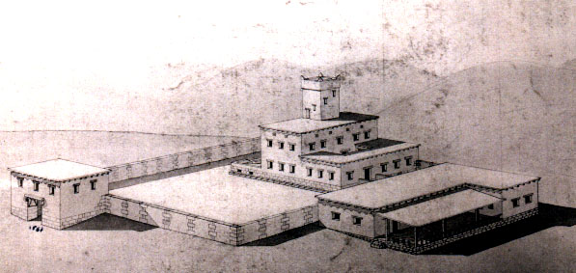
King David’s Palace--Jerusalem
An architectural reconstruction of David’s Phoenician-built palace
Constructed after his conquest of Jerusalem in 10th century B.C. in the City of David
Notes:
King David brought God's tabernacle from the wilderness to its final home in Jerusalem. He expanded the city, which showed very little growth in the thousand years prior to his arrival, and made it the spiritual and economic capital of the world of his time.
The book of 2Samuel (5:9) states that, after he conquered Jerusalem, King David made it his capital. "David then took up residence in the fortress and called it the City of David. He built up the area around it, from the supporting terraces inward." (NIV) At the same time, the Phoenician King Hiram of Tyre offered to build him a palace fit for an emperor. (2Samuel 5:11, 1Chronicles 14:1)

Slide 20
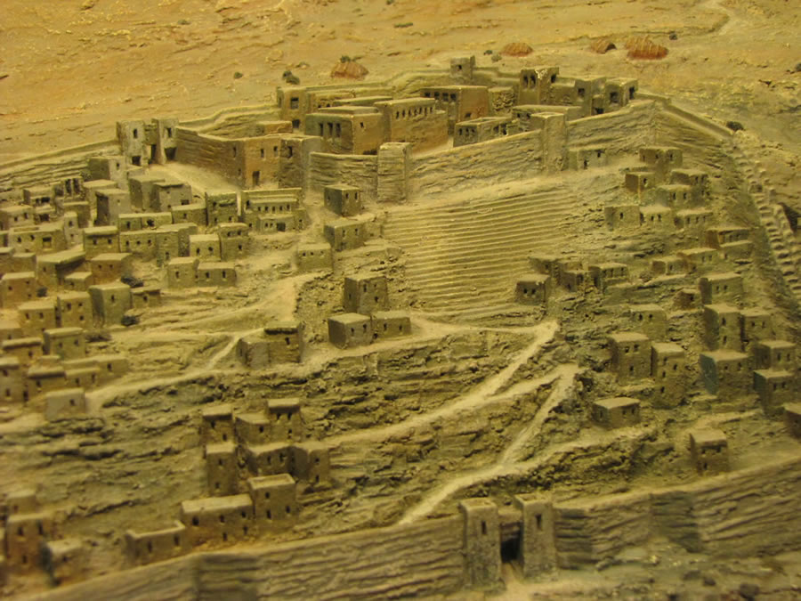
David’s Palace &
Stepped Stone Structure
Notes:
The stepped stone structure supports the palace and fortress that protected the north end of the city.

Slide 21
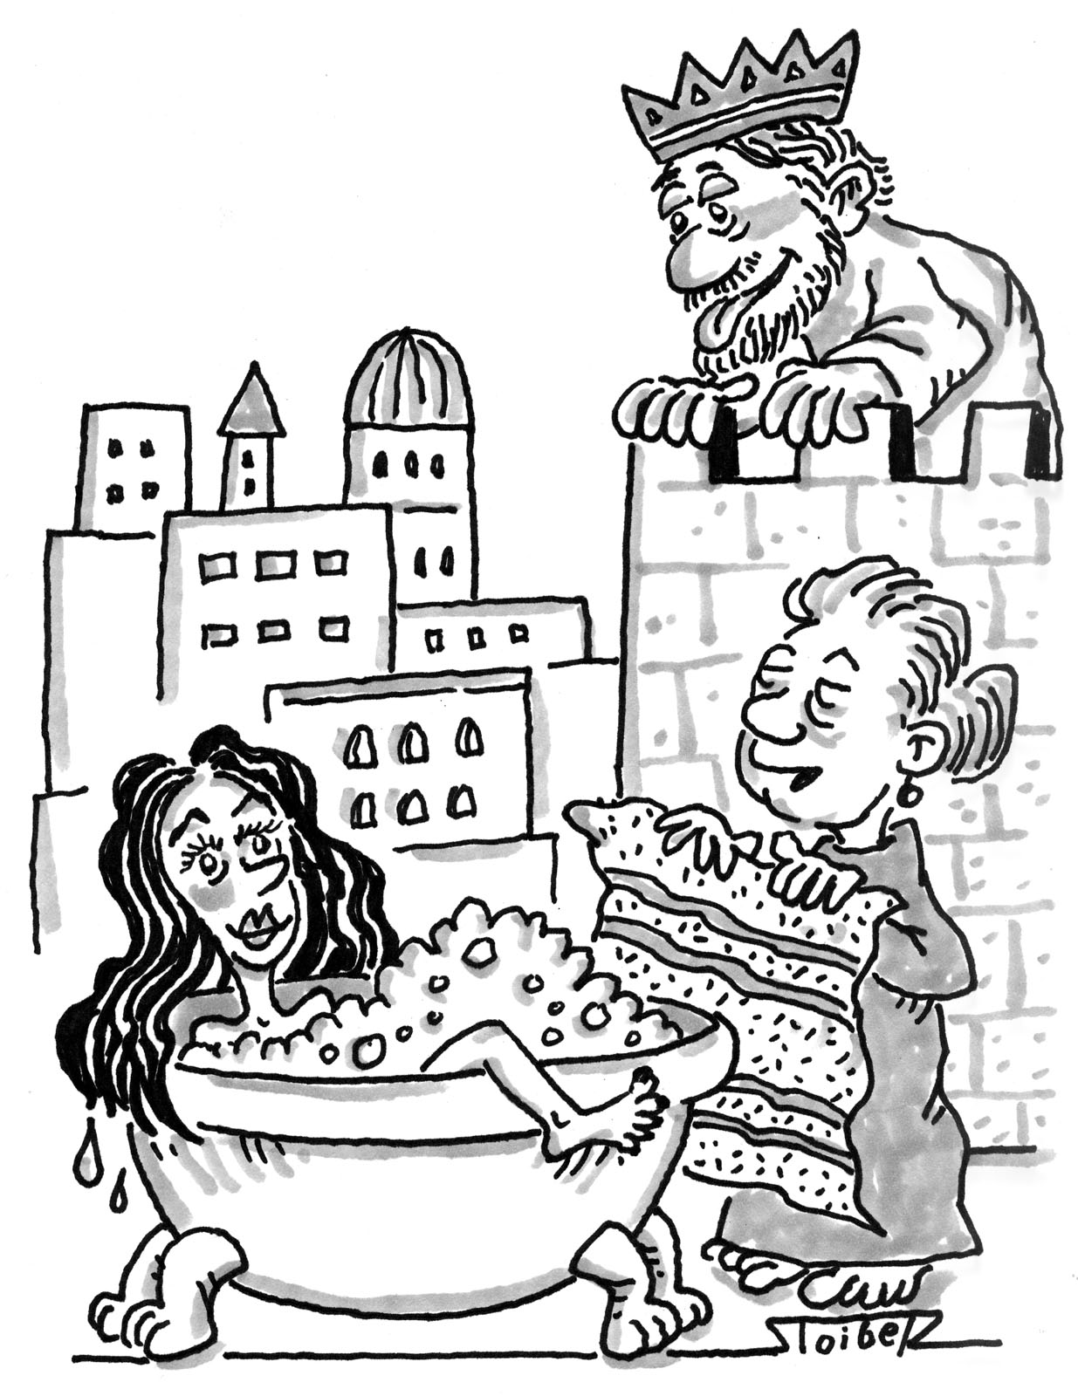
David & Bathsheba
“My, they build things fast these days! Seems like that tower went up overnight since you moved in, Bathsheba!”
BAR. Mar/Apr 2007

Slide 22
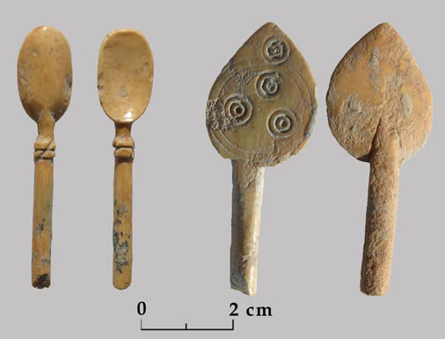
Ivory Utensils of David’s Palace
No ordinary household, Mazar says, would have carved ivory, but a royal palace likely would.

Slide 23
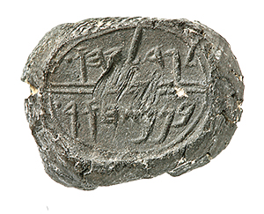
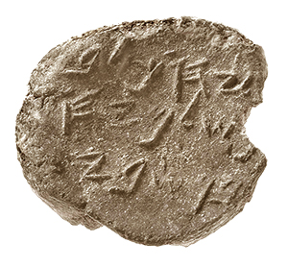
Clay Bullae of City of David
“Gedalyahu [Gedaliah] ben Pashur”
“Yehuchal [or Jehucal] ben Shelemyahu”
Seal Impressions discovered by Eilat Mazar
Mentioned in Jeremiah 38:1–13
Shows strong agreement between archaeology and Bible
Notes:
These clay bullae (seal impressions), discovered by archaeologist Eilat Mazar during her excavations of the City of David, Jerusalem, bear the names of two royal ministers mentioned in the Bible’s story of Jeremiah, prophet of the Old Testament. Photos by Gaby Laron, The Institute of Archaeology, The Hebrew University.
These two men are mentioned together in the Bible as ministers of King Zedekiah (597–587 B.C.E.). As the Babylonians closed in on Jerusalem during the last years of the First Temple period, Jeremiah, prophet to Judah’s last kings, advised Zedekiah and the people of the city to surrender to Nebuchadnezzar’s men so that their lives and city might be spared. According to Jeremiah 38:1–13, the two ministers had Jeremiah thrown into a pit because they did not like the message of surrender he was preaching to the people of Jerusalem.

Slide 24
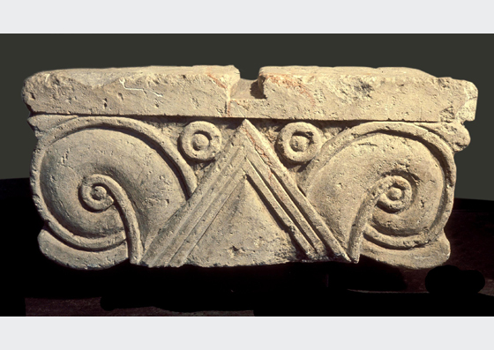
Capital from David’s Palace
An elegant proto-Aeolic capital suggestive of royal Iron Age architecture found by Kathleen Kenyon.
Notes:
Proto-Ionic (or Aeolic) Capital, i.e., pre-Greek 1960 - 1969
The Proto-Ionic Capital was discovered on the eastern slope of the City of David in the 1960’s in an excavation conducted by Kathleen Kenyon. It was found broken in half, among ruins that had rolled down from the top of the hill over the years. Its design, which predates those of the Greeks and Romans, has been found both in and outside Israel in public and government buildings of the Bronze II period (Israelite period). Inside Israel, the design is familiar in finds uncovered in Megido, Hatzor, Ramat Rachel, the Shomron, and more. The capital is currently on display in the Israel Museum.
Eilat Mazar writes: “I confirmed that ashlar stones (accurately square-cut) and an elegant proto-Aeolic capital had been found literally at the foot of the scarp at the southeastern edge of the structure in Area H. And this was just the kind of impressive remains that one would expect to come from a tenth-century B.C.E. king’s palace.”
Limestone (CaCO2) or dolomite (CaMg(CO₃)₂) commonly used in Jerusalem.

Slide 25
Current State of Biblical Credibility
Critics/Minimalists find it difficult to deny the Tel Dan stela inscription as being strong evidence of David’s existence.
Instead they relegate David’s influence to being only a local chieftain ruling a small territory.
They believe that a lack of evidence of many Hebrew cities and fortifications in Judah proves that David’s reign was insignificant, even if kingdoms were united as Israel.
However, new archaeological discoveries are giving us significant evidence of King David as a powerful ruler!
Notes:
One BAR magazine critic argued that David’s kingdom was simply “500 people with sticks in their hands shouting and cursing and spitting.” Two large cities of Judah during David’s rule were Jerusalem and Lachish. David’s life is conventionally dated c. 1040–970 BC, his reign over Judah c. 1010–1002 BC, and his reign over the United Kingdom c. 1002–970 BC (Iron Age I & II [1200BC-1000BC, and 1000BC-500BC]).

Slide 26
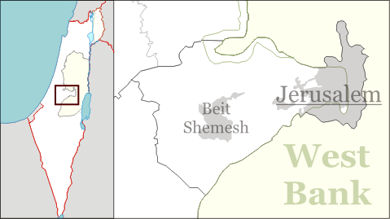
Khirbet Quiyafa
Khirbet
Quiyafa
Newly Discovered City Confirmed in Southern Kingdom of Judah!
From King David’s time: 1020-980 BC
Elah Valley, Guarded Road from coastal Philistia to Jerusalem
100 ac. urban center/military stronghold
Bible places battle of David & Goliath (of Gath) very near here
Likely Biblical city of Sha’arayim
Notes:
Pronounced: Quir bet Kee YAH fuh; Khirbet=Arabic word for "ruin" or "ruin on a hill (similar to tel)“; Quiyafa = "the place with a wide view.". The modern Hebrew name is Elah Fortress as it overlooked the Elah Valley. Dated with Carbon-14 test on olive pits. Philistine city of Gath was just 8 miles to west..
Likely Biblical city of Sha’arayim in 1 Sam 17:52: David Slays Goliath …51 “Then David ran and stood over the Philistine and took his sword and drew it out of its sheath and killed him, and cut off his head with it. When the Philistines saw that their champion was dead, they fled. V. 52, The men of Israel and Judah arose and shouted and pursued the Philistines as far as the valley, and to the gates of Ekron. And the slain Philistines lay along the way to Shaaraim, even to Gath and Ekron.”

Slide 27
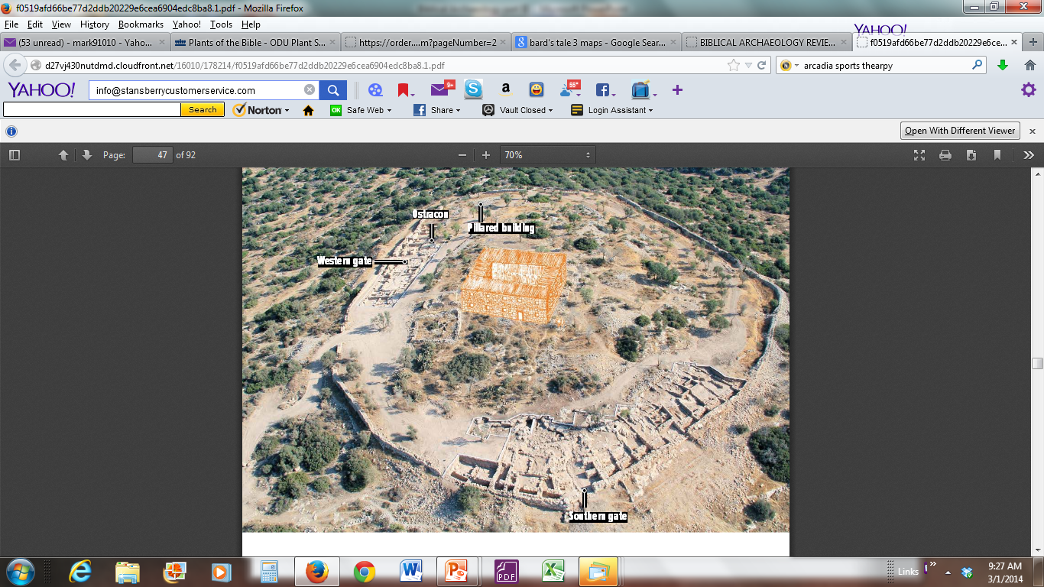
Khirbet Quiyafa
~6 acres heavily fortified city surrounded by a casement wall
One-period Iron Age site with two 4-chambered gates
2013 find--a multi-story admin. building centered on the acropolis
Notes:
Reveals an extensive civil administration and military stronghold. The governmental portion of this Judean Site is 2.3 hectares (~6 acres) in area. Excavation for past 7 seasons, now mostly complete. Casement wall=double parallel line of walls divided into internal chambers by partition walls (common type of defense in Israel). Acropolis=citidal (esp. Athens..). 4-Chambered gates characteristic of David/Solomon.
The several-story central administrative structure towered over the entire countryside. It was found in final year of dig, 2013!

Slide 28
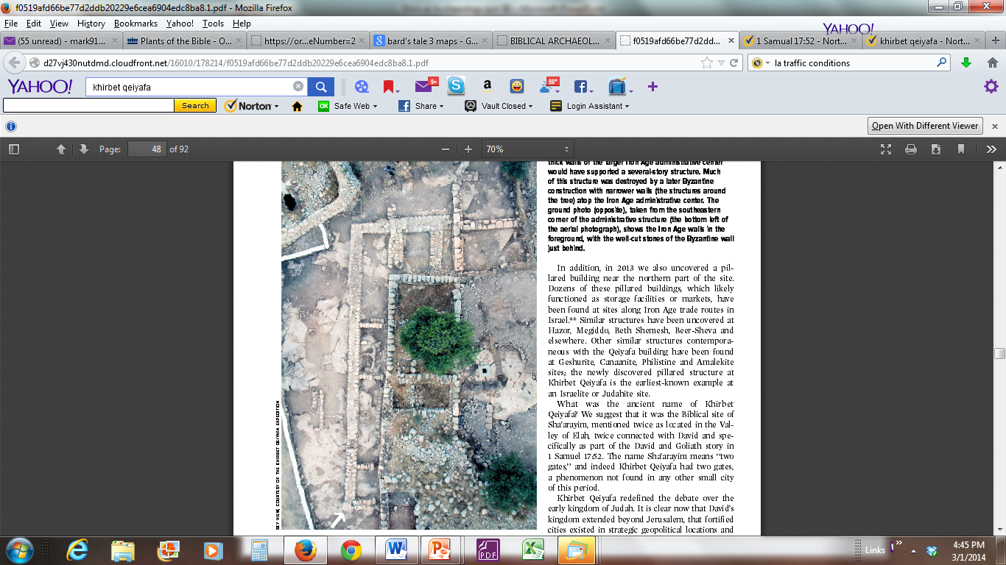
Khirbet Quiyafa
Two Buildings From Different Times
Structural Foundations of David’s Administrative Building, and later (smaller) Byzantine building
Byzantine period 5th to 15th centuries, AD
Notes:
The 3’ thick walls of the larger Iron Age administrative center would have supported a several story structure. Much of this structure was destroyed by a later Byzantine construction with narrower walls (around tree).
Byzantine periods 5th to 15th AD. When Western Roman Empire collapsed in 5th century AD, the Eastern Roman Empire was born.

Slide 29
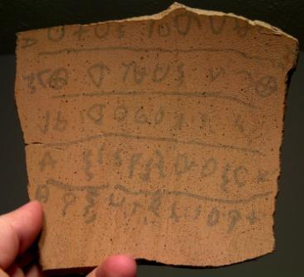
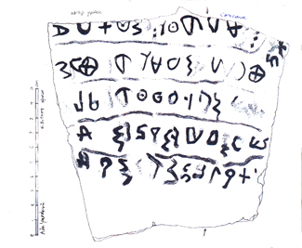
Kherbet Quiyafa Ostracon
The Khirbet Qeiyafa Ostracon
Potshard, writing on inside of pottery vessel.
Oldest known Hebrew text ever discovered (1,000 years older than Dead Sea Scrolls!
Notes:
Refutes critics notion that Israel had no written language in David’s time: the Qeiyafa Ostracon is a five-line text on a 6X6” piece of broken pottery. The inscription is remarkable because it provides evidence against the prevailing theories of the Bible’s composition. The documentary hypothesis, or JEDP theory, says that the Pentateuch (Torah—OT) was not the work of Moses, but of at least four main writers living hundreds of years after the time of Moses. The earliest portions were supposedly written around the 10th century B.C., while the legal and ritual material (such as Leviticus and Deuteronomy) were written in the 6th and 5th centuries B.C. The Khirbet Qeiyafa inscription shows that echoes of legal material thought to date very late in Israel’s history actually appear centuries earlier.
The second problem the inscription poses for critics is that it gives evidence of a centralized government in Israel at a very early stage. Unlike modern times, the vast majority of people in the ancient world were illiterate. Some of the most highly educated societies might have had a literacy rate of fewer than 10 percent. The existence of writing in the 10th century at Khirbet Qeiyafa—a border town over 30 miles southwest of Jerusalem—shows that some kind of bureaucracy existed since only a trained scribe could be responsible for the inscription.

Slide 30
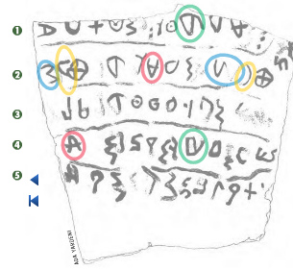
Kherbet Quiyafa Ostracon
Proto-Hebrew Script
Some letters flipped (might be due to someone trying to write upside down)
Minimalists argue that site therefore must have been Philistine.
Notes:
Last slice comment: Philistines likely didn’t have a written language, but borrowed from Semitics. Little has been found… WITH FADED INK AND MISSING LETTERS. It is written in Early Alphabetic script, prior to the development of Phoenician script from which Hebrew script was derived. Note the differences in the same letters, a characteristic of very early Inscriptions.
For example, the stance of the ‘Alep in lines 2 & 4 (red).
In line 2 the sin (blue) appears twice. One appearance (only partially preserved at the end of the line) is like the typical Phoenician and Old Hebrew stance of this letter, but the same letter is rotated 90 degrees at the beginning of the line.
The pe (yellow) near the beginning of line 2 faces right, but at the end of the line the same letter faces left.
Finally, the bet in line 1 faces down and in line 4, if it even is a bet, faces up.
Note: The comment on the slide about “…trying to write upside down,” is my own hypothesis, from experience of trying to write for my granddaughter across from me seated at a table. I would thus have to write upside-down for me and right-side up for her. I inevitably wrote some of the letters sideways or upside down for her. The writing on the ostracon had to be done looking down and into a pot and so the letters could be jumbled in the fashion I’ve described.

Slide 31
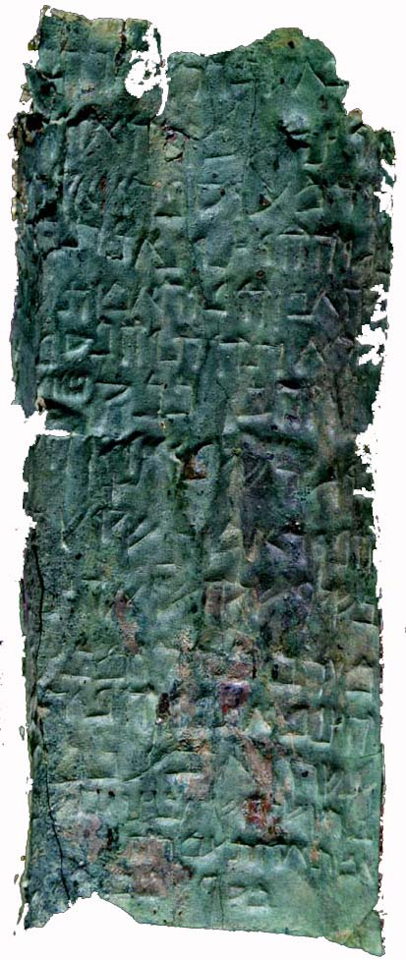
Mystery of the
Copper Scrolls
Found near Khirbet Qumran: part of the Dead Sea Scrolls
One of the most intriguing, and baffling scrolls to be found among the collection
Describes vast amounts of (Temple?) treasure hidden at many sites
4,630 talents (58-174 tons) of gold and silver are listed on the scroll
Notes:
Note: “Talent” ~30 kg (67 lbs.) Old Testament; ~59 kg (130 lbs.) New Testament…
The document was rolled into two separate scrolls (totaling 8’ length) of heavily oxidized copper which was far too brittle to unroll. All other DSS were written on parchment or papyrus. For five years scholars and experts discussed ways of opening the scroll. Finally, they decided to cut the scroll into sections from the outside using a small saw. Working very carefully they cut the scroll into 23 strips, each one curved into a half-cylinder.
The treasure of the scroll has been assumed to be treasure of the Jewish Temple, presumably the Second Temple. “In the fortress which is in the Vale of Achor, forty cubits under the steps entering to the east: a money chest and it [sic] contents, of a weight of seventeen talents." So begins the first column of the Copper Scroll. The text is in Hebrew, which is certainly a known language, but most ancient Hebrew texts that we have are religious in nature, and the Copper Scroll is anything but religious. Most of its vocabulary is simply not found in the Bible or anything else we have from ancient times.
Not only is the vocabulary of the scroll very technical, some of the geographical locations are unknown after so many years, many are too specific and some refer to places that no longer exist. Take some of the following examples:
"In the gutter which is in the bottom of the (rain-water) tank..."
"In the Second Enclosure, in the underground passage that looks east..."
"In the water conduit of [...] the north[ern] reservoir..."
There are those who have suggested that the treasure never actually existed, that the Copper Scroll is simply a work of fiction. Even if the treasure did exist, we do not know where it came from or who it belonged to. Some believe the scrolls refer to Temple treasure, hidden for safekeeping before the destruction of the Jerusalem Temple in 70 C.E. Others believe the treasure belonged to the sect that lived at Qumran, a sect usually identified with the Essenes, a Jewish group mentioned in the work of the Jewish historian Josephus, who wrote in the 1st century C.E. However, these are just educated guesses. Who the treasure belonged to, and what happened to it, we may never know.

Slide 32
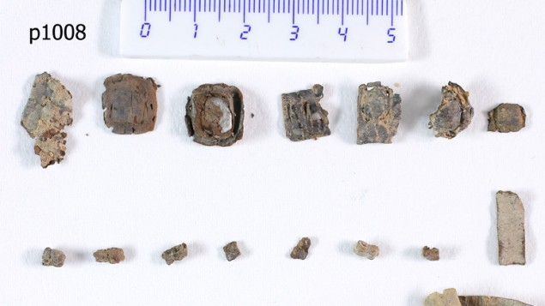
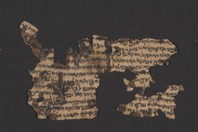
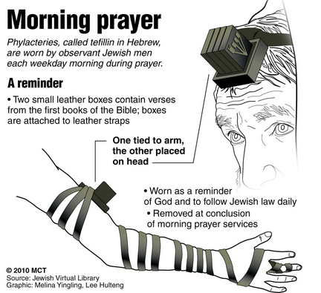
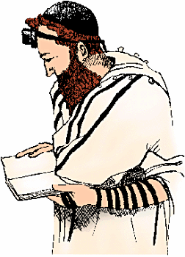
New Dead Sea Scrolls Find
Nine tiny tefillin (phylactery) scrolls had been overlooked — until now
Were placed in storage by IAA since 1952
Scrolls were in phylacteries of 2nd Temple Period
Revealed by CT scan
Shai Halevi via Israel Antiquities Authority
Notes:
Nine newfound penny-sized pieces of parchment belonging to the Dead Sea Scrolls from Qumran lay unopened for nearly six decades before they were rediscovered in Israel. But when Dr. Yonatan Adler, a lecturer at Ariel University, had CD scans done on ancient DSS phylacteries maintained by IAA, he discovered the tiny scrolls. Could shed light on the religious practices of 2nd Temple Judaism, and give comparisons with practices today.
The scrolls went unnoticed for years until one scholar came across them while searching through the Israel Antiquities Authority's (IAA) storerooms, the Times of Israel reported on 15 March 2014. “An Israeli scholar turned up the previously unexamined parchments, which had escaped the notice of academics and archaeologists as they focused on their other extraordinary finds in the 1950s.”
Phylacteries, known in Judaism by the Hebrew term tefillin, are pairs of leather cases containing biblical passages from the books of Exodus and Deuteronomy. One case is bound by leather thongs to the head and one to the arm during morning prayers, as prescribed by rabbinic interpretation of the Bible. The case worn on the head contains four scrolls in individual compartments, while the arm phylactery holds one scroll.

