Slide 1
God, who saved us and called us to a holy life—not because of anything we have done but because of His own purpose and grace. This grace was given us in Christ Jesus before the beginning of time.
2 Timothy 1:9

Slide 2
The hope of eternal life, which God, who does not lie, promised before the beginning of time.
Titus 1:2

Slide 3
Everything God created was done to further His works of redemption.

Slide 4
After this I looked and there before me was a great multitude that no one could count, from every nation, tribe, people and language, standing before the throne and in front of the Lamb. They were wearing white robes .... (Revelation 7:9)
Revelation 7:9

Slide 5
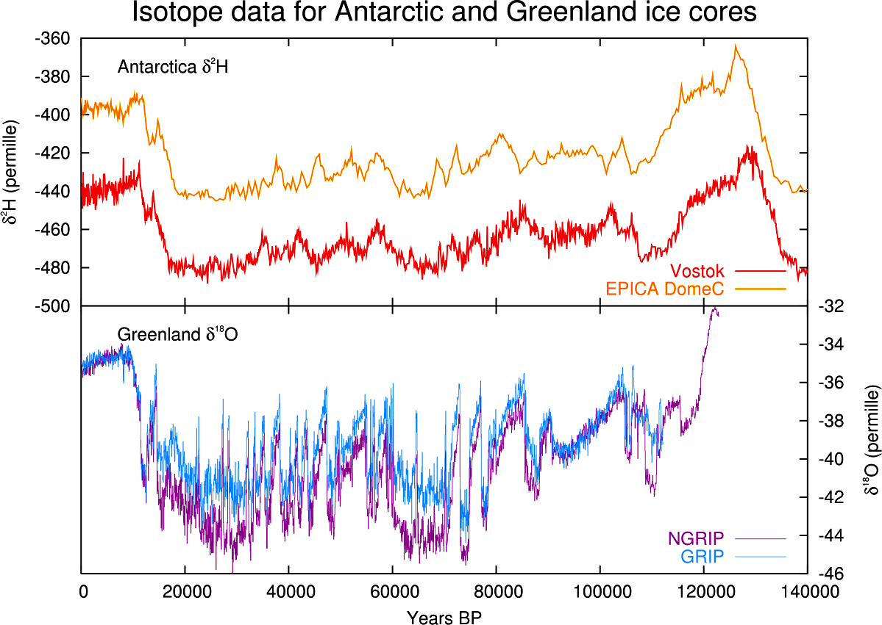

Slide 6
Non-Christians/Christians
100 AD 360
1000 AD 220
1500 AD 69
1900 AD 27
1950 AD 22
1980 AD 11
1990 AD 7
Notes:
non-Christians: people who would not identify themselves as Christians
Christians: visibly committed, Bible-believing disciples of Christ

