Slide 1
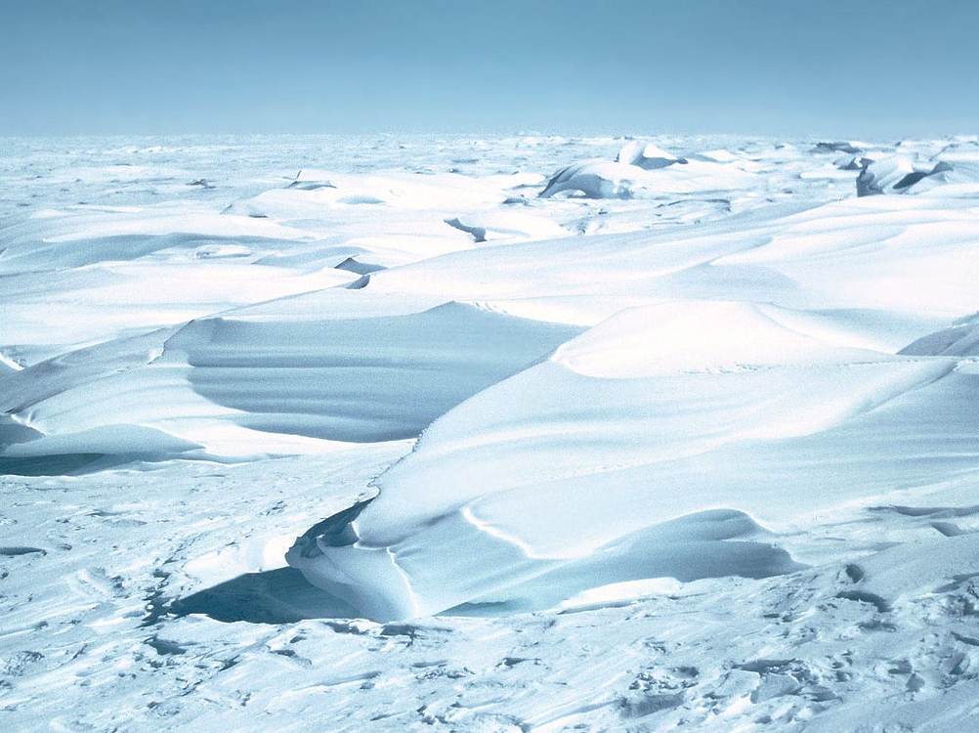
Ice Age Cycle Benefits
melting glaciers water the plains

Slide 2
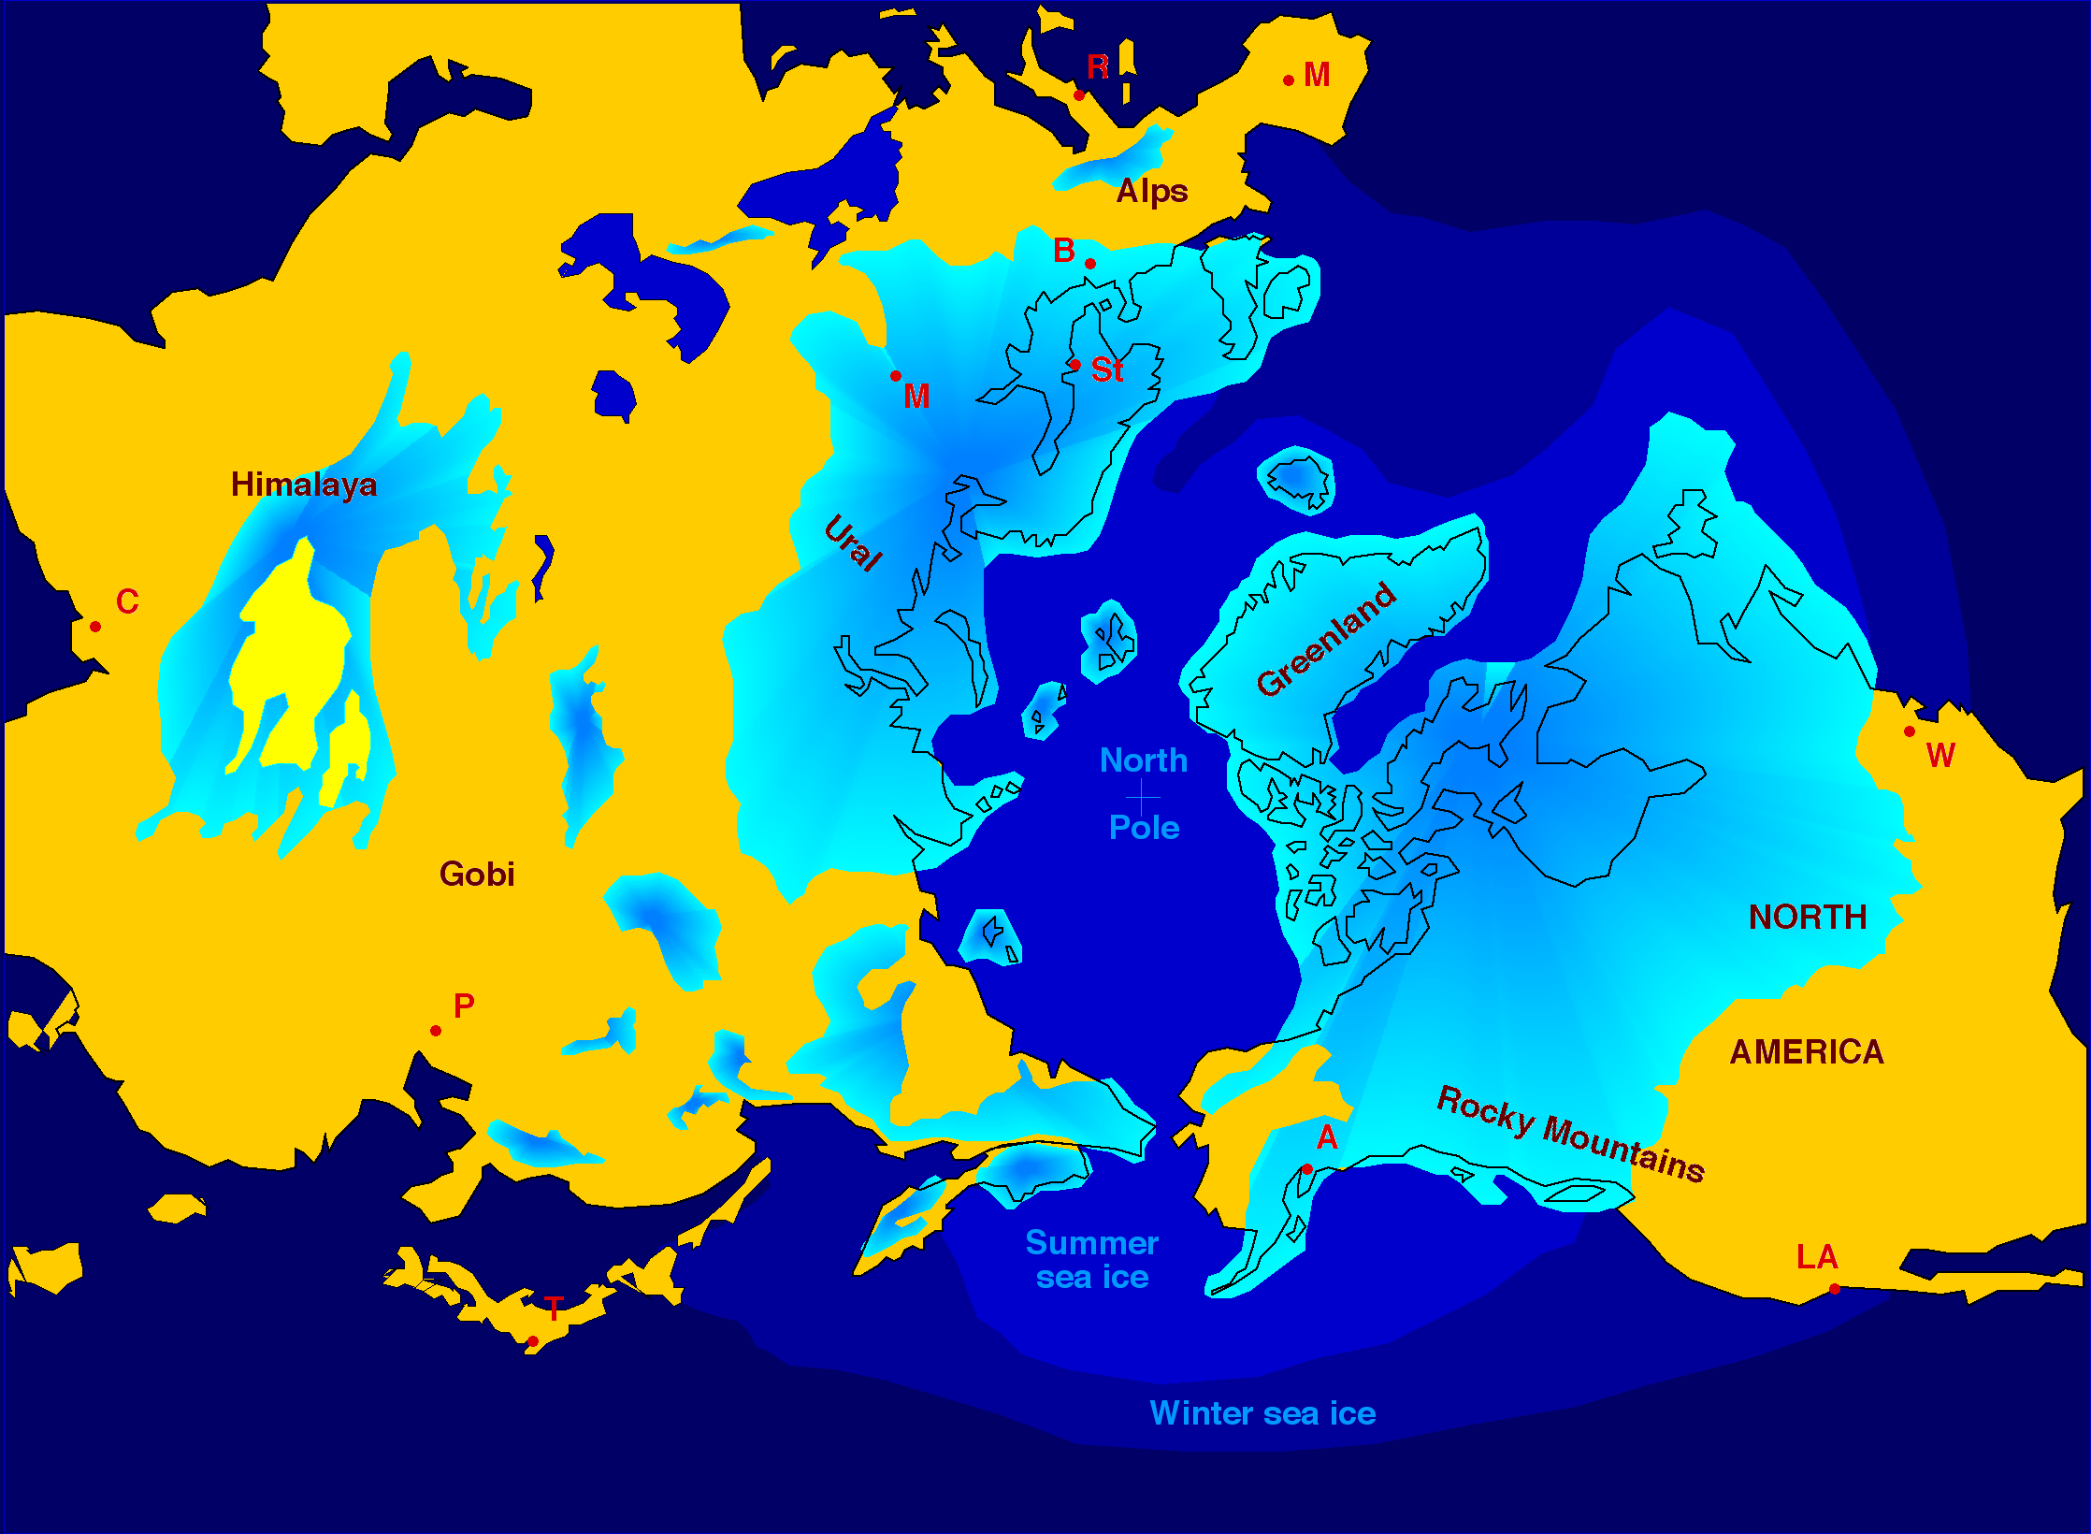

Slide 3
Ice Age Cycle Benefits
melting glaciers water the plains
wind-blown dust enriches the plains

Slide 5
Ice Age Cycle Benefits
melting glaciers water the plains
wind-blown dust enriches the plains
glacier retreat create millions of lakes
created lakes transform deserts
created relief yields hydropower

