Slide 1
AGE OF UNIVERSE & EARTH
WHAT DOES THE BIBLE SAY?
Before proceeding to what the “facts of nature” indicate, a brief examination will be given on what the Bible says about trusting in nature and its physical laws.

Slide 2
AGE OF UNIVERSE & EARTH
WHAT DOES THE BIBLE SAY?
The reason for this examination is that many young universe creationists often state that a person cannot trust in fallen men interpreting a fallen creation and its physical laws.

Slide 3
AGE OF UNIVERSE & EARTH
WHAT DOES THE BIBLE SAY?
However, these same individuals trust fallen men’s interpretation of nature’s laws when they ride in an airplane! Or, how about when they go to the doctor?!

Slide 4
AGE OF UNIVERSE & EARTH
WHAT DOES THE BIBLE SAY?
Some even go so far as to say that a person cannot trust anything in nature!!!

Slide 5
AGE OF UNIVERSE & EARTH
WHAT DOES THE BIBLE SAY?
These are attempts to avoid what the facts of nature clearly indicate about the age of the universe.
But what does the Bible say?...

Slide 6
AGE OF UNIVERSE & EARTH
WHAT DOES THE BIBLE SAY?
These are attempts to avoid what the facts of nature clearly indicate about the age of the universe.
But what does the Bible say?...

Slide 7
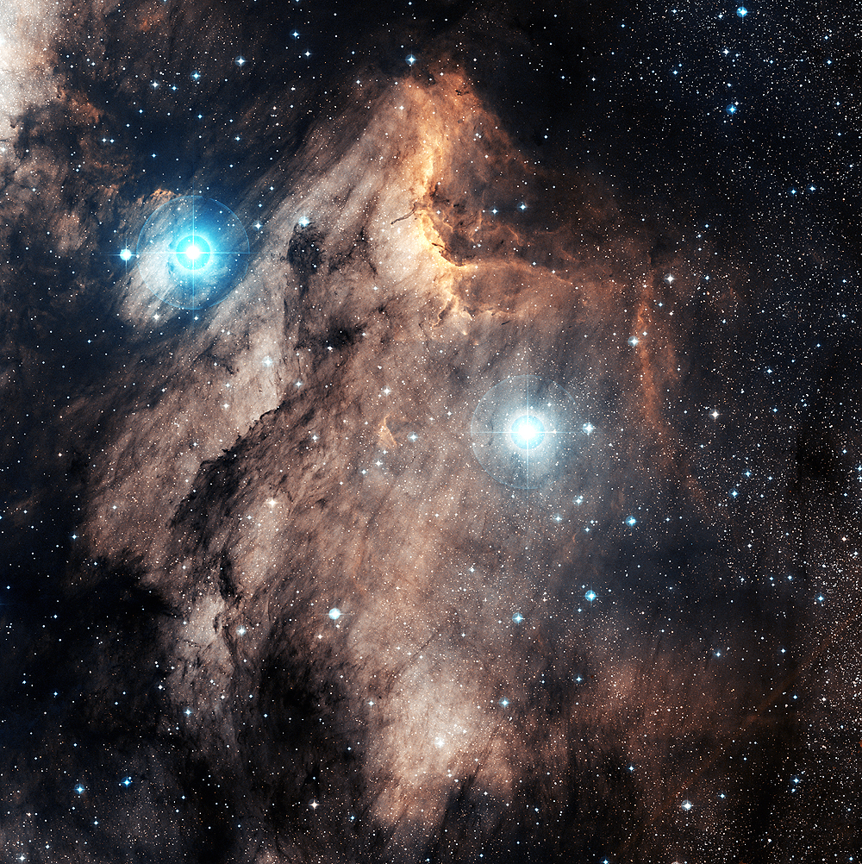
UNIVERSE’S AGE
The Bible says that nature declares the glory, knowledge (and therefore, truth), and righteousness of God. Note the following verses:
Pelican Nebula – Digitized Sky Survey; Color Composite – Charles Shahar

Slide 8
UNIVERSE’S AGE
Psalm 19:1-4 – ”The heavens declare the glory of God; the skies proclaim the work of his hands. Day after day they pour forth speech, night after night they display knowledge. There is no speech or language where their voice is not heard. Their voice goes out into all the earth, their words to the ends of the world.”
Pelican Nebula – Digitized Sky Survey; Color Composite – Charles Shahar

Slide 9
UNIVERSE’S AGE
Job 12:7 – 8 – ”Ask the animals, and they will teach you, or the birds of the air, and they will tell you; or speak to the earth, and it will teach you, or let the fish of the sea inform you.”
Pelican Nebula – Digitized Sky Survey; Color Composite – Charles Shahar

Slide 10
UNIVERSE’S AGE
Psalm 50:6 – ”Our God comes and will not be silent, And the heavens proclaim his righteousness.”
Psalm 97:6 – ”The heavens proclaim his righteousness, and all the peoples see his glory.”
Pelican Nebula – Digitized Sky Survey; Color Composite – Charles Shahar

Slide 11
UNIVERSE’S AGE
Jer. 33:25 – ”Our God comes and will not be silent, And the heavens proclaim his righteousness.”
Pelican Nebula – Digitized Sky Survey; Color Composite – Charles Shahar

Slide 12
AGE OF UNIVERSE & EARTH
WHAT DO THE FACTS OF NATURE SAY?
The Bible clearly proclaims that nature declares God’s TRUTH, righteousness, glory, and KNOWLEDGE. It also says that nature’s various physical laws are constant (therefore, have not changed, will not change).
Now we can proceed to see what the “facts of nature” have to say to us….

Slide 13
AGE OF UNIVERSE & EARTH
WHAT DO THE FACTS OF NATURE SAY?
All the facts of nature
consistently indicate a
multi-billion year universe.
Not one fact of nature
indicates to the contrary.

Slide 14
AGE OF UNIVERSE & EARTH
WHAT DO THE FACTS OF NATURE SAY?
There are about 5,000 astronomers/astrophysicists in the world.
One of the two known “young” universe astronomers/astrophysicists was asked if he was aware of any part of nature that indicated a young universe…his answer was “NO.”

Slide 15
AGE OF UNIVERSE & EARTH
WHAT DO THE FACTS OF NATURE SAY?
Special thanks to Dr. Hugh Ross
for his excellent presentation/debate on Reasons to Believe’s DVD entitled “How Old is the Universe?”

Slide 16
AGE OF UNIVERSE & EARTH
WHAT DO THE FACTS OF NATURE SAY?
On that DVD Dr. Ross debated Dr. Faulkner, a young earth creationist. A panel of 13 mutually agreed upon born again, evangelical astronomers (who are well-respected in their fields) listened to the two sides present their case.
The verdict was unanimously in favor of the evidence from Dr. Ross that the universe is billions of years old (13.7 billion years old).

Slide 17
AGE OF UNIVERSE & EARTH
WHAT DO THE FACTS OF NATURE SAY?
The presentation here on the scientific evidences for the old age of the universe is largely based on some of the information contained in the referenced DVD.
Also, some of the information is reorganized and reformatted for this presentation. The acronym “REALIST” is utilized as a memory device in the subsequent pages is this author’s creation.

Slide 18
AGE OF UNIVERSE & EARTH
WHAT DO THE FACTS OF NATURE SAY?
  The primary scientific reasons
  will be presented by using the acronym
  “REALIST”
  Think: “A ‘REALIST’ accepts ‘REALITY.’”
  ARE YOU A REALIST?

Slide 19
AGE OF UNIVERSE & EARTH
WHAT DO THE FACTS OF NATURE SAY?
  The evidences present here for an old universe are virtually free of any assumptions; they are based on solid empirical evidence, which is not debatable.
  The following information clearly shows the age of the universe and earth as being billions of years old.

Slide 20
AGE OF UNIVERSE & EARTH
WHAT DO THE FACTS OF NATURE SAY?
The old age of the universe will be presented by the next page’s list of seven reasons given in an easy-to-remember acronym:

Slide 21
AGE OF UNIVERSE & EARTH
WHAT DO THE FACTS OF NATURE SAY?
  Radiometric (chemical) levels in stars and galaxies
  Existence of stars and galaxies
  Age of stars and galaxies
  Light travel time and distance
  Ice cores on earth
  Spreading apart of galaxies
  Temperature of the cosmos

Slide 22
AGE OF UNIVERSE & EARTH
WHAT DO THE FACTS OF NATURE SAY?
  Radiometric Abundancies
Various radiometric elements (such as neptunium, uranium, etc.) have various “half-lives” or longevities.
For example, neptunium-237 has a half life of 2.144 million years. Uranium has a half-life of 4.47 billion years.

Slide 23
AGE OF UNIVERSE & EARTH
WHAT DO THE FACTS OF NATURE SAY?
  Radiometric Abundancies
Therefore, if the universe/earth were only 6 – 10,000 years old we should see an abundance of all the various radiometric elements, including neptunium, plutonium, and technetium. Even if the cosmos were 100,000,000 years there would still be a lot of the various “shorter-lived” radiometric elements present in the universe.

Slide 24
AGE OF UNIVERSE & EARTH
WHAT DO THE FACTS OF NATURE SAY?
  Radiometric Abundancies
- - - But what do we see? - - -
We only see the shorter-lived neptunium, plutonium, and technetium existing in a few young stars, which is expected.
In mature stars, including our sun (and earth), these radiometric elements do not exist; they have been depleted. However, the longer-lived ones like uranium and thorium exist.

Slide 25
AGE OF UNIVERSE & EARTH
WHAT DO THE FACTS OF NATURE SAY?
  Radiometric Abundancies
This is exactly what we would see with a multi-billion year universe.
It is exactly what we COULD NOT SEE if the universe were only 6 – 10,000 years.

Slide 26
AGE OF UNIVERSE & EARTH
WHAT DO THE FACTS OF NATURE SAY?
  Radiometric Abundancies
Some young universe proponents have suggested that the rates of radiometric decay have changed in the past.
However, photographic evidence covering 99% of the past history of the universe shows these decay rates in the stars have been constant and are totally consistent with only a multi-billion year universe.

Slide 27
AGE OF UNIVERSE & EARTH
WHAT DO THE FACTS OF NATURE SAY?
  Radiometric Abundancies
In addition, the “daughters” of plutonium on earth, called ¹³⁶Xe/ ¹³¹Xe ratios show that the past decay rates have not been faster on earth.

Slide 28
AGE OF UNIVERSE & EARTH
WHAT DO THE FACTS OF NATURE SAY?
  Existence of Stars and Galaxies
  Since the universe has been expanding (we have optical photographs back to 13.4 bya) from its initial central point (singularity), and since we know the observable size of the universe, the following can firmly be said about the speed of expansion and its age:

Slide 29
AGE OF UNIVERSE & EARTH
WHAT DO THE FACTS OF NATURE SAY?
  Existence of Stars and Galaxies
  If the universe were less than 1 million years old, the expansion rate to get to its present size would have to be so fast that all the universe would be only 100% diffuse gas, as gravity would have relative little effect on bringing together atoms and molecules “against” such a forceful, fast expansion rate.

Slide 30
AGE OF UNIVERSE & EARTH
WHAT DO THE FACTS OF NATURE SAY?
  Existence of Stars and Galaxies
  If the universe were older than one quadrillion years old, the expansion rate would be so slow that the universe would be 100% neutron stars and black holes, as gravity’s attraction would be “overpowering” in relation to such a slow expansion rate; it would attract matter “too much.”

Slide 31
AGE OF UNIVERSE & EARTH
WHAT DO THE FACTS OF NATURE SAY?
  Existence of Stars and Galaxies
  Consequently, since we have stars and galaxies, the age of the universe must be at least one million years old, and no more than one quadrillion years old.

Slide 32
AGE OF UNIVERSE & EARTH
WHAT DO THE FACTS OF NATURE SAY?
Outer edge
of universe
If cosmos expanded this far in 1 quadrillion yrs.: only get black holes,
neutron stars
If cosmos expanded this far in 1,000,000 yrs.:
get only gas
Nobody really debates:
Observable universe’s approximate size – it is measurable
That universe began from a central
point and is expanding

Slide 33
AGE OF UNIVERSE & EARTH
WHAT DO THE FACTS OF NATURE SAY?
  Age of Stars and Galaxies
  There are many ways to date the age of stars and galaxies. All of them indicate a universe of about 13.7 to 13.8 billion years old.

Slide 34
AGE OF UNIVERSE & EARTH
WHAT DO THE FACTS OF NATURE SAY?
Age of Stars and Galaxies
Stars Going Nova/Supernova:
  Have photos of stars going nova/supernova that are billions of light years away.
  As pointed out later (under “L” for light’s travel time and distance time), it would take the light of those explosions billions of years to reach us.

Slide 35
AGE OF UNIVERSE & EARTH
WHAT DO THE FACTS OF NATURE SAY?
Age of Stars and Galaxies
Stars Going Nova/Supernova:
  Although young universe proponents may try to say that in the initial creation week God artificially created light beams from the stars fully in tact to the earth or that God increased light’s speed (see “L” later in this presentation), they would not propose such ideas for after that initial week. So…

Slide 36
AGE OF UNIVERSE & EARTH
WHAT DO THE FACTS OF NATURE SAY?
Age of Stars and Galaxies
Stars Going Nova/Supernova:
  Even if these stars went nova/supernova the “next week” after God’s initial creation week (totally impossible per the laws of physics that God set up to apply), the light of those explosions would take up to billions of years to reach us.

Slide 37
AGE OF UNIVERSE & EARTH
WHAT DO THE FACTS OF NATURE SAY?
Age of Stars and Galaxies
Stars Going Nova/Supernova:
  Therefore, if the universe were only 6 – 10,000 years old, we would not be able to see the light of these explosions. The light would need up to billions of years to reach earth. The facts are beyond contention.

Slide 38
AGE OF UNIVERSE & EARTH
WHAT DO THE FACTS OF NATURE SAY?
  Age of Stars and Galaxies
  Second, it takes small to medium size stars (like our sun) billions of years to go nova/supernova (it is a very simple process, well understood)
  Huge stars take millions of years before going into their supernova stage.

Slide 39
AGE OF UNIVERSE & EARTH
WHAT DO THE FACTS OF NATURE SAY?
  Age of Stars and Galaxies
  If the universe were only 6 – 10,000 years old:
    The stars could not have reached the end of their lives after the biblical creation week and gone nova/supernova…

Slide 40
AGE OF UNIVERSE & EARTH
WHAT DO THE FACTS OF NATURE SAY?
  Age of Stars and Galaxies
  The age of stars can be determined with proven, well-known gas laws, gravitational laws, thermodynamics and nuclear physics – all laws which God has established.

Slide 41
AGE OF UNIVERSE & EARTH
WHAT DO THE FACTS OF NATURE SAY?
  Age of Stars and Galaxies
  Early Burning Stages of Stars:
  Stars are unstable in their infancy for about a couple of hundred million years before they assume a stable burning cycle.
  Most stars in the universe are now in stable burning cycles; 90% of all star formation is now complete!

Slide 42
AGE OF UNIVERSE & EARTH
WHAT DO THE FACTS OF NATURE SAY?
  Age of Stars and Galaxies
  Therefore, a young universe is impossible.
  God would not artificially speed up the early burning cycles – why would he do that? (plus it would give false data)

Slide 43
AGE OF UNIVERSE & EARTH
WHAT DO THE FACTS OF NATURE SAY?
  Age of Stars and Galaxies
  Further, we have photographs of many stars now & in the past: (1) in their infancy undergoing unstable phases; (2) in their “middle age” undergoing stable phases; and (3) in their old age age back to unstable phases. Why would God speed some up and not others? The photographic evidence shows he never did this; just God’s normal laws of physics operating.

Slide 44
AGE OF UNIVERSE & EARTH
WHAT DO THE FACTS OF NATURE SAY?
  Age of Stars and Galaxies
  Life-Cycle of Stars:
  Life-cycle of stars is typically billions of years, and their formation is more simple than rain drop formation: simple conversion of hydrogen into helium. At the end of a star’s life its fuel is expended, it explodes (nova/supernova). We know all about nuclear fusion.

Slide 45
AGE OF UNIVERSE & EARTH
WHAT DO THE FACTS OF NATURE SAY?
  Age of Stars and Galaxies
  Photos of exploding stars over the last several billions of years of the history of the universe proves it cannot be a young cosmos.
  Photos of stars at all the various stages of their lives over the past history of the universe show it cannot be a young cosmos.

Slide 46
AGE OF UNIVERSE & EARTH
WHAT DO THE FACTS OF NATURE SAY?
  Age of Stars and Galaxies
  Supernova Remnants:
  When a star goes nova/supernovae, the debris flies outward into space.
  Speed of exploding debris has known limits.

Slide 47
AGE OF UNIVERSE & EARTH
WHAT DO THE FACTS OF NATURE SAY?
  Age of Stars and Galaxies
  The fact that we have photographic evidence of the debris or remnants of stars millions of years of travel time from the stars from which the explosions occurred proves a young universe is impossible!

Slide 48
AGE OF UNIVERSE & EARTH
WHAT DO THE FACTS OF NATURE SAY?
  Age of Stars and Galaxies
  These remnants are hard to find, and their old age affects that, as the further out the remnants spread, the more diffuse they become, blending into the cosmic background. Need low density, low metallicity environments, such as the outer portion of galaxies, dwarf galaxies or low surface brightness galaxies to assist detection.

Slide 49
AGE OF UNIVERSE & EARTH
WHAT DO THE FACTS OF NATURE SAY?
  Age of Stars and Galaxies
  According to M. Still & J. Irwin in the “Astrophysical Journal” 563 (2001): 816, Remnant GSH 138-01-94 in our galaxy’s outer edge, a remnant has been found with an expansion age of 4.3 million years.
  Many others found in millions of years travel time.

Slide 50
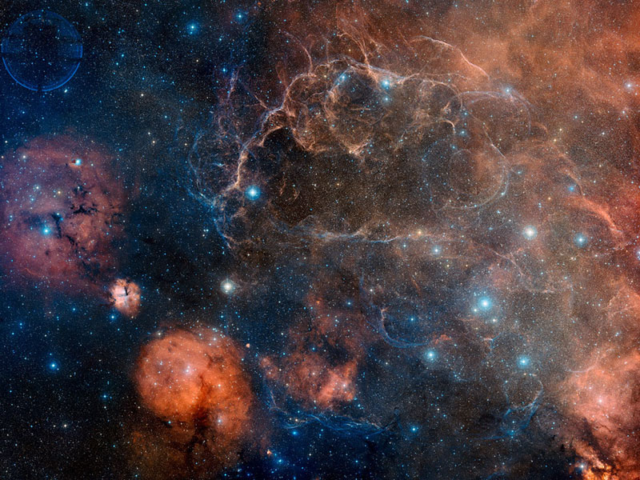
It takes exploding gas/debris (remnants) time to travel from the origin point , Point A, to Point B: we have found ones that have been traveling for several million years
Supernova Remnant
Point B
Point A
Credit-Digitized Sky Survey, ESA, ESO, NASA, FITS Liberator; Color Composite-David De Martin (Skyfactory)

Slide 51
AGE OF UNIVERSE & EARTH
WHAT DO THE FACTS OF NATURE SAY?
  Light’s Travel Time and Distance
  Light travels at 186,300 miles per second, or about an equivalent of 7.5 times around the earth/sec.
Nobody really contends the distances of the various stars and galaxies we see in the universe; galaxies are as far away as almost 13.4 billion light years.

Slide 52
AGE OF UNIVERSE & EARTH
WHAT DO THE FACTS OF NATURE SAY?
  Light’s Travel Time and Distance
  Light from the sun takes 8 minutes to reach earth. So, we are seeing the sun as it existed 8 minutes ago.
Similarly, when we see the Andromeda Galaxy, which is 2 million light years away, we are seeing the light which came from it 2 million years ago, not as it exists today.

Slide 53
AGE OF UNIVERSE & EARTH
WHAT DO THE FACTS OF NATURE SAY?
  Light’s Travel Time and Distance
  If the universe were only 6 – 10,000 years old, we could not see the light from objects that are beyond 6 – 10,000 light years distant.
  Since we do see light from objects many millions and billions of light years away, the universe cannot be only 6 – 10,000 years old.

Slide 54
AGE OF UNIVERSE & EARTH
WHAT DO THE FACTS OF NATURE SAY?
  Light’s Travel Time and Distance
  Some young universe proponents, realizing this as a major problem, try to offer various explanations to circumvent the issue. The top three follow, with their rebuttals (note: all the proposed explanations can be fully refuted):

Slide 55
AGE OF UNIVERSE & EARTH
WHAT DO THE FACTS OF NATURE SAY?
  Light’s Travel Time and Distance
  First incorrect explanation is that God created the beams of light fully in transit, fully matured from one “end” (origin of) to the other (the end point, in this case earth).

Slide 56
AGE OF UNIVERSE & EARTH
WHAT DO THE FACTS OF NATURE SAY?
  Light’s Travel Time and Distance
  This would have God creating false images of age, and therefore would be guilty of fraud as:
    The light’s spectral lines broaden and become more red the further the light travels through space, per the laws of physics God set up.
    The light we see shows it has traveled great distances/time due to its spectral lines and red shift, caused by it traveling through gas clouds.

Slide 57
AGE OF UNIVERSE & EARTH
WHAT DO THE FACTS OF NATURE SAY?
  Light’s Travel Distance and Time
    So, if God really created the beams of light fully intact, which also contain the indicators of billions of years of travel, that would be fraudulent per the laws of physics God set up!
    The Bible says, as shown earlier, that God’s creation shows God’s truth, righteousness, and glory; it does not indicate fraud!

Slide 58
AGE OF UNIVERSE & EARTH
WHAT DO THE FACTS OF NATURE SAY?
  Light’s Travel Distance and Time
  No wonder many young earth creationists are giving up this line of reasoning that God artificially created beams of light that would wrongly indicate age!

Slide 59
AGE OF UNIVERSE & EARTH
WHAT DO THE FACTS OF NATURE SAY?
  Light’s Travel Distance and Time
    The second incorrect explanation offered to try to explain away the light distance problem, is that “maybe the speed of light changed.”
    First, we have photographic evidence of the universe from the present back to less than .002% of its current age! If the speed of light changed, we would have concrete evidence of it. All evidence shows no change in light’s speed.

Slide 60
AGE OF UNIVERSE & EARTH
WHAT DO THE FACTS OF NATURE SAY?
  Light’s Travel Distance and Time
    Second, nobody disputes Einstein’s equation of E = mc² in his General Theory of Relativity. It is solid, and has never been shown to be wrong.
    E = energy; m = mass; c = speed of light. Without getting into too much detail, any change in the speed of light (“c”) would fatally affect the energy (“E”) and mass (“m”) of the universe.

Slide 61
AGE OF UNIVERSE & EARTH
WHAT DO THE FACTS OF NATURE SAY?
  Light’s Travel Distance and Time
    For example: Fill all of the universe’s 200 billion galaxies with dimes; if the amount of that “mass” right after the initial creation were to have changed by the amount of about one dime, there would never be an earth!

Slide 62
AGE OF UNIVERSE & EARTH
WHAT DO THE FACTS OF NATURE SAY?
  Light’s Travel Distance and Time
    Energy “E” is even more sensitive to the speed of light. In fact, it is one trillion by one trillion by one trillion by one trillion by one trillion times more sensitive!!!

Slide 63
AGE OF UNIVERSE & EARTH
WHAT DO THE FACTS OF NATURE SAY?
  Light’s Travel Distance and Time
    If the speed of light had changed (“c”), Adam and Eve would be burned to a cinder by the energy (E) of the sun!
    Note: Remember high school chemistry? An equation must stay in balance: E = mc…change one side’s variable, the other side’s variable(s) must change in the opposite direction to keep it balanced.

Slide 64
AGE OF UNIVERSE & EARTH
WHAT DO THE FACTS OF NATURE SAY?
  Light’s Travel Distance and Time
    Bottom line: the slightest change in “c” or the speed of light would result in fatal levels of energy or mass.

Slide 65
AGE OF UNIVERSE & EARTH
WHAT DO THE FACTS OF NATURE SAY?
  Light’s Travel Distance and Time
    This “speed of light changed theory” uses false conclusions by some from measurements made by Olaus Romer in 1675, along with its subsequent refinements by an Australian amateur scientist Barry Setterfield in 1973.

Slide 66
AGE OF UNIVERSE & EARTH
WHAT DO THE FACTS OF NATURE SAY?
  Light’s Travel Distance and Time
    Romer measured the speed of light with the results showing a 3% greater speed than today’s measurements.
    However, his error bar was GREATER than 3%! So, no problem!

Slide 67
AGE OF UNIVERSE & EARTH
WHAT DO THE FACTS OF NATURE SAY?
  Light’s Travel Distance and Time
    Correcting for one inaccurate part of Romer’s calculations, he would have had a figure that was within 0.5 % of today’s measurements.
    Setterfield, a young earth creationist who promotes the change of light’s speed, apparently misunderstood the 0.5% figure as a 0.5% reduction in light’s speed since 1675!

Slide 68
AGE OF UNIVERSE & EARTH
WHAT DO THE FACTS OF NATURE SAY?
  Light’s Travel Distance and Time
    However, this was clearly not the case (it is just a matter of refining subsequent measurements and their accuracies).
    Since Romer’s day, 50 measurements of the speed of light have been conducted, with all of them showing its speed as constant since 1675!

Slide 69
AGE OF UNIVERSE & EARTH
WHAT DO THE FACTS OF NATURE SAY?
  Light’s Travel Distance and Time
  The remaining incorrect explanation offered to try to explain the light-distance problem is that “maybe the ‘clocks’ of distant space were different than on earth.” It is suggested they were a million times slower. This has been popularized by an individual named “Russell Humphry.”

Slide 70
AGE OF UNIVERSE & EARTH
WHAT DO THE FACTS OF NATURE SAY?
  Light’s Travel Distance and Time
  Apparently, this “explanation” was made assuming we could not find “clocks” in the distant universe. However, we have!

Slide 71
AGE OF UNIVERSE & EARTH
WHAT DO THE FACTS OF NATURE SAY?
  Light’s Travel Distance and Time
  Light cycle times of cepheid variable stars, nova and supernova eruption times, gamma-ray bursts, star formation times, stellar burning rates, and galaxy rotation periods measure the same whether near or far away. (Dr. Hugh Ross, A Matter of Days, p. 167-8).

Slide 72
AGE OF UNIVERSE & EARTH
WHAT DO THE FACTS OF NATURE SAY?
  Ice Cores
Evidence from 3 ice cores in Northern Greenland and 3 in Central Antarctica demonstrate the earth cannot be only 6 – 10,000 years old.
These ice cores have annual layers, like tree rings.

Slide 73
AGE OF UNIVERSE & EARTH
WHAT DO THE FACTS OF NATURE SAY?
  Ice Cores
The oldest of the six in central Antarctica is 800,000 years old as it has 800,000 layers (the “Dome C” site).

Slide 74
AGE OF UNIVERSE & EARTH
WHAT DO THE FACTS OF NATURE SAY?
  Ice Cores
There is conclusive evidence these layers are annual as we can count the number of layers back to known historic volcanic eruptions of Krakatau in 1887 and Vesuvius in 79 A.D., and the number of layers corresponds to the exact number of years back to those events (the two layers have debris from those eruptions).

Slide 75

AGE OF UNIVERSE & EARTH
WHAT DO THE FACTS OF NATURE SAY?
Depris deposit from eruption of Krakotua in 1879
For iIllustrative purposes, let us
assume that the 800,000 yr. old ice
core was cored out at end of 2000 A.D.
(drawing not to scale)
Depris deposit from eruption of Vesuvius in 79 A.D.
121 ice layers = 121 yrs.
1,800 ice layers =
1800 yrs.
799,079 ice layers =
799,079 yrs.
800,000 ice layers = 800,000 yrs.

Slide 76
AGE OF UNIVERSE & EARTH
WHAT DO THE FACTS OF NATURE SAY?
  Ice Cores
All six ice cores are over 100,000 years old each.
The oldest one (800,000 yrs.) shows 8 cycles of the 100,000 year orbital eccentricity patterns of the earth’s revolutions around the sun.
The annual sediment cores (not ice cores) off the coast of New Zealand show over 1 million years.

Slide 77
AGE OF UNIVERSE & EARTH
WHAT DO THE FACTS OF NATURE SAY?
  Ice Cores
Some young earth proponents say that each layer does not necessarily equate to one year’s passage of time. This is true, for example in Southern Greenland where the ice can melt and freeze several times a year. BUT it is NOT true for the ice cores referenced earlier which are found in Northern Greenland and in Antarctica.

Slide 78
AGE OF UNIVERSE & EARTH
WHAT DO THE FACTS OF NATURE SAY?
  Spreading Out Rate of Galaxies
The spreading out of the cosmos, or the expansion rate, is extremely fine tuned.
In fact, just after the Big Bang it was finely tuned to one part out of 10⁵⁷, otherwise there would be no earth-like planet…ever.

Slide 79
AGE OF UNIVERSE & EARTH
WHAT DO THE FACTS OF NATURE SAY?
  Spreading Out Rate of Galaxies
That precision of design is like saying that if you took all the grains of sands on all the beaches of earth (~10²³), and multiplied them by 1 trillion, 1 trillion, by 10 billion times, and marked one of the grains of sand and then mixed them all up and then dived down blindfolded and found that marked grain on the first try!!!!!

Slide 80
AGE OF UNIVERSE & EARTH
WHAT DO THE FACTS OF NATURE SAY?
  Spreading Out Rate of Galaxies
We know what the expansion rate is and has been throughout cosmic history. There is actual photographic evidence for it.
For it to expand to its current size at the known rate it would be impossible in a 6 – 10,000 year universe, but only in a 13.7 billion year universe (as shown earlier under “E”).

Slide 81
AGE OF UNIVERSE & EARTH
WHAT DO THE FACTS OF NATURE SAY?
  Temperature of the Cosmos
  Given :
  an explosion from a central point
  with known, continual expansion outward
  with known original temperatures involved...

Slide 82
AGE OF UNIVERSE & EARTH
WHAT DO THE FACTS OF NATURE SAY?
  Temperature of the Cosmos
  The temperature can be calculated at any given time in the past after the initial event (explosion). It is very simple to do. …

Slide 83
AGE OF UNIVERSE & EARTH
WHAT DO THE FACTS OF NATURE SAY?
  Temperature of the Cosmos
  All these conditions are clearly known about the Big Bang and its subsequent expansion.
  Measuring the temperatures of the universe at different distances (times), only a multi-billion year universe is consistent with the actual temperatures measured.

Slide 84
AGE OF UNIVERSE & EARTH
WHAT DO THE FACTS OF NATURE SAY?
  Temperature of the Cosmos
  NASA’s COBE instrument in the 1990s measured the universe’s background radiation today at 2.725 degrees Kelvin (that’s -454.49 degrees Fahrenheit!)... 2.725 Kelvin is almost a temperature of “no usable energy” – where absolutely no heat is emitted).

Slide 85
AGE OF UNIVERSE & EARTH
WHAT DO THE FACTS OF NATURE SAY?
  Temperature of the Cosmos
  That low of a temperature could not be reached from the almost infinitely high temperature at the creation point if the universe were only 6-10,000 years old.
  To cool down to 2.725 Kelvin would take 13.8 billion years according to the physics of the universe that God has established.

Slide 86
AGE OF UNIVERSE & EARTH
WHAT DO THE FACTS OF NATURE SAY?
  Temperature of the Cosmos
  The 2.725 degrees Kelvin temperature was actually predicted by the physics of the Big Bang before its actual measurement!
  Since the COBE instrument’s measurements, several more have been taken by other means which have verified the original measurement.

Slide 87
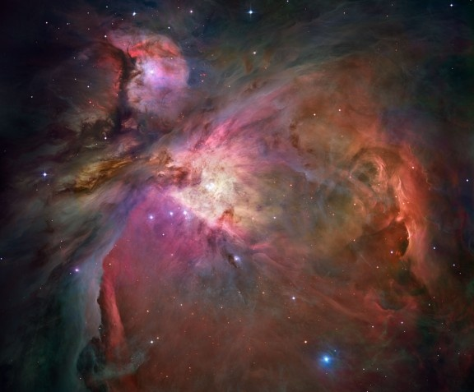
ORION NEBULA
ARE YOU A R-E-A-L-I-S-T?
DO YOU BELIEVE IN REALITY?
GOD CERTAINLY DOES!...HE CREATED IT!
- Credit – NASA, ESA, M. Roberto (STScI, ESA), The Hubble Space Telescope Orion Treasury project Team

