Slide 1
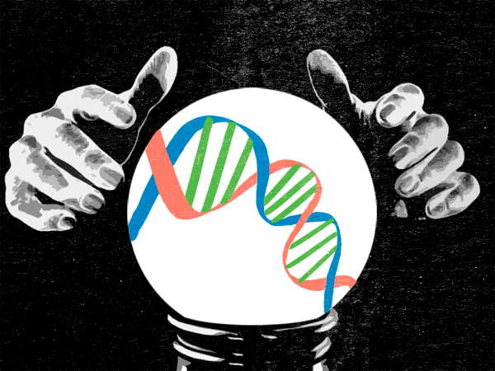
Fated ?
Do your genes
decide your
fate?
Paradoxes
August 4, 2013
Dr. Katie Galloway
Notes:
So today we are going to be considering several questions:
Do you genes decide your fate? Are we all run away biochemical reactors?
How does our will change us? In light of what we know, how then should we live?
This talk began as an answer to a number of questions that arose as a result of popular news reports indicating the ‘such-n-such’ gene had been discovered.
God, our genes, our environment, or some stupid programmer keying in code at an ancient terminal - there's no way free will can ever exist if we as individuals are the result of some external cause.
Orson Scott Card
.

Slide 2
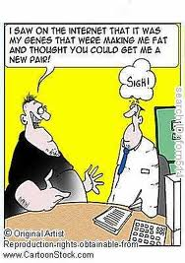
Fat gene?
Notes:
Reports got generally translated into “Here is the fat gene…if you have the fat gene you will be fat…

Slide 3
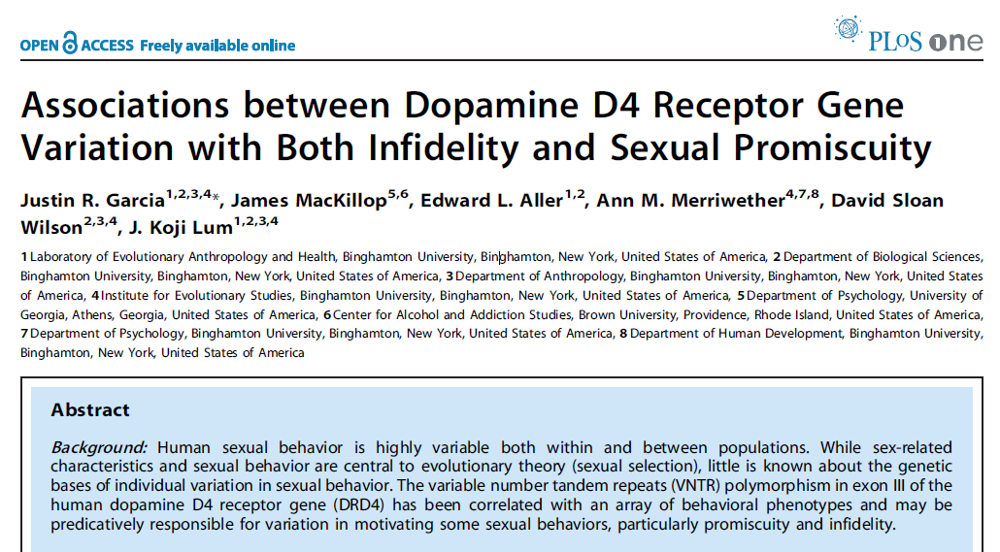
Infidelity gene?
Notes:
We found the infidelity gene and if you have it is not possible to be faithful.

Slide 4
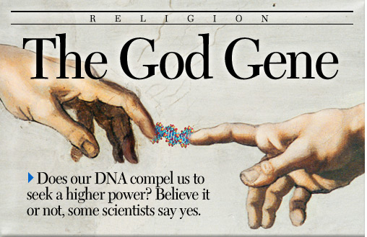
Notes:
Ah, and now we have the God gene…you believe in God because you have been deluded by your genes…etc.”

Slide 5
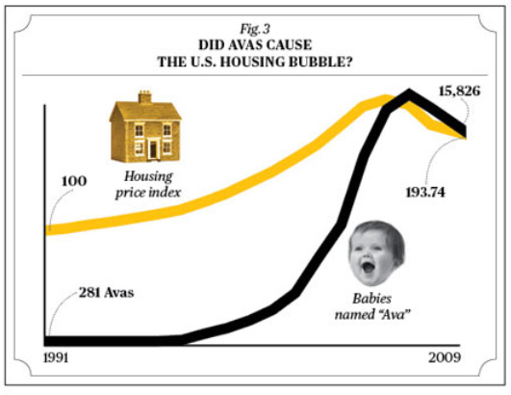
Identifies-meaningless-correlations gene?

Slide 6
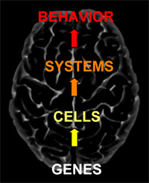
A bottom-up approach
““We are survival machines – robot vehicles blindly programmed to preserve the selfish molecules known as genes.”
– Richard Dawkins, biologist
Notes:
These poor translations of real research adopted a bottom-up model of how genes drive cells and cells drive systems which in turn drive behavior. We call this bottom-up because it is at the smallest scale that processes are controlled. Additionally, when interpreted from the perspective of naturalism you end up with a rather depressing result summarized here by Richard Dawkins:
““We are survival machines – robot vehicles blindly programmed to preserve the selfish molecules known as genes.”
– Richard Dawkins, biologist
Let me just say…We have no idea how his wife feels about this statement. :s

Slide 7
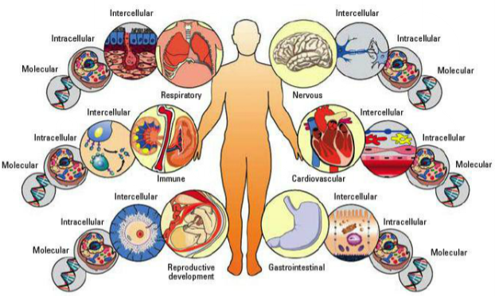
A Reductionist view of Biology
Environment
& society
Input:
Initial conditions
Molecules
Networks
Cells
Tissues
Systems
Organism
Output:
Fate
Notes:
Despite the depressing conclusion, there is evidence that your genes do influence a number of factors in your life. Your proclivity to certain vices, your disposition, your metabolism, your level of optimism, your resilience to stress can all be changed by what happens at the genetic level and not just to you, but even your parents and what has happened to them. So is it true then? Are we fated to a particular condition? Fate to a predetermined life? Locked into belief or disbelief? Or is this actually part of God’s grace? Is there hope?
Today we are going to look at what biology can tell us about the material factors that shape our lives. What I think you will see is that at every level we observe there is both order and design. And while this order and design does not preclude the possibility of alternative, naturalistic explanations, it supports the Biblical claims that God carefully ordered the universe, designed biological systems, and endowed humans with the image of God. Also, I hope you will see though this talk that how biological system are designed provides for God’s mercy and grace in our life and that it also provides for our free will as well as the gift of the Holy Spirit.

Slide 8
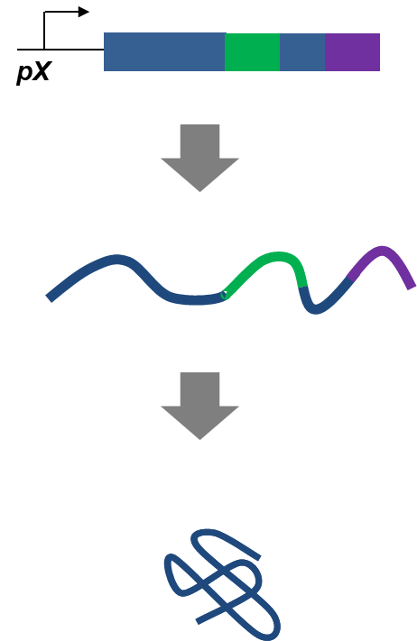
Layers of design
Environment
& society
Input:
Initial conditions
Molecules
Networks
Cells
Tissues
Systems
Organism
Output:
Fate

Slide 9
Gene expression: Running genetic program
Promoter:
Controls production RNA from DNA
DNA
pX
mRNA
protein
Notes:
Different parts control how the program is run…at the DNA level a promoter dictates how much RNA is made from the DNA template.

Slide 10
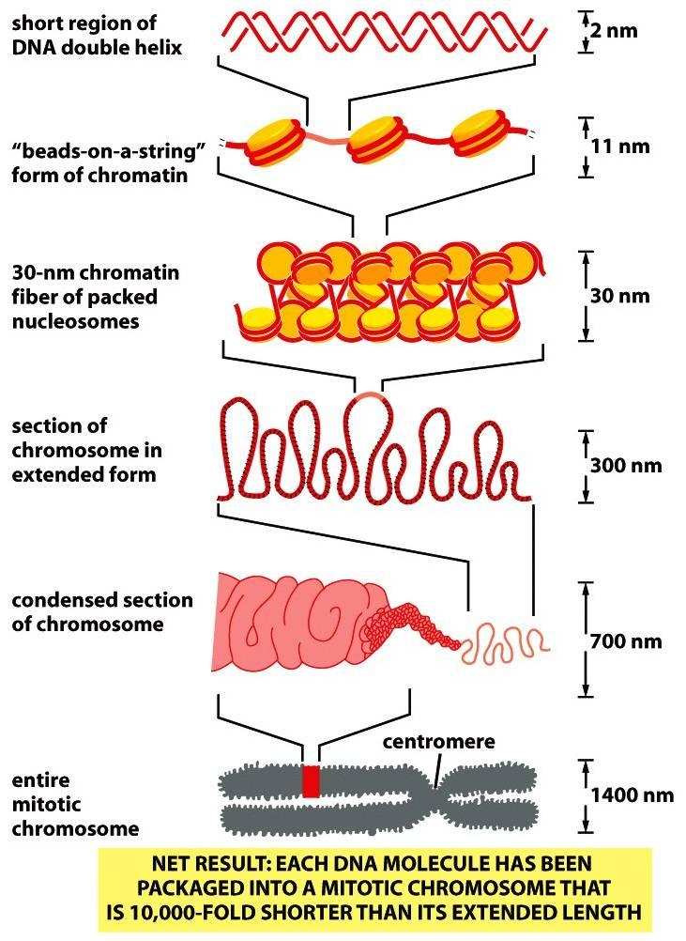
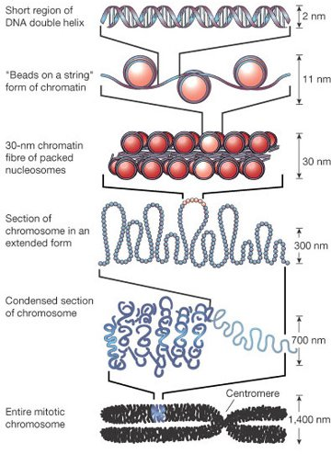
http://www.studyblue.com/notes/note/n/chapter-4-dna-chromosomes-and-genomes/deck/1404309
Epigenetics and structure of DNA

Slide 11
http://www.studyblue.com/notes/note/n/chapter-4-dna-chromosomes-and-genomes/deck/1404309
Loose packing of DNA turns on genes

Slide 12
http://www.studyblue.com/notes/note/n/chapter-4-dna-chromosomes-and-genomes/deck/1404309
Tight packing of DNA turns off genes
10,000 fold packing during cell division!

Slide 13
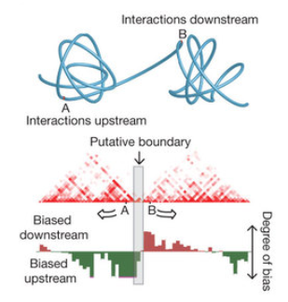
http://www.studyblue.com/notes/note/n/chapter-4-dna-chromosomes-and-genomes/deck/1404309
3D structure of the genome influences how sets of genes interact

Slide 14

DNA wrapped for tangle free, dynamic loosing and rewrapping

Slide 15
Gene expression: Running the program
Promoter:
Controls transcription of DNA to RNA
DNA
pX
Non-coding RNA:
Controls processing of mRNA into proteins
mRNA
protein
Notes:
mRNA is translated into proteins and this process can be controlled by non-coding RNAs, increasing or reducing protein output

Slide 16
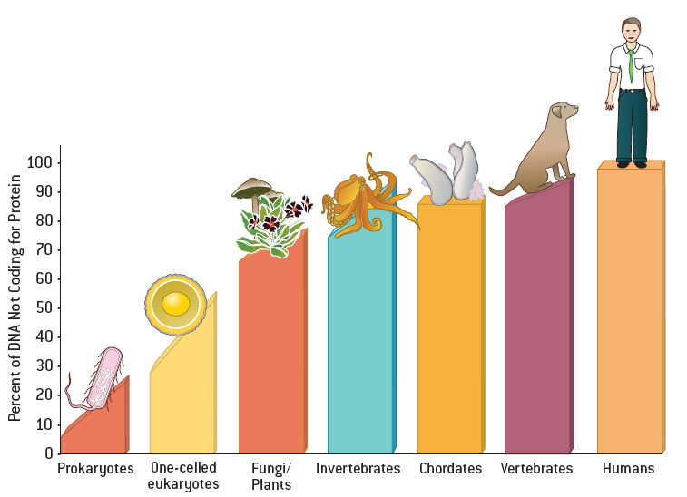
Percent of non-coding DNA increases with organism complexity
Mattick, J.S. Scientific American 2004
Notes:
The answer may lie in another curiousity that researchers have been unraveling.
For humans and other complex multicellular life forms, most of the genome is devoted to non-coding DNA, or DNA that doesn’t code for proteins.

Slide 17
“Junk DNA” is not so “junky”
98% of human non-coding DNA is translated into RNA
Mattick, J.S. Scientific American 2004
Notes:
Perhaps far more curiously, in humans 98% of this DNA is turned into RNA, meaning cells spend an enormous amount of resources on things that don’t have an apparent physical product.

Slide 18
Diversity of proteins 50x > genes!
~20,000 genes
DNA
mRNA
~1,000,000 proteins
protein

Slide 19
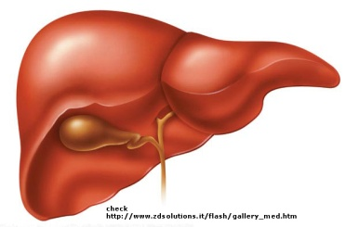
Not the size of your genome, but how you use it
DNA
RNA
translation
Brain protein
Liver protein
Notes:
What we now suspect and are beginning to confirm, is that non-coding RNA is critical for controlling gene expression and ultimately cell fate.

Slide 20
Natural RNA control systems intervene in gene expression to direct cellular fate
DNA
Post-transcriptional processing
transcription
pre-mRNA
editing, splicing
silencing
mRNA
translation
Brain protein
Liver protein
Notes:
Post-transcriptional processing, the steps after RNA is made, generates significant protein diversity, directing cellular fate.
So non-coding RNA is one significant way nature controls fate, as we are looking to understand natural control schemes, we are simultaneously engineering synthetic RNA controllers.

Slide 21
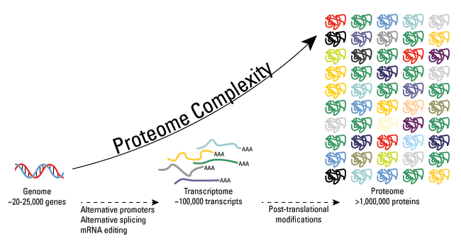
Enormous amount of information in RNA and proteins regulate cellular fate
~20,000 genes
DNA
mRNA
~1,000,000 proteins
protein
Notes:
Following the sequencing of the human genome and the genomes of other organisms, a curiosity emerged. There are far fewer genes than expected.

Slide 22
Gene expression: Running the program
Promoter:
Controls transcription of DNA to RNA
DNA
pX
Non-coding RNA:
Controls processing of mRNA into proteins
mRNA
Proteins:
Provide structure, energy production, regulation, define various cell types
protein
Notes:
Finally, proteins are the cell’s work horses….they provide structure, they store ,convert, and generate energy, and they ultimately define the various cell types.

Slide 23



Genetically identical but different
pX
…………………………
pX
…………………………
Protein 1
…………………………
Protein N
Heart muscle cells
Blood cells
Brain cells
Notes:
Now again if you if you consider the different tissues, they are genetically identical… they all have genes for proteins 1 through N…but obviously they are different. What makes them different is gene expression.

Slide 24
Levels of gene expression define cell types
pX
…………………………
pX
…………………………
Protein 1
…………………………
Protein N
<
~
>
Heart muscle cells
Blood cells
Brain cells
Notes:
The levels of gene expression defines cells type. In a simplified version, proteins 1 through N are made in the cells and what may define the cells are the levels and ratios of these proteins relative to each other.

Slide 25
Levels of gene expression define cell types
Protein 1
Levels of expression
Protein N
Spectrum of fate
<
~
>
Heart muscle cells
Blood cells
Brain cells
Notes:
By building programs that change the levels of gene expression we can shift these ratios and thus we can change cell fate.
But we can’t just change any genes to control cell fate…we need to focus on the genes that already control cell fate… and to do that we turn towards the master regulators of fate, MAPK pathways.

Slide 26
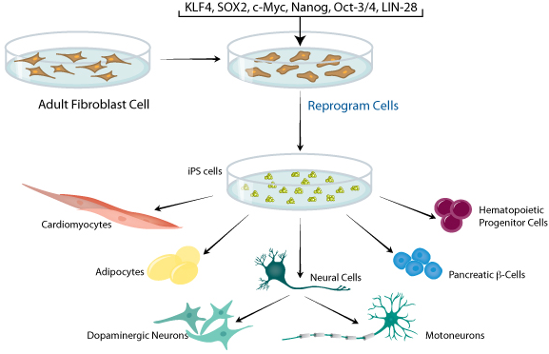
Synthetic control systems control gene expression to reprogram cell fate
Figure adapted from Amabile, G. & A. Meissner (2009) Trends Mol. Med. 15:59.
Notes:
There necessarily exists an antagonistic relationship between reprogramming and differentiation. Synthetic control systems may allow optimization of both reprogramming and differentiation. Further synthetic control systems may be programmed to resist undesirable responses from therapuetic cells such as teratoma formation or fibrosis at the site of injury/inflammation.

Slide 27
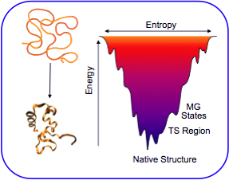
Simple model for proper protein folding
Native protein structure goes to lowest energy state, process runs downhill

Slide 28
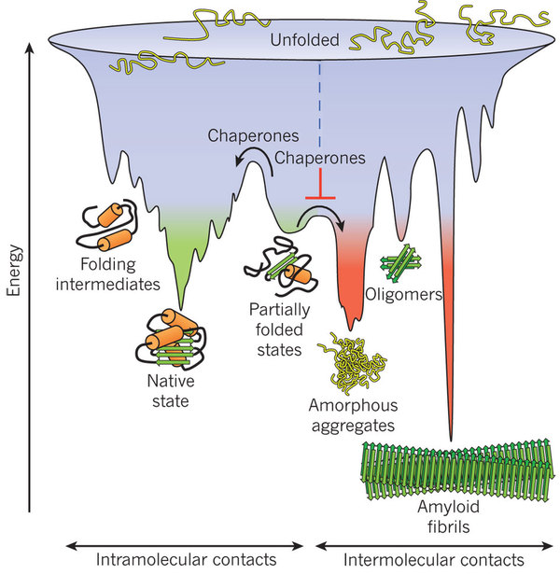
Multi-level control for proper protein folding
Native protein structure is metastable, kinetically entrapped, guided to native fold

Slide 29
Important molecular control at all three levels
Promoter:
Controls transcription of DNA to RNA
DNA
pX
Non-coding RNA:
Controls processing of mRNA into proteins
mRNA
Proteins:
Provide structure, energy production, regulation, define various cell types
protein
Notes:
Finally, proteins are the cell’s work horses….they provide structure, they store ,convert, and generate energy, and they ultimately define the various cell types.

Slide 30
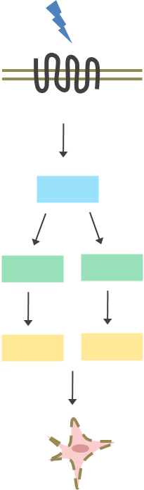
Layers of design
Environment
& society
Input:
Initial conditions
Molecules
Networks
Cells
Tissues
Systems
Organism
Output:
Fate

Slide 31

No gene is an island

Slide 32
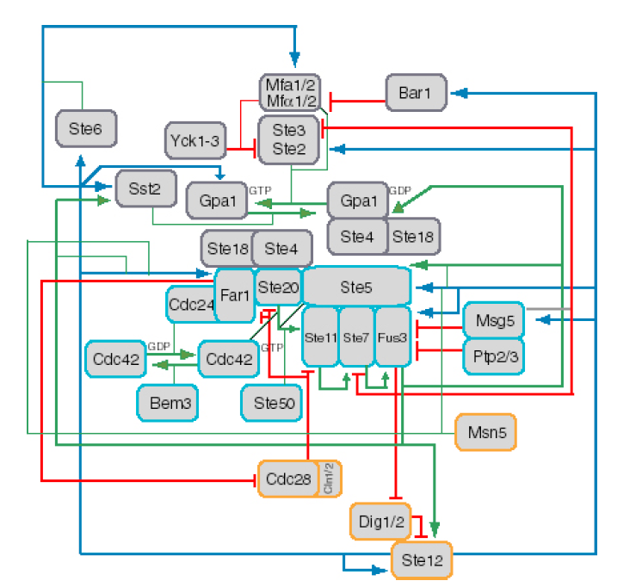
A systems view of the yeast mating pathway: model cancer pathway
Fast negative regulation
Fast positive regulation
Transcriptional regulation
Figure courtesy of D.Endy. 2006
Notes:
and the first things we need are these regulators…

Slide 33
MAPK pathways: regulators of cell fate
Yeast
Mammalian
Extracellular signal
Pheromone
Growth factors, cytokines, cell stress
Transmembrane receptor
MAPKKK
MAPKK
MAPK
Fus3
Erk1/2
JNK
p38
Pathway response
Mating
Proliferation
Differentiation
Development
Inflammation
Apoptosis
Development
Notes:
MAPK pathways are an important class of highly conserved signaling pathways. By “conserved,” I mean that means across multiple organisms, from yeast to mammals, the same forms and often functions are preserved in these pathways.
The signal in the MAPK pathway starts with an extracellular stimulus that is transduced across the cell membrane and relayed down to a three-tiered MAPK cascade, which ultimately induces a phenotypic response (or “fate” choice) generally involving up- and down-regulation of critical genes. Responses like Mating in yeast and growth, specialization, and death in mammals are the programmed rational response of these pathways.

Slide 34
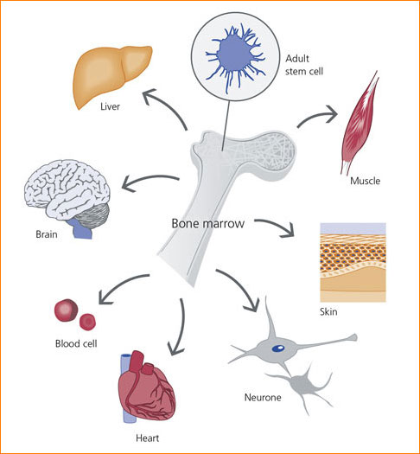
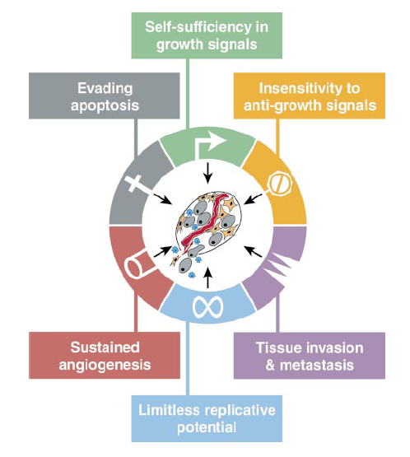
Implications in disease and therapeutics
Stem Cells
Cancer
Hanahan, D. and R.A. Weinberg, The hallmarks of cancer. Cell, 2000. 100(1): p. 57-70
Notes:
Because MAPK pathways control cell fate, they are extremely important in controlling stem cell differentiation, an important objective for tissue engineering and other regenerative medicines. These pathways are also important in the development and onset of cancer.
Importance of the MAPK pathways has generated an extensive body of knowledge, but it has only been recently, with the advent of systems biology, that some of the systems level properties of these networks have been elucidated. These systems properties shed light on how we can control these pathway and thus control cell fate.

Slide 35
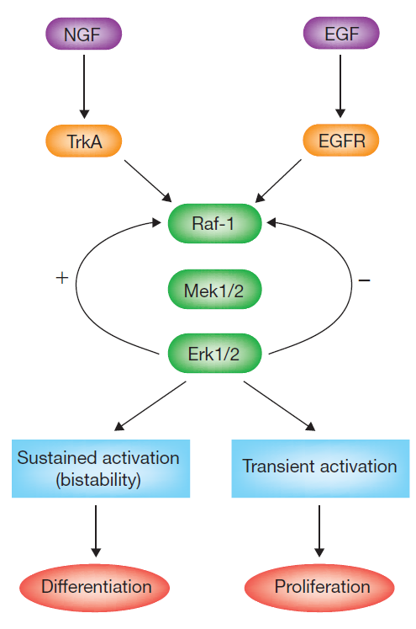
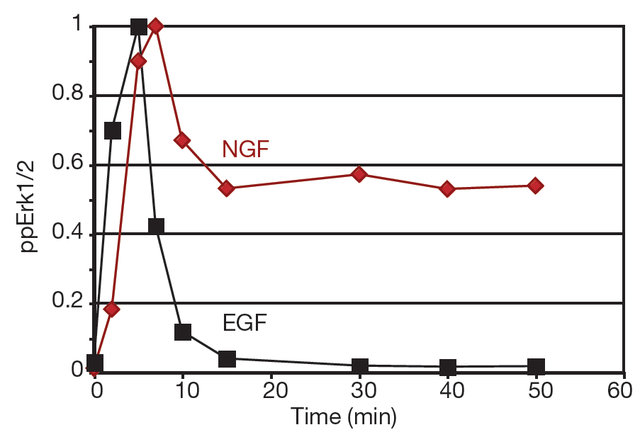
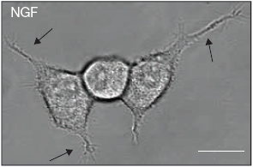
Signaling = Biology’s Morse code
NGF
EGF
Differentiation
+
-
Proliferation
Proliferation
Differentiation
Proliferation
Adapted from Santos, SD et al. Growth factor-induced MAPK network topology shapes Erk response determining PC-12 cell fate. Nat Cell Biol 2007
Notes:
Researchers determined that the growth factors induced different network structures. NGF stimulated positive feedback allowing sustained activity, EGF showed negative feedback resulting in transient pathway activation.

Slide 36
Complex signal processing used to direct cell fate
NGF
EGF
Differentiation
-
+
Proliferation
Proliferation
Proliferation
Differentiation
Adapted from Santos, SD et al. Growth factor-induced MAPK network topology shapes Erk response determining PC-12 cell fate. Nat Cell Biol 2007
Notes:
By synthetically switching the regulation, cells could be cross-wired to achieve the opposite fate.
So we see how by reshaping the network, different responses can be programmed.
Next we are going to look at how we can reshape the yeast mating pathway.

Slide 37
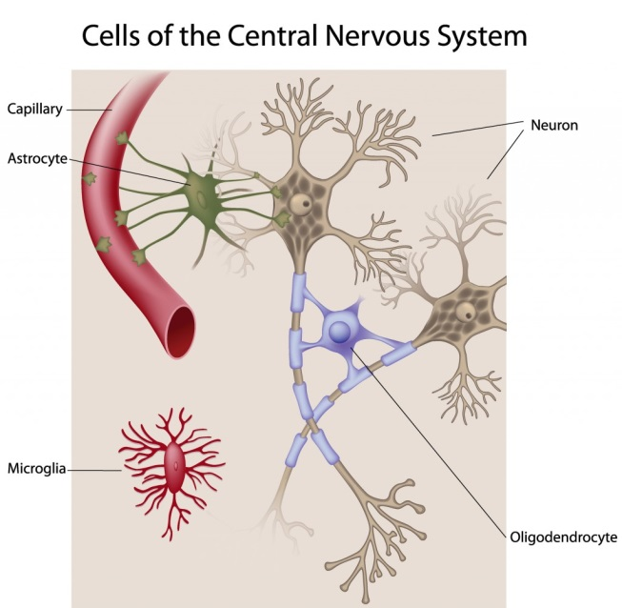
Layers of design
Environment
& society
Input:
Initial conditions
Molecules
Networks
Cells
Tissues
Systems
Organism
Output:
Fate

Slide 38
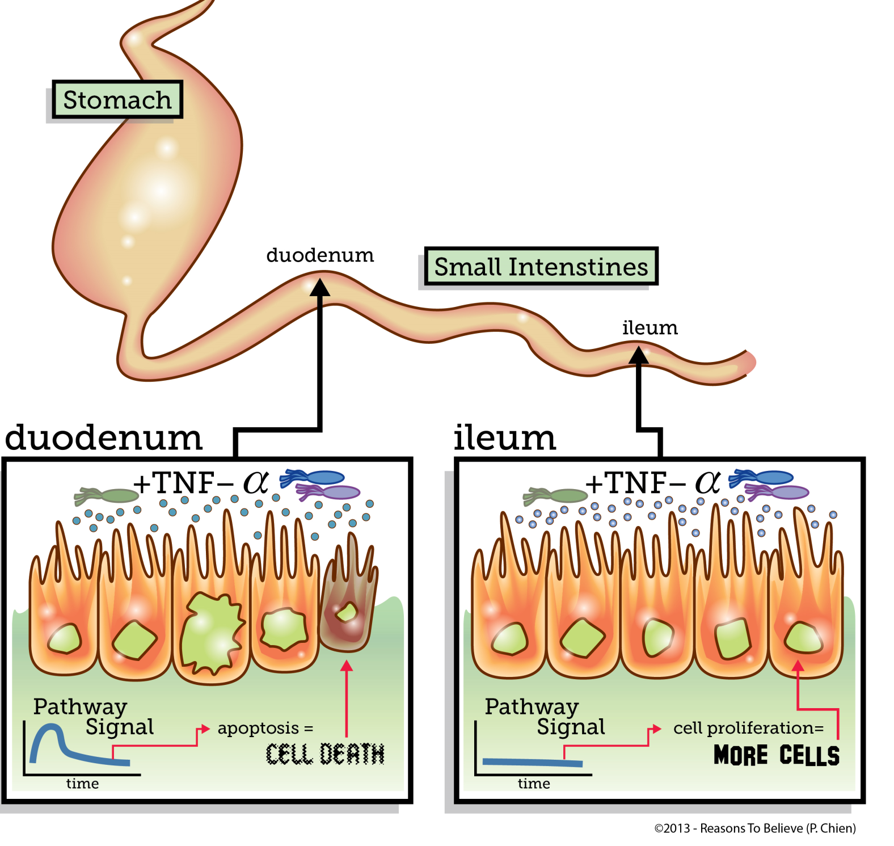
Life or death in response to pro-death signal is context dependent

Slide 39
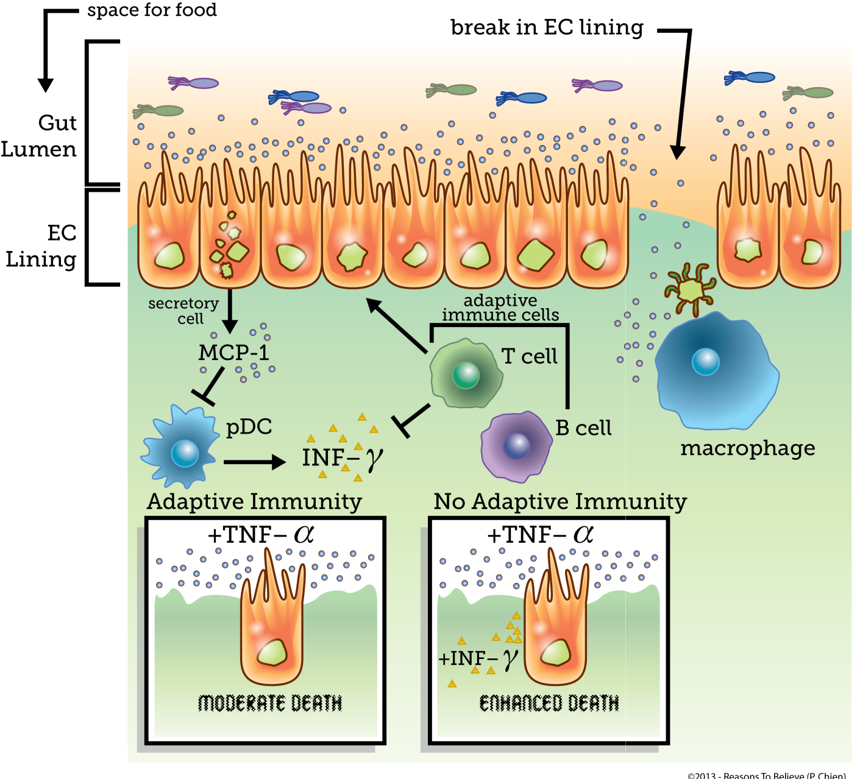
Coordination of homeostasis in the intestine

Slide 40
Coordination of multiple cell types required to prevent megadeath, disaster in the intestine

Slide 41

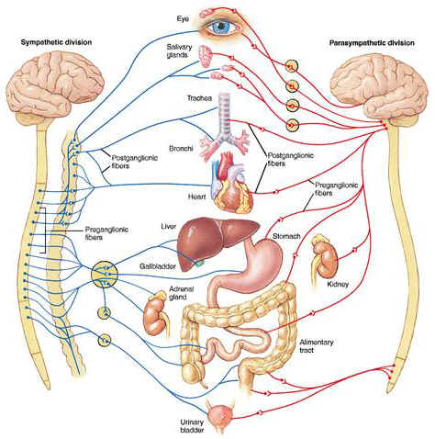
Layers of design
Environment
& society
Input:
Initial conditions
Molecules
Networks
Cells
Tissues
Systems
Organism
Output:
Fate

Slide 42
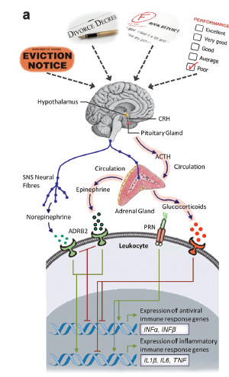
Stress is translated into changes in hormones, genes, and ultimately cell fate
http://www.sciencedirect.com/science/article/pii/S0889159112004941

Slide 43
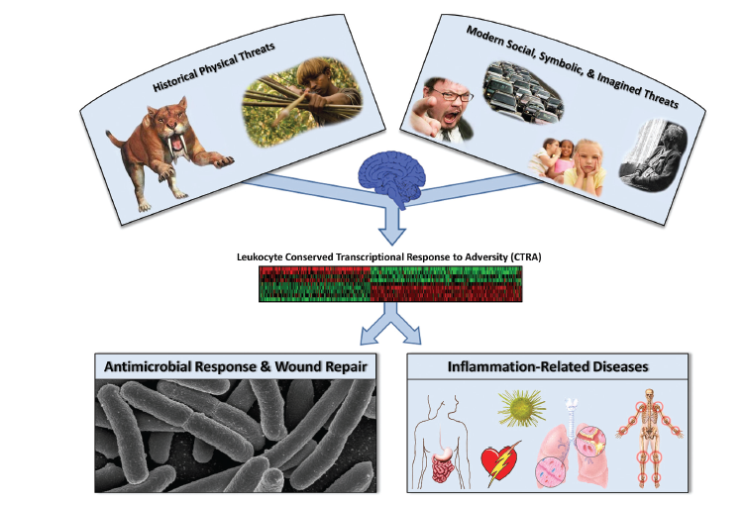
Stress can impair the immune system, brain function

Slide 44
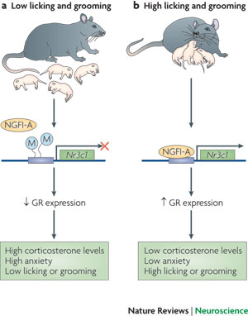


Maternal nurturing reduces stress

Slide 45

Layers of design
Environment
& society
Input:
Initial conditions
Molecules
Networks
Cells
Tissues
Systems
Organism
Output:
Fate

Slide 46
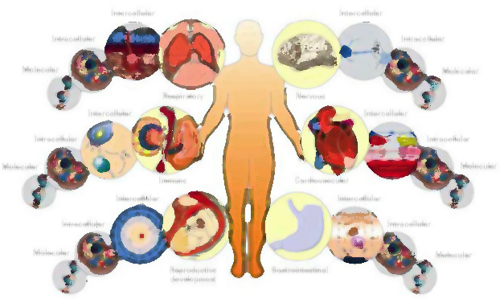
Feedback changes the nature of integrated system
Environment
& society
Input:
Initial conditions
Molecules
Networks
Cells
Tissues
Systems
Organism
Output:
Fate

Slide 47
Even with feedback this is still a biochemical machine
Environment
& society
Input:
Initial conditions
Molecules
Networks
Cells
Tissues
Systems
Organism
Output:
Fate

Slide 48
Unless there is a mind and free will
Environment
& society
Input:
Initial conditions
Molecules
Networks
Cells
Tissues
Systems
Organism
Output:
Fate
Mind, Will

Slide 49
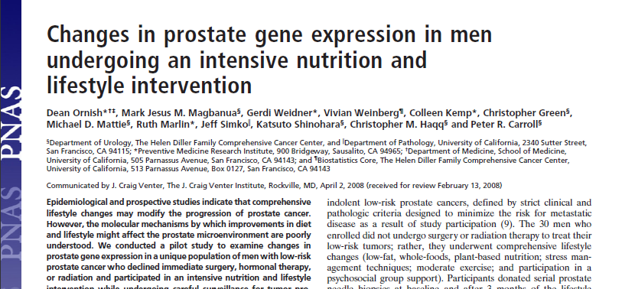
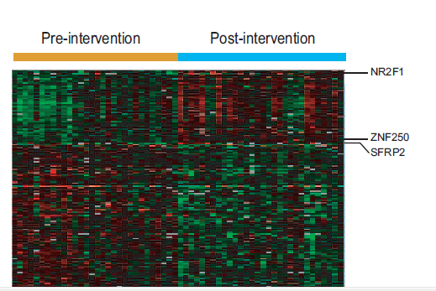
Modifying fate via behavior

Slide 50
Yet, if our hope is in our will, do we have hope?
Environment
& society
Input:
Initial conditions
Molecules
Networks
Cells
Tissues
Systems
Organism
Output:
Fate
Mind, Will

Slide 51
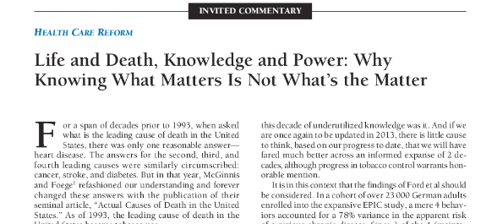
Hope in free will? Yes and no.
For I do not do the good I want to do, but the evil I do not want to do—this I keep on doing. -Romans 7: 19

Slide 52
God’s intervention, mercy and grace give hope
Environment
& society
Input:
Initial conditions
Molecules
Networks
Cells
Tissues
Systems
Organism
Output:
Fate
Mind, Will
God, Holy Spirit, Mercy, Grace

Slide 53
God’s intervention, mercy and grace give hope
Environment
& society
Input:
Initial conditions
Molecules
Networks
Cells
Tissues
Systems
Organism
Output:
Fate
Mind, Will
God is able and willing to help those who recognize their need
And Jesus said to him, “ ‘If You can?’ All things are possible to him who believes.” Immediately, the boy’s father cried out and said, “I do believe; help my unbelief.”
-Mark 9:23-24
God, Holy Spirit, Mercy, Grace

Slide 54
Quick summary: layers of design
Environment
& society
Input:
Initial conditions
Molecules
Networks
Cells
Tissues
Systems
Organism
Output:
Fate

Slide 55
Quick Summary: more than a biochemical machine
Environment
& society
Input:
Initial conditions
Molecules
Networks
Cells
Tissues
Systems
Organism
Output:
Fate
Mind, Will

Slide 56
Quick Summary: God designed free will & hope into our very being via our bodies, minds, and the Holy Spirit
Environment
& society
Input:
Initial conditions
Molecules
Networks
Cells
Tissues
Systems
Organism
Output:
Fate
Mind, Will
God, Holy Spirit, Mercy, Grace

Slide 57
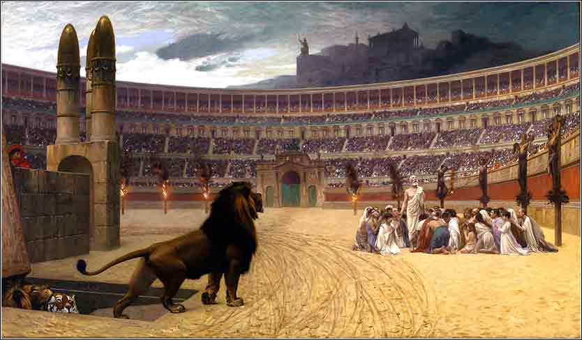
A word of caution…
Jesus answered them. “Love the Lord your God with all your heart and with all your soul and with all your mind.’ This is the first and greatest commandment. And the second is like it: ‘Love your neighbor as yourself.’ All the Law and the Prophets hang on these two commandments.” -Matthew 22:37-40
Notes:
Christianity is not a self-help program… to obtain happiness or your best life.

Slide 58
Questions for reflection
Is the material world enough to account for the design I see in nature? If the material world is all that there is, am I satisfied knowing I am a biochemical machine?
For those that embrace the potential of life beyond materialism, is the will enough? Is the will enough to make you the person you should be?
Evidence for a personal, loving, merciful God?
In light of how important the mind is to knowing God and how important social interactions can be on influencing the brain, am I acting as lovingly as I can? Am I being as kind? As gracious? Am I forgiving? Am I avoiding anger, resolving conflict?
How will you allow the Holy Spirit to transform you?
How will you build your faith today?

Slide 59
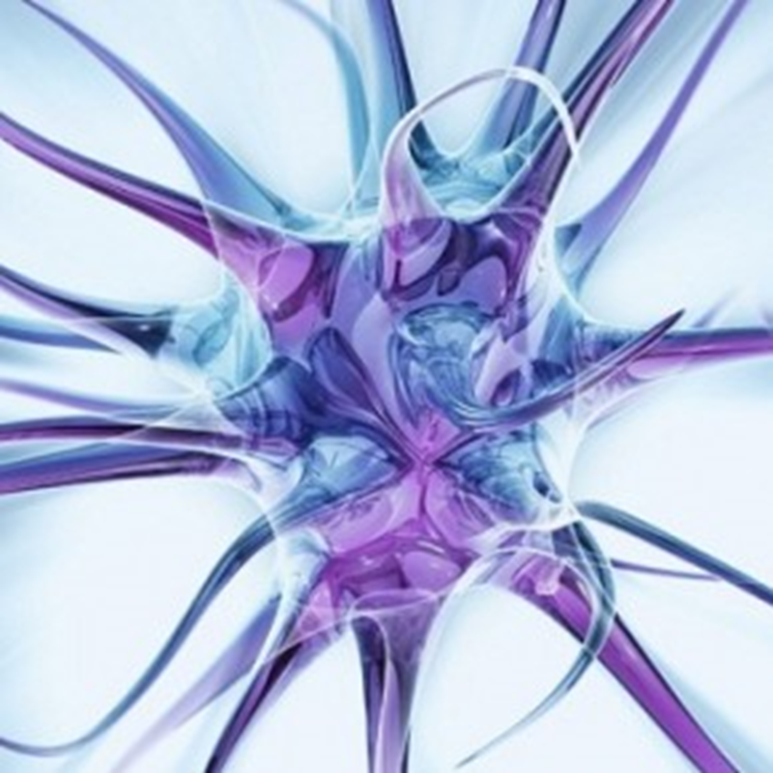
Questions…?

