Slide 1
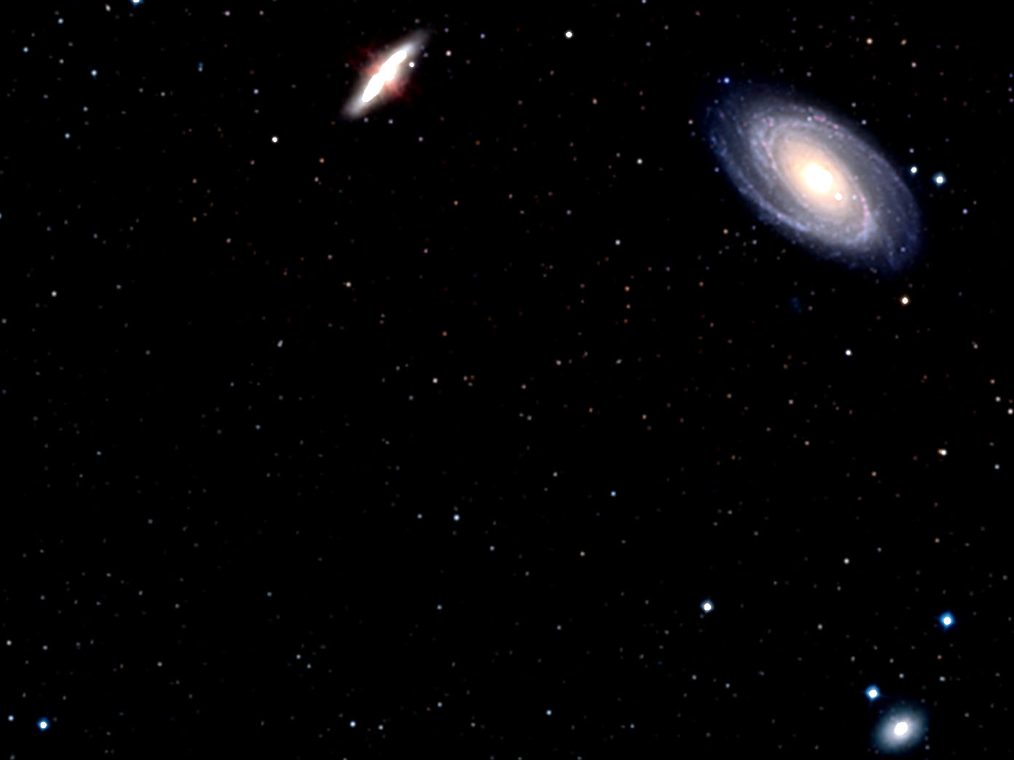
Why is the universe so very massive?
The universe’s mass determines its makeup of elements.
ESA/Hubble and Digitized Sky Survey 2

Slide 2
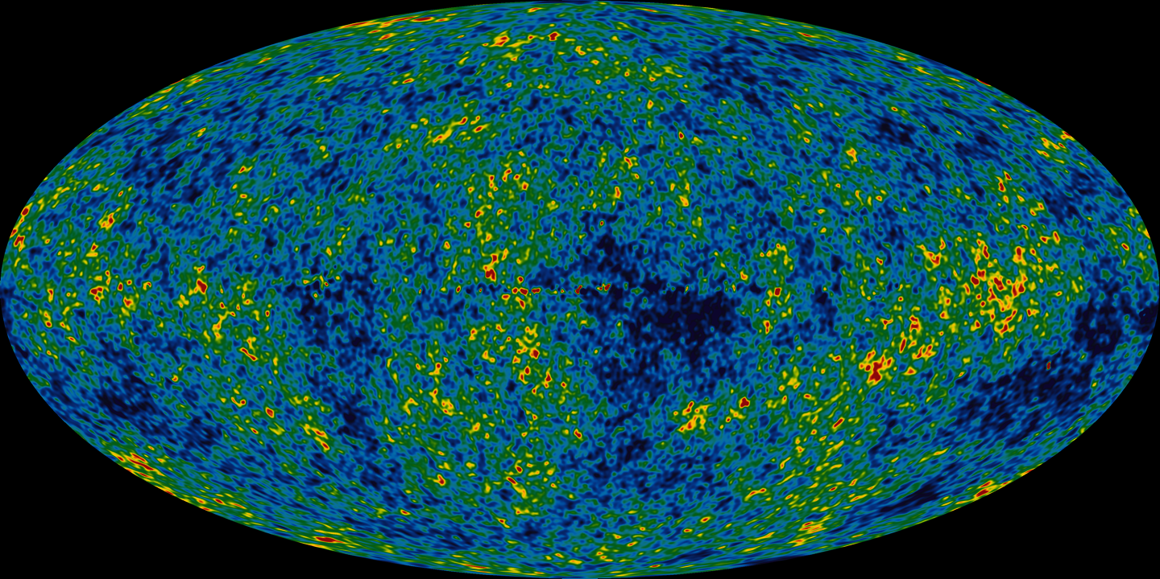
The more massive the universe, the more of its hydrogen is fused into helium during the first four minutes after cosmic origin.
NASA
Notes:
Too little helium, no elements heavier than boron will form.
Too much helium, the first stars quickly fuse all ordinary matter into elements as heavy or heavier than iron.
In both instances, no carbon, nitrogen, or oxygen—hence no life.

Slide 3


2 billion years ago
12 billion years ago
The universe’s mass also plays a crucial role in determining the cosmic expansion rate.
NASA//ESA/Hubble Heritage Team (STScI/AURA)

Slide 4
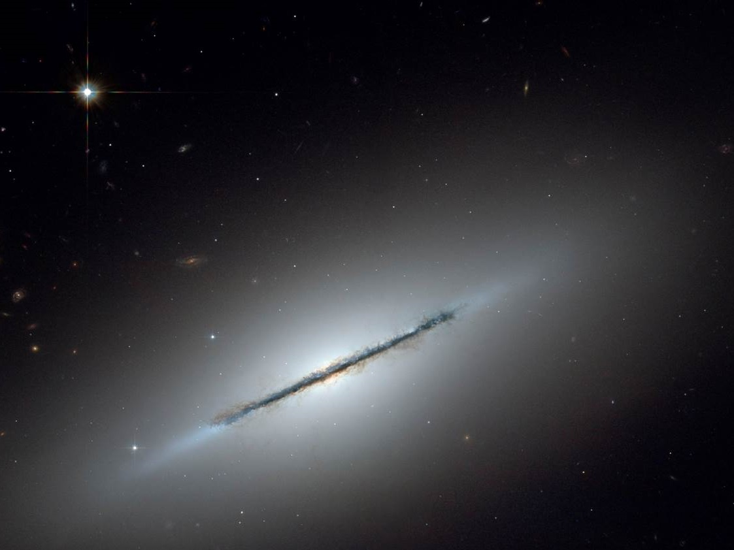
If the universe’s mass were the tiniest fraction greater or smaller, no life would be possible anytime or anywhere in the universe.
NASA//ESA/Hubble Heritage Team (STScI/AURA)/W. Keel, Univ. of Alabama, Tuscaloosa
Notes:
We’ll explain why in our next session together.

Slide 5
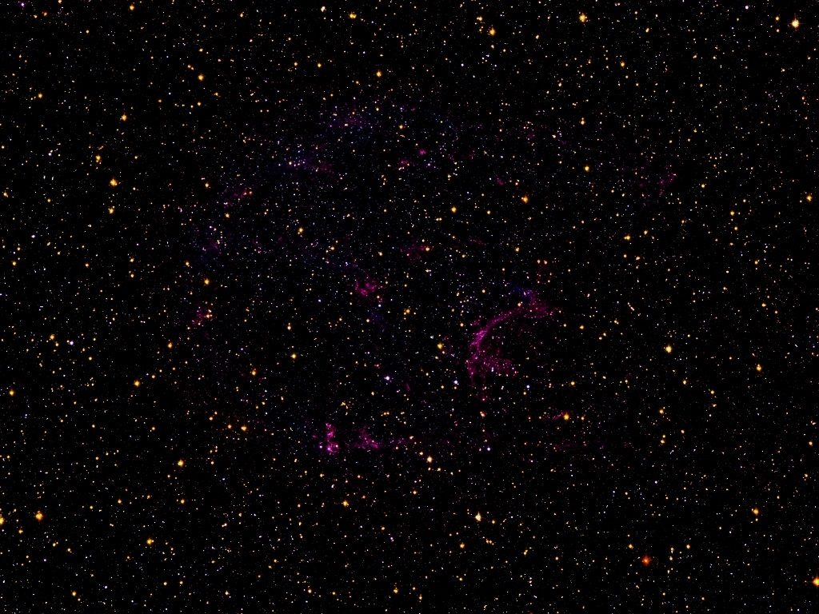
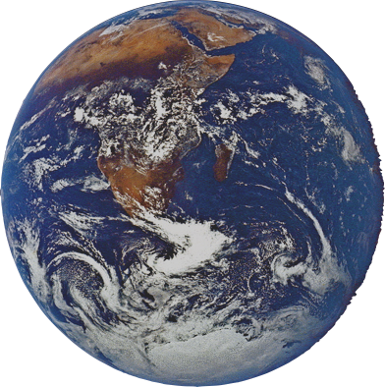
For God so loved humanity that He created fifty billion trillion stars plus a hundred times more stuff so that we could have one “pale blue dot” on which to live and enjoy life.
NASA/ESA/Hubble Heritage (STScI/AURA)
Notes:
This is just the start of our understanding why the universe is the way it is.
Even more astonishing conclusions are coming in our subsequent sessions together.

