Slide 1
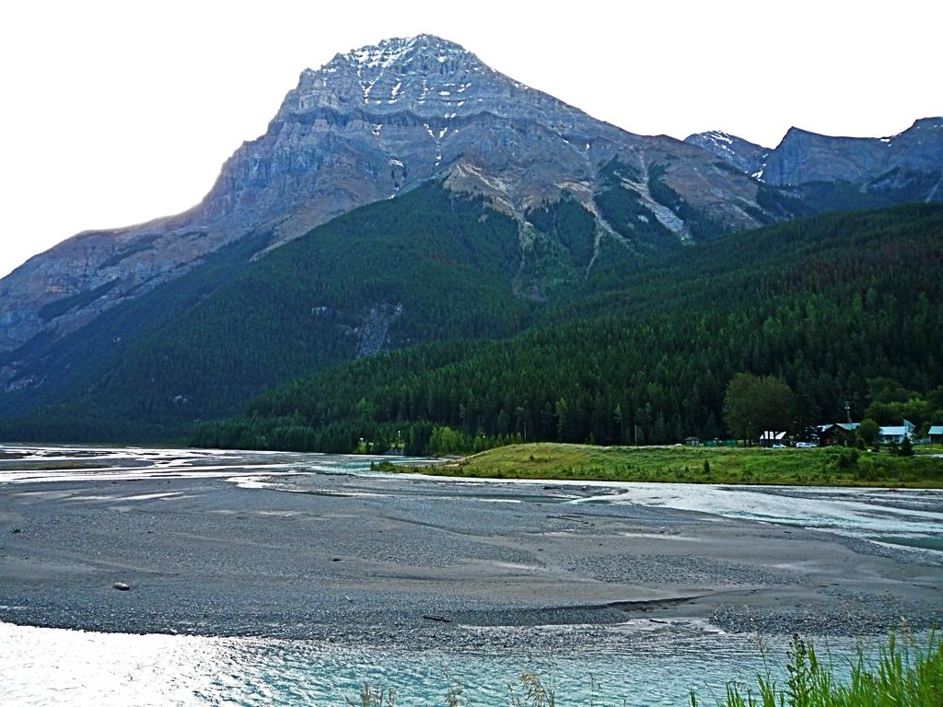

Slide 2


Slide 3
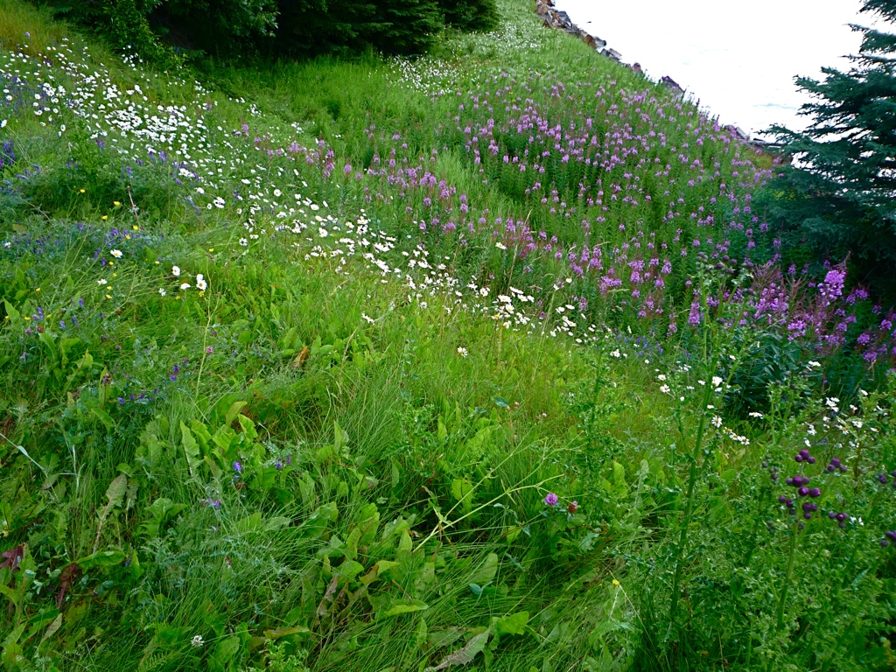

Slide 4
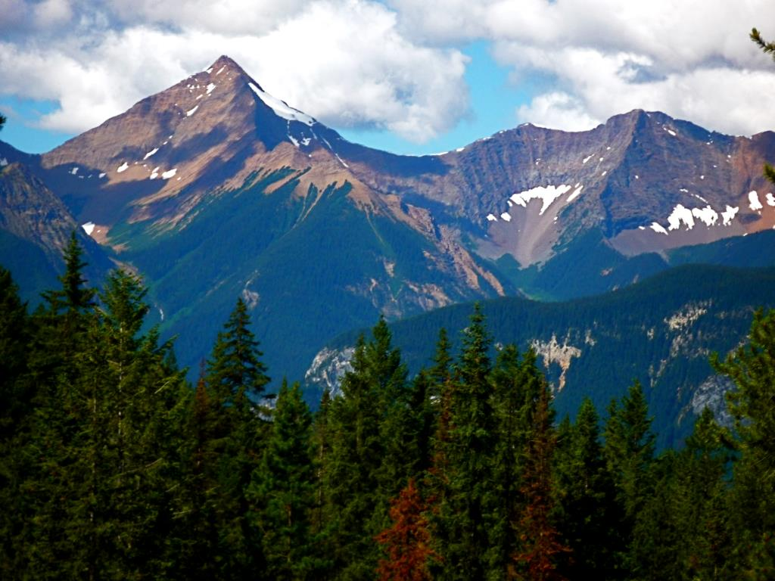

Slide 5
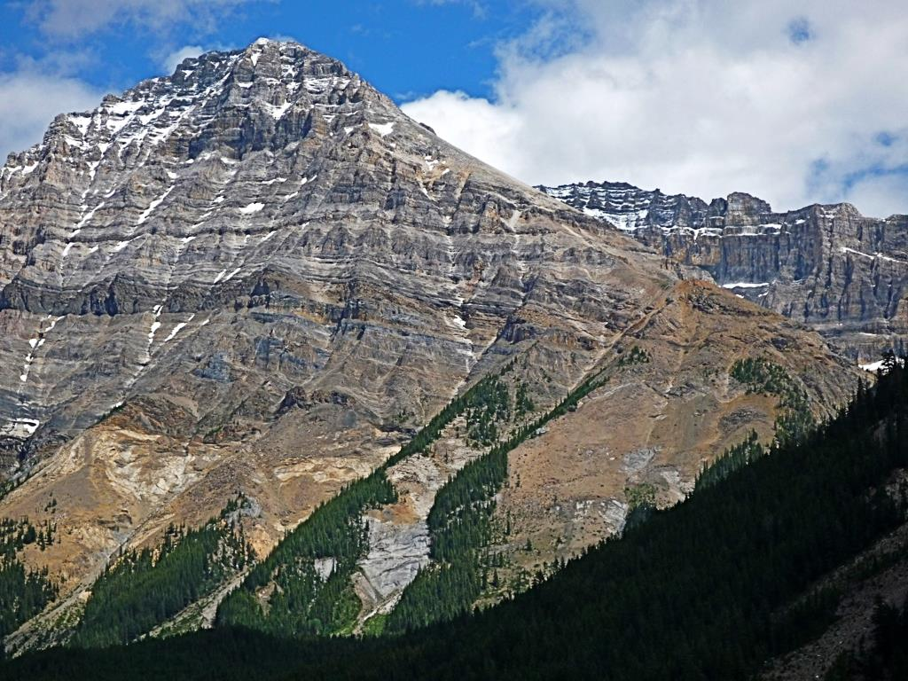

Slide 6
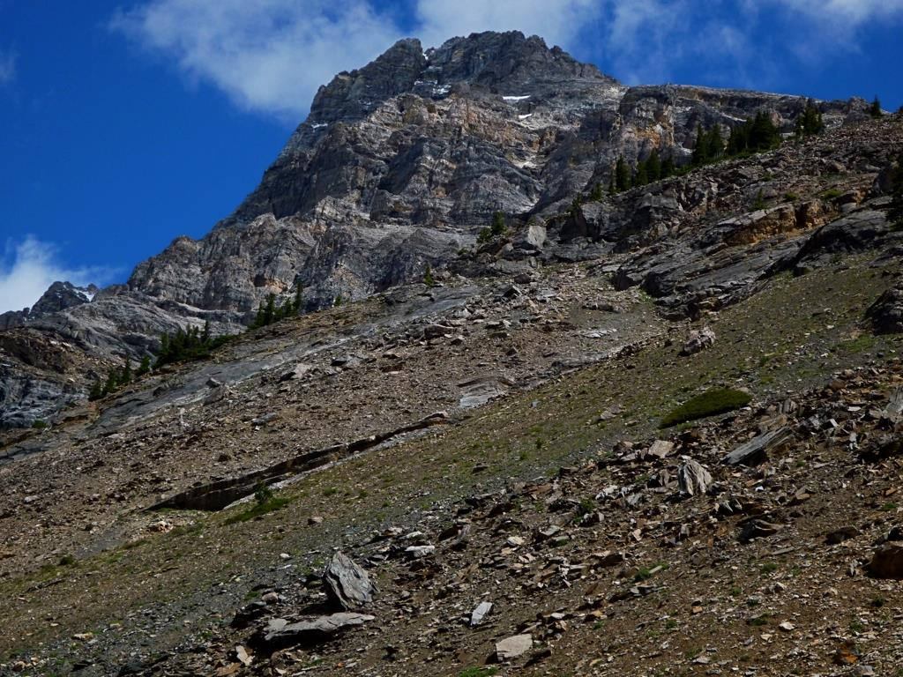

Slide 7
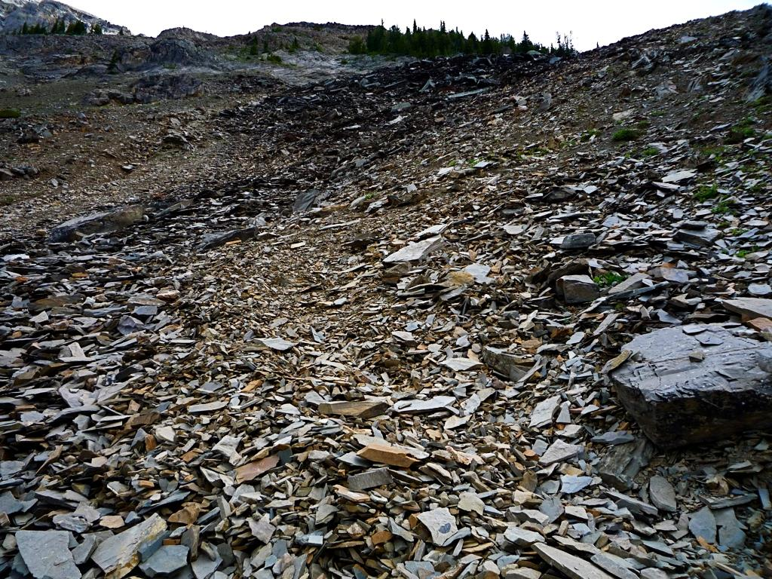

Slide 8
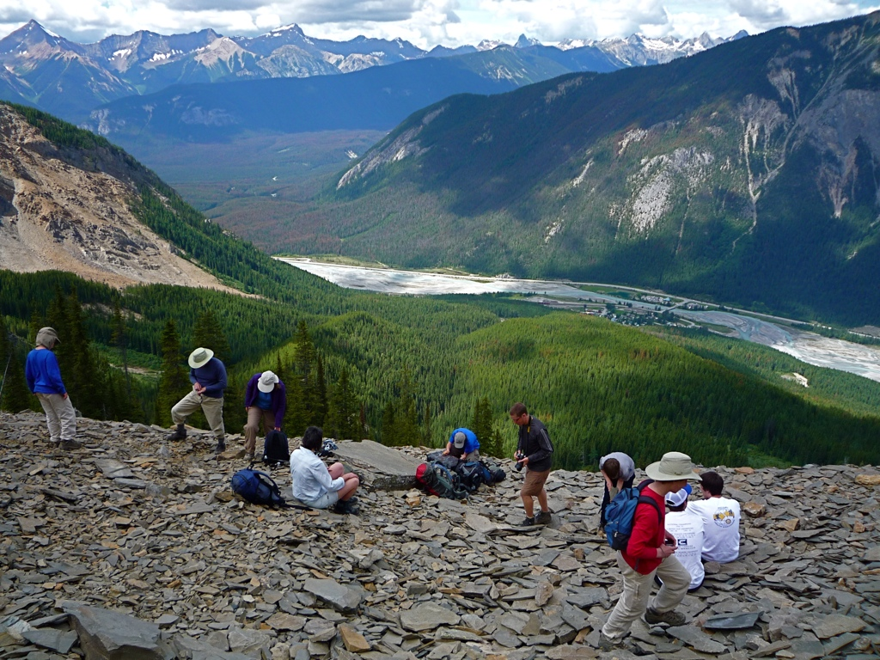

Slide 9
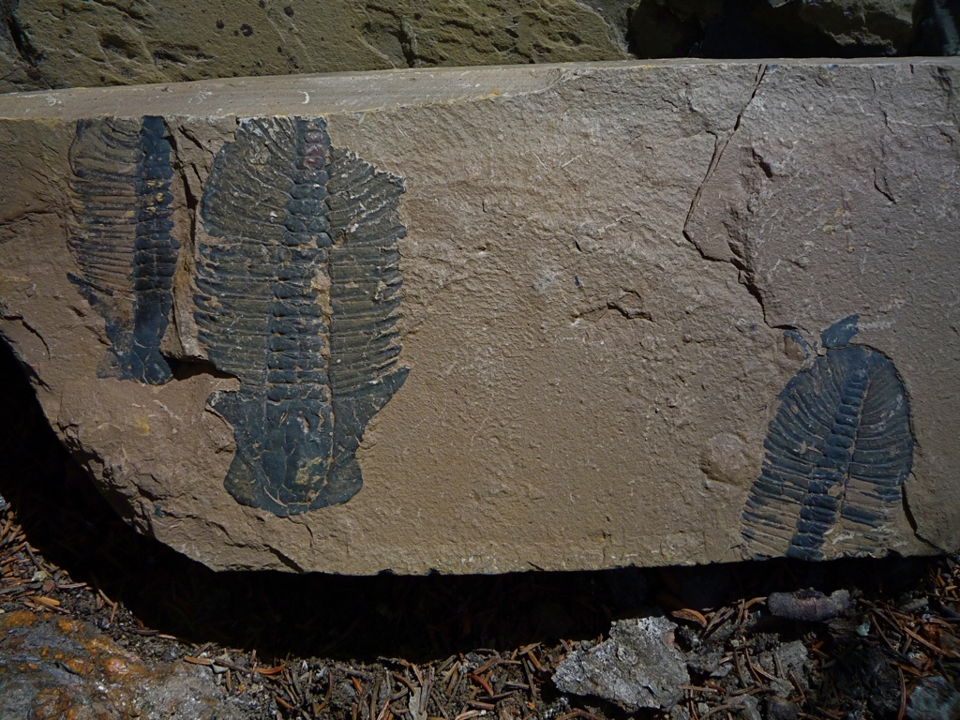

Slide 10
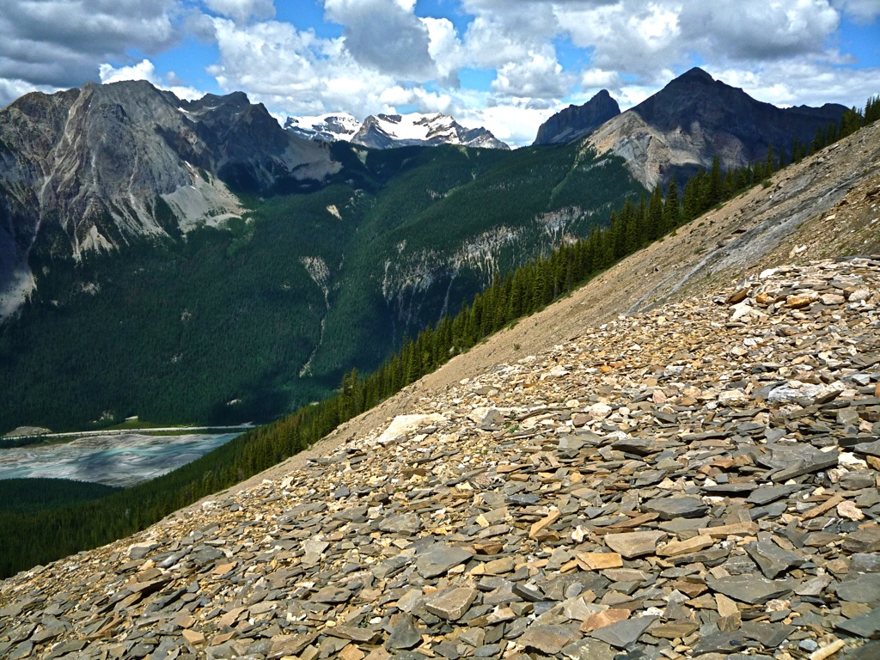

Slide 11
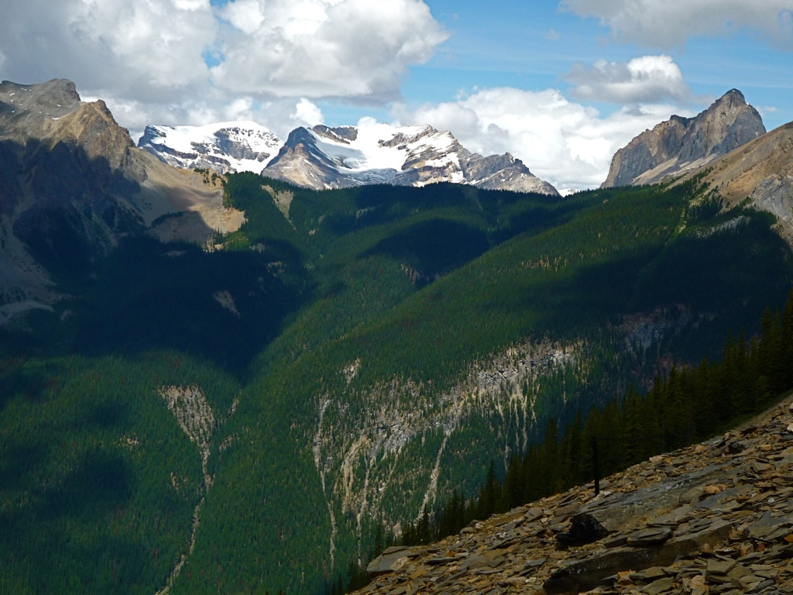

Slide 12
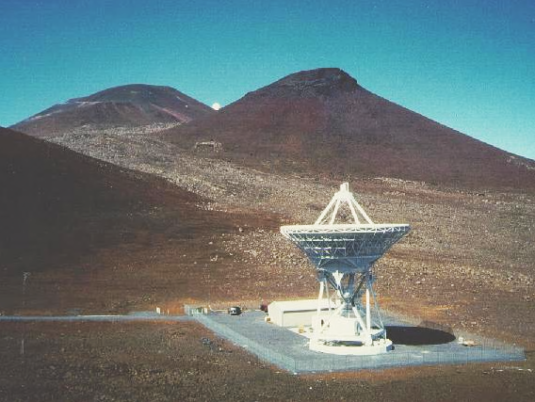
Notes:
Mauna Kea, Hawaii
credit: NRAO

Slide 13
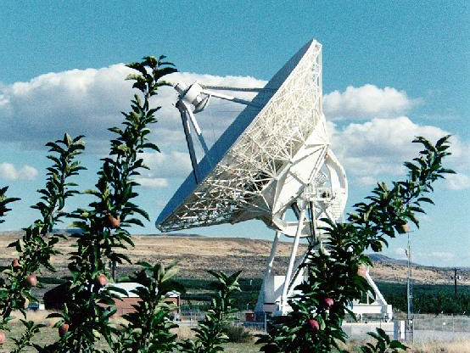
Notes:
Brewster, Washington
credit: NRAO

Slide 14
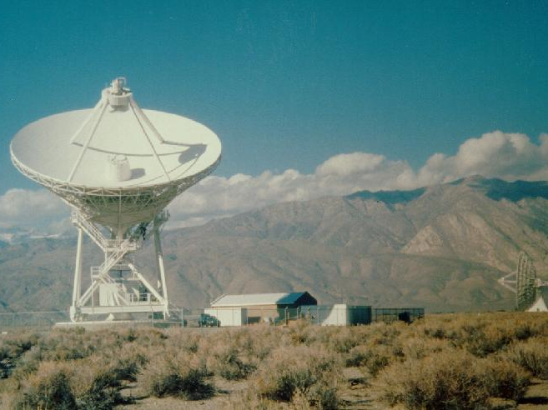
Notes:
Owens Valley, California
credit: NRAO

Slide 15
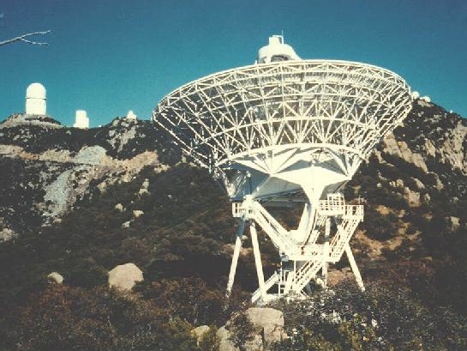
Notes:
Kitt Peak, Arizona
credit: NRAO

Slide 16
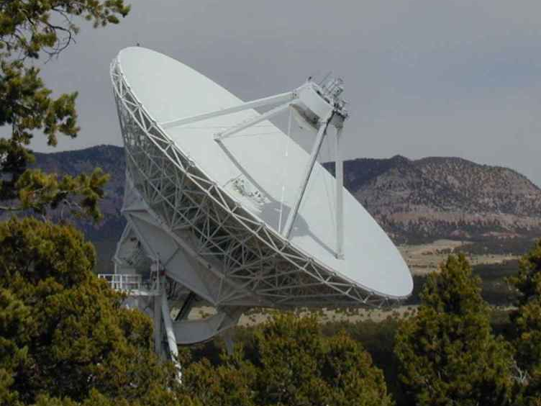
Notes:
Pie Town, New Mexico
credit: NRAO

Slide 17
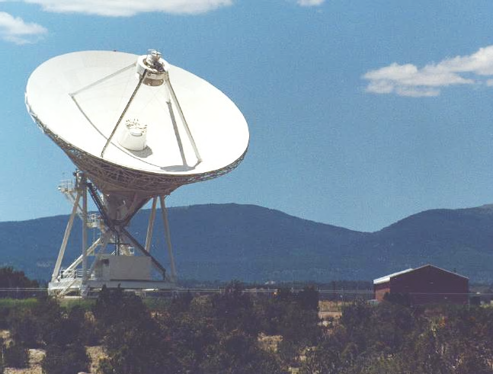
Notes:
Los Alamos, New Mexico
credit: NRAO

Slide 18
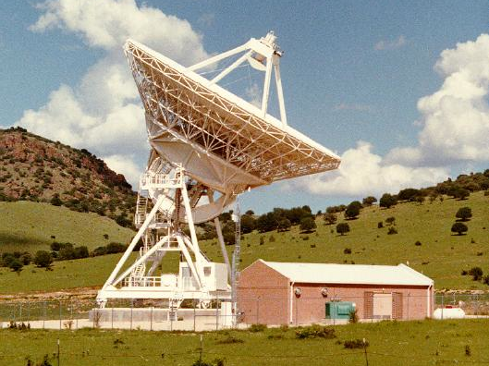
Notes:
Fort Davis, Texas
credit: NRAO

Slide 19
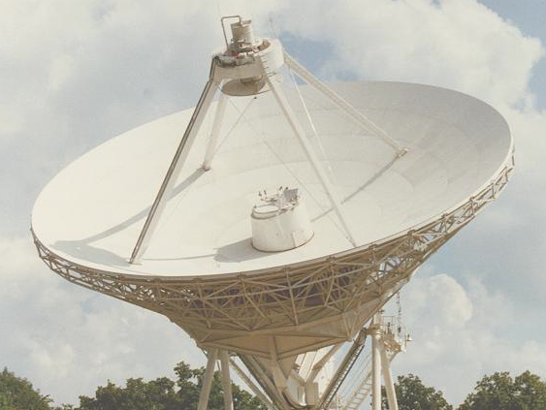
Notes:
North Liberty, Iowa
credit: NRAO

Slide 20
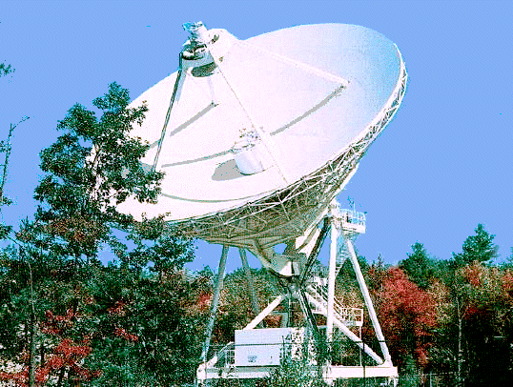
Notes:
Hancock, New Hamshire
credit: NRAO

Slide 21
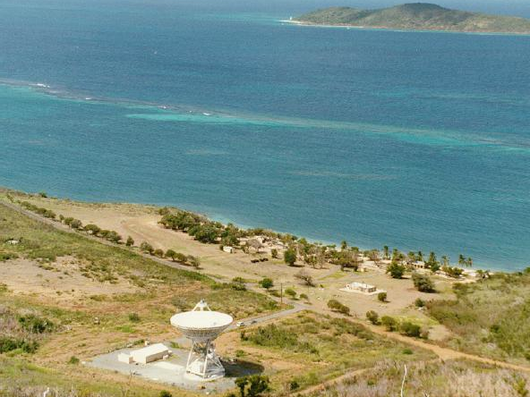
Notes:
St. Croix, Virgin Islands
credit: NRAO

Slide 22
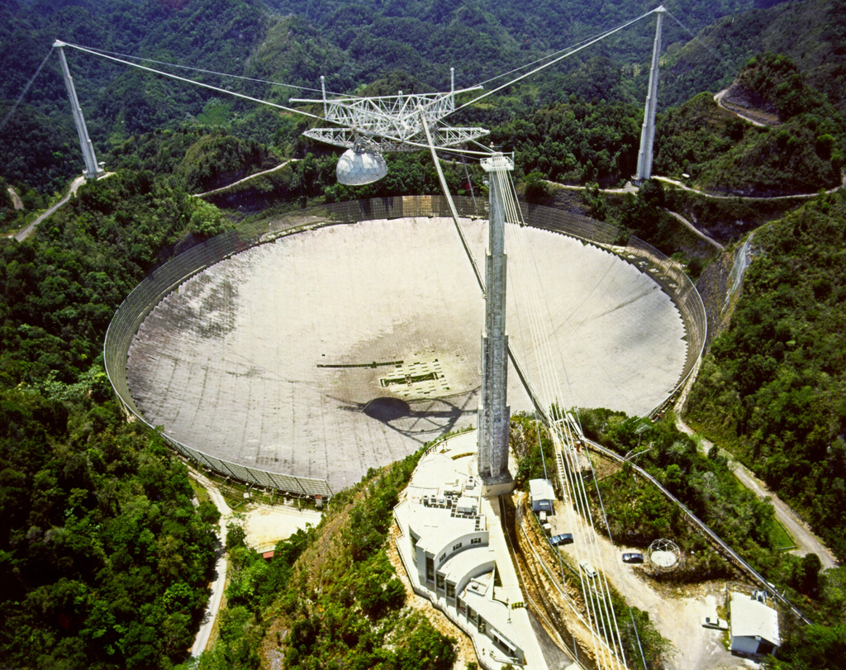
Notes:
1000-foot diameter Arecibo Telescope
credit: NOAA

Slide 23
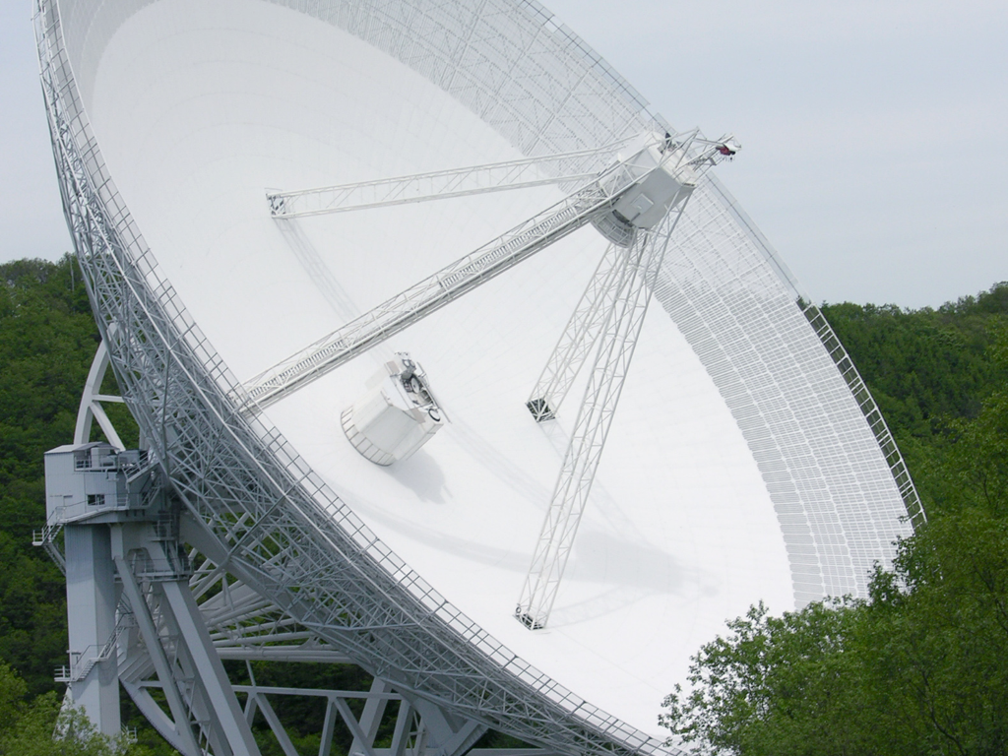
Notes:
328-foot diameter Effelsberg Telescope
credit: Dr. Schorsch,

Slide 24
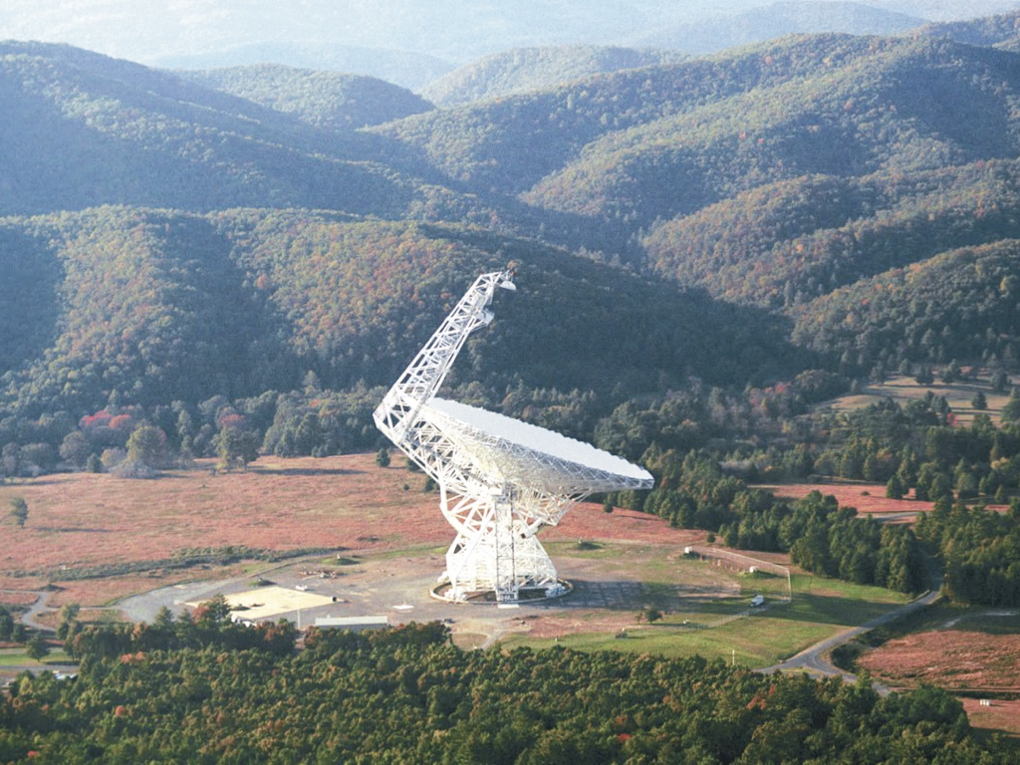
Notes:
328-foot diameter Greenbank Telescope
credit: NRAO/AUI

Slide 25
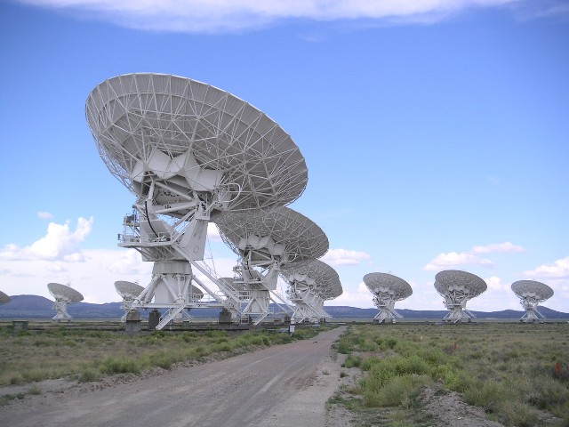
Notes:
Very Large Array (27 82-foot diameter telescopes), Socorro, NM
credit: Hajor

Slide 26
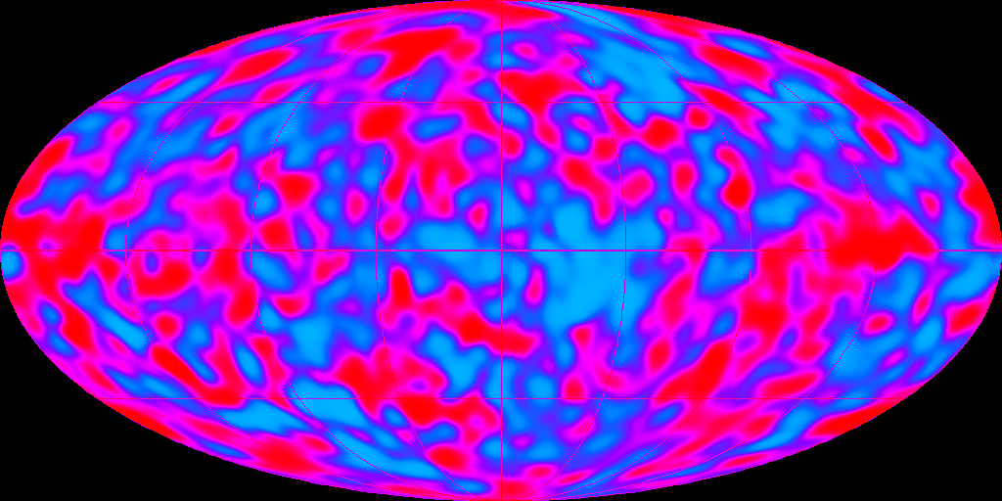
Notes:
COBE
credit: NASA

Slide 27
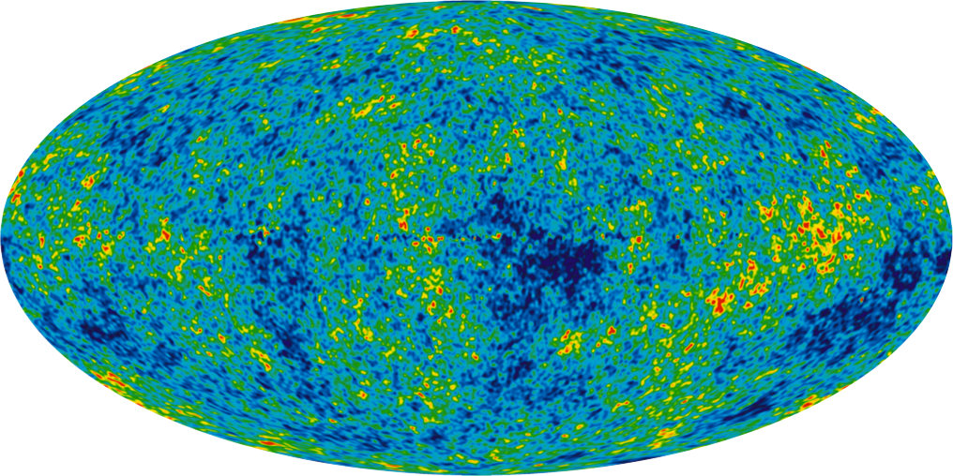
Notes:
9-year WMAP
credit: NASA

Slide 28
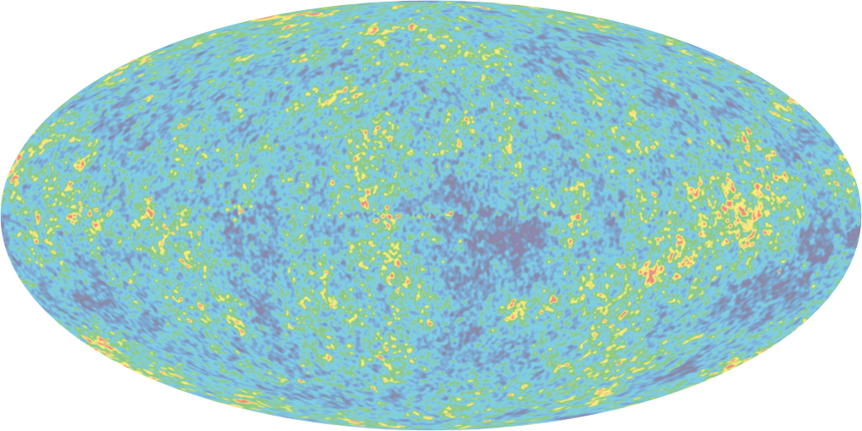
H0 = 69.3 ± 1.2
  t0 = 13.772 ± 0.059
  Ω = 0.713 ± 0.010
  ns = 0.9608 ± 0.0080
  Ωk = -0.0027 ± 0.0039
  w = -1.037 ± 0.070
>
Notes:
9-year WMAP
credit: NASA

Slide 29
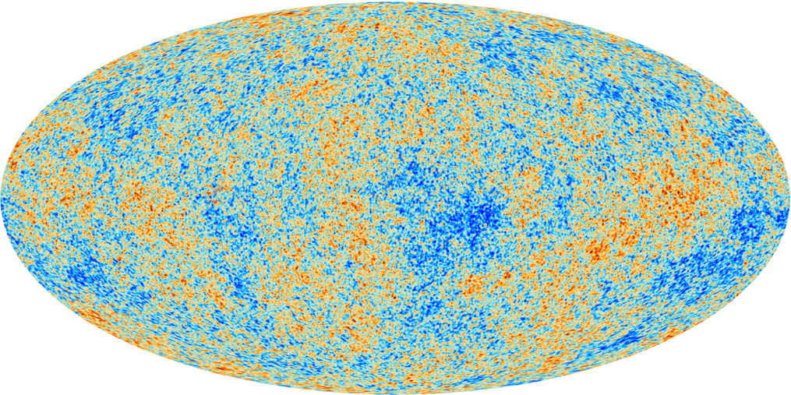
Notes:
all sky Cosmic Microwave Background map
credit: ESA, Planck HFI & LFI Consortia

Slide 30
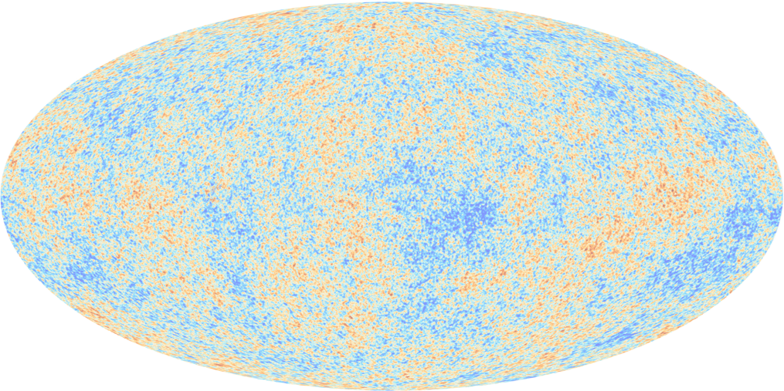
H0 = 67.3 ± 1.2
  t0 = 13.81 ± 0.05
  Ω = 0.685 ± 0.017
  ns = 0.9585 ± 0.0070
  Ωk = -0.0005 ± 0.0066
  w = -1.13 ± 0.24
>
Notes:
all sky Cosmic Microwave Background map
credit: ESA, Planck HFI & LFI Consortia

Slide 31
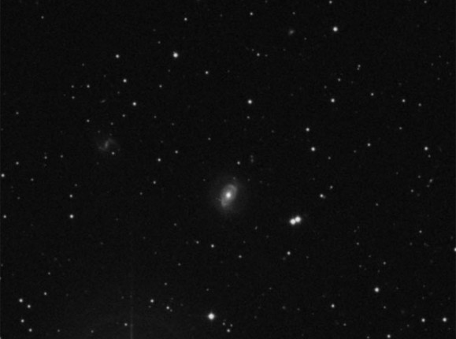

Slide 32
H0 = 68.5 ± 7.0
  t0 = 13.79 ± 1.30

Slide 33
H0 = 67.3 ± 1.2 (Planck)
H0 = 68.5 ± 7.0 (VLBA)
H0 = 69.3 ± 0.8 (WMAP)

