Slide 1
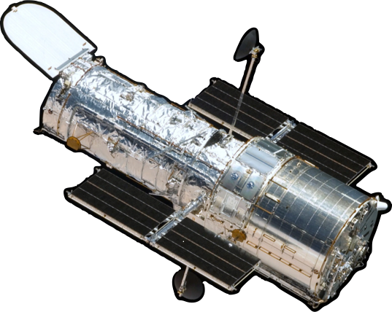
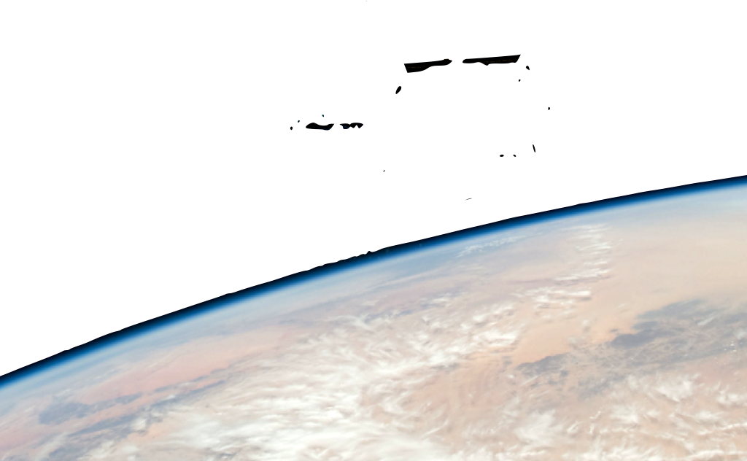
NASA/crew of STS-125
Notes:
The Hubble Space Telescope here is like a giant digital camera.
use a digital camera as a demo

Slide 2
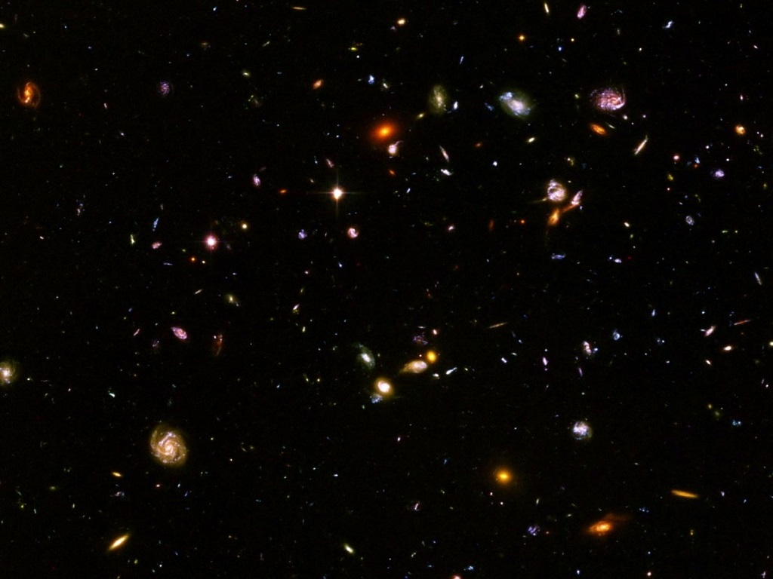
NASA/Hubble Heritage Team STScI/AURA
NASA/ESA/Hubble Heritage (STScI/AURA)
Notes:
use a digital camera as a demo
a million second exposure (278 hours, nearly two weeks) on a portion of the sky just one tenth of a moon diameter across

Slide 3
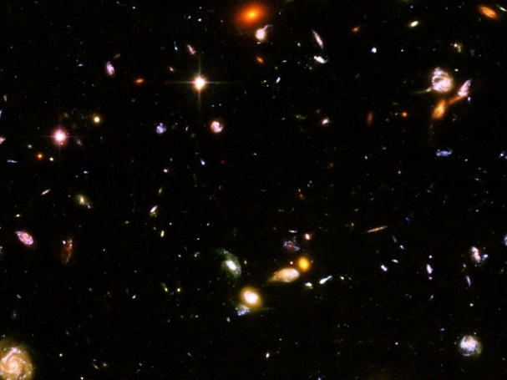
NASA/Hubble Heritage Team STScI/AURA
NASA/ESA/Hubble Heritage (STScI/AURA)
Notes:
The Hubble Ultra Deep Field images all the large and medium-sized galaxies that exist in this part of the universe.

Slide 4
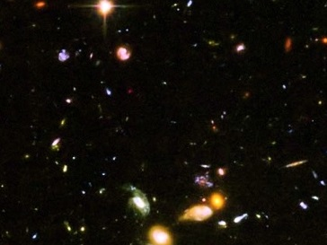
NASA/Hubble Heritage Team STScI/AURA
NASA/ESA/Hubble Heritage (STScI/AURA)
Notes:
Over 10,000 galaxies are visible in the HUDF.
That works out to over 200 billion medium- and large-sized galaxies in the observable universe.
Dwarf galaxies are a hundred times as numerous.

Slide 5
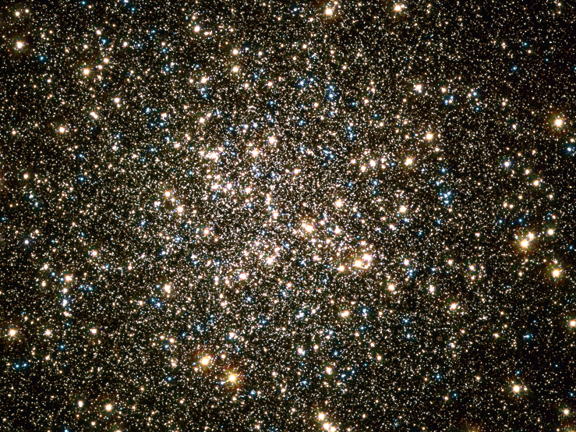
credit: NASA, ESA, /Hubble Heritage (STScI/AURA)
acknowledgment: C. Bally and W. van Altena (Yale), W. Lewin (MIT), A. Sarajedini (U. of Florida)
NASA/ESA/Hubble Heritage (STScI/AURA)
Notes:
This is 1 of 151 globular clusters in our Milky Way Galaxy. Its on the small side containing just 100,000 stars.

Slide 6
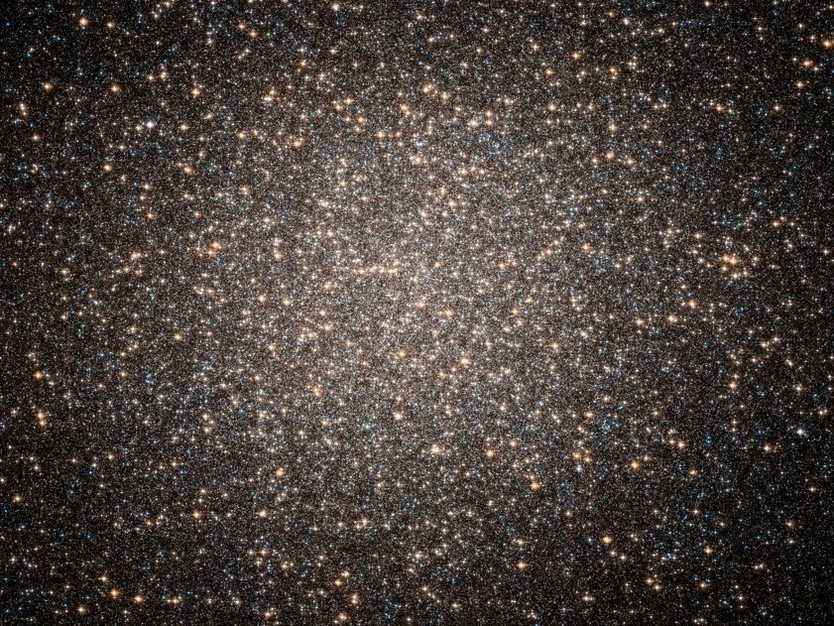
NASA/ESA/Hubble Heritage Team (STSiI/AURA)
NASA/ESA/Hubble Heritage (STScI/AURA)
Notes:
This one is on the large side. It contains 10,000,000 stars.

