Slide 1

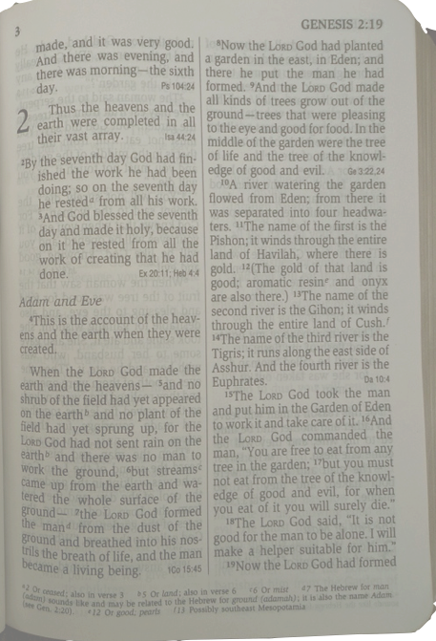


Genesis 2 Humanity’s Mission
Hugh Ross

Slide 2
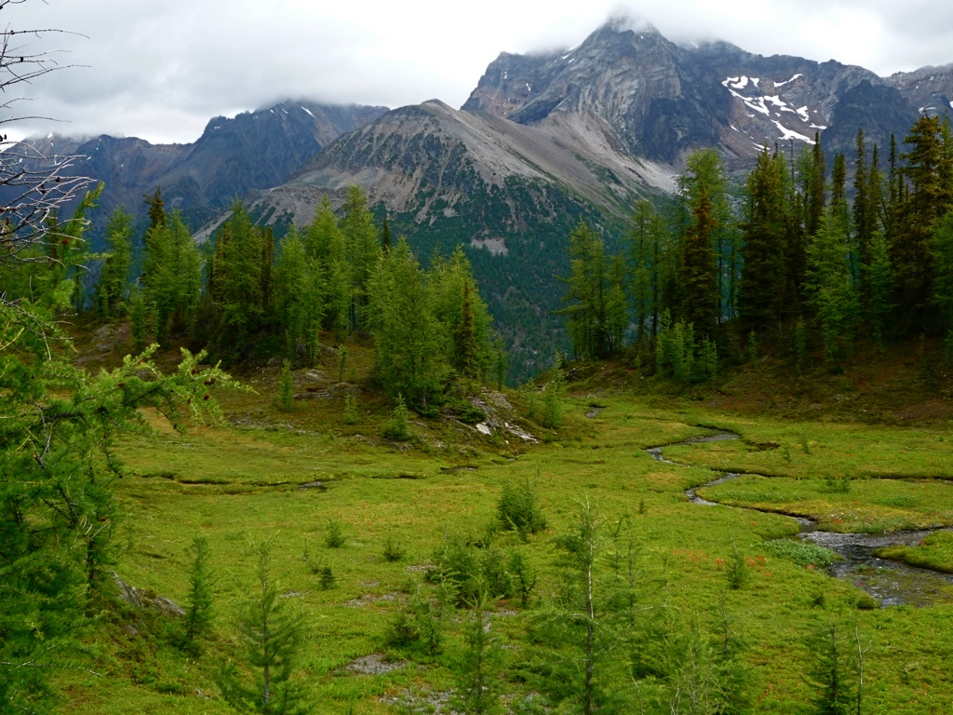
Why Two Accounts?
Genesis 1 has a physical focus: God creates three different kinds of life.
Genesis 2 has a spiritual focus: God introduces Adam to three different kinds of life.

Slide 3
Why Two Accounts?
Genesis 1: Physical events are sequenced but not the relational events.
Genesis 2: Relational events are sequenced but not the physical events.

Slide 4
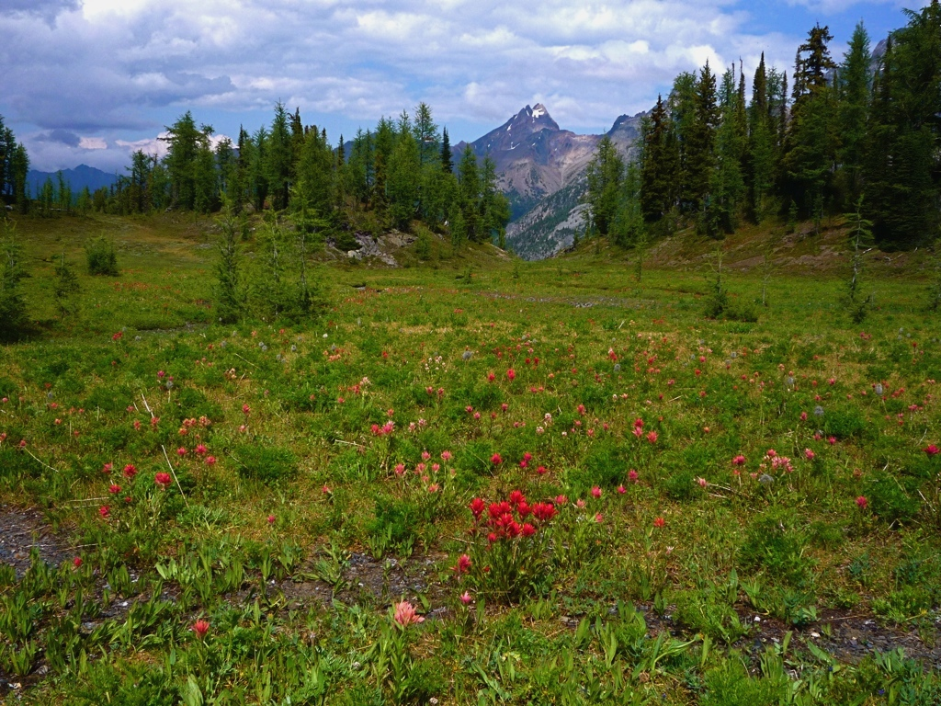
Gen. 2 Physical Events
In the region of Eden before God planted the Garden there were no shrubs, plants, rain, or humans (verse 5).
Verse 19 states that birds and mammals predated Adam.

Slide 5
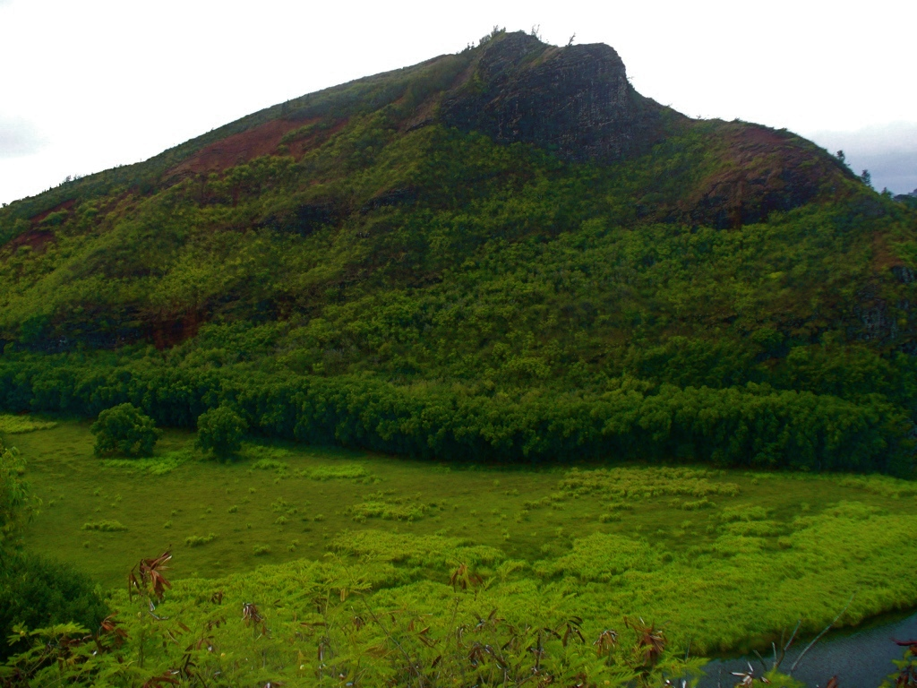
Location of Eden
“in the east” (verse 8)
where four rivers come together: the Pishon from Havilah, the Gihon from Cush, and the Tigris and Euphrates from Asshur (verses 11-14)
Notes:
The land of Nod is “east of Eden.”

Slide 6
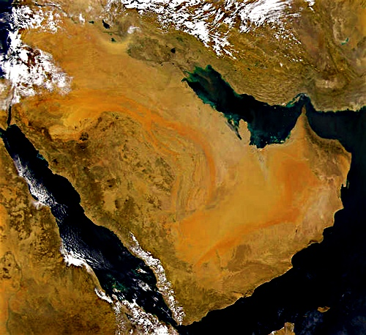
Asshur
¥
Eden?
Havilah
Cush

Slide 7
Asshur
¥
Eden
Havilah
Cush

Slide 8
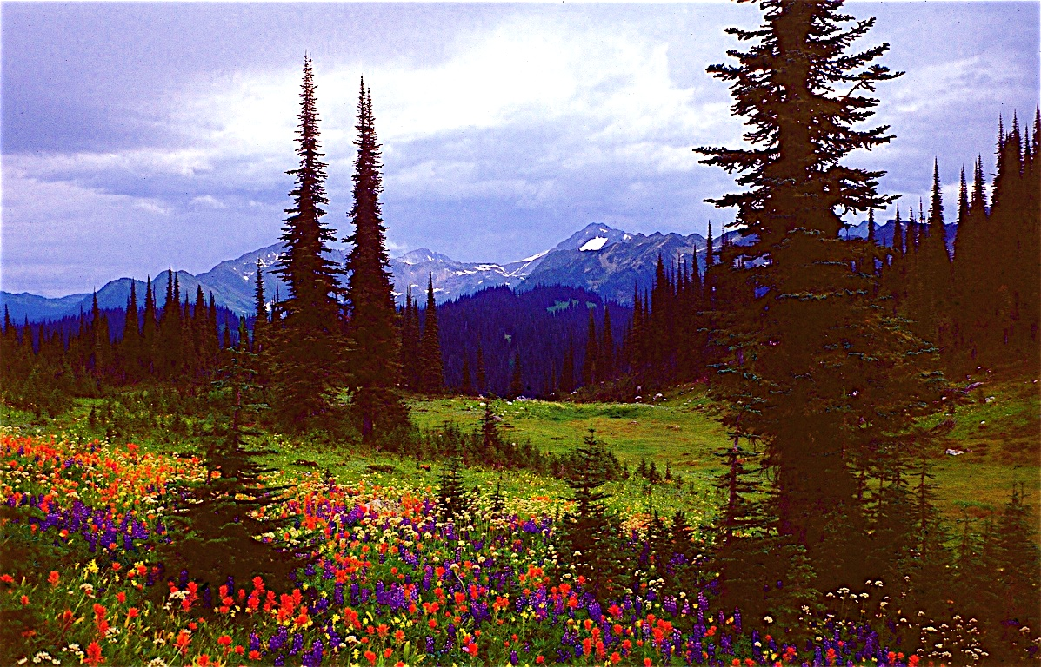
Adam: physical life

Slide 9
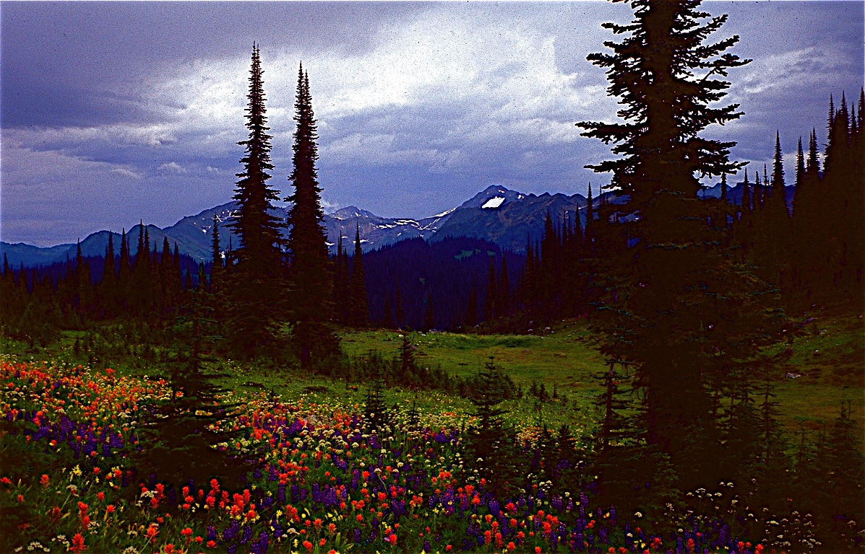
Adam: physical life
created outside of Eden
watched Eden’s trees grow
tended the Garden
received pleasure and some satisfaction from the Garden
Notes:
recognizes the difference between a wilderness and a well designed and tended garden
God taught Adam how to relate to the physical part of creation.

Slide 10
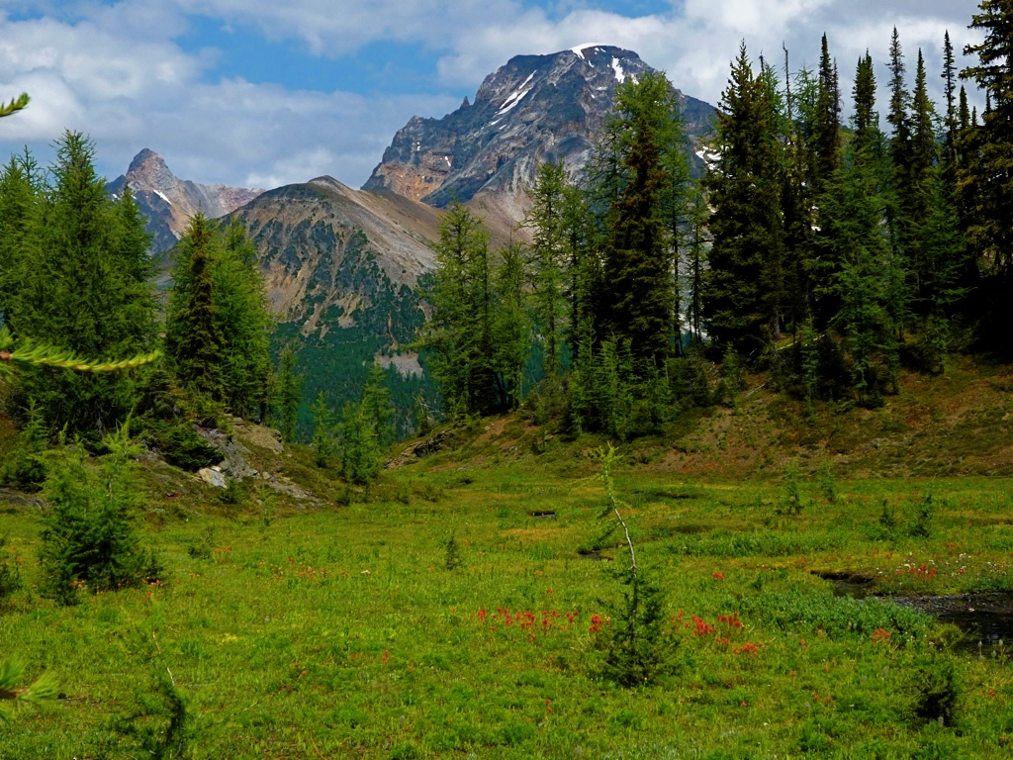

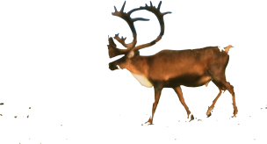
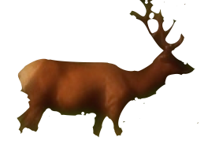
Adam: soulish life
Hugh Ross

Slide 11
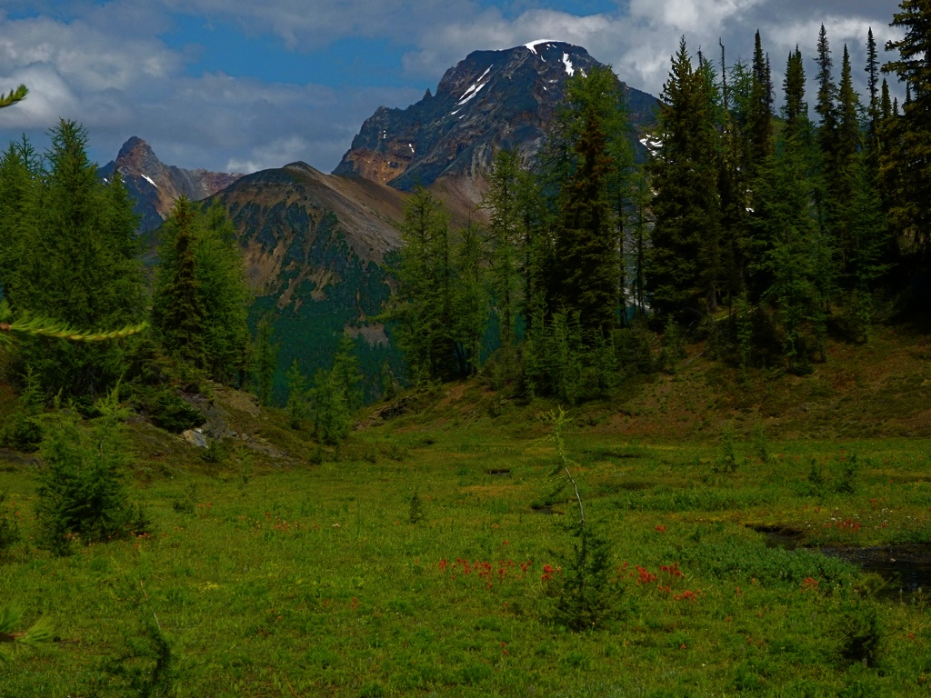
Adam: soulish life
examined all the nephesh kinds
determined how God designed each one to serve and please him in a distinct manner
Hugh Ross

Slide 12
Adam: soulish life
received pleasure, service, and much fulfillment from the nepesh
Nevertheless, something was missing. He was still lonely.
Hugh Ross

Slide 13


Adam: spiritual life
God made Eve from a biopsy from Adam’s side.
Of all creatures only Eve could fulfill Adam physically, soulishly, and spiritually.

Slide 14
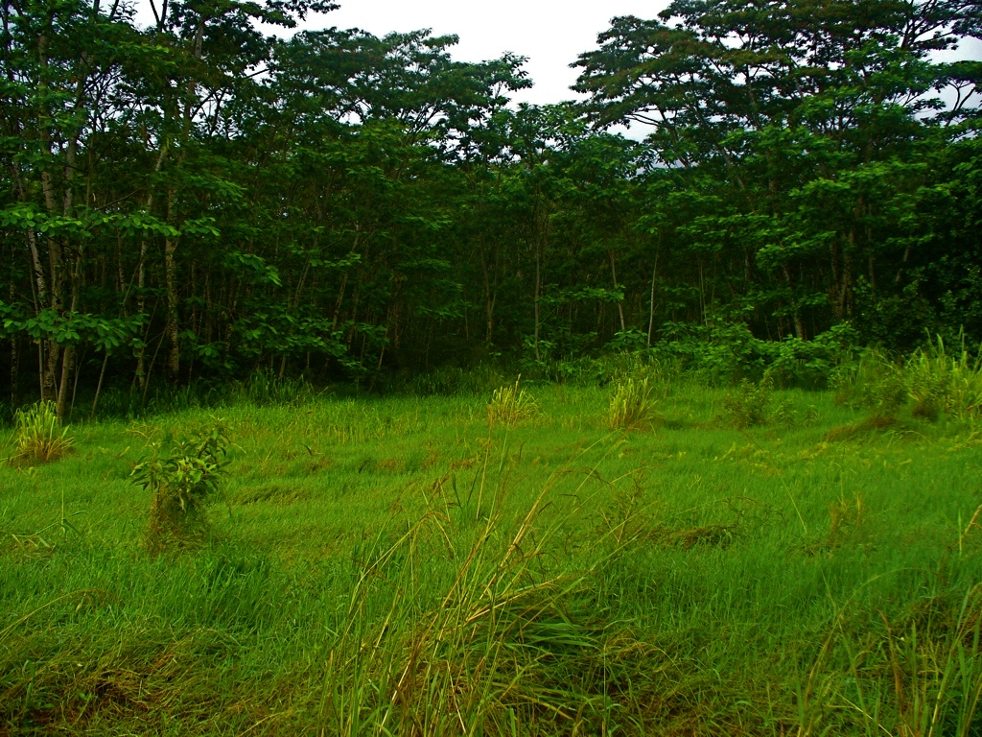
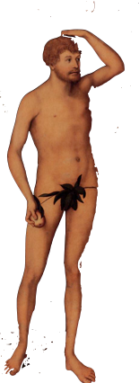
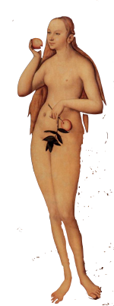
Three Creation Methods
from the dust of the ground
from re-engineering a DNA sample
from an act transcendent to space and time

