Slide 1


Ezer
“assistant in the context of a military ally or source of reinforcement for the completion of an assigned task”
—Carl Schultz
Notes:
It takes both men and women to fulfill the Great Commission.

Slide 2
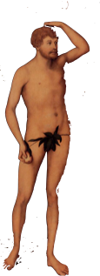
“Put on God’s armor so that you can make a stand against the tricks of the devil. We aren’t fighting against human enemies but against rulers, authorities, forces of cosmic darkness, and spiritual powers of evil in the heavens.” (Eph. 6:11-12 CEB)
Notes:
It takes both men and women to fulfill the Great Commission.

Slide 3
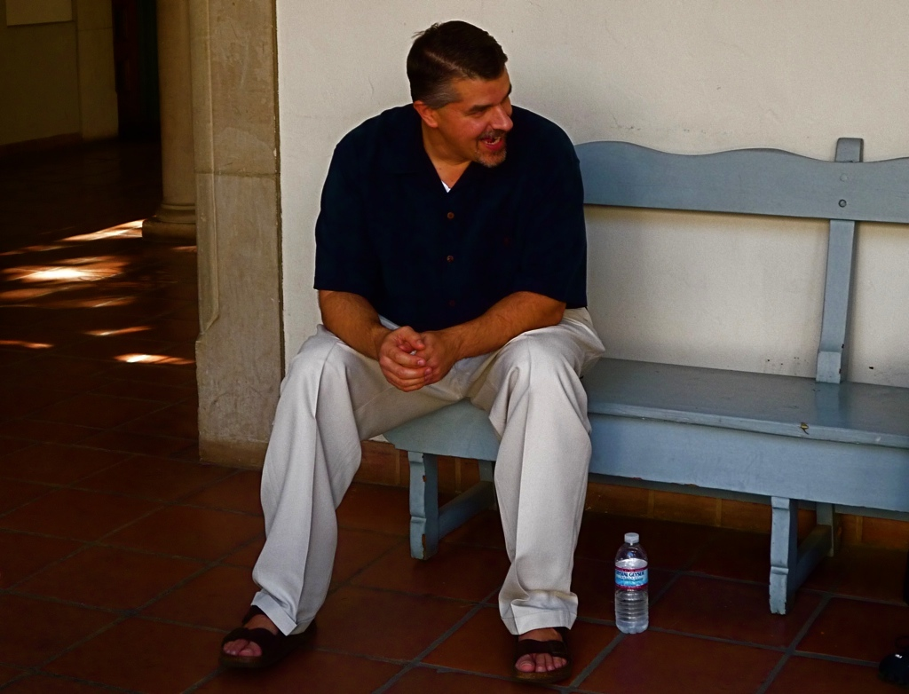

Slide 4
Always be prepared to give an answer to everyone who asks you to give the reason for the hope that you have.

Slide 5
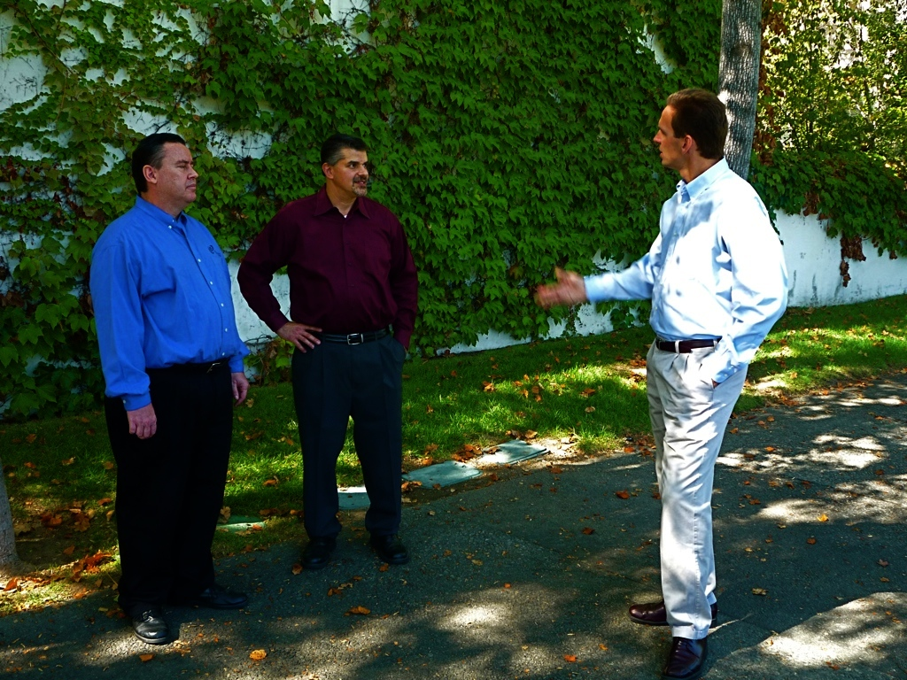

Slide 6
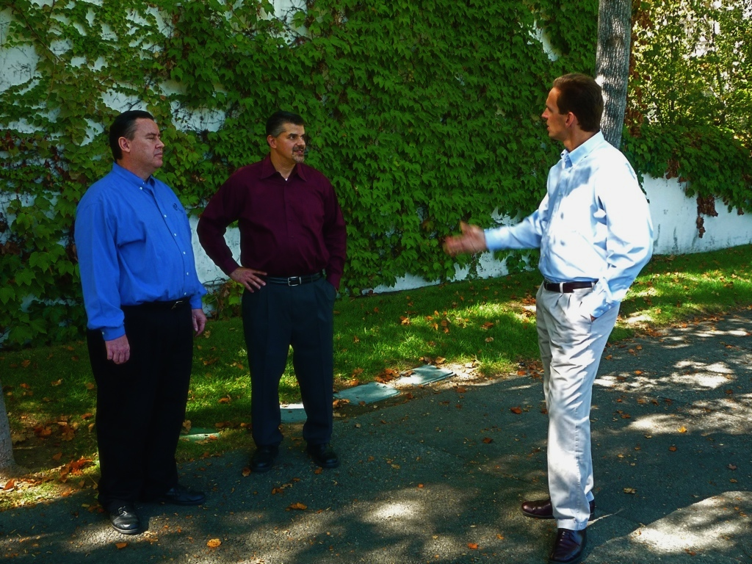
But do this with gentleness and respect keeping a clear consciense, so that those who speak maliciously against your good behavior in Christ may be ashamed of their slander.
—1 Peter 3:15-16

