Slide 1
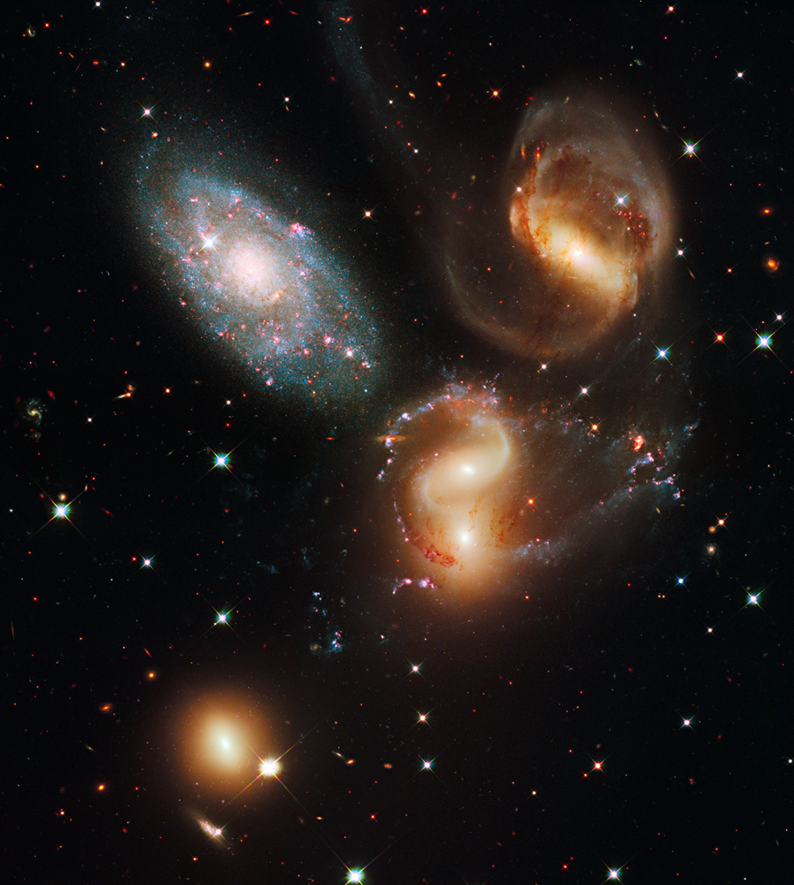
What is the Age of…
…the Universe and Earth?
.

Slide 2
AGE OF UNIVERSE & EARTH
BIBLE’S TEACHING
FACTS OF NATURE
Will analyze:
The Literal Days of Genesis 1
Days of Genesis 1
Day 3: Plant Growth
Day 6: Multiple Events
Day 7: It’s a L-O-N-G one!
One Day of Genesis 2 = 6 Days of Genesis 1!
Other Bible Passages
But what about…?
The universe’s age will be analyzed by:
Radiometric abundances
Existence of stars & galaxies
Age of stars
Light’s time & travel distance
Ice Cores
Spreading of galaxies
Temperature of the cosmos

Slide 3
AGE OF UNIVERSE & EARTH
WHAT DOES THE BIBLE SAY?
The Literal Days of Genesis 1:
Hebrew word for “day” is “yom”
“Yom,” depending on the context, can have a literal definition referring: 12 hrs., 24 hrs., daylight, or a longer, although limited, timeframe. Any Hebrew lexicon will support this. Context determines which is the literal definition.
Hebrew, at the time of Moses, did not have a word, other than “yom” for a finite period longer than 24 hrs. Therefore, for what we would call an “eon” or “age,” Hebrew only had the word “yom.”

Slide 4
AGE OF UNIVERSE & EARTH
WHAT DOES THE BIBLE SAY?
DAY 3 (Gen. 1:11-13): Plant Growth:
Gen. 1:11-13 (the Third “Day”): Then God said, “Let the land produce vegetation; seed-bearing plants and trees on the land that bear fruit with seed in it, according to their various kinds. And it was so. The land produced vegetation: plants bearing seed according to their kinds, and trees bearing fruit with seed in it according to their kinds…”

Slide 5
AGE OF UNIVERSE & EARTH
WHAT DOES THE BIBLE SAY?
Comment on Gen. 1:11-13:
  Text clearly states that plants and trees were bearing (on an on-going basis) seed and fruit, respectively. This takes longer than one 24-hr. period.
  Text in no way infers any kind of speeded-up supernatural growth after vegetation’s initial creation.

Slide 6
AGE OF UNIVERSE & EARTH
WHAT DOES THE BIBLE SAY?
Day 6: Multiple Events (Gen. 1:24-27; 2:15-23)
  God creates three types of land animals
  God creates man
  God plants a garden (Garden of Eden)
  God puts Adam into the Garden
  Adam takes care of the Garden
  Adam names the animals
  Adam gets lonely – wants a mate

Slide 7
AGE OF UNIVERSE & EARTH
WHAT DOES THE BIBLE SAY?
  Day 6: Multiple Events (cont.):
  God creates Eve
  In v. 23 Adam says about Eve in Hebrew something like “At long last” (in English the literal translation is “This is now” but it’s meaning is better translated as “At long last” or “Finally!”).

Slide 8
AGE OF UNIVERSE & EARTH
WHAT DOES THE BIBLE SAY?
DOES THIS SOUND LIKE A
24 HR. DAY?
-OR-
SOMETHING LONGER?

Slide 9
AGE OF UNIVERSE & EARTH
WHAT DOES THE BIBLE SAY?
1 Day of Genesis 2 = 6 Days of Genesis 1:
  Gen. 2:4 > “This is the generations (account) of the day of creation.”
  Comment on Gen. 2:4 > The one day of Gen. 2:4 refers back to the 6 creation days of Gen. 1. Now, “one day” refers to six days. This illustrates the multiple uses of the word “day” in the Genesis context. The word “generations”/account never refers to 24 hrs.

Slide 10
AGE OF UNIVERSE & EARTH
WHAT DOES THE BIBLE SAY?
7th Day: A L-O-N-G Day! We are Still in It!
  Heb. 4:1 – 11 (drawing from Ps. 95:11) > “For somewhere [God] has spoken about the seventh day in these words: ‘and on the seventh day God rested from all his work.’…It still remains that some will enter that rest for the people of God; …Let us, therefore, make every effort to enter that rest.”

Slide 11
AGE OF UNIVERSE & EARTH
WHAT DOES THE BIBLE SAY?
  John 5:16 – 18 > Jesus defends his “working” on the Sabbath with an illustration that the Father is working on his “Sabbath” or day of rest (from creation).
Comment: It is clear that God is still in his day of rest, which is the seventh day of Genesis 1. This seventh day is obviously much longer than a 24-hr. period.

Slide 12
AGE OF UNIVERSE & EARTH
WHAT DOES THE BIBLE SAY?
Comparison of God’s everlasting nature to the “everlasting” nature of creation:
  Ps. 90:2 > States that God was before the mountains, earth, and is from everlasting to everlasting
  Prov. 8:24 – 26 > Before there was the created order, Wisdom was present
  Eccl. 1:4, 7, 10 > The earth remains “forever”
  Micah 6:2 > the “everlasting” mountains

Slide 13
AGE OF UNIVERSE & EARTH
WHAT DOES THE BIBLE SAY?
Comment: God’s eternality is compared to the “eternality” of the created order. If the creation order were only about 3,000 - 3,500 years older (creation date of 4,004 BC according to some) than when these passages were written, comparing God’s everlasting nature to a 3,000 – 3,500 old universe would not mean very much! Methuselah lived 969 years!

Slide 14
AGE OF UNIVERSE & EARTH
WHAT DOES THE BIBLE SAY?
But What about proposed counter-arguments some may try from the Bible? They are as follows, with their rebuttal:
Argument: A common sense interpretation of the word “Day” is 24 hrs. The simple explanation is the best.

Slide 15
AGE OF UNIVERSE & EARTH
WHAT DOES THE BIBLE SAY?
  Rebuttal: Actually, the common sense interpretation of the six “Days” in Genesis 1 and 2 shows a longer timeframe because of the details/context discussed earlier.

Slide 16
AGE OF UNIVERSE & EARTH
WHAT DOES THE BIBLE SAY?
  Argument: Whenever the Bible uses an ordinal (first, second, etc.) with the word “day” it refers to a 24 hr. day.

Slide 17
AGE OF UNIVERSE & EARTH
WHAT DOES THE BIBLE SAY?
  Rebuttal: There is NO rule of Hebrew grammar which supports the above contention of when an ordinal is used with “yom” that it equals 24 hrs.; quite the opposite.

Slide 18
AGE OF UNIVERSE & EARTH
WHAT DOES THE BIBLE SAY?
    In Hosea 6:2, where ordinals are used, “day” refers to a longer period, perhaps up to a thousand years or more according to biblical scholars. Hosea 6:2 - “After two days (“yom”) he [God] will revive us [Israel]; on the third day (“yom”) he will restore us.”

Slide 19
AGE OF UNIVERSE & EARTH
WHAT DOES THE BIBLE SAY?
Argument: The use of “evening and morning” shows a 24 hr. period.
Rebuttal: Hebrews used “evening to evening,” and sometimes “morning to morning” to denote a regular day.

Slide 20
AGE OF UNIVERSE & EARTH
WHAT DOES THE BIBLE SAY?
  Also, in reference to hours, “evening and morning” was only a 12 hr. period!! That would make a “3.5” day creation week!
  Hebrews used “evening and morning” to denote the beginning and end/completion of a period, respectively (evening - 6 PM by Jewish reckoning was the beginning of their day).

Slide 21
AGE OF UNIVERSE & EARTH
WHAT DOES THE BIBLE SAY?
Argument: Does not Exodus 20:9, 11 show the days of Genesis to be 24 hrs. since it says, “Six days you shall labor…, but the seventh day is a Sabbath..For in six days the Lord made the heavens and the earth…but he rested on the seventh day.”

Slide 22
AGE OF UNIVERSE & EARTH
WHAT DOES THE BIBLE SAY?
Rebuttal: Noted Hebrew scholar Gleason Archer states, “By no means does this [Exodus 20:9-11] demonstrate that 24-hour intervals were involved in the first six ‘days,’ any more than the eight-day celebration of the Feast of Tabernacles proves that the wilderness wanderings under Moses occupied only eight days.” (Gleason L. Archer, “A response to the Trustworthiness of Scripture in Areas Relating to Natural Science,” in Hermeneutics, Inerrancy, and the Bible, ed. Earl D. Radmacher and Robert D. Pteus (Grand Rapids, MI: Academic Books, 1986), p. 329)

Slide 23
AGE OF UNIVERSE & EARTH
WHAT DOES THE BIBLE SAY?
    It should also be pointed out:
    that the Ex. 20 reference is one of five that deals with keeping the Sabbath. In three of them no connection is drawn to the Genesis week.
    This argument only holds any influence if the Hebrew word “yom” for “day” is limited to a 24 hour period, but it is not.

Slide 24
AGE OF UNIVERSE & EARTH
WHAT DOES THE BIBLE SAY?
    Lastly, in Leviticus 25:4 the “Sabbath” is a full year! So, the Sabbath can take on different meanings.

Slide 25
AGE OF UNIVERSE & EARTH
WHAT DOES THE BIBLE SAY?
Argument: If the universe and earth are billions of years old, then there would have to be animal death before Adam’s fall. That would contradict Rom. 5:21, and I Cor. 15:21 where it says death entered through the fall/sin of Adam.
Rebuttal: The above makes several wrong assumptions and constitutes bad biblical interpretation. First, quoting:

Slide 26
AGE OF UNIVERSE & EARTH
WHAT DOES THE BIBLE SAY?
  Rom. 5:12 > Therefore, just as sin entered the world through one man, and death through sin, and in this way death came to all men, because all sinned –
  I Cor. 15:21 > For since death came through a man, the resurrection of the dead comes also through a man. For as in Adam all die,…

Slide 27
AGE OF UNIVERSE & EARTH
WHAT DOES THE BIBLE SAY?
  Both passages are clear that sin entered mankind ONLY (“death came to all men”). Adam’s sin caused death ONLY to humans; animals are thereby excluded from these two verses. Animals do not sin. Sin is exclusively a human condition/problem.

Slide 28
AGE OF UNIVERSE & EARTH
WHAT DOES THE BIBLE SAY?
  Many contend God would never have planned the predator/prey situation as it is “horrible, bloody.”
  That perspective is a philosophically biased one, not supported by any biblical text.

Slide 29
AGE OF UNIVERSE & EARTH
WHAT DOES THE BIBLE SAY?
  God actually supplies the lions, etc. with their meat (Job 38:39-41). If predatory behavior were somehow wrong/sinful, the Bible would not have God taking part in such a process!

Slide 30
AGE OF UNIVERSE & EARTH
WHAT DOES THE BIBLE SAY?
  Gen. 1:29-30 God gives man and animals vegetation for food; does not preclude predatory behavior on the part of the animals since the text does NOT say that the “only” foods for animals are green plants.
  Green plants are the basis of the whole food chain! Without them, plant eaters would die, which in turn would kill off the predators!

Slide 31
AGE OF UNIVERSE & EARTH
WHAT DOES THE BIBLE SAY?
  Gen. 9:2-3 > after the flood, God also adds meat to man’s diet.
  Note this change of diet for man occurs a long time after the Fall of Adam, NOT at the time of the Fall. Therefore, meat-eating has nothing to do with the Fall or sin; God would not add meat to man’s diet if carnivorous activity were somehow inherently evil.

Slide 32
AGE OF UNIVERSE & EARTH
WHAT DOES THE BIBLE SAY?
  Man’s life spans before the Fall were in hundreds of years, wherein meat would have been detrimental to health. Life spans after the Flood steadily decreased.

Slide 33
AGE OF UNIVERSE & EARTH
WHAT DOES THE BIBLE SAY?
  Even if the creation week were six 24-hr. days, animal death was still an unavoidable reality:
    Plant death – Adam and Eve had to eat.
    Animal digestion involves bacteria death in the gut.

Slide 34
AGE OF UNIVERSE & EARTH
WHAT DOES THE BIBLE SAY?
    With every step taken, and every bite of plant food eaten by larger animals God would have to had removed any and all insects/bacteria from harm’s way to prevent their deaths!

Slide 35
AGE OF UNIVERSE & EARTH
WHAT DOES THE BIBLE SAY?
    In Gen. 1 God told Adam, Eve, and the animals to reproduce. As we know, it takes millions of sperm in each “attempt” to make one new life. One gets the prize, and the other “unlucky” sperm all die. If there was no death before the Fall, then God had to keep all these little guys alive for EACH sexual act of each member of the millions of species.

Slide 36
AGE OF UNIVERSE & EARTH
WHAT DOES THE BIBLE SAY?
    Could God do that? Of course. However, what does your intuition say God actually did?
    Day 3 shows ongoing plant growth. To accomplish that, plant death is involved.

Slide 37
AGE OF UNIVERSE & EARTH
WHAT DOES THE BIBLE SAY?
    Some say the lower animals and plants are not “alive” in trying to escape the above problems. The Bible uses the same word for man’s physical death as it does for animal death.
    Besides, to claim lower type animals and plants are not alive simply does not make sense, and contradicts every law of bio-physics God has set up.

Slide 38
AGE OF UNIVERSE & EARTH
WHAT DOES THE BIBLE SAY?
    If all the current carnivorous animals were suddenly changed from plant-eating to meat-eating at Adam’s Fall (young- creationists advocate this), God would have had to re-create their teeth (molars to incisors), their entire digestive tracts, etc.

Slide 39
AGE OF UNIVERSE & EARTH
WHAT DOES THE BIBLE SAY?
    This would contradict the biblical record that God has been at “rest” in terms of creation since the completion of the sixth day!
    Have we ever found any “plant-eating” version of any of the carnivores that existed since Adam’s Fall? For example, a T-Rex with molars???

Slide 40
AGE OF UNIVERSE & EARTH
WHAT DOES THE BIBLE SAY?
Of course not! Therefore, God created them with incisors from the beginning, and he would only do that if incisors were needed for meet-eating creatures; it would be a real bad design for plant-eating only animals! God is not a bad Designer!

Slide 41
AGE OF UNIVERSE & EARTH
WHAT DOES THE BIBLE SAY?
Adherents to the young universe perspective, claim Adam was created at about 4004 B.C.
They also erroneously contend that the biblical genealogies from Adam to Noah are contiguous (no gaps between names).
  Note: There are intentional gaps between various names!

Slide 42
AGE OF UNIVERSE & EARTH
WHAT DOES THE BIBLE SAY?
Assuming their incorrect position of the genealogies, there was only a 1,656 year span from Adam to the flood (when Noah was 600 years old).
That means the flood ended in about the year 2,348 B.C.!! (4004 B.C. – 1,656 yrs. = 2,348 B.C.)

Slide 43
AGE OF UNIVERSE & EARTH
WHAT DOES THE BIBLE SAY?
That would present some MAJOR problems as the Egyptian empire was thriving at that point in history!
Not to mention other major civilizations like the earlier Sumerians, etc.

Slide 44
AGE OF UNIVERSE & EARTH
WHAT DOES THE BIBLE SAY?
Another major problem would be this: young-earth proponents claim that Noah’s ark contained at the most 30,000 species of animals.
However, at 2500 B.C. millions of species existed, all over the entire planet!

Slide 45
AGE OF UNIVERSE & EARTH
WHAT DOES THE BIBLE SAY?
Even if Noah’s ark were “pushed back” a few thousand years (or millions of years), there would not be enough time for 30,000 species to “naturally” evolve into millions! (Note: evolution could not do it, regardless of the time involved)

Slide 46
AGE OF UNIVERSE & EARTH
WHAT DOES THE BIBLE SAY?
Such a process would have to be on a “naturalistic” evolutionary basis as God ceased his creation activities at the end of the sixth “day” of creation.
Many, if not most (all?), young earth proponents agree it would be by a naturalistic process due to God previously ceasing his creation activities.

Slide 47
AGE OF UNIVERSE & EARTH
WHAT DOES THE BIBLE SAY?
Even the most ardent evolutionists would claim such a rapid evolutionary process is totally impossible.
Further, the fossil record shows no such huge expansion of the number of species, except when God was creating in his creation “week.”

Slide 48
AGE OF UNIVERSE & EARTH
WHAT DOES THE BIBLE SAY?
In summary,
the young universe/earth position does not hold up to biblical teaching or reality.

Slide 49
AGE OF UNIVERSE & EARTH
WHAT DOES THE BIBLE SAY?
Before proceeding to what the “facts of nature” indicate, a brief examination will be given on what the Bible says about trusting in nature and its physical laws.

Slide 50
AGE OF UNIVERSE & EARTH
WHAT DOES THE BIBLE SAY?
The reason for this examination is that many young universe creationists often state that a person cannot trust in fallen men interpreting a fallen creation and its physical laws.

Slide 51
AGE OF UNIVERSE & EARTH
WHAT DOES THE BIBLE SAY?
However, these same individuals trust fallen men’s interpretation of nature’s laws when they ride in an airplane! Or, how about when they go to the doctor?!

Slide 52
AGE OF UNIVERSE & EARTH
WHAT DOES THE BIBLE SAY?
Some even go so far as to say that a person cannot trust anything in nature!!!

Slide 53
AGE OF UNIVERSE & EARTH
WHAT DOES THE BIBLE SAY?
These are attempts to avoid what the facts of nature clearly indicate about the age of the universe.
But what does the Bible say?...

Slide 54
AGE OF UNIVERSE & EARTH
WHAT DOES THE BIBLE SAY?
These are attempts to avoid what the facts of nature clearly indicate about the age of the universe.
But what does the Bible say?...

Slide 55
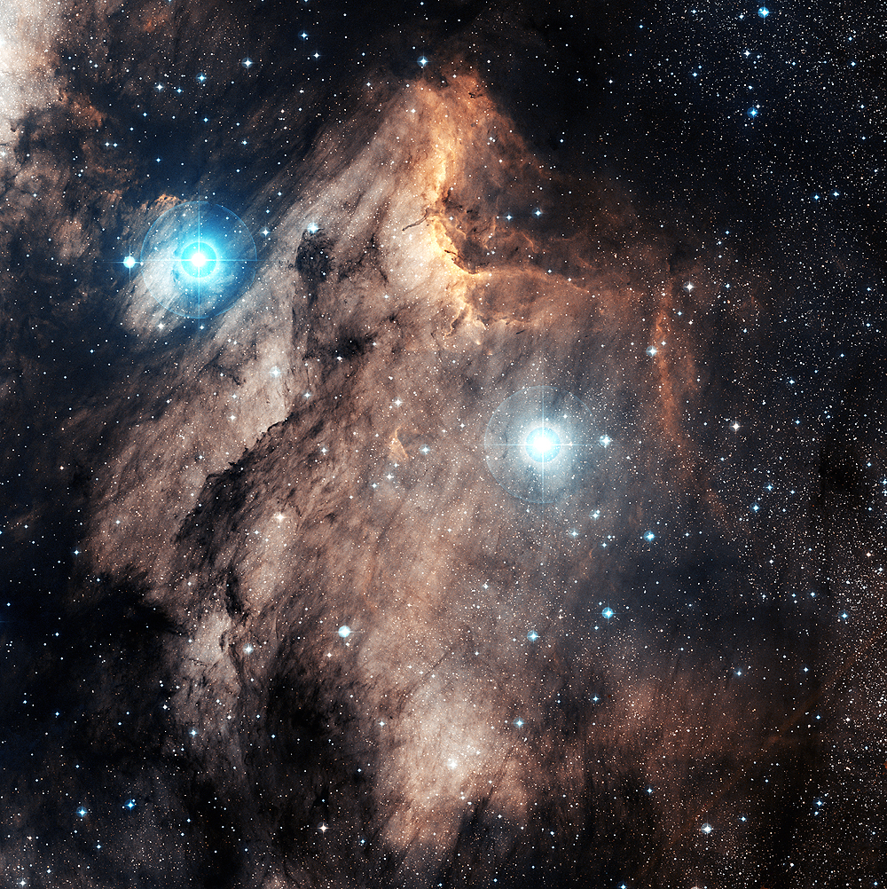
UNIVERSE’S AGE
The Bible says that nature declares the glory, knowledge (and therefore, truth), and righteousness of God. Note the following verses:
Pelican Nebula – Digitized Sky Survey; Color Composite – Charles Shahar

Slide 56
UNIVERSE’S AGE
Psalm 19:1-4 – ”The heavens declare the glory of God; the skies proclaim the work of his hands. Day after day they pour forth speech, night after night they display knowledge. There is no speech or language where their voice is not heard. Their voice goes out into all the earth, their words to the ends of the world.”
Pelican Nebula – Digitized Sky Survey; Color Composite – Charles Shahar

Slide 57
UNIVERSE’S AGE
Job 12:7 – 8 – ”Ask the animals, and they will teach you, or the birds of the air, and they will tell you; or speak to the earth, and it will teach you, or let the fish of the sea inform you.”
Pelican Nebula – Digitized Sky Survey; Color Composite – Charles Shahar

Slide 58
UNIVERSE’S AGE
Psalm 50:6 – ”Our God comes and will not be silent, And the heavens proclaim his righteousness.”
Psalm 97:6 – ”The heavens proclaim his righteousness, and all the peoples see his glory.”
Pelican Nebula – Digitized Sky Survey; Color Composite – Charles Shahar

Slide 59
UNIVERSE’S AGE
Jer. 33:25 – ”Our God comes and will not be silent, And the heavens proclaim his righteousness.”
Pelican Nebula – Digitized Sky Survey; Color Composite – Charles Shahar

