Slide 1
Biblical
Archaeology
Introduction
Notes:
Give vocabulary handouts.

Slide 2
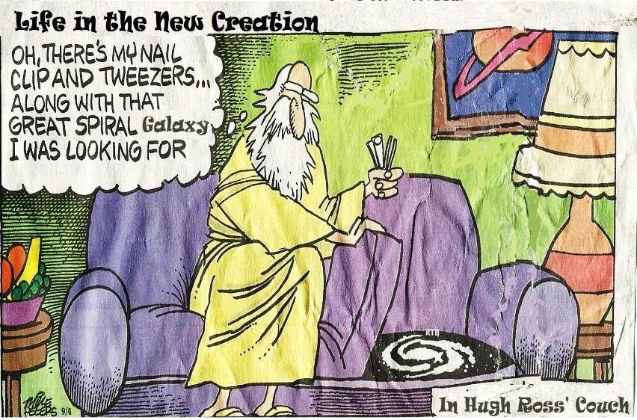
BIBLICAL ARCHAEOLOGY

Slide 3
Biblical Archaeology Course from RTB
www.Reasons.Org; Education; Reasons Institute; Biblical Archaeology.
Dr. John Bloom of Biola U.; Audit or College Credit.
15 Weeks; all on line; next January 2013.
Includes:
  Egypt and the Exodus
  Conquest of Jericho
  David and Solomon's kingdom
  Assyrian and Babylonian conquest
  Survey of major artifacts related to the New Testament
Notes:
SHOW REFERENCES. SHOW REFERENCES MATERIALS
My Story: I’m not an archaeologist, but an ecologist; i.e., I studied and worked to regulate the effects man has on his environment.
Just to show you that I’m not a total armchair archaeologist,
I worked for the USACE as a manager/supervisor of scientists and engineers for 23 years and retired two years ago.
One of the fields my work included was “Cultural Resources”, which encompassed anthropology and archaeology.
I worked to administer Federal laws dealing with the National Historic Preservation Act, Native American Grave and Repatriation Act (NAGPRA) and other related laws.
I’ve helped survey and collect artifacts on cultural resources sites, and I’ve been in several legal wrangles.
I’ve participated on at least 10 paleontological digs when I worked for the LA Co. Natural History Museum.
I have a strong liking for early man (hominid) studies—I have a nice collection of skulls and artifacts and I was able to give a 3-part talk here in Paradoxes about 5 yrs. ago.
Taking the RTB BA course motivated me to do this presentation.

Slide 4

What is Archaeology?
Grab & Run!
Raiders of the Lost Ark (1981)

Slide 5
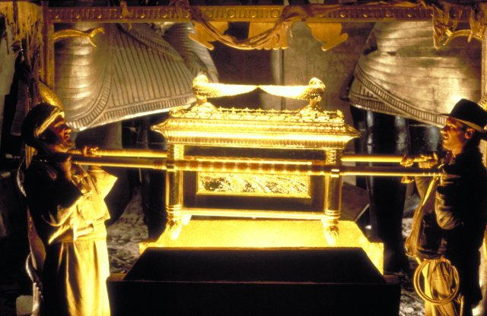
What is Biblical Archaeology?
Fabulous Discoveries!
Raiders of the Lost Ark (1981)
Notes:
Movie: “Raiders of the Lost Arc”, Harrison Ford (Indina Jones) and John Rhys-Davies with Arc Of The Covenant.

Slide 6

What is Biblical Archaeology?—Work!
Raiders of the Lost Ark (1981)

Slide 7

What is Biblical Archaeology?
Danger!
© 1981 - Lucasfilm, Ltd., Titles: Raiders of the Lost Ark

Slide 8
Can Archaeology Prove The Bible?
Notes:
Not reasonable. Can give picture of conditions at time, a better feel for the lives of those who lived during those times. With the eons of time that have passed, only “one-in-a-million” potential artifacts are preserved and found (most burn, rust, weather, or are deliberately destroyed). One item of high value are pot shards… Spectacular finds occasionally found such as a real name of a famous biblical figure: King Hezakiah’s signet ring (worn as bulla [amulet] on neck).

Slide 9
History of Biblical Archaeology
Phase I (early individuals)
  Edward Robinson & Eli Smith, Americans. 1838
  Lieutenant W.F. Lynch, American Expedition, 1847-48
  Frederic de Saulcy, French, 1850-63
Notes:
Edward Robinson & Eli Smith: 1st major survey of Palestine. Consulted local Arabs for place names, then correlated with ancient names. Explored Siloam Tunnel, Jerusalem and Temple Mount; Robinson Arch.
Lieutenant W.F. Lynch Expedition: Charted Jordan R. course, Sea of Galilee to Dead Sea. Massed data and discovered that Dead Sea lowest pt. on earth (-1,300’ msl).
Frederic de Saulcy: “1st modern excavator of Palestine per William Albright, though primitive digging and mis-IDs. Systematic numbering of dig items. Arguments about Baalbek (mostly city of fantastic ancient Roman ruins in Lebanon; more recently Neolithic finds back to 9000BC) having been built before the Romans, later used by folks like Erich von Daniken to argue for the construction of the site by aliens or god-like beings

Slide 10
History of Biblical Archaeology
Phase II (investigations by societies)
  Palestine Foundation Fund, British, 1871 – 1877
  American Palestine Exploration Society, 1871
  Deutcher Palastina-Verein, German, 1877
  Ecole Biblique et Archeologique Francaise, 1890
Notes:
Palestine Foundation Fund, British, 1871 – 1877: Charles Warren (Warren’s Tunnel) excavated in Jerusalem, found first genuine biblical artifact (pottery jar handles stamped “belonging to the king”, scientifically excavated in Holy City. Lts. Claude Conder and JJ Kitchner surveyed and mapped entire land of Palestine west of Jordan R.; published four volumes for 6000 sq mi. Also, Condor surveyed 500 sq mi of eastern Palestine (stopped by Ottoman govt).
American Palestine Exploration Society, 1871: John A. Paine know for identifying ancient site of Pisgah.
Deutcher Palastina-Verein, German, 1877: Gottlieb Schumacher surveyed the Golan east of Sea of Galilee.
Ecole Biblique et Archeologique Francaise, 1890: General surveying

Slide 11
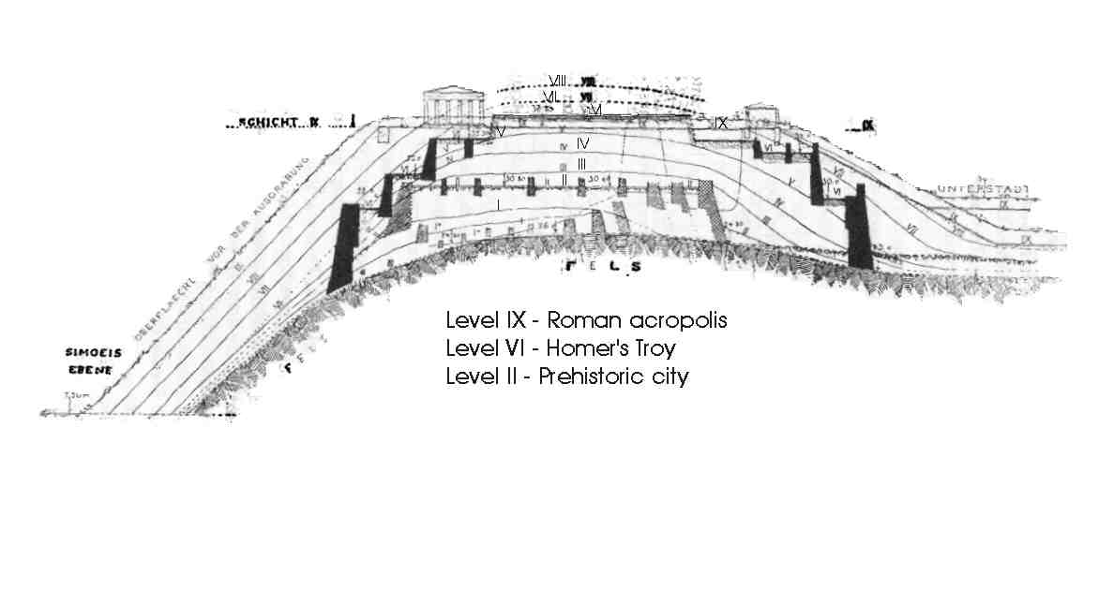
History of Biblical Archaeology
Phase III (tell excavations, 1890 – 1914)
  William Petrie
  Turkey, Tell el-Hesi (Troy)
Notes:
Wilhelm Dorpfeld's map of Hisarlik Turkey, dated 1902. From David Traill's Schliemann of Troy: Treasure and Deceit.
Petri Copied Heinrich Schliemann’s mound dig techniques at Troy for Palestine tels. At his excavations of Tell el-Hesi he discovered that each occupational layer of the mound has its own characteristic pottery. He thus argued that each layer of any site could be dated per the characteristic pottery found. This was revolutionary.
SEE VOCABULARY, Pg. 2 of handout. >>>
Tell (Akkadian or Sumerian) or Tel (Hebrew): mound or ruin heap; hill or mound of a series of progressively older occupations layers; ruined cities built over one another in a chronological order consisting of oldest at the bottom and newest at the top layer.
Stratum/Strata: layer/layers, often in reference to geological features.
Stratigraphy: Study of deposition and relationships of layers of a tel or other geographic feature.

Slide 12
History of Biblical Archaeology
Phase IV (Systematic Archaeology, 1918-1940)
  C.S. Fisher
  William F. Albright
  Benjamin Mazar
Notes:
Sophistication brought to field through methodical and scholarly scientific investigations. Concept of “locus/loci” (site coordinates, peculiar to it, or even longitude/latitude/elevation).
C.S. Fisher: famous for excavations at Megiddo, Beth Shean and Beth Shemest, also principal excavator for most sites throughout Palestine during this phase.
William F. Albright: most profound BA who’s influence still impacts us today. He mastered the crafts of ceramic topology and stratigraphic analysis. Posited that all places, events, dates mentioned in the Bible were without error (now called a “Maximalists” [modern maximalists are sometimes referred to as “neo-Albrighteans”]).
Benjamin Mazar: First Israeli BA to conduct official excavation, around Temple Mount. For decades he served as the chairman of the Israel Exploration Society and of the Archaeological Council of Israel (which he founded as the authority responsible for all archaeological excavations and surveys in Israel). Discovered largest Jerusalem catacombs at Beit She'arim. Grandaughter is Eilat Mazar (2006 claim to have discovered King David’s palace).

Slide 13
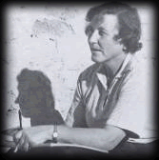
History of Biblical Archaeology
Phase V (Methodological Revolution, 1948 – 1967)
  Kathleen Kenyon, student of William Albright, developed “British Archaeological Method” or “Wheeler-Kenyon Method.
Notes:
British Archaeological Method (or Wheeler-Kenyon Method): dug in small squares within a grid leaving intervening catwalks or balks.

Slide 14
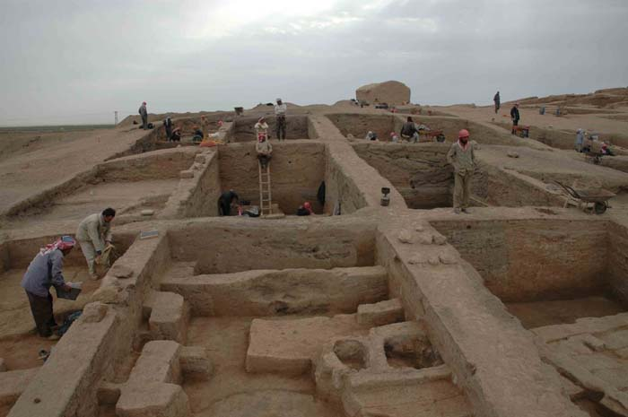
History of Biblical Archaeology
Archaeological Excavation in grid showing Balks
Notes:
The excavation in the northwestern part of Tell Sabi Abyad (Operation III), with settlement remains dating between 6800 and 6200 BC.

Slide 15
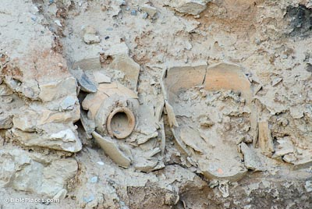
History of Biblical Archaeology
Store-jars retained in a Balk
Notes:
The storejars pictured here still remain in one of Kenyon's balks at Jericho.

Slide 16
History of Biblical Archaeology
Phase VI (“New Horizons”, 1967 -- , combines Wheeler-Kenyon Method with Architectural Method)
  William Dever (American)
  Israel Finkelstein (Israeli)
  Eilat Mazar (Israeli)
  Joe Seger (American)
Notes:
Now highly multi-disciplinary: historians, linguists, osteologists, botanists, geologists, zoologists, computer analysts, …
Now we use combined “Wheeler-Kenyon Method” (small area, highly concentrated effort with grid/square pits) with “Architectural Method” (wide area survey and some digging); this allows for greater time efficiency as the Wheeler-Kenyon Method is very time consuming and expensive, and much more territory can be examined in a given time.

Slide 17
Documentary (Wellhausen) Theory—anti-Biblical Archaeology
Belief that Pentateuch is based on scant evidence & that Jews couldn’t write during Moses’ time.
Must have extra-biblical evidence.
From Higher Critics, 1790-1940
Modern Pentateuch is a “redacted” or synthesized from earlier (J,E,D & P) versions.
Notes:
JEPD may also refer to Jointly Exhaustive, Pairwise Disjoint.
Diagram of the Documentary Hypothesis. * includes most of Leviticus † includes most of Deuteronomy ‡ "Deuteronomic history": Joshua, Judges, 1 & 2 Samuel, 1 & 2 Kings
The documentary hypothesis, (DH) (sometimes called the Wellhausen hypothesis), holds that the Torah was derived from originally independent, parallel and complete narratives, which were subsequently combined into the current form by a series of redactors (editors). The number of these is usually set at four, but this is not an essential part of the hypothesis.
The hypothesis was developed in the 18th and 19th centuries from the attempt to reconcile perceived inconsistencies in the biblical text. Biblical scholars, using source criticism, eventually arrived at the theory that the Torah was composed of selections woven together from separate, at times inconsistent, sources, each originally a complete and independent document. By the end of the 19th century it was generally agreed that there were four main sources, combined into their final form by a series of redactors, R. These four sources came to be known as the Yahwist, or Jahwist, J (J being the German equivalent of the English letter Y); the Elohist, E; the Deuteronomist, D, (the name comes from the Book of Deuteronomy, D's contribution to the Torah); and the Priestly Writer, P.^{[1]}
Julius Wellhausen's contribution was to order these sources chronologically as JEDP, giving them a coherent setting in the evolving religious history of Israel, which he saw as one of ever-increasing priestly power. Wellhausen's formulation was:
the Yahwist source ( J ) : written c. 950 BC in the southern Kingdom of Judah.
the Elohist source ( E ) : written c. 850 BC in the northern Kingdom of Israel.
the Deuteronomist ( D ) : written c. 600 BC in Jerusalem during a period of religious reform.
the Priestly source ( P ) : written c. 500 BC by Kohanim (Jewish priests) in exile in Babylon.
While the hypothesis has been increasingly challenged by other models in the last part of the 20th century, its terminology and insights continue to provide the framework for modern theories on the origins of the Torah.^{[2]}

Slide 18
History Cont., Documentary Theory Refuted
Allegation: Writing unknown to Hebrews prior to Davidic monarchy
Refutations:
  Gezar Calendar
  Ugaritic Tablets
  Sera bit el Khadim Alphabetic inscriptions
Notes:
Gezar Calendar: 925 BC shows art of writing well-known even to children; from Canaanite city of Gezar.
Ugaritic Tablets: 1400 BC (found 1926); Hebrew related Semitic language. Wellhausen said these Canaanite poetic text were supposed to have arisen a thousand years later…
Sera bit el Khadim Alphabetic inscriptions, proto-Semitic grafitti similar to later Phoenician, 1500 BC, in Egyptian turquoise mines. Shows even low class of society could read and write. Possibly from expelled Hyksos of Egypt.

Slide 19
History Cont., Documentary Theory Refuted
Allegation: Abraham & descendants untrustworthy & non-historical.
Refutations:
    City of Ur found
    Name “Abram” discovered
    Shechem & Bethyl inhabited in Abraham’s time.
    Jordan Valley inhabited in Abraham’s time.
    Mesopotamian kings found to be real.
    Mari tablets found
    Nuzu tablets found
    Hittite Legal Code
    Camels
Notes:
Ur excavation: 1922-34, Leonard Wooley; ~2000BC; Southern Sumer (North Mesopotamia plane, modern Iraq).
“Abram” name found in 1556 BC Akkadin script: “Farmer named Abrabama hired an ox.”
Mari tablets; 20,000 mid-Euphrates in 1933; Akkadian 18th century BC; Abrahams brother Nahor—city named for him.
Nuzu tablets, on Tigris, 1925; 15th century BC. Confirms customs and usages of Abraham & patriarchs prior to Egypt.
Hittite Legal Code; 1300 BC; explains why Abraham purchased only a cave at Machpalah & not entire parcel in order to avoid having to perform duties of “ilku”—pagan feudal (services required for holding land) services.
Camels: usage as with Rebekah’s courtship and Joseph’s sell into slavery; Fodder list from Tel Atshana found for Old Babylonia (2000-1700BC). Early Sumerian text speaks of camel milk; many more.

Slide 20
History Cont., Documentary Theory Refuted
Allegation: Priestly Code had to be Post-Exilic; i.e., after Babylonian captivity, 538 BC .
Refutations: Code of Hammurabi stela
Notes:
Priestly Code: ~1/3 of Jewish law, mostly Leviticus and some Numbers
Code of Hammurabi Stela; 1780 BC 6’ finger with 282 laws and rules such as eye-for-an-eye, breach of contract, divorce… King Hammurabi was 6th Babylonian king of middle era; written in ancient Semitic (Akkadian) cuneiform.

Slide 21
History Cont., Documentary Theory Refuted
Allegation: Hebrew Conquest of Trans-Jordan & Palestine Unhistorical & out of Harmony with Facts.
Refutations:
  Egyptian Execration Texts
  Tel el Amarna Tablets
  Merneptah Victory Stela
Notes:
Egyptian Execration Texts: voodooistic ritual whereby sethe bowls (starting from ~1820BC) or other objects had written curses made for Pharaoh's enemy’s; bowls were broken and buried for effect; some shards tell of rebellious kings and cities in Palestine during time of Pentateuch (shortly after Exodus..?).
Tel el Amarna Tablets: 1400-1370 BC, Akkadian cuneiform, message from Palestinian and Syrian Princelings to Egypt of “alarming reports of depredations of fierce invaders, and urgent request for Egyptian troops. Mentions “Habiru’ Apiru”… Towns mentioned were Israelites first invaded. Located on Nile R in mid-Egypt, known as Akhataten.
Merneptah Victory Stela: of 1229BC, contains the only extant reference to Hebrew nation as “Israel”. King Merneptah’s “irrestible troups in lands of Hittites, Canaan, Ashkelon, Gezer and Israel. “Israel laid waste; his seed is not.” ~12’ tall.

Slide 22
History Cont., Documentary Theory Refuted—THE LAST STRAW!
  Ebla Tablets --thoroughly refute Wellhausen Documentary Hypothesis.
Notes:
Ebla Tablets: Italians in 1964 discovered 20,000 clay tablets from 2500-2250BC at Tel Mardikh in present NW Syria, Aleppo (by Turkish border).
The language is close to Cannanite/Akkadian in Laban’s time (Rachael’s father, i.e., Jacob’s (Israel’s) father-in-law); has many names as in bible/Genesis: Ishmael, Israel, Michael, etc. Had social, political and commercial relations with Dan, Hazor, Megiddo, Shalem (Jerusalem), Gaza. Also, traded with Sodom and Zobuiim, two of plain pentapolis where Lot lived. /thoroughly refuted Wellhausen Documentary Hypothesis…

Slide 23
History Cont.: A New Threat Arises—The Minimalists
“Minimalist” coined as a retort in 1990’s for archaeologists that claim all places, dates and names in the Old Testament are fictional.
  Philip R. Davies, Thomas L. Thompson, Keith Whitelam
“Maximalist” coined as a retort by “Minimalists” for those archaeological scholars supporting historicity of the bible.
  Secular (bible has some historical fact): William Dever
  Traditional (bible historically accurate): Bryant Wood, Josef Garfinkel, James Hoffmeier
Notes:
Minimalism, Biblical (also known as The Copenhagen School because two of its most prominent figures taught at Copenhagen University). Is a movement or trend in biblical scholarship in the 1990s which made two main claims: first, that the Bible cannot be considered reliable evidence for what had happened in ancient Israel; and second, that "Israel" itself is a problematic subject for historical study.^{[1]}
Minimalism was not a unified movement, but rather a label that came to be applied to several scholars at different universities who held similar views, chiefly Niels Peter Lemche and Thomas L. Thompson at the University of Copenhagen, Philip R. Davies, and Keith Whitelam. Minimalism gave rise to intense debate during the 1990s - the term "minimalists" was in fact a derogatory one given by its opponents, who were consequently dubbed "maximalists", but in fact neither side accepted either label. The so-called Maximalists, or neo-Albrightians, were composed of two quite distinct groups, the first represented by the archaeologist William Dever and the influential publication Biblical Archaeology Review, the second by conservative evangelical Christians such as biblical scholar Iain Provan and Egyptologist Kenneth Kitchen.^{[2]} Although these debates were in some cases heated, most scholars stayed in the middle ground between minimalists and maximalists evaluating the arguments of both schools critically, and since the 1990s, while some of the minimalist arguments have been challenged or rejected, others have been refined and adopted into the mainstream of biblical scholarship.^{[3]}
By the opening of the 20th century the stories of the Creation, Noah's ark, and the Tower of Babel - in short, chapters 1 to 11 of the Book of Genesis - had ceased to be taken literally by scholars, and the starting point for biblical history was regarded as the stories of Abraham, Isaac, and the other Hebrew patriarchs. Then in the 1970s, largely through the publication of two books, Thomas Thompson's "The Historicity of the Patriarchal Narratives" and John Van Seters' "Abraham in History and Tradition", it became widely accepted that the remaining chapters of Genesis were equally non-historical. At the same time, archaeology and comparative sociology convinced most scholars in the field that there was equally little historical basis to the biblical stories of the Exodus and the Israelite conquest of Canaan.^{[4]}
By the 1980s, the Bible's stories of the Patriarchs and Exodus and Conquest were no longer considered historical, but biblical histories continued to use the Bible as a primary source and to take the form of narrative records of political events arranged in chronological order, with the major role played by (largely Judean) kings and other high-status individuals. At the same time, new tools and approaches were being brought to bear on scholars' knowledge of the past of ancient Palestine, notably new archaeological methods and approaches (for example, this was the age of surface surveys, used to map population changes which are invisible in the biblical narrative), and the social sciences (an important work in this vein was Robert Coote and Keith Whitlam's "The Emergence of Early Israel in Historical Perspective", which used sociological data to argue, in contradiction to the biblical picture, that it was kingship that formed Israel, and not the other way round). Then in the 1990s a school of thought emerged from the background of the 1970s and 1980s which held that the entire enterprise of studying ancient Israel and its history was seriously flawed by an over-reliance on the biblical text, which was too problematic (meaning untrustworthy) to be used even selectively as a source for Israel's past, and that Israel itself was in any case itself a problematic subject. This movement came to be known as biblical minimalism.^{[5]}
Biblical minimalism
The scholars that have come to be called "minimalists" are not a unified group, and in fact deny that they form group or "school": Philip Davies points out that while he argues that the bulk of the Bible can be dated to the Persian period (the 5th century BCE), Niels Peter Lemche prefers the Hellenistic period (3rd to 2nd centuries BCE), while Whitelam has not given any opinion at all. Similarly, while Lemche holds that the Tel Dan stele (an inscription from the mid 9th century BCE which seems to mention the name of David) is probably a forgery, Davies and Whitelam do not. In short, the minimalists do not agree on much more than that the Bible is a doubtful source of information about ancient Israel.^{[6]}

Slide 24
History Cont.: A New Threat Quashed!—The Minimalists
Recent discoveries refuting Minimalist's claims:
  Tel Dan stela
  Mesha stela (re-examination)
  Carbon-14 radiometric dating in Northern Kingdom
  Khirbet Quiyafa
Notes:
Tel Dan stela: 1993 -1994 fragements of an Aramaic stela at this excavation by Avraham Biran of Hebrew Union College. Dates from 9th century BC. Inscription reads “House of David” which means a king of the dynasty of David.
Mesha stela: found over a century ago, this 9th century BC Moabite (king Mesha of Moab) inscription was recently found to include a reference to “House of David”.
Carbon-14 radiometric dating of Northern Kingdom: Minimalist Israel Finkelstein (Tel Aviv U.) actually published this information, saying that radiocarbon dating at the sites of Megiddo (stratum K-4), Yokneam (stratum XVII), Tell Keisan (stratum 9a) date to 10th century BC—the time of David and Solomon’s dynasty. Note: Minimalist ok with North Kingdom’s (Israel) 10th century existence, but not Southern (Judah).
Khirbet Quiyafa: Minimalist contend that Judah was an agrarian society until the end of the 10th century (David’s reign) has now been shown to be an inaccurate belief; this was a heavily fortified site in Judah on the Israelite/Philistine border and is dated to the early 10th century. Garfinkel and Minimalist unintentionally showed that Judah arose around 1000 BC, at least 100 years before the first heavily fortified urban centers appeared in the northern kingdom of Israel. Radiocarbon dating fits this site ato 969 BC, within David’s reign of 1000 – 965 BC. This showed that Iron Age IIA began in Judah at the very end of the 11th century BC, thus rendering the Finklestein’s Low Chronology paradigm wrong. Other supporting evidence include securely dated pottery, no pig bones…, entrance faced Jerusalem and not Philistia, double casement wall common in Judah but unknown in Philistia, pot shard ostracon (with writing) of proto-Canaanite letters in Hebrew language.

