Slide 1
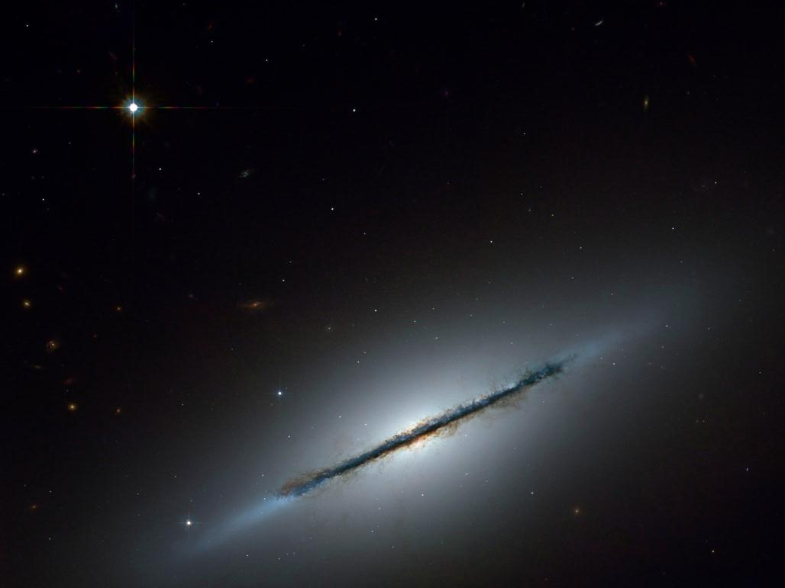
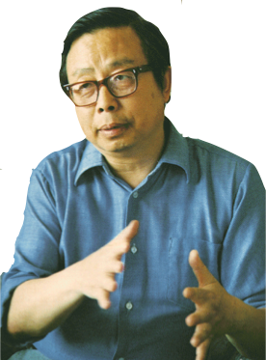
“A question that has always been considered a topic of metaphysics or theology—the creation of the universe—has now become an area of active research in physics.”
Fang Li Zhi
Creation of the Universe, p.173
NASA//ESA/Hubble Heritage Team (STScI/AURA)/W. Keel, Univ. of Alabama, Tuscaloosa

Slide 2
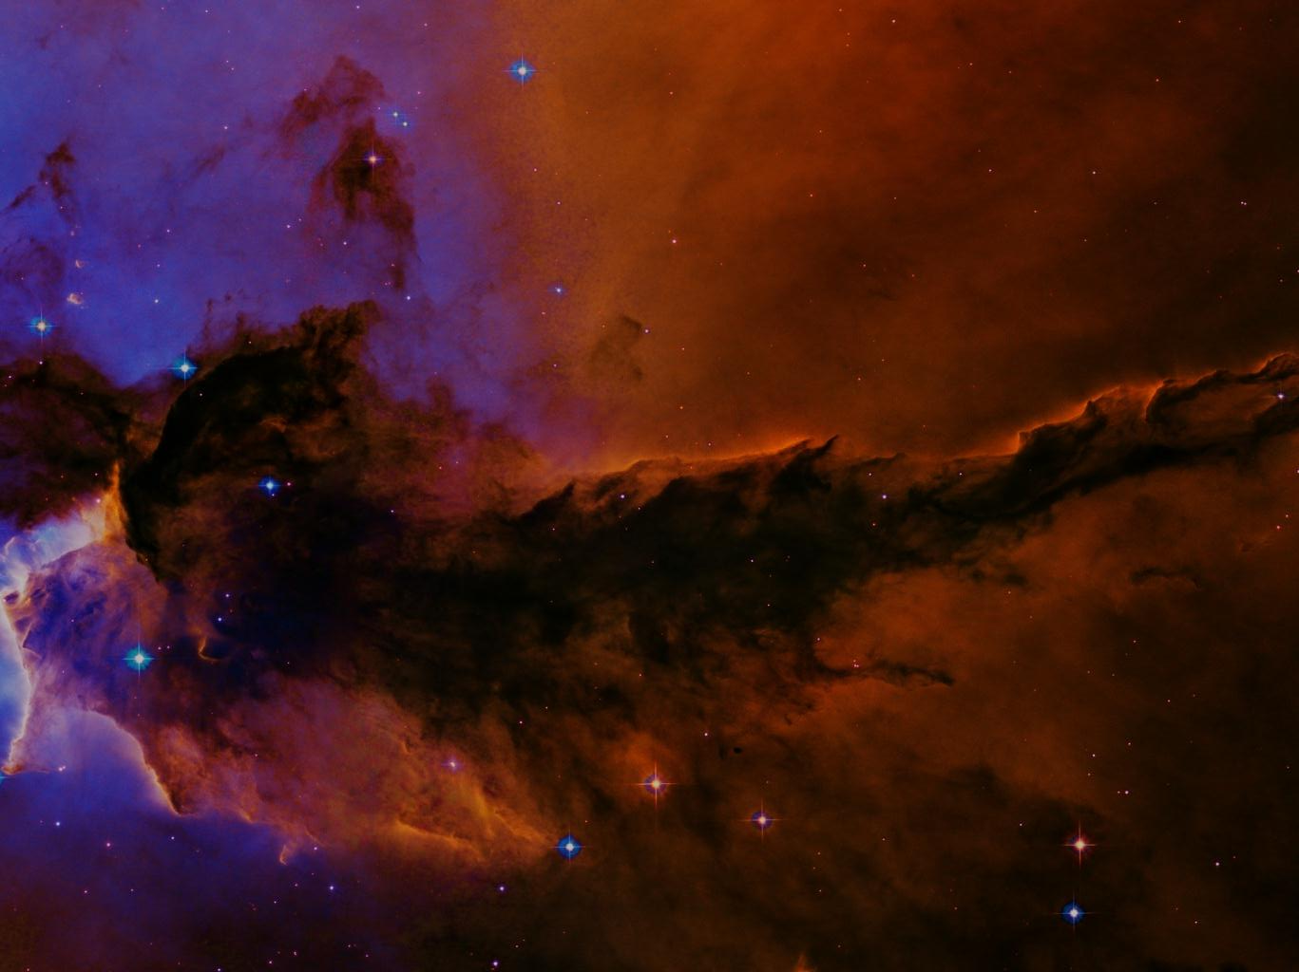
If no Creator …
Fine-tuning will be for life in general, not humans in particular.
NASA//ESA/Hubble Heritage Team (STScI/AURA)

Slide 3
If Creator …
Fine-tuning necessary for humans will be more exacting.
NASA//ESA/Hubble Heritage Team (STScI/AURA)

Slide 4
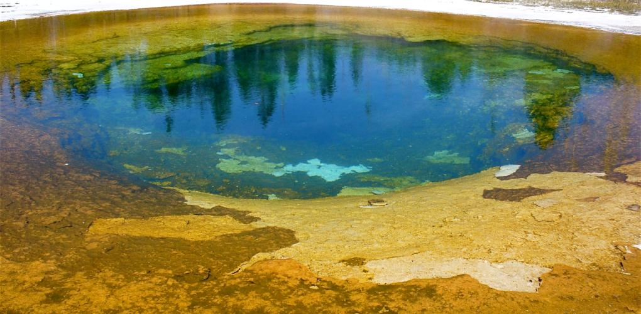
Bacteria vs. Humans
Hugh Ross
Notes:
WAIT

Slide 5
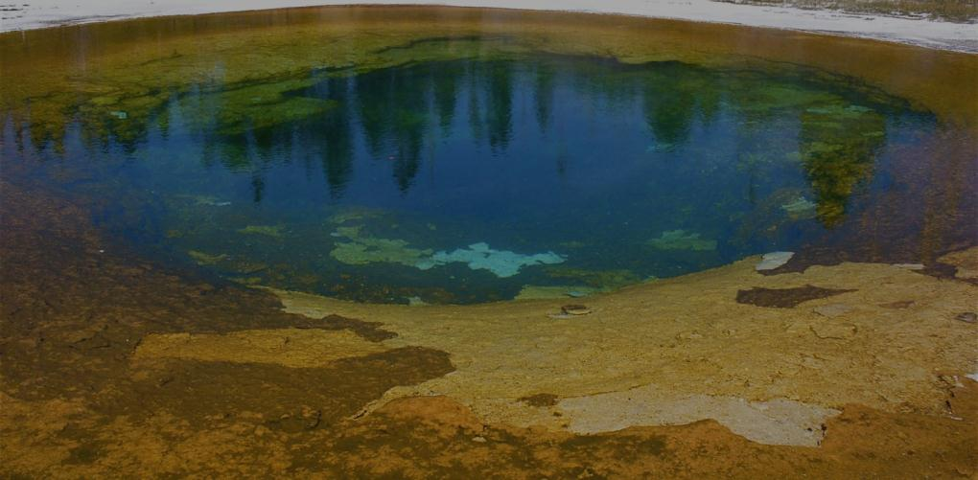
Bacteria vs. Humans
life form | # features | probability
90-day bacteria | 501 | 10⁻³¹¹
3-Gyr bacteria | 676 | 10⁻⁵⁵⁶
humans | 824 | 10⁻¹⁰⁵⁰
Hugh Ross
features/citations: reasons.org/fine-tuning for citations.

Slide 6
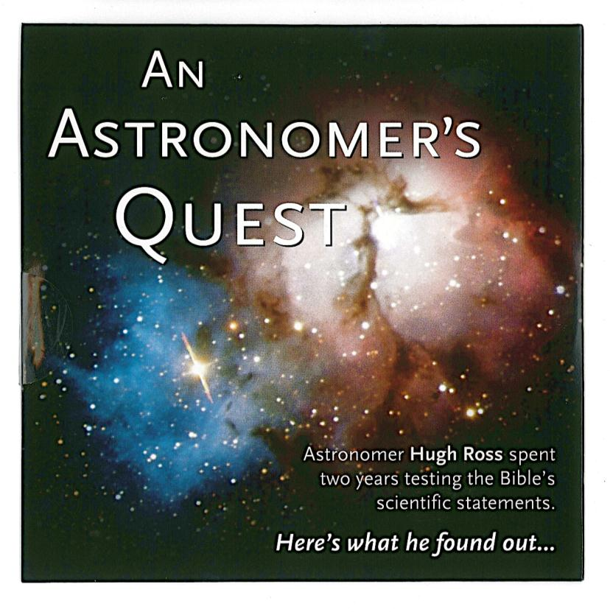

Slide 8
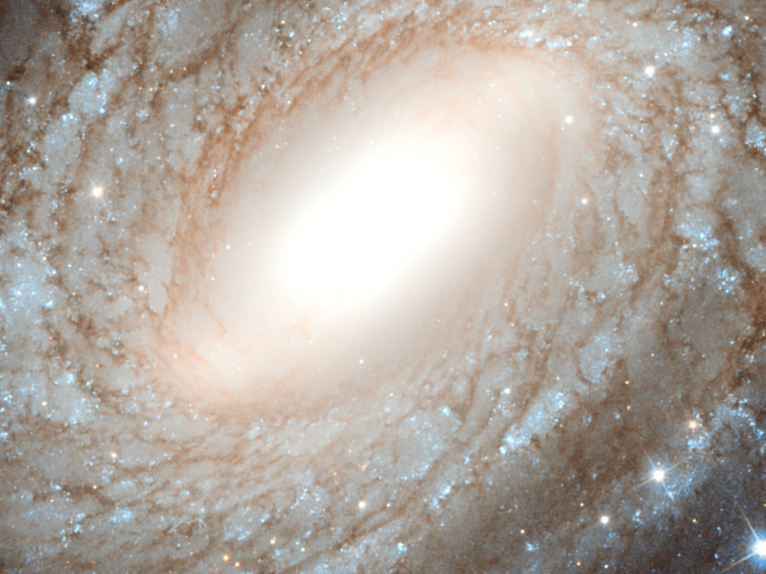

www.reasons.org
NASA/ESA/Hubble SM4 ERO Team
Notes:
Reasons To Believe is all about brand new reasons from the frontiers of scientific research to trust Christ as Creator and Lord.

Slide 9
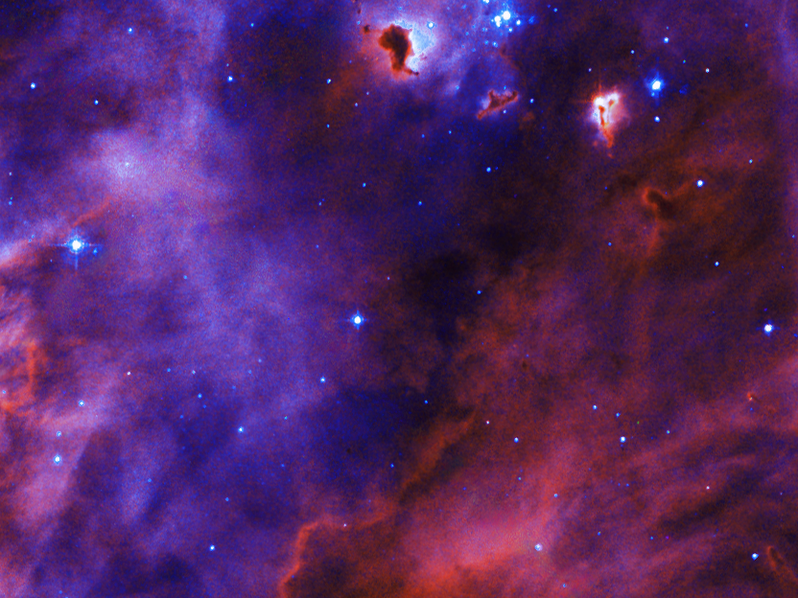
NASA/ESA/Hubblr Heritage Team (STScI/AURA)
ESO

Slide 10
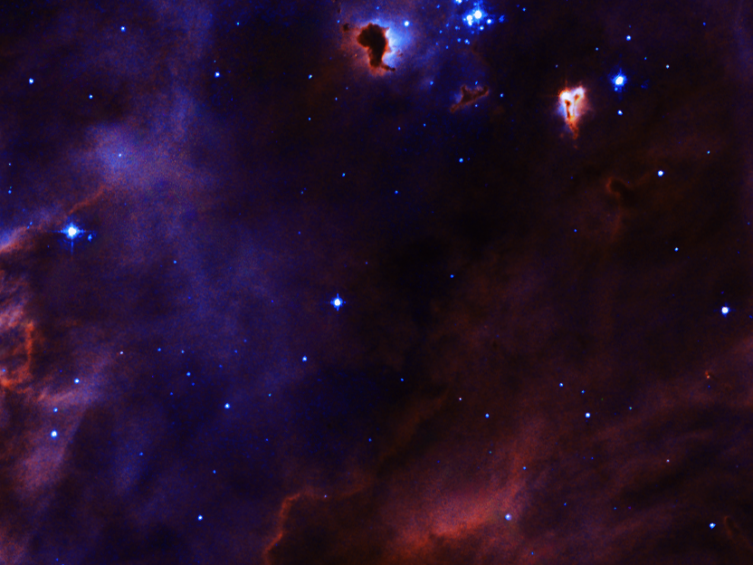
Today’s New RTB
articles on new scientific discoveries giving more evidence for the biblical creation message
www.reasons.org
NASA/ESA/Hubblr Heritage Team (STScI/AURA)
Notes:
FREE!

Slide 11
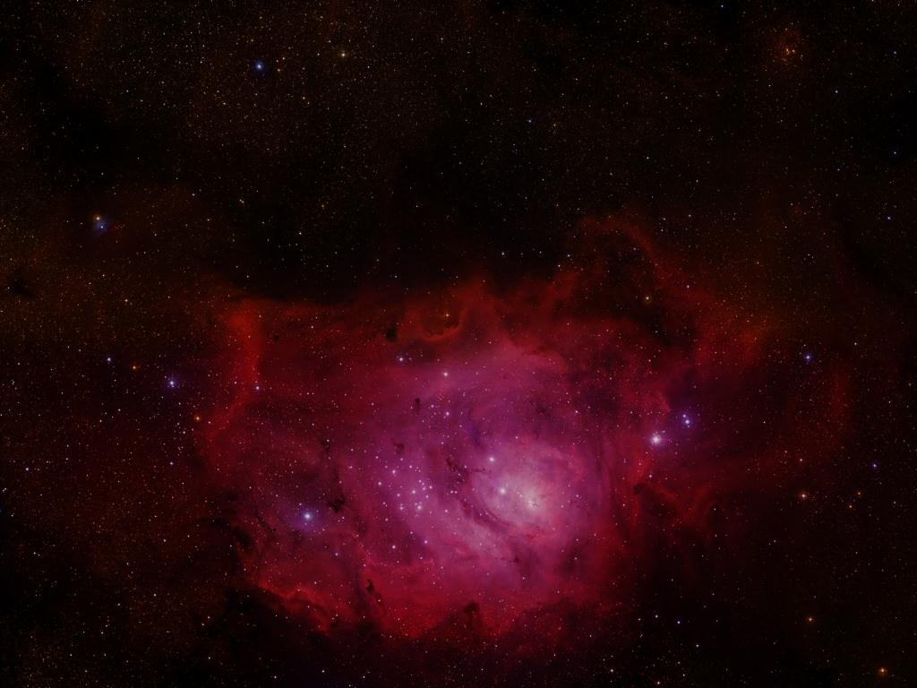
Science Newsflash
2-4 times per week hear/view podcasts giving a theological perspective on a just-announced scientific discovery
subscribe: iTunes or reasons.org
ESO

Slide 12
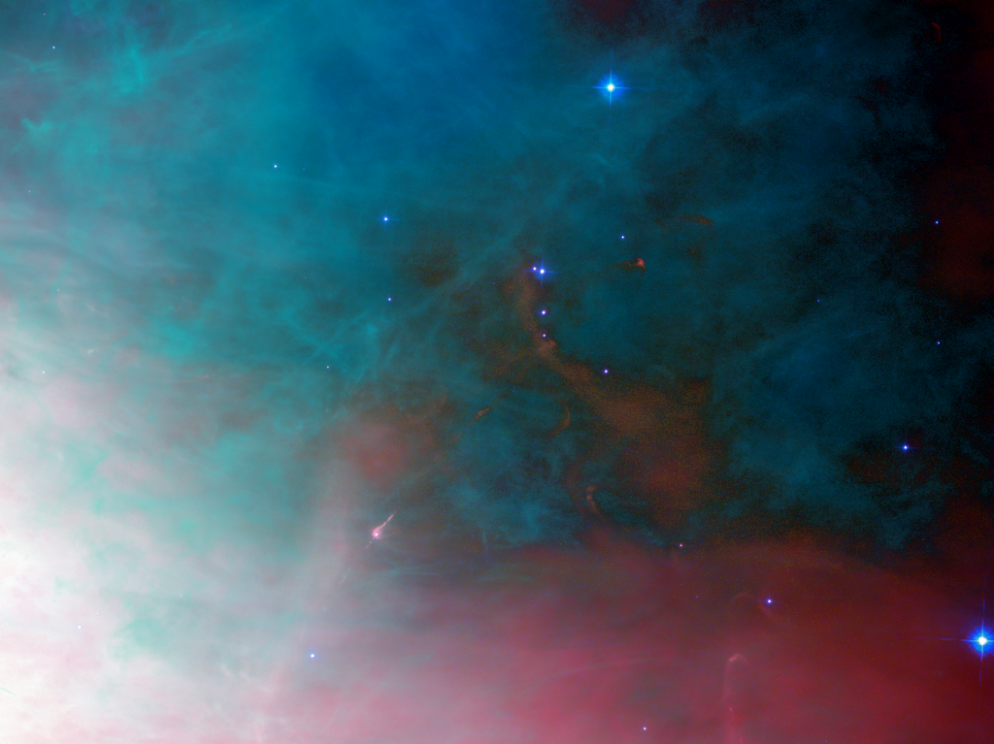
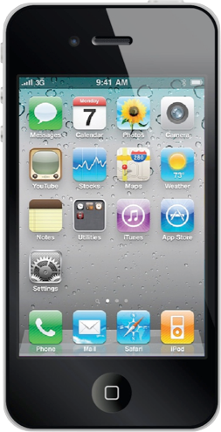
Reasons To Believe App
NASA/ESA/Hubble Space Telescope
ESO

Slide 13
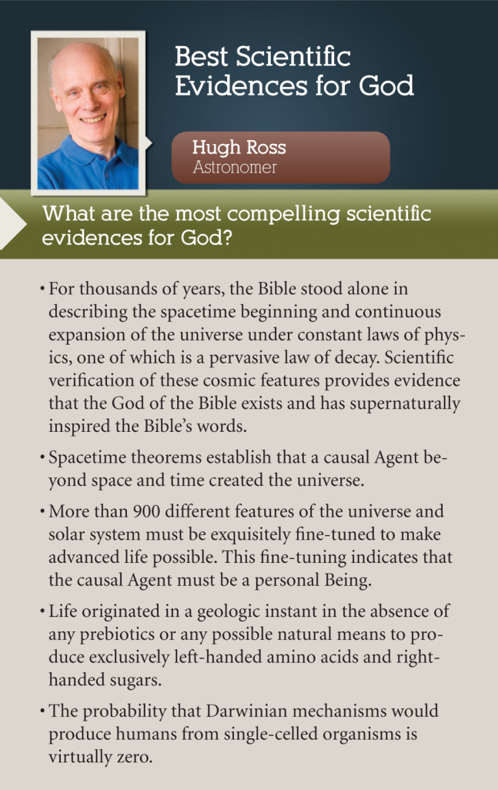

Slide 14
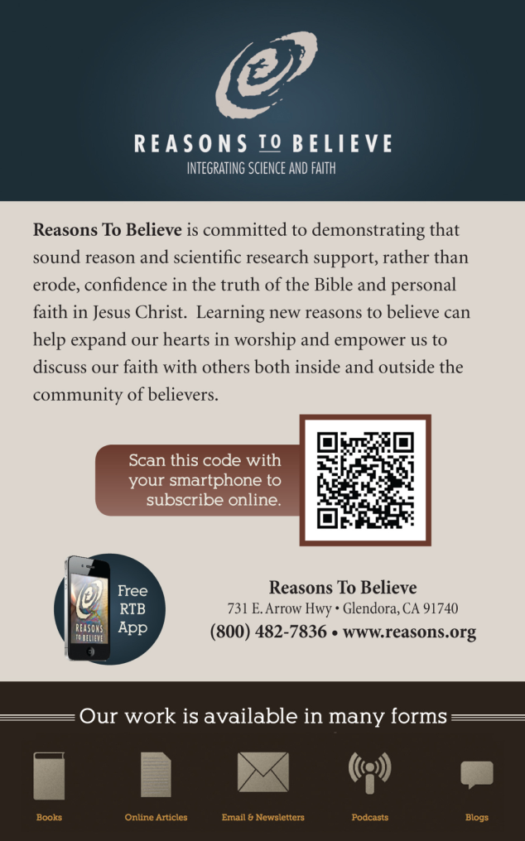

Slide 15
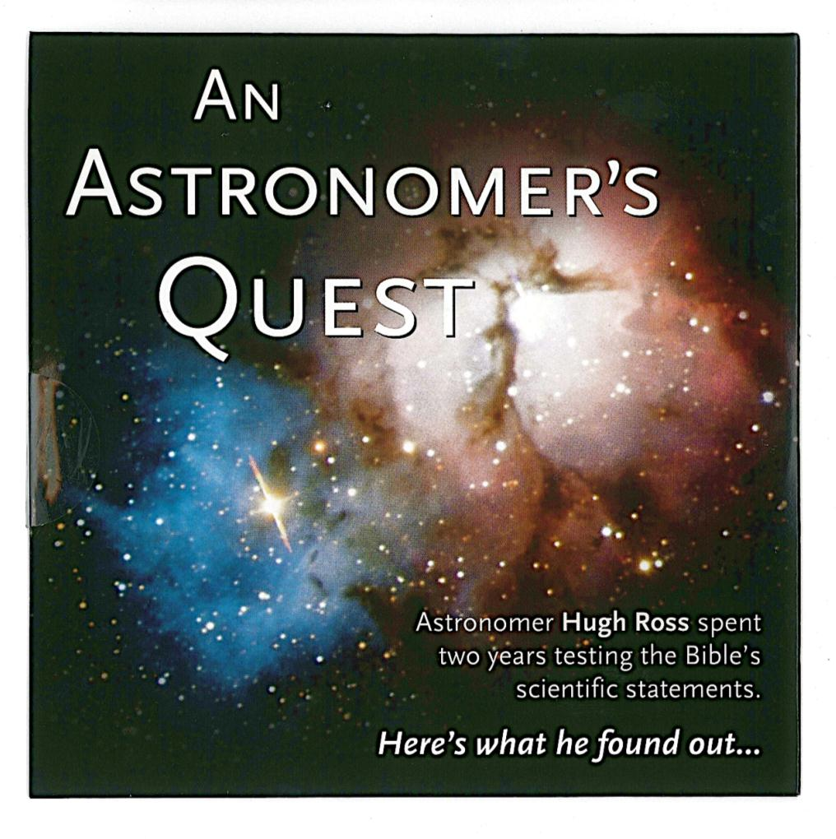

Slide 16
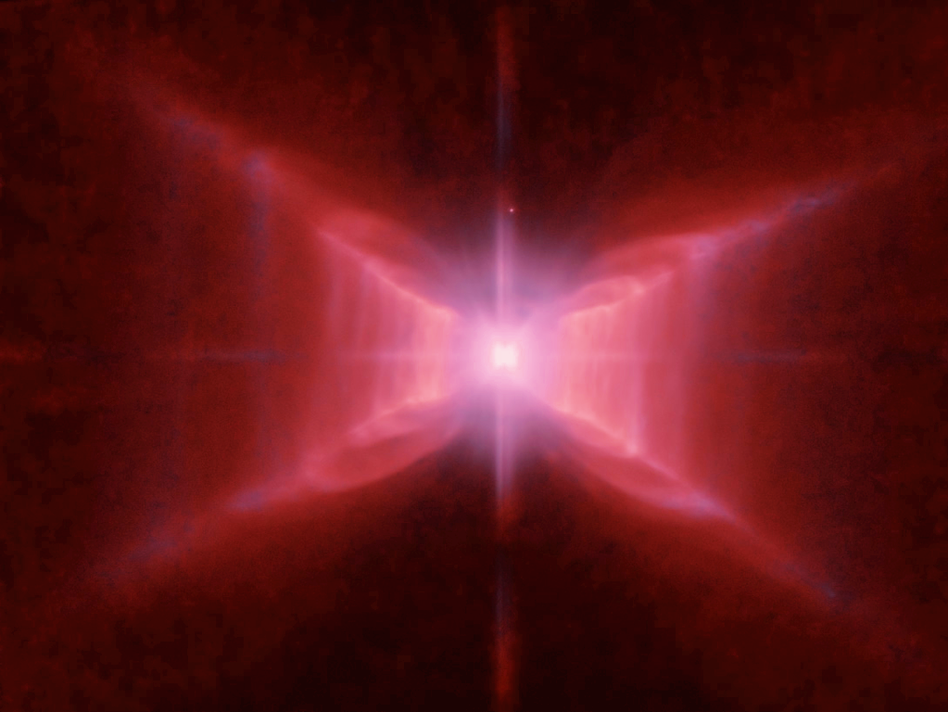
God and Science
Hugh Ross
www.reasons.org
NASA/ESA/Hubble

Slide 17
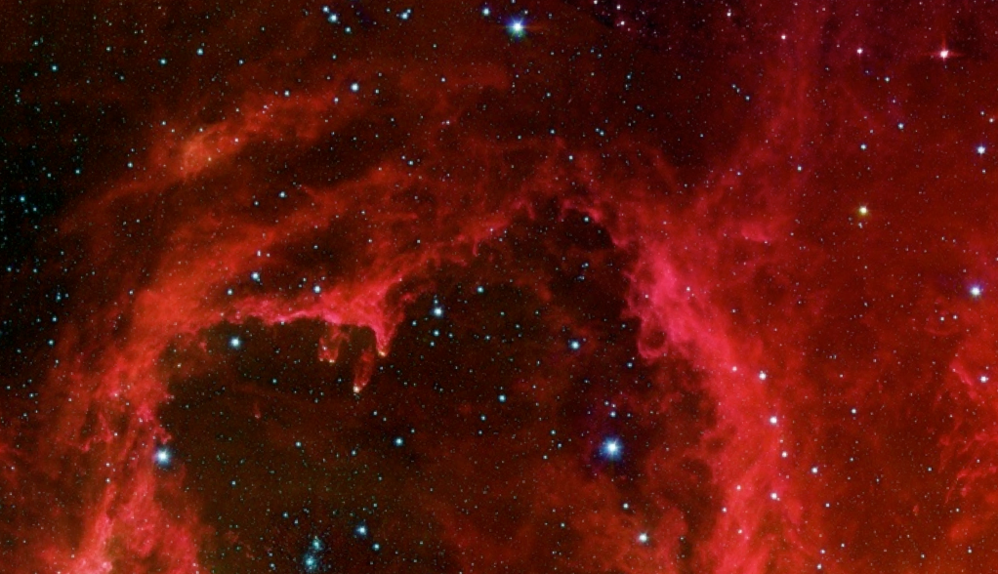
cosmic reasons to believe in Christ
NASA/JPL-Caltech/Harvard Smithsonian CfA

Slide 18
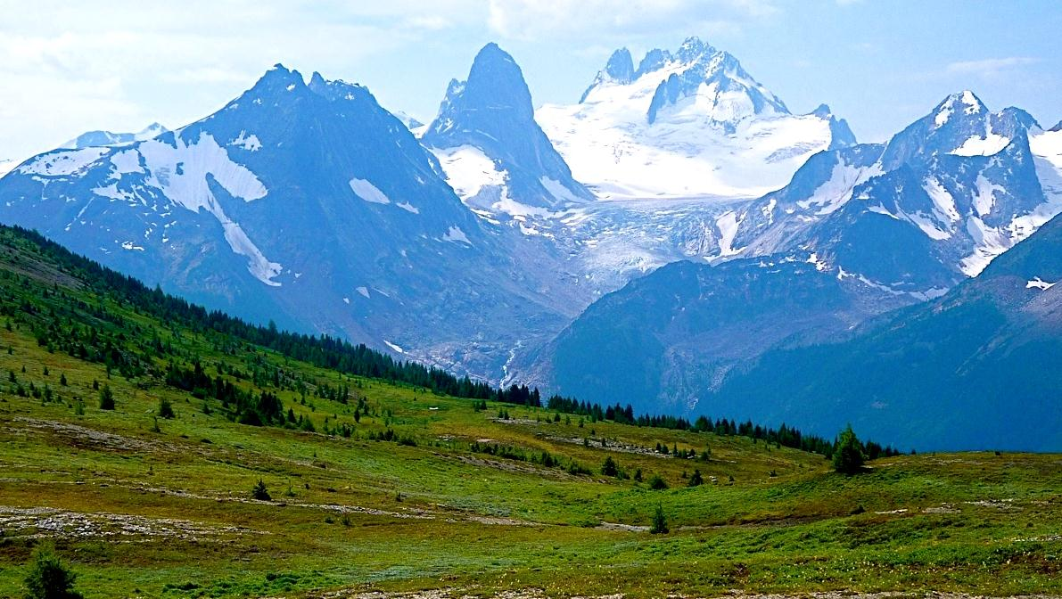
Can science test creation?
Hugh Ross
Notes:
Have you ever heard the charge that creation is not science because it’s not testable?
That’s why we’ve spent 25 years building a biblical creation model that is testable, falsifiable, and predictive.

Slide 19
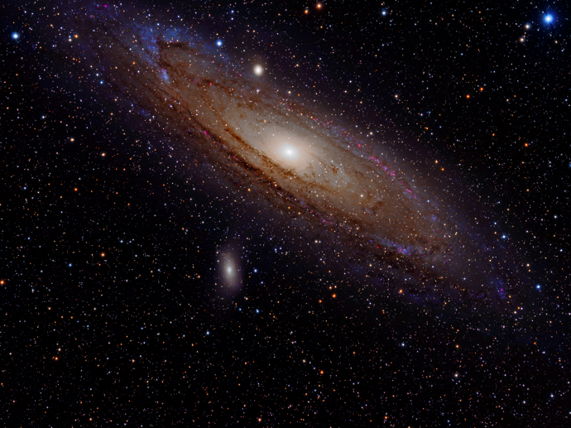

“The impression of design is overwhelming.”
Jacob Appelbaum
ASU/Tom Story
—The Cosmic Blueprint, p. 203
Paul Davies
NASA/ESA/Hubble SM4 ERO Team
Adam Evans, creative commons attribution
Notes:
Design is not the issue.
Everyone agrees we see design in nature.
It’s the nature of the Designer that is questioned.

Slide 20
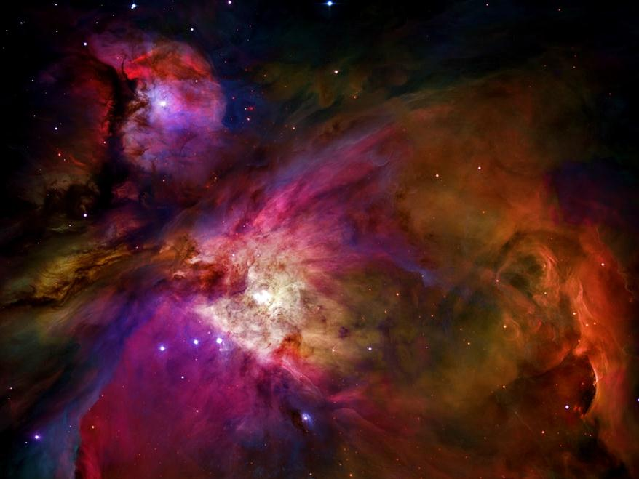
Identifying the Designer
Two Questions …
NASA/Hubble Heritage Team STScI/AURA
Notes:
Now, our creation model is a biblical model.

Slide 21
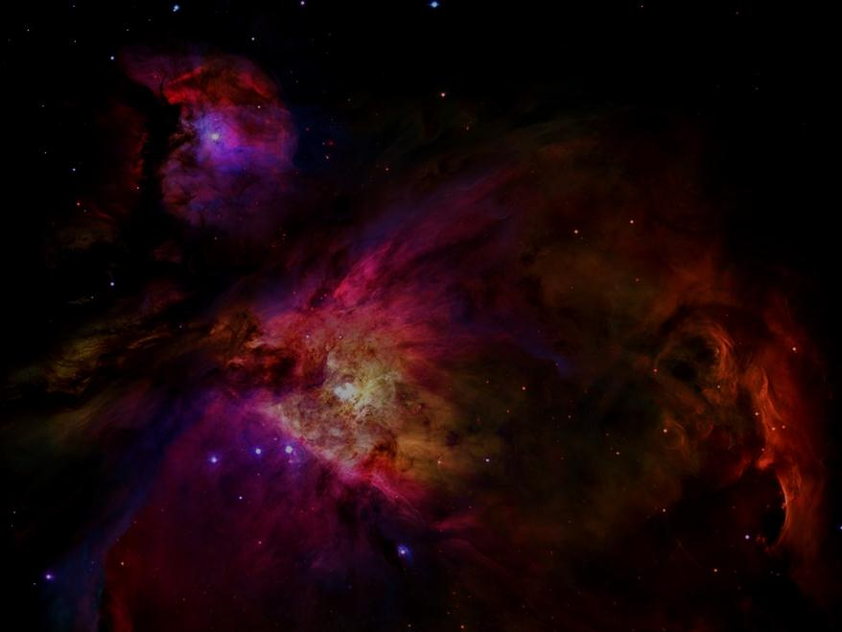
Identifying the Designer
Two Questions …
Is evidence for the Creator’s existence shrinking or growing?
Can we eliminate some or all alternate explanations?
NASA/Hubble Heritage Team STScI/AURA
Notes:
Now, our creation model is a biblical model.

Slide 22
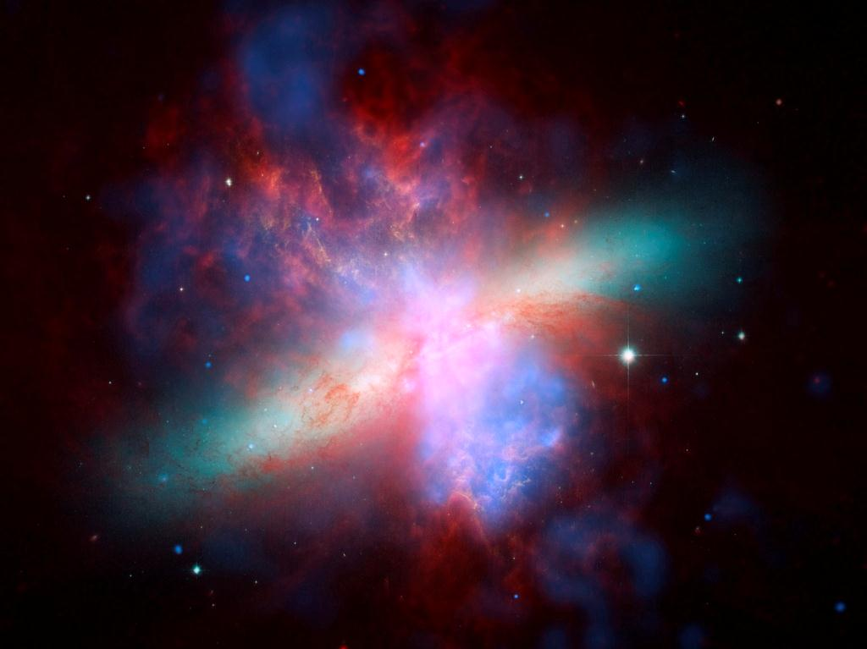
NASA//ESA/CXC/JPL-Caltech
Notes:
WAIT

Slide 23
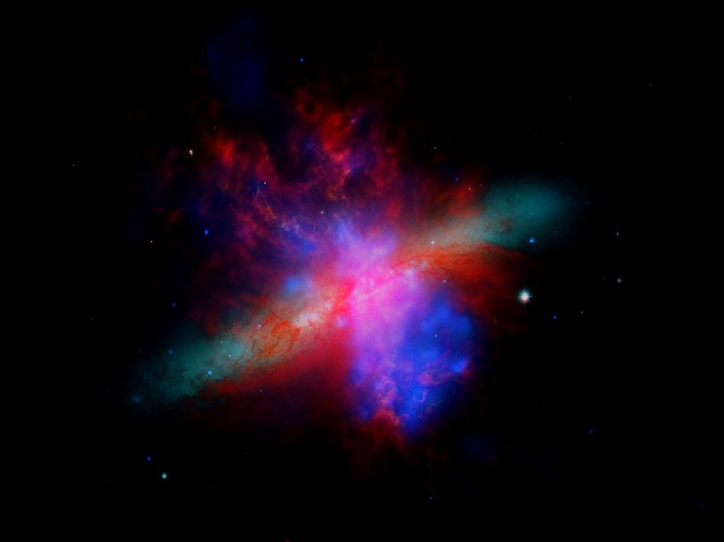

“There is a good deal of cosmology in the Bible. …It is a remarkable conception.”
- Sir Fred Hoyle
Nature of the Universe, p. 109
NASA//ESA/CXC/JPL-Caltech
Notes:
Indeed, the Bible has ten times as much content on cosmology than any other holy book.
Thus, we can build a detailed biblical cosmic model.

Slide 24
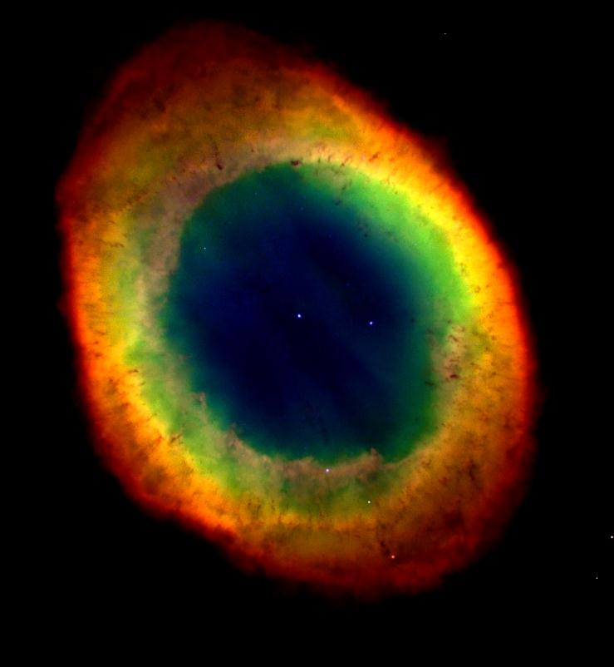
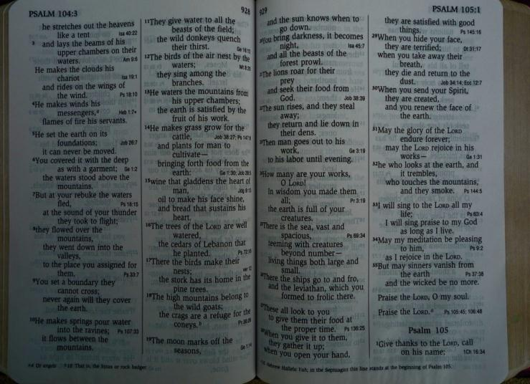

Biblical Cosmology
singularity beginning
fine-tuned expansion
constant physical laws
pervasive law of decay
NASA//Hubble Heritage Team (STScI/AURA)

Slide 25
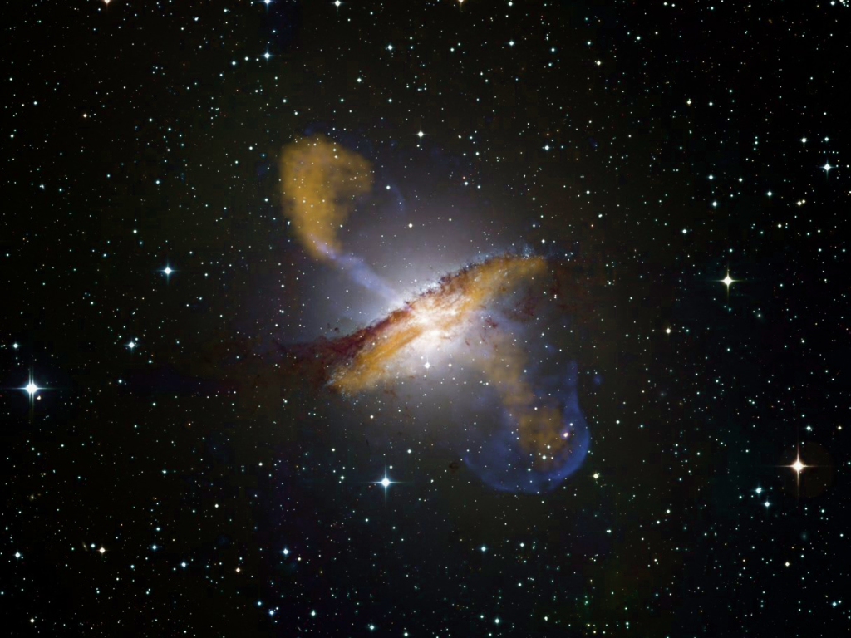
Singularity Beginning
Genesis 1:1
Isaiah 42:5
Genesis 2:3
Isaiah 45:18
Genesis 2:4
John 1:3
Psalm 148:5
Col. 1:15-17
Isaiah 40:26
Hebrews 11:3
Notes:
The universe was formed at God’s command.
It was not made out of what was visible.
Other Bible verses declare space and time were created when the universe began. Today, we can put these declarations to a scientific test.

Slide 26
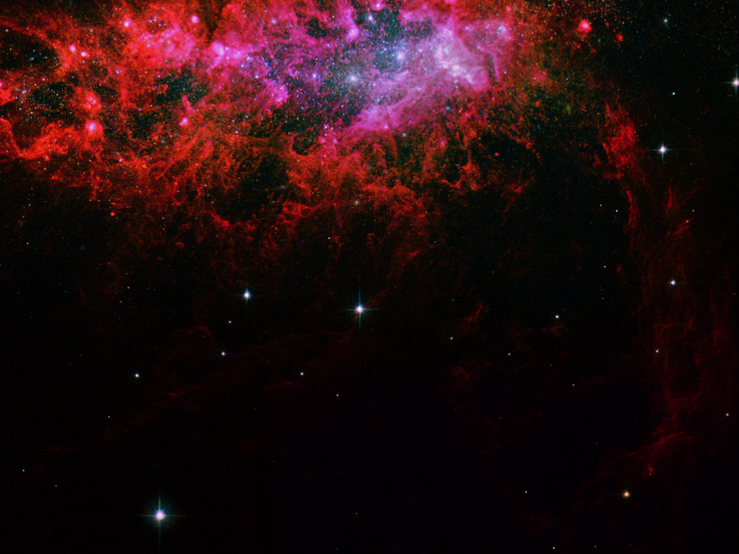
Space-Time Theorems
If mass exists and general relativity reliably predicts cosmic dynamics, then space and time must be created by a Causal Agent who transcends space and time.
NASA//ESA/Hubble Heritage (STScI/AURA)
Notes:
The Gods of religions not based on the Bible create within space and time.
The God of the Bible creates independent of space and time.
makes these the most theologically important theorems of all time

Slide 27
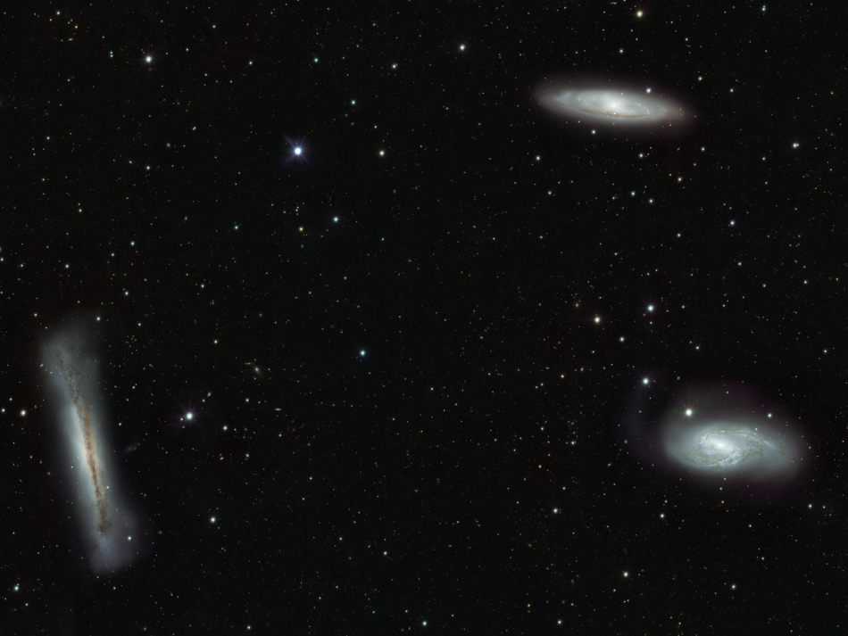
Space-Time Theorems
Any universe that expands (on average) has a beginning in the finite past and must be created by a transcendent causal Agent.
Borde, Vilenkin, Guth
NASA//ESA/Hubble Legacy Archive
Notes:
Today, we have an even more powerful space-time theorem.

Slide 28
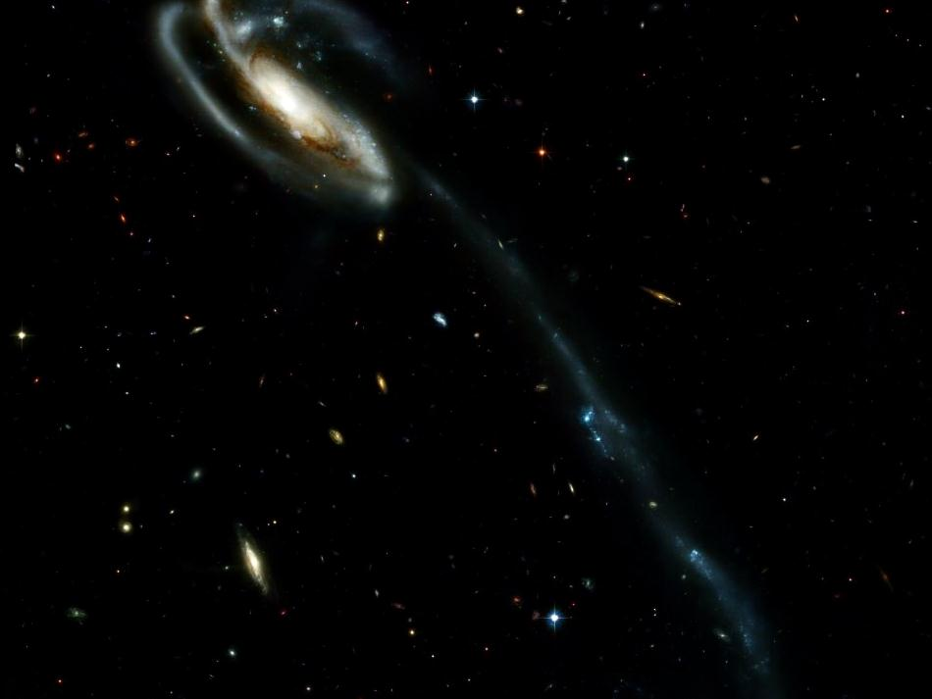

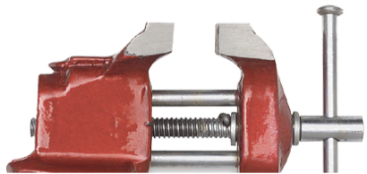
Space-Time Theorems
All reasonable expanding universe models are subject to the relentless grip of the spacetime theorems.
NASA

Slide 29
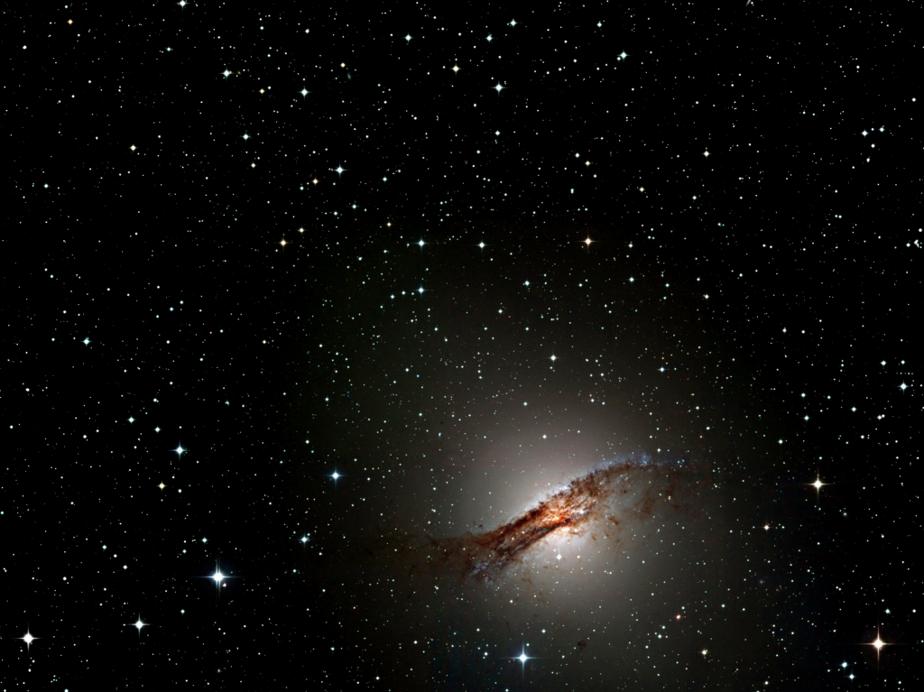
Scientists no longer can presume all causes are natural.
ESO

Slide 30
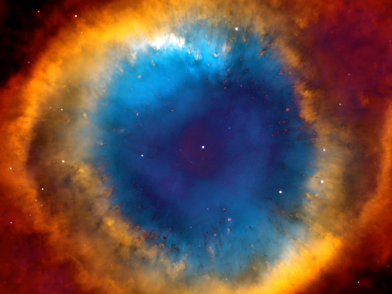
Stretching the Heavens
Job 9:8
Isaiah 45:12
Psalm 104:2
Isaiah 48:13
Isaiah 40:22
Isaiah 51:13
Isaiah 42:5
Jeremiah 10:12
Isaiah 44:24
Jeremiah 51:15
Zechariah 12:1
ESO
Notes:
natah
These texts use three different verb forms for natah. Therefore, they can’t be metaphorical. They must refer to a literal continual expansion of the universe.
No other science or theology book made this claim until the 20th century.

Slide 31


12 billion light years away
2 billion light years away
NASA//ESA/Hubble Heritage Team (STScI/AURA)
Notes:
12 billion years ago vs. 2 billion years ago

Slide 32
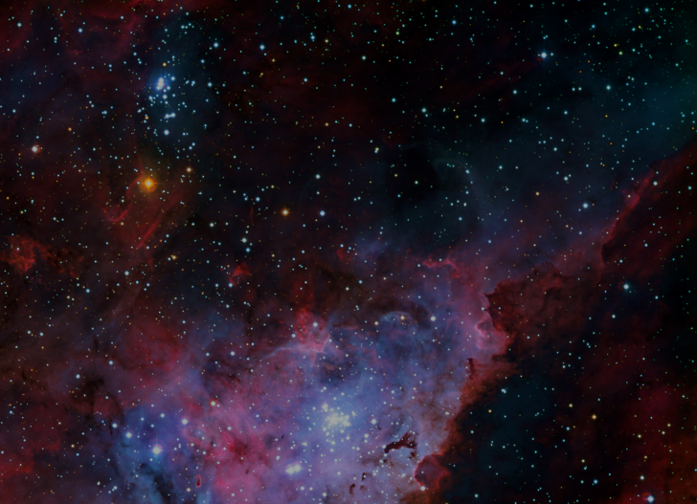
Jeremiah 33:25
I have established …the fixed laws of heaven and earth.
ESO

Slide 33
Romans 8:20-22
The whole creation groans … subject to its bondage to decay.
ESO

Slide 34
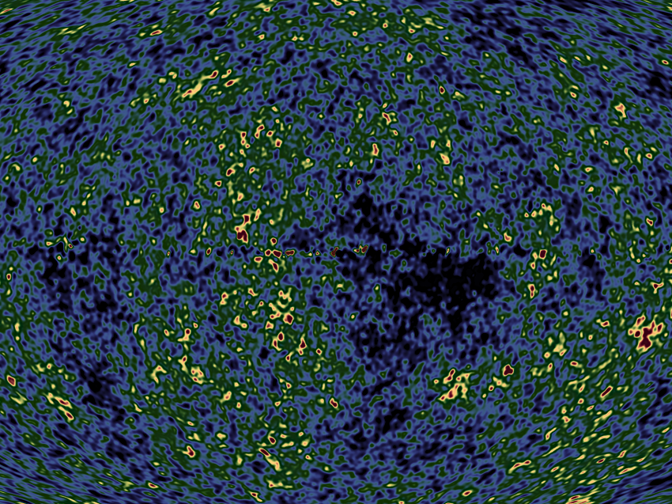
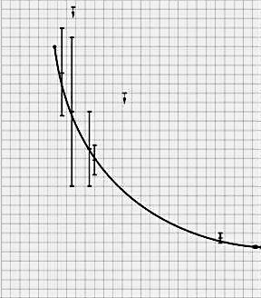
15
10
CMB temperature (°K)
5
0
0 2 4 6 8 10 12 13.7
billions of years after creation
NASA
Notes:
Actual temperature measurements fit the curve.
Now, let’s look at the physical features most responsible for cosmic expansion and cooling and see what they tell us about God.

Slide 35
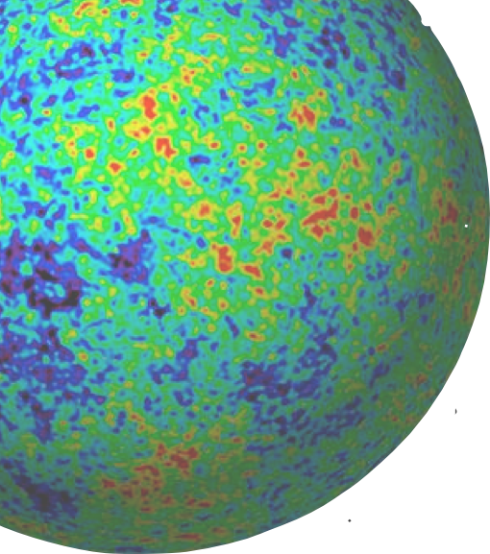
Dark Energy
NASA//WMAP
Notes:
72% of the universe’s stuff is dark energy.
Dark energy is the dominant factor governing cosmic expansion.
Cosmic expansion rates determine what kinds of stars and planets will form and at what time. Here lies the most spectacular evidence for supernatural design.

Slide 36
Dark Energy
Fine-tuning exceeds the best human design success (gravity wave telescopes) by 10⁹⁸ times.
NASA//WMAP

Slide 37
Dark Energy Quotes
“Arranging the universe as we think it is arranged would have required a miracle.”
- Dyson, Kleban, & Susskind
quoted by Phillip Ball, NatureNews 8/13/02
NASA//WMAP

Slide 38
Dark Energy Quotes
“An external agent [external to space and time] intervened in cosmic history for reasons of its own.”
- Dyson, Kleban, & Susskind
quoted by Phillip Ball, NatureNews 8/13/02
NASA//WMAP

Slide 39
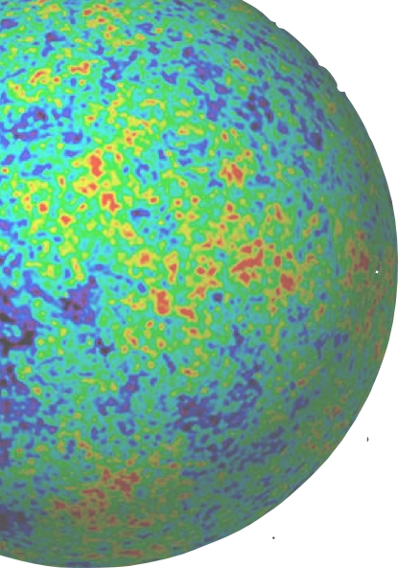
Dark Energy Quotes
“Perhaps the only reasonable conclusion is that we do not live in a world with a true cosmological constant.”
- Dyson, Kleban, & Susskind
Journal of High Energy Physics 10 (2002): 011
NASA//WMAP

Slide 40
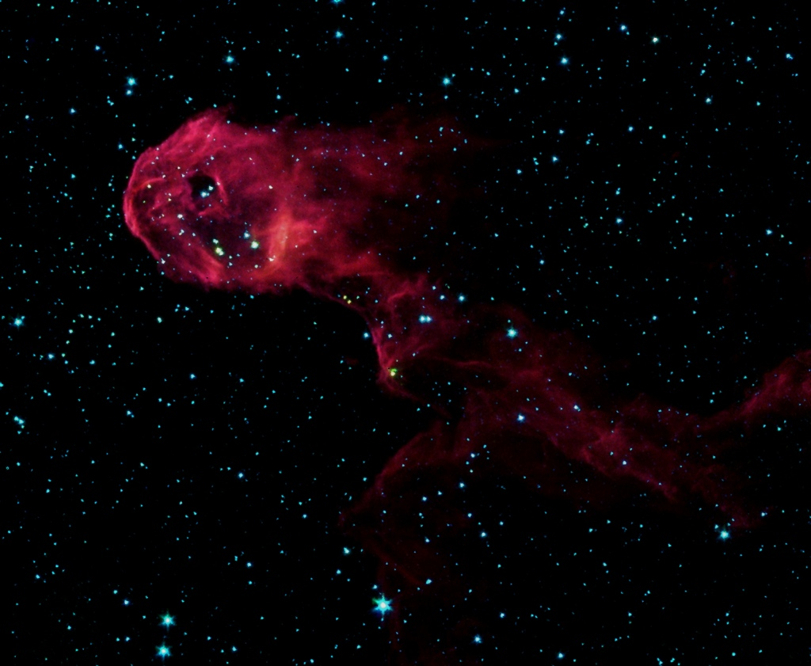
Dark Energy Confirmed
6. radio galaxy distributions
7. Sloan Digital Sky Survey
8. Two-Degree Field Survey
9. velocity distributions
1. galaxy cluster x-rays
2. WMAP of CMB
3. ground-based CMB
4. type Ia supernovae
5. gravitational lenses
www.reasons.org/articles/rtb-s-dark-energy-articles
NASA/JPL=Caltech
Notes:
Dark energy is not the only physical factor indicating supernatural design.

Slide 41
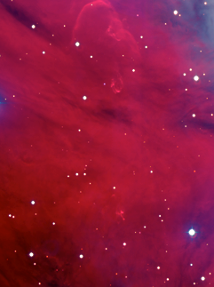
Cosmic Design for C-Life
6. proton-to-electron number ratio
7. electron-to-proton mass ratio
8. velocity of light
cosmic expansion rate
cosmic entropy level
1. gravitational force constant
2. strong nuclear force const.
3. weak nuclear force const.
4. electromagnetic force const.
5. e-m to grav. force ratio
ESO
Notes:
carbon-based life
If the design is supernatural, we would expect this list to grow as we learn more about the universe.

Slide 42
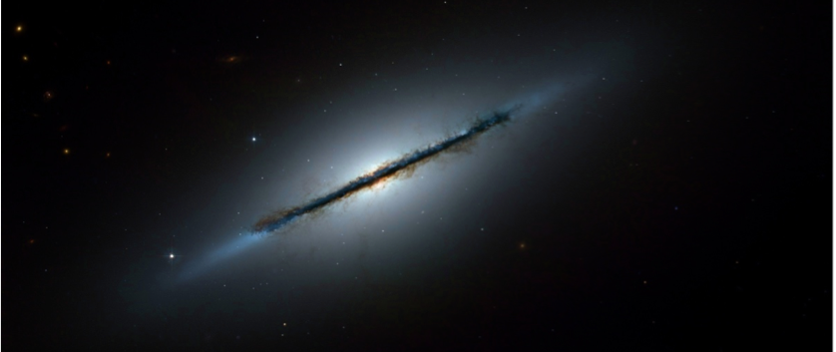
Cosmic Design for Life
date | # known features
1991 | 17
1995 | 26
2001 | 35
2004 | 86
2006 | 140..
2011 | 180 +
features/citations: reasons.org/fine-tuning for citations.
NASA//ESA/Hubble Heritage Team (STScI/AURA)/W. Keel, Univ. of Alabama, Tuscaloosa

Slide 43
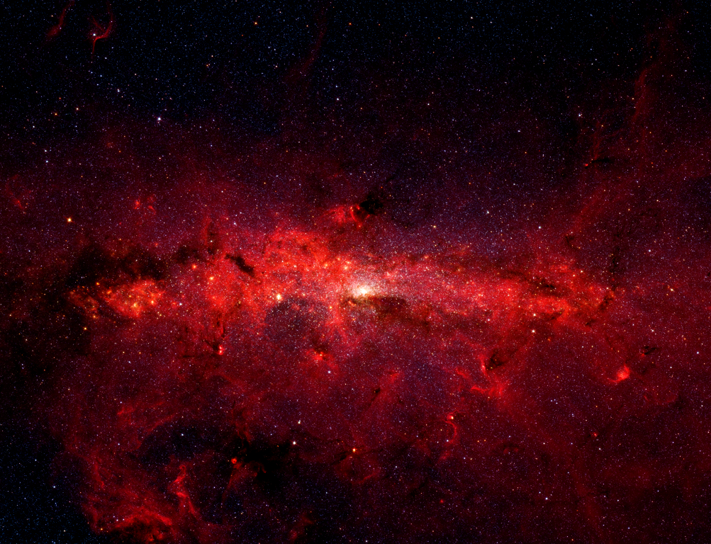
The heavens are the work of your hands.
—Hebrews 1:10
NASA/JPL-Caltech/S. Stolovy (SSC-Caltech)
Notes:
It’s not just at the largest scale size where we see design.

Slide 44
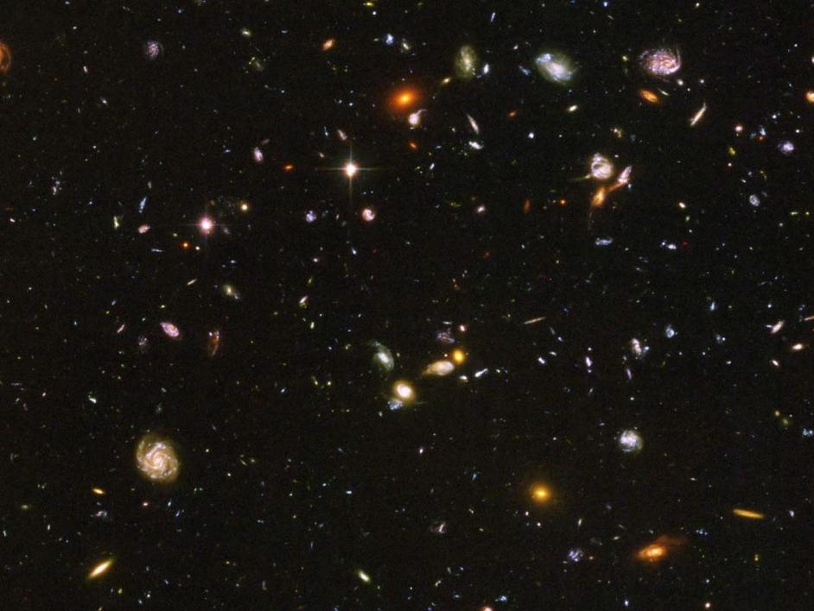
Heavenly Body Design
Just right universe
Just right galaxy cluster
Just right galaxy
Just right star
Just right Jupiter, Saturn
Just right Earth
Just right Moon
NASA/Hubble Heritage Team STScI/AURA

Slide 45
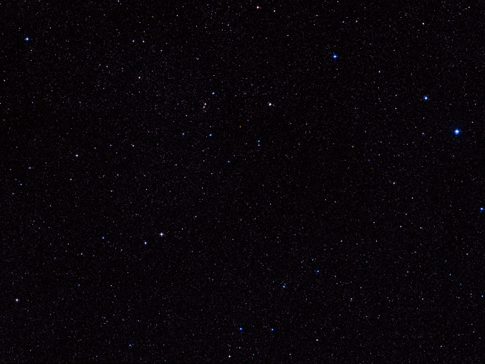
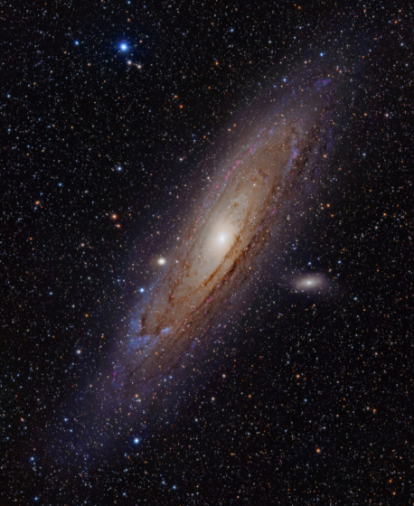


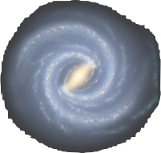
Heavenly Body Design
Just right universe
Just right galaxy cluster
Just right galaxy
Just right star
Just right Jupiter, Saturn
Just right Earth
Just right Moon
NASA

Slide 46
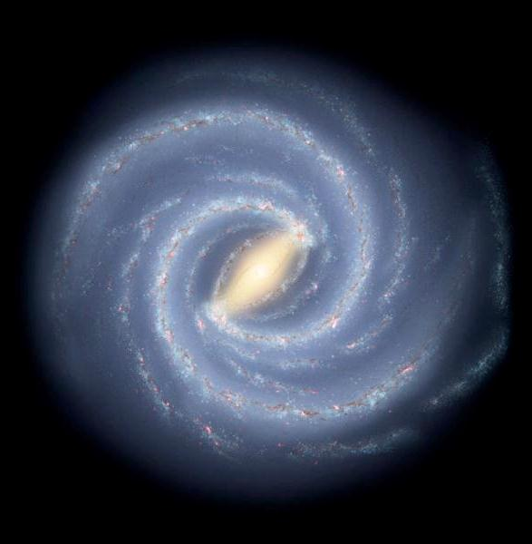
Heavenly Body Design
Just right universe
Just right galaxy cluster
Just right galaxy
Just right star
Just right Jupiter, Saturn
Just right Earth
Just right Moon
NASA/JPL-Caltech/R. Hurt (SSC-Caltech)

Slide 47
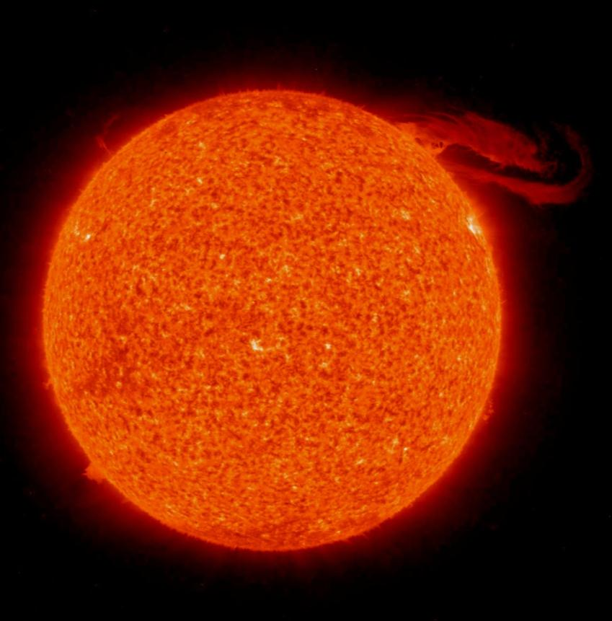
Heavenly Body Design
Just right universe
Just right galaxy cluster
Just right galaxy
Just right star
Just right Jupiter, Saturn
Just right Earth
Just right Moon
NASA

Slide 48
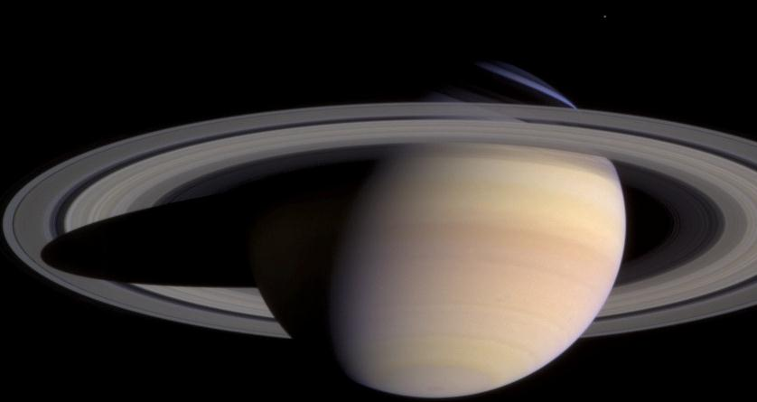
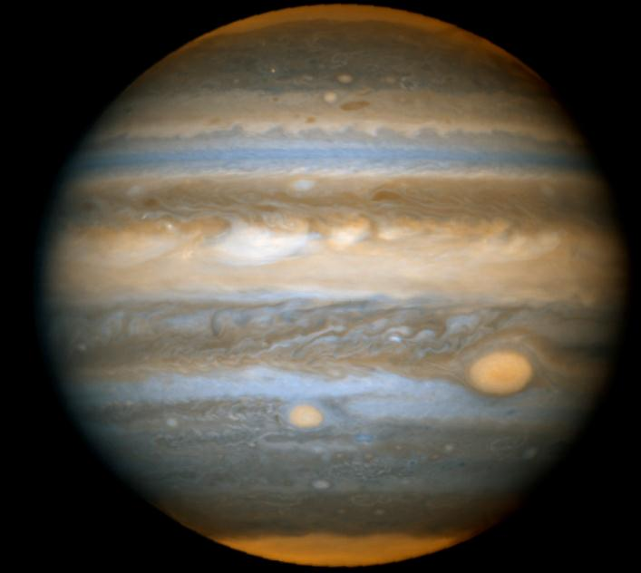
Heavenly Body Design
Just right universe
Just right galaxy cluster
Just right galaxy
Just right star
Just right Jupiter, Saturn
Just right Earth
Just right Moon
NASA
Notes:
WAIT

Slide 49
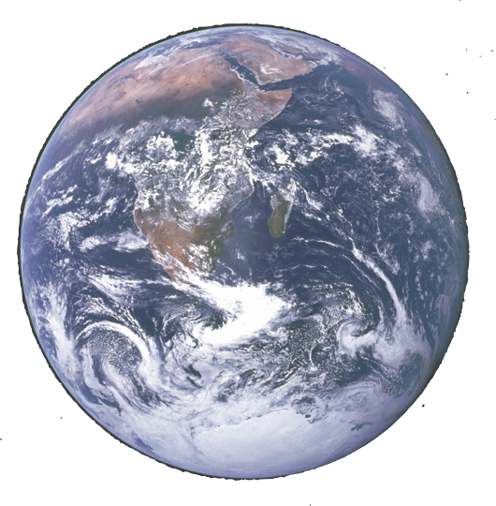
Heavenly Body Design
Just right universe
Just right galaxy cluster
Just right galaxy
Just right star
Just right Jupiter, et al
Just right Earth
Just right Moon
NASA

Slide 50

Heavenly Body Design
Just right universe
Just right galaxy cluster
Just right galaxy
Just right star
Just right Jupiter, et al
Just right Earth
Just right Moon
NASA

Slide 51
If no Creator …
Design evidences will decrease in strength & number.
Evidence for biblical God as Designer will get progressively weaker.
NASA//ESA/Hubble Heritage Team (STScI/AURA)

Slide 52
If Creator …
Design evidences will increase in strength & number.
Evidence for biblical God as Designer will get progressively stronger.
NASA//ESA/Hubble Heritage Team (STScI/AURA)

Slide 53


41 Design Features (as of Jan. 1995)
Accounting for dependency factors and max # of planets, probability was less than 1 in 10³¹ that one body would possess all 41 features with just-right values for life.
NASA
Notes:
… in a naturalistic model.

Slide 54
Planet Fine-Tuned for Life
date | # features | probability
1995 | 41 | 10⁻³¹
2000 | 128 | 10⁻¹⁴⁴
2002 | 202 | 10⁻²¹⁷
2004 | 322 | 10⁻²⁸²
2006 | 676 | 10⁻⁵⁵⁶
NASA
NASA
See reasons.org for features & citations.
Notes:
We can say to the skeptic, “If you’re not yet convinced, wait one month.”

Slide 55


“The more I examine the universe, … the more evidence I find that the universe in some sense must have known we were coming.”
Jacob Appelbaum
—Disturbing the Universe, p. 250
Freeman Dyson
NASA/ESA, Hubble Heritage Team (/STScI/AURA)

Slide 56
If no Creator …
Astronomers will find many systems capable of permitting advanced life like the Milky Way Galaxy, Sun, Moon, Earth, and Earth’s planetary partners.
NASA//ESA/Hubble Heritage Team (STScI/AURA)
Notes:
a risky prediction for atheists

Slide 57
If Creator …
The Milky Way Galaxy, Sun, Moon, Earth, and Earth’s planetary partners will prove to be unique in their capacity to permit advanced life.
NASA//ESA/Hubble Heritage Team (STScI/AURA)
Notes:
a risky prediction for Christians

Slide 58


Discovery of extrasolar planets “makes the coincidences of our planetary conditions …far less compelling evidence that the Earth was carefully designed just to please us humans.”
Stephen Hawking
—The Grand Design, p. 153
ESO
Notes:
Hawking himself through down the gauntlet.

Slide 59





 | candidates | # of twins
 | thousands
body
NASA
NASA//ESA/Hubble Heritage Team (STScI/AURA)

Slide 60
 | candidates | # of twins
 | thousands | 0
body
NASA
NASA//ESA/Hubble Heritage Team (STScI/AURA)

Slide 61
 | candidates | # of twins
 | thousands | 0
 | millions
body
NASA
NASA//ESA/Hubble Heritage Team (STScI/AURA)

Slide 62
 | candidates | # of twins
 | thousands | 0
 | millions | 0
body
NASA
NASA//ESA/Hubble Heritage Team (STScI/AURA)

Slide 63
 | candidates | # of twins
 | thousands | 0
 | millions | 0
 | 777
body
NASA
NASA//ESA/Hubble Heritage Team (STScI/AURA)

Slide 64
 | candidates | # of twins
 | thousands | 0
 | millions | 0
 | 777 | 0
body
NASA
NASA//ESA/Hubble Heritage Team (STScI/AURA)

Slide 65

Jupiter
m = 1.00 d = 5.20 AU e = 0.048
upsilon Andromedae e
m = 1.06+ d = 5.25 AU e = 0.005
NASA
Notes:
Upsilon Andromedae e is the only exoplanet that comes close to the characteristics of a solar system planet.

Slide 66
upsilon Andromedae c
m = 14.57+ d = 0.86 AU e = 0.24
upsilon Andromedae d
m = 10.19+ d = 2.55 AU e = 0.274
NASA
Notes:
ups And b: m = 0.69+; d = 0.59; e = 0.013
ups And A: 1.28 SM; 3.4 SL; 3.3 Gyr
ups And B: M4.5V at 750 AU away

Slide 67
 | candidates | # of twins
 | thousands | 0
 | millions | 0
 | 777 | 0
 | 178
body
NASA
NASA//ESA/Hubble Heritage Team (STScI/AURA)

Slide 68
 | candidates | # of twins
 | thousands | 0
 | millions | 0
 | 777 | 0
 | 178 | 0
body
NASA
NASA//ESA/Hubble Heritage Team (STScI/AURA)
Notes:
evidence so far

Slide 69


Origin of Physical Life
Rocky Mountain Laboratories, NAID, NIH
ESO

Slide 70


Life naturally arose in a vast sea of concentrated prebiotics percolating for nearly a billion years.
Carl Sagan
NASA/JPL, Hugh Ross

Slide 71


Life Origin Paradoxes
no time

Slide 72

















Late Heavy Bombardment
4.6 3.9 3.0
billions of years ago
NASA/ESO

Slide 73

Life Origin Paradoxes
no time
no soup
oxygen/uv crisis

Slide 74



Bacteria to Man?
Hugh Ross
Notes:
WAIT

Slide 75
Bacteria to Man?
probability = 10^{-1,000,000}
—Francisco Ayala
probability = 10^{-24,000,000}
—Barrow, Carter, Tipler
Hugh Ross

Slide 76


Causality Laws
Effects cannot be greater than their causes.
The created cannot be greater than the creator.

Slide 77


The living, personal, conscious, mindful, emotional, volitional, and spiritual cannot come from what is unconscious, impersonal, non-living, mindless, and unspiritual.

Slide 78



The Earth is the Lord’s, and everything in it.
—Psalm 24:1
NASA/ESA/Hubble Heritage (STScI/AURA)

Slide 79

God-of-the Gaps?
Gaps exist on both sides of the debate.
Gaps allow us to test different creation/evolution models.
Hugh Ross
Notes:
We’ll never know everything.

Slide 80
Nature-of-the Gaps?
Do naturalistic explanatory gaps get bigger or smaller, more or less problematic as scientists learn more?
Hugh Ross

Slide 81
Nature-of-the Gaps?
For the origins of the universe, Earth, life, and humanity and for cosmic fine-tuning the gaps are getting dramatically larger.
Hugh Ross

Slide 82

God’s sabbath (epoch of rest) explains why present-day science reveals only natural outcomes.
Hugh Ross
Notes:
WAIT for build.
NOTE: A scientist who only studies seventh-day data will never discover scientific evidence for God’s miraculous interventions in nature.

Slide 83


NASA/ESA/Hubble Heritage Team (STScI/AURA)
Notes:
RTB Live, volume 1

Slide 84


NASA/ESA/Hubble Heritage Team (STScI/AURA)

Slide 85


Do not use font size < 26 pt Stay within dark blue area
CCN Formatting
Hugh Ross

Slide 88

Genesis 1 Score
NASA/JPL=Caltech
Hugh Ross

Slide 89

Genesis 1 Score
With yôm = long time period and reference frame = Earth’s surface, science accuracy score is:
Initial Conditions: 4 for 4
Creation Events: 10 for 10
NASA/JPL=Caltech
Hugh Ross

