Slide 1

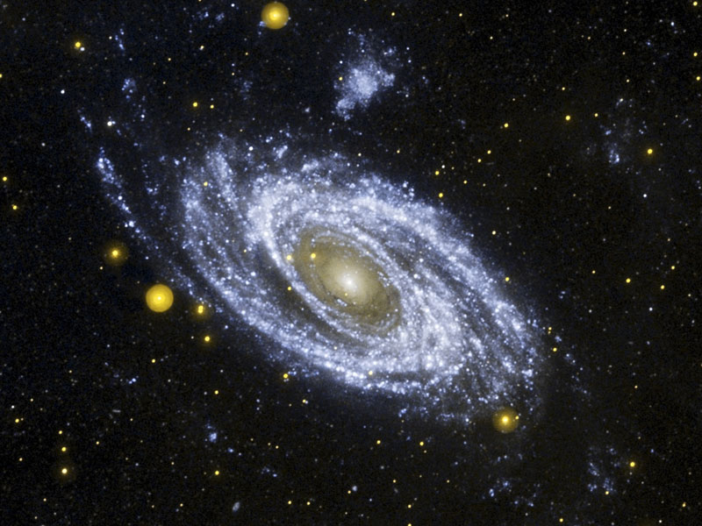
TWO DIVINE REVELATIONS
The Bible
The Record of Nature
  Written
    Specific
      Inerrant
        Literal
Emphasis on God’s love and salvation in Jesus Christ
Creation/nature
  More General
    Reveals truth
Declares God’s truth, justice, wisdom, righteousness, power

Slide 2
TWO DIVINE REVELATIONS
What the Bible says about Itself
Psalm 12:6 & Prov. 30:5 > ”…flawless.”
Psalm 19:7-8 & 119:160 > “…perfect… trustworthy…right…true.”
John 10:35 > “…cannot be broken.”

Slide 3
TWO DIVINE REVELATIONS
What the Bible says about the Record of Nature:
Psalm 19:1-4 > The heavens declare the glory of God; the skies proclaim the work of his hands. Day after day they pour forth speech, night after night they display knowledge. There is no speech or language where their voice is not heard. Their voice goes out into all the earth, their words to the ends of the world.

Slide 4
TWO DIVINE REVELATIONS
What the Bible says about the Record of Nature:
Job 12:7 -8 > Ask the animals, and they will teach you, or the birds of the air, and they will tell you; or speak to the earth, and it will teach you, or let the fish of the sea inform you.

Slide 5
TWO DIVINE REVELATIONS
What the Bible says about the Record of Nature:
Psalm 50:6 > Our God comes and will not be silent, And the heavens proclaim his righteousness.
Psalm 97:6 > The heavens proclaim his righteousness, and all the peoples see his glory.
Romans 1:20 > Because of the things which are seen [in nature, the created order] man is without excuse.

Slide 6
TWO DIVINE REVELATIONS
What the Bible says about the Record of Nature:
Some Young Earth Creationists (YEC) say fallen man cannot properly interpret (via science) a fallen creation in an attempt to avoid problems with the old age of the universe, etc. as revealed by science.
The previous Bible verses clearly disagree!

Slide 7
TWO DIVINE REVELATIONS
What the Bible says about the Record of Nature:
Thought for the Day: Of those who try to say truth cannot be obtained from a fallen nature by fallen man, how many of them go to the dentist, doctor, or fly on a plane or ride a car or work in a skyscraper, all of which critically depend on fallen men’s interpretation of the realities and laws of nature???

Slide 8
TWO DIVINE REVELATIONS
What the Bible says about the Record of Nature:
  Some YECs try to say the laws of nature have changed from before Adam’s fall compared to after.
  Jer. 33:25 says, “This is what the Lord says: ‘If I have not established my covenant with day and night and the fixed laws of heaven and earth, then I will reject the descendants of Jacob and David…”

Slide 9
TWO DIVINE REVELATIONS
What the Bible says about the Record of Nature:
  Jeremiah and other passages show that the laws of nature have been consistent since their creation. Therefore, they are the same from before Adam’s fall as compared to after.
  We also have photographs of the universe all the way back to less than 1% of its age showing the laws of nature have not changed.

Slide 10
TWO DIVINE REVELATIONS
What the Bible says about the Record of Nature:
  Romans 8: 20-21 states that creation has been subjected to decay by God himself
  This decay is scientifically known as the second law of thermodynamics.
  This does not have to refer to any kind of “fallen” state of nature. It is simply the way God created it.

Slide 11
TWO DIVINE REVELATIONS
What the Bible says about the Record of Nature:
  But rejoice! God in the next creation has something better in store for his children! A perfect “new heaven and earth.” The current one is “very good” (Gen. 1), but the next one will be “perfect.”
  This “very good” creation is intended to lead the righteous in Jesus Christ to a subsequent perfect creation.

Slide 12
TWO DIVINE REVELATIONS
What the Bible says about the Record of Nature:
  Without the second law of thermodynamics animals/man could not move, digest food, stars could not shine, etc. In short, life would be impossible without decay (i.e., the movement of heat from hot bodies to cold) under the laws of physics God has set up.

Slide 13
TWO DIVINE REVELATIONS
The Bible
Properly interpreted
Nature & Its Laws
Properly interpreted
WILL ALWAYS AGREE!
ALL TRUTH IS FROM GOD, REGARDLESS OF THE SOURCE
THEREFORE, TRUTH FROM THE BIBLE WILL AGREE WITH TRUTH FROM NATURE

Slide 14
So…
“Let us discern for ourselves what is right;
Let us learn together what is good (Job 34:4)
“Come now, let us reason together” (Isaiah 1:18)
“…Always be prepared to give an answer to everyone who asks you to give the reason for the hope that you have. But do this with gentleness and respect.” (I Peter 3:15)

Slide 15
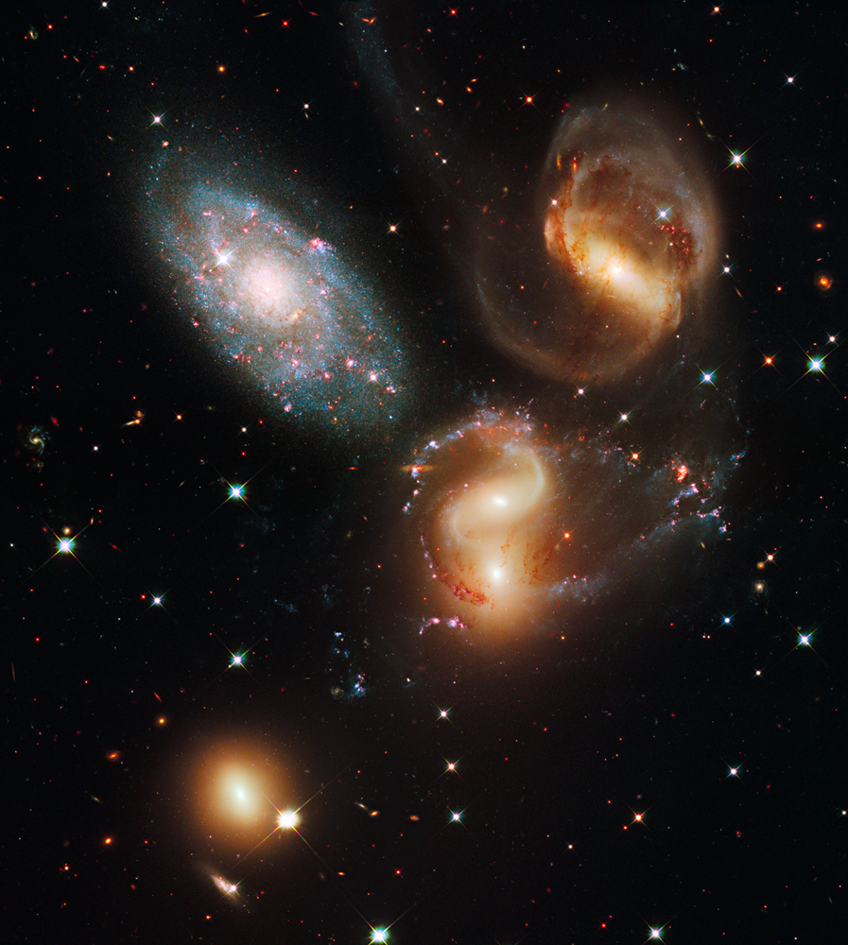
What is the Age of…
…the Universe and Earth?
.

Slide 16
AGE OF UNIVERSE & EARTH
The issue of the age of the universe and Earth inevitably comes up when discussing science and Genesis.
Therefore, the next section will deal with this topic before proceeding to a verse by verse study of Genesis 1.

Slide 17
AGE OF UNIVERSE & EARTH
BIBLE’S TEACHING
FACTS OF NATURE
Will analyze:
“Days” of Genesis
Day 3’s Plant Growth
Events of Day 6
Genesis 2’s “Day”
Oh, that seventh day!
Other Bible Passages
But what about…?
The universe’s age will be analyzed by:
Temperature of the cosmos
Existence of stars and galaxies
Age of stars
Radiometric abundances
Spreading of galaxies
Ice Cores
Time distance travel of light

Slide 18
ON THE ISSUE OF THE AGE OF THE UNIVERSE, A DETAILED DISCUSSION COULD EASILY TAKE A LARGE SIZE BOOK. SINCE THE MAIN EMPAHSIS OF THIS PRESENTATION IS TO SHOW HOW GENESIS 1 AND THE FACTS OF NATURE COMPARE, THE “SUB-ISSUE” OF THE AGE OF THE UNIVERSE AND EARTH WILL NECESSARILY BE MORE OF A SUMMARY.
A HIGHLY RECOMMENDED BOOK ON THE SUBJECT IS: A MATTER OF DAYS BY ASTROPHYSICIST/ORDAINED PASTOR, DR. HUGH ROSS (http://www.reasons.org).

Slide 19
AGE OF UNIVERSE & EARTH
WHAT DOES THE BIBLE SAY?
The “Days” of Genesis 1 & 2:
Hebrew word for “day” is “yom”
“Yom,” depending on the context, can refer to the following periods of time: 12 hrs., 24 hrs., daylight, or a longer, although limited, timeframe. Any Hebrew lexicon will support this. Context determines which is right.
Hebrew, at the time of Moses, did not have a word, other than “yom” for a finite period longer than 24 hrs. Therefore, for what we would call an “eon” or “age,” Hebrew only had the word “yom.”

Slide 20
AGE OF UNIVERSE & EARTH
WHAT DOES THE BIBLE SAY?
Context of Genesis 1 – 2 supports the “long, but finite period of time” interpretation because:
Gen. 1:11-13 (the Third “Day”): Then God said, “Let the land produce vegetation; seed-bearing plants and trees on the land that bear fruit with seed in it, according to their various kinds. And it was so. The land produced vegetation: plants bearing seed according to their kinds, and trees bearing fruit with seed in it according to their kinds…”

Slide 21
AGE OF UNIVERSE & EARTH
WHAT DOES THE BIBLE SAY?
Comment on Gen. 1:11-13:
  Text clearly states that plants and trees were bearing (on an on-going basis) seed and fruit, respectively. This takes longer than one 24-hr. period.
  Text in no way infers any kind of speeded-up supernatural growth after vegetation’s initial creation.

Slide 22
AGE OF UNIVERSE & EARTH
WHAT DOES THE BIBLE SAY?
Gen. 1:24-27; 2:15-23 – “Day 6’s Sequence:”
  God creates three types of land animals
  God creates man
  God plants a garden (Garden of Eden)
  God puts Adam into the Garden
  Adam takes care of the Garden
  Adam names the animals
  Adam gets lonely – wants a mate

Slide 23
AGE OF UNIVERSE & EARTH
WHAT DOES THE BIBLE SAY?
  “Day 6’s Sequence (cont.):”
  God creates Eve
  In v. 23 Adam says about Eve in Hebrew something like “At long last” (in English the literal translation is “This is now” but it’s meaning is better translated as “At long last” or “Finally!”).

Slide 24
AGE OF UNIVERSE & EARTH
WHAT DOES THE BIBLE SAY?
DOES THIS SOUND LIKE A
24 HR. DAY?
-OR-
SOMETHING LONGER?

Slide 25
AGE OF UNIVERSE & EARTH
WHAT DOES THE BIBLE SAY?
Gen. 2:4 > “This is the generations (account) of the day of creation.”
Comment on Gen. 2:4 > This is most likely referring back to the six creation days of Gen. Now, “one day” refers to six days. This illustrates the multiple uses of the word “day” in the Genesis context. The word “generations”/account never refers to 24 hrs.

Slide 26
AGE OF UNIVERSE & EARTH
WHAT DOES THE BIBLE SAY?
Oh, that Seventh Day!
  Heb. 4:1 – 11 (drawing from Ps. 95:11) > “For somewhere [God] has spoken about the seventh day in these words: ‘and on the seventh day God rested from all his work.’…It still remains that some will enter that rest for the people of God; …Let us, therefore, make every effort to enter that rest.”

Slide 27
AGE OF UNIVERSE & EARTH
WHAT DOES THE BIBLE SAY?
  John 5:16 – 18 > Jesus defends his “working” on the Sabbath with an illustration that the Father is working on his “Sabbath” or day of rest (from creation).
Comment: It is clear that God is still in his day of rest, which is the seventh day of Genesis 1. This seventh day is obviously much longer than a 24-hr. period.

Slide 28
AGE OF UNIVERSE & EARTH
WHAT DOES THE BIBLE SAY?
Comparison of God’s everlasting nature to the “everlasting” nature of creation:
  Ps. 90:2 > States that God was before the mountains, earth, and is from everlasting to everlasting
  Prov. 8:24 – 26 > Before there was the created order, Wisdom was present
  Eccl. 1:4, 7, 10 > The earth remains “forever”
  Micah 6:2 > the “everlasting” mountains

Slide 29
AGE OF UNIVERSE & EARTH
WHAT DOES THE BIBLE SAY?
Comment: God’s eternality is compared to the “eternality” of the created order. If the creation order were only about 3,000 - 3,500 years older (creation date of 4,004 BC according to some) than when these passages were written, comparing God’s everlasting nature to a 3,000 – 3,500 old universe would not mean very much! Methuselah lived 969 years!

Slide 30
AGE OF UNIVERSE & EARTH
WHAT DOES THE BIBLE SAY?
But What about proposed counter-arguments some may try from the Bible? They are as follows, with their rebuttal:
  Argument: A common sense interpretation of the word “Day” is 24 hrs. The simple explanation is the best.

Slide 31
AGE OF UNIVERSE & EARTH
WHAT DOES THE BIBLE SAY?
  Rebuttal: Actually, the common sense interpretation of the six “Days” in Genesis 1 and 2 shows a longer timeframe because of the details/context discussed earlier.

Slide 32
AGE OF UNIVERSE & EARTH
WHAT DOES THE BIBLE SAY?
    Second, there is NO rule of Hebrew grammar which supports the above contention of when an ordinal is used with “yom” that it equals 24 hrs.; quite the opposite.

Slide 33
AGE OF UNIVERSE & EARTH
WHAT DOES THE BIBLE SAY?
    Third, in Hosea 6:2, where ordinals are used, “day” refers to a longer period, perhaps up to a thousand years or more according to biblical scholars. Hosea 6:2 - “After two days (“yom”) he [God] will revive us [Israel]; on the third day (“yom”) he will restore us.”

Slide 34
AGE OF UNIVERSE & EARTH
WHAT DOES THE BIBLE SAY?
Argument: The use of “evening and morning” shows a 24 hr. period.
  Rebuttal: Hebrews used “evening to evening,” and sometimes “morning to morning” to denote a regular day.

Slide 35
AGE OF UNIVERSE & EARTH
WHAT DOES THE BIBLE SAY?
  Rebuttal:
  Also, in reference to hours, “evening and morning” was only a 12 hr. period!! That would make a “3.5” day creation week!
  Hebrews used “evening and morning” to denote the beginning of a period (evening - 6 PM by Jewish reckoning was the beginning of their day) and the completion or end (morning) of a period.

Slide 36
AGE OF UNIVERSE & EARTH
WHAT DOES THE BIBLE SAY?
Argument: Does not Exodus 20:9, 11 show the days of Genesis to be 24 hrs. since it says, “Six days you shall labor…, but the seventh day is a Sabbath..For in six days the Lord made the heavens and the earth…but he rested on the seventh day.”

Slide 37
AGE OF UNIVERSE & EARTH
WHAT DOES THE BIBLE SAY?
Rebuttal: Noted Hebrew scholar Gleason Archer states, “By no means does this [Exodus 20:9-11] demonstrate that 24-hour intervals were involved in the first six ‘days,’ any more than the eight-day celebration of the Feast of Tabernacles proves that the wilderness wanderings under Moses occupied only eight days.” (Gleason L. Archer, “A response to the Trustworthiness of Scripture in Areas Relating to Natural Science,” in Hermeneutics, Inerrancy, and the Bible, ed. Earl D. Radmacher and Robert D. Pteus (Grand Rapids, MI: Academic Books, 1986), p. 329)

Slide 38
AGE OF UNIVERSE & EARTH
WHAT DOES THE BIBLE SAY?
    It should also be pointed out:
    that the Ex. 20 reference is one of five that deals with keeping the Sabbath. In three of them no connection is drawn to the Genesis week.
    This argument only holds any influence if the Hebrew word “yom” for “day” is limited to a 24 hour period; it is not.

Slide 39
AGE OF UNIVERSE & EARTH
WHAT DOES THE BIBLE SAY?
    Lastly, in Leviticus 25:4 the “Sabbath” is a full year! So, the Sabbath can take on different meanings.

Slide 40
AGE OF UNIVERSE & EARTH
WHAT DOES THE BIBLE SAY?
Argument: If the universe and earth are billions of years old, then there would have to be animal death before Adam’s fall. That would contradict Rom. 5:21, and I Cor. 15:21 where it says death entered through the fall/sin of Adam.
Rebuttal: The above makes several wrong assumptions and constitutes bad biblical interpretation. First, quoting:

Slide 41
AGE OF UNIVERSE & EARTH
WHAT DOES THE BIBLE SAY?
  Rom. 5:12 > Therefore, just as sin entered the world through one man, and death through sin, and in this way death came to all men, because all sinned –
  I Cor. 15:21 > For since death came through a man, the resurrection of the dead comes also through a man. For as in Adam all die,…

Slide 42
AGE OF UNIVERSE & EARTH
WHAT DOES THE BIBLE SAY?
  Both passages are clear that sin entered mankind ONLY (“death came to all men”). Adam’s sin caused death ONLY to humans; animals are thereby excluded from these two verses. Animals do not sin. Sin is exclusively a human condition/problem.

Slide 43
AGE OF UNIVERSE & EARTH
WHAT DOES THE BIBLE SAY?
  Many contend God would never have planned the predator/prey situation as it is “horrible, bloody.”
  That perspective is a philosophically biased one, not supported by any biblical text.

Slide 44
AGE OF UNIVERSE & EARTH
WHAT DOES THE BIBLE SAY?
  God actually supplies the lions, etc. with their meat (Job 38:39-41). If predatory behavior were somehow wrong/sinful, the Bible would not have God taking part in such a process!

Slide 45
AGE OF UNIVERSE & EARTH
WHAT DOES THE BIBLE SAY?
  Gen. 1:29-30 God gives man and animals vegetation for food; does not preclude predatory behavior on the part of the animals since the text does NOT say that the “only” foods for animals are green plants.

Slide 46
AGE OF UNIVERSE & EARTH
WHAT DOES THE BIBLE SAY?
  Gen. 9:2-3 > after the flood, God also adds meat to man’s diet.
  Note this change of diet for man occurs a long time after the Fall of Adam, NOT at the time of the Fall. Therefore, meat-eating has nothing to do with the Fall or sin.

Slide 47
AGE OF UNIVERSE & EARTH
WHAT DOES THE BIBLE SAY?
  Man’s life spans before the Fall were in hundreds of years, wherein meat would have been detrimental to health. Life spans after the Flood steadily decreased.

Slide 48
AGE OF UNIVERSE & EARTH
WHAT DOES THE BIBLE SAY?
  Even if the creation week were six 24-hr. days, animal death was still an unavoidable reality:
    Plant death – Adam and Eve had to eat.
    Animal digestion involves bacteria death in the gut.

Slide 49
AGE OF UNIVERSE & EARTH
WHAT DOES THE BIBLE SAY?
    With every step taken, and every bite of food eaten, by larger animals, God would have to remove any and all insects/bacteria from harm’s way to prevent their deaths!

Slide 50
AGE OF UNIVERSE & EARTH
WHAT DOES THE BIBLE SAY?
    In Gen. 1 God told Adam, Eve, and the animals to reproduce. As we know, it takes millions of sperm in each “attempt” to make one new life. One gets the prize, and the other “unlucky” sperm all die. If there was no death before the Fall, then God had to keep all these little guys alive for EACH sexual act of each member of the millions of species.

Slide 51
AGE OF UNIVERSE & EARTH
WHAT DOES THE BIBLE SAY?
    Could God do that? Of course. However, what does your intuition say God actually did?
    Day 3 shows ongoing plant growth. To accomplish that, plant death is involved.

Slide 52
AGE OF UNIVERSE & EARTH
WHAT DOES THE BIBLE SAY?
    Some say the lower animals and plants are not “alive” in trying escape the above problems. The Bible uses the same word for man’s physical death as it does for them.
    Besides, to claim lower type animals and plants are not alive simply does not make sense, and contradicts every law of bio-physics God has set up.

Slide 53
AGE OF UNIVERSE & EARTH
WHAT DOES THE BIBLE SAY?
    If all the current carnivorous animals were suddenly changed from plant-eating to meat-eating at Adam’s Fall (young- creationists advocate this), God would have had to re-create their teeth (molars to incisors), their entire digestive tracts, etc.

Slide 54
AGE OF UNIVERSE & EARTH
WHAT DOES THE BIBLE SAY?
    This would contradict the biblical record that God has been at “rest” in terms of creation since the completion of the sixth day!
    Have we ever found any “plant-eating” version of any of the carnivores that existed since Adam’s Fall? For example, a T-Rex with molars???

Slide 55
AGE OF UNIVERSE & EARTH
WHAT DOES THE BIBLE SAY?
Of course not! Therefore, God created them with incisors from the beginning, and he would only do that if incisors were needed for meet-eating creatures; it would be a bad design for plant-eating only animals! God is not a bad Designer!

Slide 56
AGE OF UNIVERSE & EARTH
WHAT DO THE FACTS OF NATURE SAY?
All the facts of nature
consistently indicate a
multi-billion year universe.
Not one fact of nature
indicates to the contrary.

Slide 57
AGE OF UNIVERSE & EARTH
WHAT DO THE FACTS OF NATURE SAY?
Special thanks to Dr. Hugh Ross
for his excellent presentation/debate on Reasons to Believe’s DVD entitled “How Old is the Universe?”

Slide 58
AGE OF UNIVERSE & EARTH
WHAT DO THE FACTS OF NATURE SAY?
On that DVD Dr. Ross debated Dr. Faulkner, a Young Earth Creationist. A panel of 13 mutually agreed upon born again, evangelical astronomers (who are well-respected in their fields) listened to the two sides present their case.
The verdict was unanimously in favor of the evidence from Dr. Ross that is universe is billions of years old (13.7 billion years old).

Slide 59
AGE OF UNIVERSE & EARTH
WHAT DO THE FACTS OF NATURE SAY?
The presentation here on the scientific evidences for the old age of the universe is largely based on some of the information contained in the referenced DVD.
However, it has been somewhat reorganized and reformatted for this presentation. Also, the acronym utilized in the subsequent pages is this author’s creation.

Slide 60
AGE OF UNIVERSE & EARTH
WHAT DO THE FACTS OF NATURE SAY?
  The discussion here on the scientific evidences for the old age (billions of years) universe will be presented in two parts:
  Primary scientific arguments supporting an old universe
  Secondary considerations, dealing with further young creationists arguments. This discussion is in the Appendix.

Slide 61
AGE OF UNIVERSE & EARTH
WHAT DO THE FACTS OF NATURE SAY?
  The primary reasons will be presented by the acronym “Tears It” as in “That Tears It,” a highly technical term (!) or expression that means “a particular argument or position that effectively negates another argument(s).

Slide 62
AGE OF UNIVERSE & EARTH
WHAT DO THE FACTS OF NATURE SAY?
  In this context, the old universe arguments presented here effectively “tear” apart or negate the young universe position.
  No sarcasm or rude intent is meant by this acronym; it is only a “memory” device that is both indicative of what it is about and makes the subject matter easier to remember.

Slide 63
AGE OF UNIVERSE & EARTH
WHAT DO THE FACTS OF NATURE SAY?
  The evidences present here for an old universe are virtually free of any assumptions; they are based on solid empirical evidence.
  The following information clearly shows the age of the universe as being billions of years old:

Slide 64
AGE OF UNIVERSE & EARTH
WHAT DO THE FACTS OF NATURE SAY?
  Temperature of the cosmos
  Existence of stars and galaxies
  Age measurements of stars and galaxies
  Radiometric abundances in the cosmos
  Spreading apart of galaxies
  Ice cores
  Time and distance travel of light

Slide 65
AGE OF UNIVERSE & EARTH
WHAT DO THE FACTS OF NATURE SAY?
  Temperature of the Cosmos
  Given :
  an explosion from a central point
  with continual expansion outward
  at a relatively consistent rate
  with known original temperatures and mass involved...

Slide 66
AGE OF UNIVERSE & EARTH
WHAT DO THE FACTS OF NATURE SAY?
  Temperature of the Cosmos
  The temperature can be relatively simply to calculate at any given time in the past after the initial event (explosion).

Slide 67
AGE OF UNIVERSE & EARTH
WHAT DO THE FACTS OF NATURE SAY?
  Temperature of the Cosmos
  All these conditions are clearly known about the Big Bang and its subsequent expansion.
  Measuring the temperatures of the universe at different distances (times), only a multi-billion year universe is consistent with the actual temperatures measured.

Slide 68
AGE OF UNIVERSE & EARTH
WHAT DO THE FACTS OF NATURE SAY?
  Temperature of the Cosmos
  All these conditions are clearly known about the Big Bang and its subsequent expansion.
  Measuring the temperatures of the universe at different distances (times), only a multi-billion year universe is consistent with the actual temperatures measured.

Slide 69
AGE OF UNIVERSE & EARTH
WHAT DO THE FACTS OF NATURE SAY?
  Temperature of the Cosmos
  NASA’s COBE instrument in the 1990s measured the universe’s background radiation today at 2.725 degrees Kelvin (or -454.495 degrees Fahrenheit). That low of a temperature (almost absolute zero) could not be reached if the universe were only 6-10,000 years old (too soon after the initial creation event).

Slide 70
AGE OF UNIVERSE & EARTH
WHAT DO THE FACTS OF NATURE SAY?
  Temperature of the Cosmos
  In fact, that temperature was actually predicted by the physics of the Big Bang before its actual measurement!
  Since the COBE instrument’s measurements, several more have been taken by other means which have verified the original measurement.

Slide 71
AGE OF UNIVERSE & EARTH
WHAT DO THE FACTS OF NATURE SAY?
  Existence of Stars and Galaxies
  Since the universe began from a central point (singularity), and since we know its observable size, the following can firmly be said about the speed of expansion and its age:

Slide 72
AGE OF UNIVERSE & EARTH
WHAT DO THE FACTS OF NATURE SAY?
  Existence of Stars and Galaxies
  If the universe were less than 1 million years old, the expansion rate to get to its present size would have to be so fast that all the universe would be only 100% diffuse gas as gravity would have relative little effect on bringing together atoms and molecules.

Slide 73
AGE OF UNIVERSE & EARTH
WHAT DO THE FACTS OF NATURE SAY?
  Existence of Stars and Galaxies
  If the universe were older than one quadrillion years old, the expansion rate would be so slow that the universe would be 100% neutron stars and black holes, as gravity’s attraction would be “overpowering” in relation to the expansion rate; it would attract matter too much.

Slide 74
AGE OF UNIVERSE & EARTH
WHAT DO THE FACTS OF NATURE SAY?
  Existence of Stars and Galaxies
  Consequently, since we have stars and galaxies, the age of the universe must be at least one million years old, and no more than one quadrillion years old.

Slide 75
AGE OF UNIVERSE & EARTH
WHAT DO THE FACTS OF NATURE SAY?
  Age of Stars and Galaxies
  There are many ways to date the age of stars and galaxies. All of them indicate a universe of about 13.7 billion years old.

Slide 76
AGE OF UNIVERSE & EARTH
WHAT DO THE FACTS OF NATURE SAY?
Age of Stars and Galaxies
Photographs of Star Explosions:
  Have photos of stars going nova/supernova that are billions of light years away.
  As pointed out later (under “T” for time and travel distance for light), it would take the light of those explosions billions of years to reach us.

Slide 77
AGE OF UNIVERSE & EARTH
WHAT DO THE FACTS OF NATURE SAY?
  Age of Stars and Galaxies
  Second, it takes small to medium size stars (like our sun) billions of years to go nova/supernova (it is a very simple process, well understood)
  Huge stars take millions of years before going into their supernova stage.

Slide 78
AGE OF UNIVERSE & EARTH
WHAT DO THE FACTS OF NATURE SAY?
  Age of Stars and Galaxies
  If the universe were only 6 – 10,000 years old:
    The stars could not have reached the end of their lives after the biblical creation week and gone nova/supernova…

Slide 79
AGE OF UNIVERSE & EARTH
WHAT DO THE FACTS OF NATURE SAY?
  Age of Stars and Galaxies
    And after that, the light of the explosion of these stars billions of light years distance could never have reached earth (it would take billions of years).

Slide 80
AGE OF UNIVERSE & EARTH
WHAT DO THE FACTS OF NATURE SAY?
  Age of Stars and Galaxies
  The age of stars can be determined with proven, well-known gas laws, gravitational laws, thermodynamics and nuclear physics – all laws which God has established.

Slide 81
AGE OF UNIVERSE & EARTH
WHAT DO THE FACTS OF NATURE SAY?
  Age of Stars and Galaxies
  Early Burning Stages of Stars:
  Stars are unstable in their infancy for about a couple of hundred million years before they assume a stable burning cycle.
  Most stars are now in stable burning cycles.

Slide 82
AGE OF UNIVERSE & EARTH
WHAT DO THE FACTS OF NATURE SAY?
  Age of Stars and Galaxies
  Therefore, a young universe is impossible.
  God would not artificially speed up the early burning cycles – what reason would there be to do that? (plus it would give false data).

Slide 83
AGE OF UNIVERSE & EARTH
WHAT DO THE FACTS OF NATURE SAY?
  Age of Stars and Galaxies
  Have photographs of many stars now & in the past, in their infancy, undergoing unstable phases… why would God speed some up and not others? The photographic evidence shows he never did this.

Slide 84
AGE OF UNIVERSE & EARTH
WHAT DO THE FACTS OF NATURE SAY?
  Age of Stars and Galaxies
  Life-Cycle of Stars:
  Life-cycle of stars is typically billions of years, and their formation is more simple than rain drop formation: simple conversion of hydrogen into helium. At the end of a star’s life its fuel is expended, it explodes (nova/supernova). We know all about nuclear fusion.

Slide 85
AGE OF UNIVERSE & EARTH
WHAT DO THE FACTS OF NATURE SAY?
  Age of Stars and Galaxies
  Photos of exploding stars over the last several billions of years of the history of the universe proves it cannot be a young cosmos.
  Photos of stars at all the various stages of their lives over the past history of the universe show it cannot be a young cosmos.

Slide 86
AGE OF UNIVERSE & EARTH
WHAT DO THE FACTS OF NATURE SAY?
  Age of Stars and Galaxies
  Supernova Remnants:
  When a star goes nova/supernovae, the debris flies outward into space.
  Speed of exploding debris has known limits.

Slide 87
AGE OF UNIVERSE & EARTH
WHAT DO THE FACTS OF NATURE SAY?
  Age of Stars and Galaxies
  The fact that we photographic evidence of the debris or remnants of stars millions of years of travel time from the star from which the explosion occurred proves a young universe is impossible!

Slide 88
AGE OF UNIVERSE & EARTH
WHAT DO THE FACTS OF NATURE SAY?
  Age of Stars and Galaxies
  These remnants are hard to find, and their old age affects that, as the further out the remnants spread, the more diffuse they become, blending into the cosmic background. Need low density, low metallicity environments, such as the outer portion of galaxies, dwarf galaxies or low surface brightness galaxies.

Slide 89
AGE OF UNIVERSE & EARTH
WHAT DO THE FACTS OF NATURE SAY?
  Age of Stars and Galaxies
  According to M. Still & J. Irwin in the Astrophysical Journal 563 (2001): 816, Remnant GSH 138-01-94 in our galaxy’s outer edge, a remnant has been found with an expansion age of 4.3 million years.
  Many others found in millions of years travel time.

Slide 90
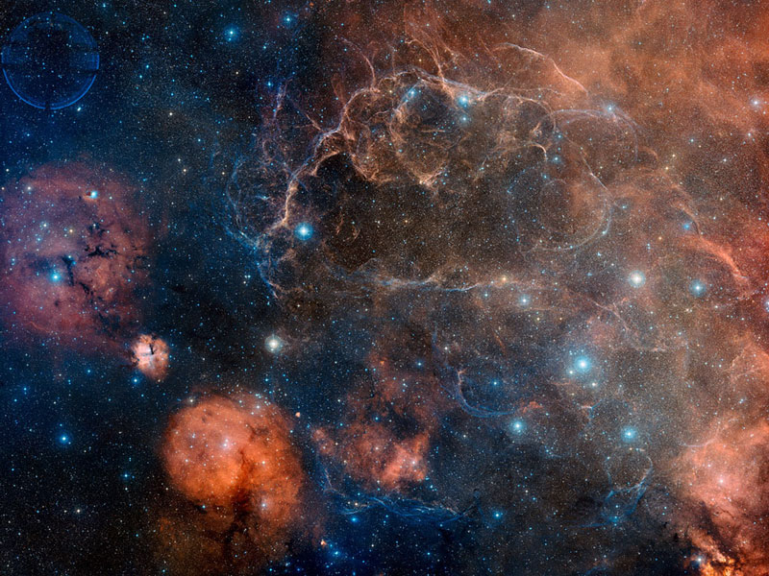
Vela Supernova Remnant
Credit-Digitized Sky Survey, ESA, ESO, NASA, FITS Liberator; Color Composite-David De Martin (Skyfactory)

Slide 91
AGE OF UNIVERSE & EARTH
WHAT DO THE FACTS OF NATURE SAY?
  Radiometric Abundancies
Various radiometric elements (such as neptunium, uranium, etc.) have various “half-lives” or longevities.
For example, neptunium-237 has a half life of 2.144 million years. Uranium has a half-life of 4.47 billion years.

Slide 92
AGE OF UNIVERSE & EARTH
WHAT DO THE FACTS OF NATURE SAY?
  Radiometric Abundancies
Therefore, if the universe/earth were only 6 – 10,000 years old we should see an abundance of all the various radiometric elements, including neptunium, plutonium, and technetium. Even if the cosmos were 100,000,000 years or less, there would be a lot of various “shorter-lived” radiometric elements.

Slide 93
AGE OF UNIVERSE & EARTH
WHAT DO THE FACTS OF NATURE SAY?
  Radiometric Abundancies
- - - But what do we see? - - -
We only see neptunium, plutonium, and technetium existing in a few young stars, which is expected.
In mature stars, including our sun and earth, these radiometric elements do not exist; they have been depleted. However, uranium and thorium exist.

Slide 94
AGE OF UNIVERSE & EARTH
WHAT DO THE FACTS OF NATURE SAY?
  Radiometric Abundancies
This is exactly what we would see with a multi-billion year universe.
It is exactly what we COULD NOT SEE if the universe were only 6 – 10,000 years.

Slide 95
AGE OF UNIVERSE & EARTH
WHAT DO THE FACTS OF NATURE SAY?
  Radiometric Abundancies
Some young universe proponents have suggested that the rates of radiometric decay have changed in the past.
However, photographic evidence covering 99% of the past history of the universe shows these decay rates have been constant.

Slide 96
AGE OF UNIVERSE & EARTH
WHAT DO THE FACTS OF NATURE SAY?
  Radiometric Abundancies
In addition, the “daughters” of plutonium on earth, called ¹³⁶Xe/ ¹³¹Xe ratios show that the past decay rates have not been faster.
Lastly, refer to the “T” below, wherein it is shown that the speed of light has not changed.

Slide 97
AGE OF UNIVERSE & EARTH
WHAT DO THE FACTS OF NATURE SAY?
  Spreading Out (Rate) of Galaxies
The spreading out of the cosmos, or the expansion rate, is extremely fine tuned.
In fact, just after the Big Bang it was finely tuned to one part out of 10⁵⁷, otherwise there would be no earth-like planet ever.

Slide 98
AGE OF UNIVERSE & EARTH
WHAT DO THE FACTS OF NATURE SAY?
  Spreading Out (Rate) of Galaxies
That precision of design is like saying that if you took all the grains of sands on all the beaches of earth (~10²³), and multiplied them by 1 trillion, 1 trillion, by 10 billion times, and marked one of the grains of sand and then mixed them all up and then dived down blindfolded and found that marked grain on the first try!!!!!

Slide 99
AGE OF UNIVERSE & EARTH
WHAT DO THE FACTS OF NATURE SAY?
  Spreading Out (Rate) of Galaxies
We know what the expansion rate is and has been throughout cosmic history. There is actual photographic evidence for it.
For it to expand to its current size at the known rate it would be impossible in a 6 – 10,000 year universe, but only in a 13.7 billion year universe.

Slide 100
AGE OF UNIVERSE & EARTH
WHAT DO THE FACTS OF NATURE SAY?
  Ice Cores
Evidence from 3 ice cores in Northern Greenland and 3 in Central Antarctica demonstrate the earth cannot be only 6 – 10,000 years old.
These ice cores have annual layers, like tree rings.

Slide 101
AGE OF UNIVERSE & EARTH
WHAT DO THE FACTS OF NATURE SAY?
  Ice Cores
For example, the oldest of the six in central Antarctica is 800,000 years old as it has 800,000 layers (the “Dome C” site).

Slide 102
AGE OF UNIVERSE & EARTH
WHAT DO THE FACTS OF NATURE SAY?
  Ice Cores
There is conclusive evidence these layers are annual as we can count the number of layers back to known historic volcanic eruptions of Krakatau in 1887 and Vesuvius in 79 A.D., and the number of layers corresponds to the exact number of years back to those events (the two layers have debris from those eruptions).

Slide 103
AGE OF UNIVERSE & EARTH
WHAT DO THE FACTS OF NATURE SAY?
  Ice Cores
All six ice cores are over 100,000 years old.
Further, the oldest one shows 8 cycles of the 100,000 year orbital eccentricity patterns of the earth’s revolutions around the sun.
The annual sediment cores (not ice cores) off the coast of New Zealand show over one million years.

Slide 104
AGE OF UNIVERSE & EARTH
WHAT DO THE FACTS OF NATURE SAY?
  Time & Distance for Light Travel
  Light travels at 186,300 miles per second, or about an equivalent of 7.5 times around the earth/sec.
Nobody really contends the distances of the various stars and galaxies we see in the universe; galaxies are as far away as almost 13 billion light years.

Slide 105
AGE OF UNIVERSE & EARTH
WHAT DO THE FACTS OF NATURE SAY?
  Time & Distance for Light Travel
  Light from the sun takes 8 minutes to reach earth. So, we are seeing the sun as it existed 8 minutes ago.
Similarly, when we see the Andromeda Galaxy, which is 2 million light years away, we are seeing the light which came from it 2 million years ago.

Slide 106
AGE OF UNIVERSE & EARTH
WHAT DO THE FACTS OF NATURE SAY?
  Time & Distance for Light Travel
  If the universe were only 6 – 10,000 years old, we could not see the light from objects that are beyond 6 – 10,000 light years distant.
  Since we do see light from objects many millions and billions of light years away, the universe cannot be only 6 – 10,000 years old.

Slide 107
AGE OF UNIVERSE & EARTH
WHAT DO THE FACTS OF NATURE SAY?
  Time & Distance for Light Travel
  Some young universe proponents, realizing this as a major problem, try to offer various explanations to circumvent the problem. The top three follow, with their rebuttals (note all the proposed explanations can be fully rebuttalled):

Slide 108
AGE OF UNIVERSE & EARTH
WHAT DO THE FACTS OF NATURE SAY?
  Time & Distance for Light Travel
  First explanation is that God created the beams of light fully in transit, fully matured from one “end” (origin of) to the other (the end point, in this case earth).

Slide 109
AGE OF UNIVERSE & EARTH
WHAT DO THE FACTS OF NATURE SAY?
  Time & Distance for Light Travel
  This would have God creating false images of age, and therefore would be guilty of fraud as:
    The light’s spectral lines broaden and become more red the further the light travels per the laws of physics God set up.
    The light we see shows it has traveled great distances due to its spectral lines and red shift, caused by it traveling through gas clouds.

Slide 110
AGE OF UNIVERSE & EARTH
WHAT DO THE FACTS OF NATURE SAY?
  Time & Distance for Light Travel
    So, if God really created the beams of light fully intact which also contain the indicators of billions of years of travel, that would be fraudalent!
    The Bible says, as shown earlier, that God’s creation shows God’s truth, righteousness, and glory; it does not indicate fraud!

Slide 111
AGE OF UNIVERSE & EARTH
WHAT DO THE FACTS OF NATURE SAY?
  Time & Distance for Light Travel
  No wonder many young earth creationists are giving up this line of reasoning that God artificially created beams of light that would wrongly indicate age!

Slide 112
AGE OF UNIVERSE & EARTH
WHAT DO THE FACTS OF NATURE SAY?
  Time & Distance for Light Travel
    The next explanation offered to try to explain away the light distance problem, is that “maybe the speed of light changed.”
    First, we have photographic evidence of the universe from the present back to less than .002% of its current age! If the speed of light changed, we would have concrete evidence of it. All evidence shows no change in light’s speed.

Slide 113
AGE OF UNIVERSE & EARTH
WHAT DO THE FACTS OF NATURE SAY?
  Time & Distance for Light Travel
    Second, nobody disputes Einstein’s equation of E = mc² in his General Theory of Relativity. It is solid, and has never been shown to be wrong.
    E = energy; m = mass; c = speed of light. Without getting into too much detail, any change in the speed of light (“c”) drastically affects the energy (“E”) and mass (“m”) of the universe.

Slide 114
AGE OF UNIVERSE & EARTH
WHAT DO THE FACTS OF NATURE SAY?
  Time & Distance for Light Travel
    So, taking the explanation that the speed of light has changed, Adam and Eve would be burned to a cinder by the energy of the sun!

Slide 115
AGE OF UNIVERSE & EARTH
WHAT DO THE FACTS OF NATURE SAY?
  Time & Distance for Light Travel
    This “speed of light changed theory” uses false conclusions by some from measurements made by Olaus Romer in 1675 along with its subsequent refinements by an Australian amateur scientist Barry Setterfield in 1973.

Slide 116
AGE OF UNIVERSE & EARTH
WHAT DO THE FACTS OF NATURE SAY?
  Time & Distance for Light Travel
    Romer measured the speed of light with the results showing a 3% greater speed than today’s measurements.
    However, his error bar was GREATER than 3%! So, no problem!

Slide 117
AGE OF UNIVERSE & EARTH
WHAT DO THE FACTS OF NATURE SAY?
  Time & Distance for Light Travel
    Correcting for one inaccurate part of Romer’s calculations, he would have had a figure that was within 0.5 % of today’s measurements.
    Setterfield, a young earth creationist who promotes the change of light’s speed, apparently misunderstood the 0.5% figure as a 0.5% reduction in light’s speed since 1675!

Slide 118
AGE OF UNIVERSE & EARTH
WHAT DO THE FACTS OF NATURE SAY?
  Time & Distance for Light Travel
    However, this was clearly not the case (it is just a matter of refining subsequent measurements and their accuracies).
    Since Romer’s day, 50 measurements of the speed of light have been conducted, with all of them showing its speed as constant since 1675!

Slide 119
AGE OF UNIVERSE & EARTH
WHAT DO THE FACTS OF NATURE SAY?
  Time & Distance for Light Travel
  The last explanation offered to try to explain the light-distance problem is that “maybe the ‘clocks’ of distant space were different than on earth.” It is suggested they were a million times slower. This has been popularized by an individual named “Russell Humphry.”

Slide 120
AGE OF UNIVERSE & EARTH
WHAT DO THE FACTS OF NATURE SAY?
  Time & Distance for Light Travel
  Apparently, this “explanation” was made assuming we could not find “clocks” in the distant universe. However, we have!

Slide 121
AGE OF UNIVERSE & EARTH
WHAT DO THE FACTS OF NATURE SAY?
  Time & Distance for Light Travel
  Light cycle times of cepheid variable stars, nova and supernova eruption times, gamma-ray bursts, star formation times, stellar burning rates, and galaxy rotation periods measure the same whether near or far away. (Dr. Hugh Ross, A Matter of Days, p. 167-8).

Slide 122
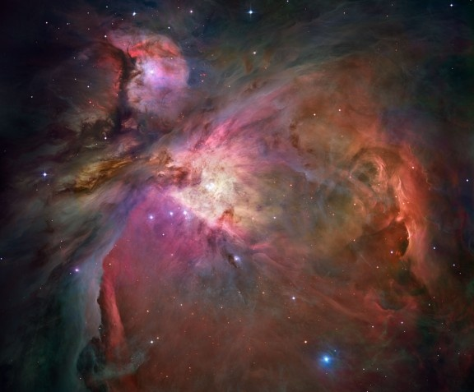
ORION NEBULA
- Credit – NASA, ESA, M. Robberto (STScI, ESA), The Hubble Space Telescope Orion Treasury project Team

