Slide 1
What is a Worldview?
Mark Perez
July 29, 2012

Slide 2
Worldview Definition
A worldview is the set of beliefs about fundamental aspects of reality that ground and influence all one's perceiving, thinking, knowing, and doing.
—Dr. Ken Funk II, Oregon State Univ.

Slide 3
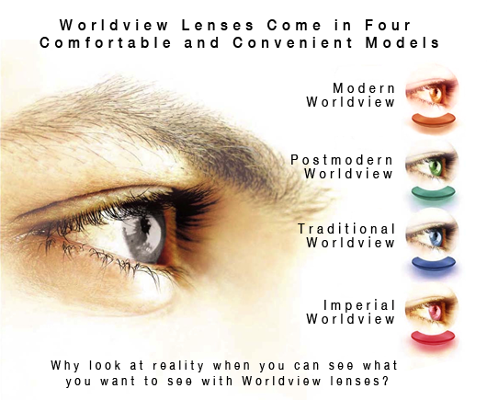
Worldview Lenses Come in Four Comfortable and Convenient Models

Slide 4
Elements of Worldview
Epistemology
Metaphysics
Cosmology
Teleology
Theology
Anthropology
Axiology

Slide 5
Epistemology
Beliefs about the nature and sources of knowledge.
Is knowledge merely a state of the brain?
Manifestation of a cosmic mind?
Does it only come from sense experience?
Is there knowledge from beyond the senses?
Is there anything one can know for certain

Slide 6
Metaphysics
What is the ultimate nature of reality?
Is everything just matter & energy?
Truth: Correspondence? Coherence? Pragmatic?
Is reality discovered empirically? Otherwise?

Slide 7
Cosmology
Origin of the universe, life, and humanity.
Is the universe a chance event? Created?
Did life originate by purely natural causes?
Did humanity originate by chance?

Slide 8
Teleology
The big question about purpose of the cosmos.
Is there any reason or purpose or end for the cosmos?
If so, whose purpose is it?
If so, what purpose is it?

Slide 9
Theology
The existence and nature of a god or gods.
Is there a god or any number of gods?
If so, what is the nature of the god(s)?
What is the relationship of the god(s) to universe?
What is the relationship of the god(s) to humanity?

Slide 10
Anthropology
The nature of humanity.
Are humans basically good? Evil?
Do humans have free will?
Are humans merely advanced animals?
Is there such a thing as “human nature”?

Slide 11
Axiology
The nature and study of values.
What is the highest good? Peace? Self-actualization? Pleasure? Knowledge?
Are there intrinsically valuable things?
Who determines value?
Are there morals? Are they objective? Subjective? Discovered? Created?

Slide 12
Questions
Should we care about the worldviews other hold? If yes, why?
Can a person’s worldview be changed? If so, how?

Slide 13


Slide 14


