Slide 1

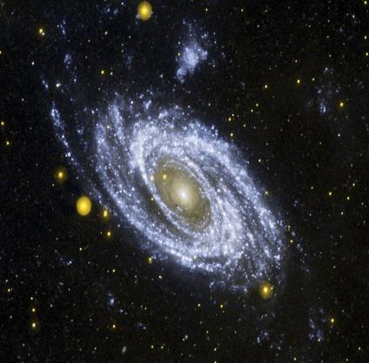
TWO DIVINE REVELATIONS
The Bible
The Record of Nature
  Written
    Specific
      Inerrant
        Literal
Emphasis on God’s love and salvation in Jesus Christ
Creation/nature
  More General
    Reveals truth
Declares God’s truth, justice, wisdom, righteousness, power

Slide 2
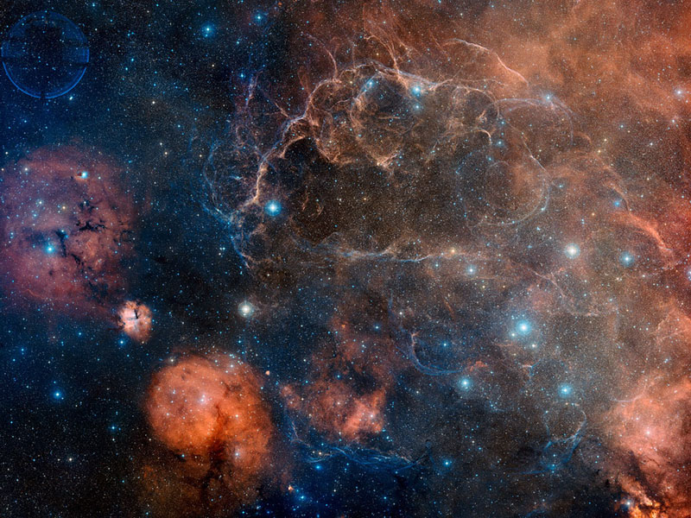
Vela Supernova Remnant
Credit-Digitized Sky Survey, ESA, ESO, NASA, FITS Liberator; Color Composite-David De Martin (Skyfactory)

Slide 3
AGE OF UNIVERSE & EARTH
WHAT DO THE FACTS OF NATURE SAY?
  Radiometric Abundancies
Various radiometric elements (such as neptunium, uranium, etc.) have various “half-lives” or longevities.
For example, neptunium-237 has a half life of 2.144 million years. Uranium has a half-life of 4.47 billion years.

Slide 4
AGE OF UNIVERSE & EARTH
WHAT DO THE FACTS OF NATURE SAY?
  Radiometric Abundancies
Therefore, if the universe/earth were only 6 – 10,000 years old we should see an abundance of all the various radiometric elements, including neptunium, plutonium, and technetium. Even if the cosmos were 100,000,000 years or less, there would be a lot of various “shorter-lived” radiometric elements.

Slide 5
AGE OF UNIVERSE & EARTH
WHAT DO THE FACTS OF NATURE SAY?
  Radiometric Abundancies
- - - But what do we see? - - -
We only see neptunium, plutonium, and technetium existing in a few young stars, which is expected.
In mature stars, including our sun and earth, these radiometric elements do not exist; they have been depleted. However, uranium and thorium exist.

Slide 6
AGE OF UNIVERSE & EARTH
WHAT DO THE FACTS OF NATURE SAY?
  Radiometric Abundancies
This is exactly what we would see with a multi-billion year universe.
It is exactly what we COULD NOT SEE if the universe were only 6 – 10,000 years.

Slide 7
AGE OF UNIVERSE & EARTH
WHAT DO THE FACTS OF NATURE SAY?
  Radiometric Abundancies
Some young universe proponents have suggested that the rates of radiometric decay have changed in the past.
However, photographic evidence covering 99% of the past history of the universe shows these decay rates have been constant.

Slide 8
AGE OF UNIVERSE & EARTH
WHAT DO THE FACTS OF NATURE SAY?
  Radiometric Abundancies
In addition, the “daughters” of plutonium on earth, called ¹³⁶Xe/ ¹³¹Xe ratios show that the past decay rates have not been faster.
Lastly, refer to the “T” below, wherein it is shown that the speed of light has not changed.

Slide 9
AGE OF UNIVERSE & EARTH
WHAT DO THE FACTS OF NATURE SAY?
  Spreading Out (Rate) of Galaxies
The spreading out of the cosmos, or the expansion rate, is extremely fine tuned.
In fact, just after the Big Bang it was finely tuned to one part out of 10⁵⁷, otherwise there would be no earth-like planet ever.

Slide 10
AGE OF UNIVERSE & EARTH
WHAT DO THE FACTS OF NATURE SAY?
  Spreading Out (Rate) of Galaxies
That precision of design is like saying that if you took all the grains of sands on all the beaches of earth (~10²³), and multiplied them by 1 trillion, 1 trillion, by 10 billion times, and marked one of the grains of sand and then mixed them all up and then dived down blindfolded and found that marked grain on the first try!!!!!

Slide 11
AGE OF UNIVERSE & EARTH
WHAT DO THE FACTS OF NATURE SAY?
  Spreading Out (Rate) of Galaxies
We know what the expansion rate is and has been throughout cosmic history. There is actual photographic evidence for it.
For it to expand to its current size at the known rate it would be impossible in a 6 – 10,000 year universe, but only in a 13.7 billion year universe.

Slide 12
AGE OF UNIVERSE & EARTH
WHAT DO THE FACTS OF NATURE SAY?
  Ice Cores
Evidence from 3 ice cores in Northern Greenland and 3 in Central Antarctica demonstrate the earth cannot be only 6 – 10,000 years old.
These ice cores have annual layers, like tree rings.

Slide 13
AGE OF UNIVERSE & EARTH
WHAT DO THE FACTS OF NATURE SAY?
  Ice Cores
For example, the oldest of the six in central Antarctica is 800,000 years old as it has 800,000 layers (the “Dome C” site).

Slide 14
AGE OF UNIVERSE & EARTH
WHAT DO THE FACTS OF NATURE SAY?
  Ice Cores
There is conclusive evidence these layers are annual as we can count the number of layers back to known historic volcanic eruptions of Krakatau in 1887 and Vesuvius in 79 A.D., and the number of layers corresponds to the exact number of years back to those events (the two layers have debris from those eruptions).

Slide 15
AGE OF UNIVERSE & EARTH
WHAT DO THE FACTS OF NATURE SAY?
  Ice Cores
All six ice cores are over 100,000 years old.
Further, the oldest one shows 8 cycles of the 100,000 year orbital eccentricity patterns of the earth’s revolutions around the sun.
The annual sediment cores (not ice cores) off the coast of New Zealand show over one million years.

Slide 16
AGE OF UNIVERSE & EARTH
WHAT DO THE FACTS OF NATURE SAY?
  Time & Distance for Light Travel
  Light travels at 186,300 miles per second, or about an equivalent of 7.5 times around the earth/sec.
Nobody really contends the distances of the various stars and galaxies we see in the universe; galaxies are as far away as almost 13 billion light years.

Slide 17
AGE OF UNIVERSE & EARTH
WHAT DO THE FACTS OF NATURE SAY?
  Time & Distance for Light Travel
  Light from the sun takes 8 minutes to reach earth. So, we are seeing the sun as it existed 8 minutes ago.
Similarly, when we see the Andromeda Galaxy, which is 2 million light years away, we are seeing the light which came from it 2 million years ago.

Slide 18
AGE OF UNIVERSE & EARTH
WHAT DO THE FACTS OF NATURE SAY?
  Time & Distance for Light Travel
  If the universe were only 6 – 10,000 years old, we could not see the light from objects that are beyond 6 – 10,000 light years distant.
  Since we do see light from objects many millions and billions of light years away, the universe cannot be only 6 – 10,000 years old.

Slide 19
AGE OF UNIVERSE & EARTH
WHAT DO THE FACTS OF NATURE SAY?
  Time & Distance for Light Travel
  Some young universe proponents, realizing this as a major problem, try to offer various explanations to circumvent the problem. The top three follow, with their rebuttals (note all the proposed explanations can be fully rebuttalled):

Slide 20
AGE OF UNIVERSE & EARTH
WHAT DO THE FACTS OF NATURE SAY?
  Time & Distance for Light Travel
  First explanation is that God created the beams of light fully in transit, fully matured from one “end” (origin of) to the other (the end point, in this case earth).

Slide 21
AGE OF UNIVERSE & EARTH
WHAT DO THE FACTS OF NATURE SAY?
  Time & Distance for Light Travel
  This would have God creating false images of age, and therefore would be guilty of fraud as:
    The light’s spectral lines broaden and become more red the further the light travels per the laws of physics God set up.
    The light we see shows it has traveled great distances due to its spectral lines and red shift, caused by it traveling through gas clouds.

Slide 22
AGE OF UNIVERSE & EARTH
WHAT DO THE FACTS OF NATURE SAY?
  Time & Distance for Light Travel
    So, if God really created the beams of light fully intact which also contain the indicators of billions of years of travel, that would be fraudalent!
    The Bible says, as shown earlier, that God’s creation shows God’s truth, righteousness, and glory; it does not indicate fraud!

Slide 23
AGE OF UNIVERSE & EARTH
WHAT DO THE FACTS OF NATURE SAY?
  Time & Distance for Light Travel
  No wonder many young earth creationists are giving up this line of reasoning that God artificially created beams of light that would wrongly indicate age!

Slide 24
AGE OF UNIVERSE & EARTH
WHAT DO THE FACTS OF NATURE SAY?
  Time & Distance for Light Travel
    The next explanation offered to try to explain away the light distance problem, is that “maybe the speed of light changed.”
    First, we have photographic evidence of the universe from the present back to less than .002% of its current age! If the speed of light changed, we would have concrete evidence of it. All evidence shows no change in light’s speed.

Slide 25
AGE OF UNIVERSE & EARTH
WHAT DO THE FACTS OF NATURE SAY?
  Time & Distance for Light Travel
    Second, nobody disputes Einstein’s equation of E = mc² in his General Theory of Relativity. It is solid, and has never been shown to be wrong.
    E = energy; m = mass; c = speed of light. Without getting into too much detail, any change in the speed of light (“c”) drastically affects the energy (“E”) and mass (“m”) of the universe.

Slide 26
AGE OF UNIVERSE & EARTH
WHAT DO THE FACTS OF NATURE SAY?
  Time & Distance for Light Travel
    So, taking the explanation that the speed of light has changed, Adam and Eve would be burned to a cinder by the energy of the sun!

Slide 27
AGE OF UNIVERSE & EARTH
WHAT DO THE FACTS OF NATURE SAY?
  Time & Distance for Light Travel
    This “speed of light changed theory” uses false conclusions by some from measurements made by Olaus Romer in 1675 along with its subsequent refinements by an Australian amateur scientist Barry Setterfield in 1973.

Slide 28
AGE OF UNIVERSE & EARTH
WHAT DO THE FACTS OF NATURE SAY?
  Time & Distance for Light Travel
    Romer measured the speed of light with the results showing a 3% greater speed than today’s measurements.
    However, his error bar was GREATER than 3%! So, no problem!

Slide 29
AGE OF UNIVERSE & EARTH
WHAT DO THE FACTS OF NATURE SAY?
  Time & Distance for Light Travel
    Correcting for one inaccurate part of Romer’s calculations, he would have had a figure that was within 0.5 % of today’s measurements.
    Setterfield, a young earth creationist who promotes the change of light’s speed, apparently misunderstood the 0.5% figure as a 0.5% reduction in light’s speed since 1675!

Slide 30
AGE OF UNIVERSE & EARTH
WHAT DO THE FACTS OF NATURE SAY?
  Time & Distance for Light Travel
    However, this was clearly not the case (it is just a matter of refining subsequent measurements and their accuracies).
    Since Romer’s day, 50 measurements of the speed of light have been conducted, with all of them showing its speed as constant since 1675!

Slide 31
AGE OF UNIVERSE & EARTH
WHAT DO THE FACTS OF NATURE SAY?
  Time & Distance for Light Travel
  The last explanation offered to try to explain the light-distance problem is that “maybe the ‘clocks’ of distant space were different than on earth.” It is suggested they were a million times slower. This has been popularized by an individual named “Russell Humphry.”

Slide 32
AGE OF UNIVERSE & EARTH
WHAT DO THE FACTS OF NATURE SAY?
  Time & Distance for Light Travel
  Apparently, this “explanation” was made assuming we could not find “clocks” in the distant universe. However, we have!

Slide 33
AGE OF UNIVERSE & EARTH
WHAT DO THE FACTS OF NATURE SAY?
  Time & Distance for Light Travel
  Light cycle times of cepheid variable stars, nova and supernova eruption times, gamma-ray bursts, star formation times, stellar burning rates, and galaxy rotation periods measure the same whether near or far away. (Dr. Hugh Ross, A Matter of Days, p. 167-8).

Slide 34
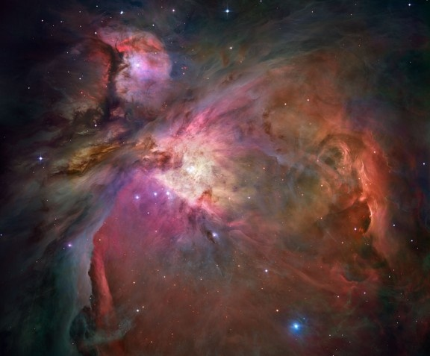
ORION NEBULA
- Credit – NASA, ESA, M. Robberto (STScI, ESA), The Hubble Space Telescope Orion Treasury project Team

Slide 35
Now Let Us Examine
Genesis Chapter One

Slide 36
SUMMARY OF GENESIS 1
BEFORE DAY 1 (vs. 1-2):
CREATION OF UNIVERSE AND OF EARTH
( v. 1 - 13.7 bya to 4.55 bya)
Day 1 (vs. 3 - 5):
  Light reaches earth’s surface
  Timeframe: Somewhere between 4.45 – 3.8 bya
Day 2 (vs. 6 - 8):
  God separates the waters on surface from waters in the atmosphere.
  Timeframe: Before 3.5 bya

Slide 37
SUMMARY OF GENESIS 1
Day 3 (vs. 9 - 13):
  Dry land appears
  Vegetation created
  Timeframe: Dry land - Most likely started 3.5 – 2.0 bya and some increase thereafter
Day 4 (vs. 14 - 19):
  Translucent (cloud-like) atmosphere becomes transparent showing heavenly bodies from surface Point-of-View (POV)
  Timeframe: Must be completed before 543 mya

Slide 38
SUMMARY OF GENESIS 1
Day 5 (vs. 20 – 23):
  Ocean life created
  Birds created
  Timeframe: 543 mya – 50 mya
Day 6 (vs. 24 – 27):
  3 types of land animals created
  Man created
  Timeframe: Maximum start of under 50 mya to most likely 40-60,000 ya

Slide 39
GENESIS BEFORE DAY 1: V. 1
In the beginning god created [“bara”] the heavens [“hashamayim”] and [“we”] the [“ha’ ”] earth [“erets”].
“bara:” Only used for God’s creative activity. Usually means something that is brand new, which did not exist before, and is often “out of nothing” as it is meant here.
Hebrews 11:3 states, “…the universe was formed at God’s command so that what is seen was not made out of what was visible.”

Slide 40
GENESIS BEFORE DAY 1: V. 1
“hashamayim we ha’ erets:” “heavens and the earth,” a coupled noun (heavens – earth) meaning entire universe and all that is in it, including earth.
90+% of conservative commentaries agree that this expression refers to all the universe and its contents, and not just earth and its atmosphere. So, gas, planets, stars, OUR STAR - THE SUN, galaxies, comets, etc. are definitely included here.

Slide 41
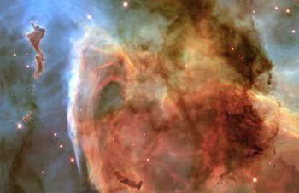

Slide 42
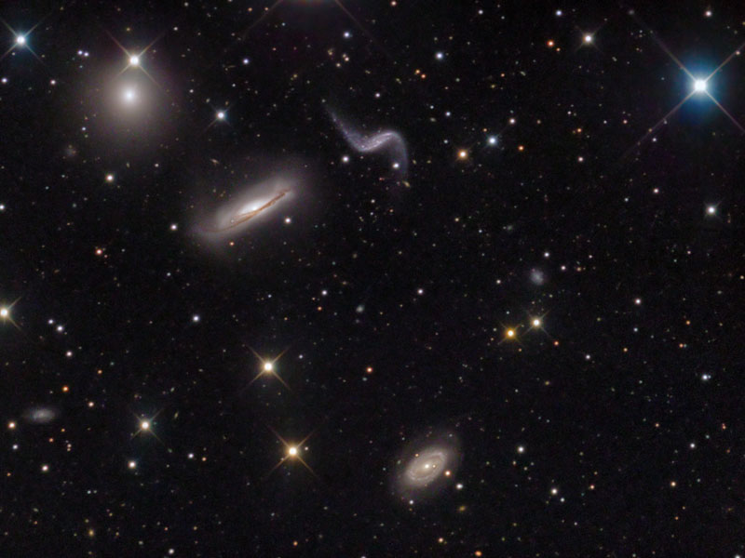

Slide 43
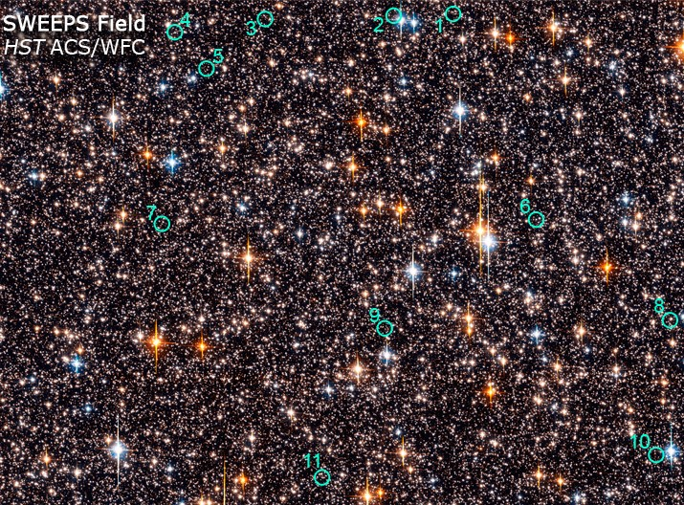
THE HUBBLE SWEEP SEARCHING FOR OTHER PLANETS: Credit – NASA, ESA, K. Sahu (STScI) & the SWEEPS Science Team

Slide 44
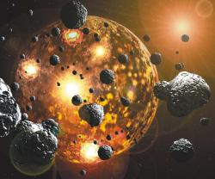
Earth’s Hadean Era:
Life not feasible from 4.55 – 3.85 bya due to the horrific bombardment of comets, meteors and asteroids – liquifying rocks, vaporizing oceans; conditions precluded any time for the development of prebiotics as life occurred right after the end of the Hadean Era.
The result: No prebiotic soup for anything to develop in before life appeared!

Slide 45
GENESIS BEFORE DAY 1: V. 1
“Hashamayim we ha’ erets (‘heavens’ plural and ‘earth’ singular with the definite articles and the conjunction) carries a distinct meaning, just as the English words ‘under’ and ‘statement’ or ‘dragon’ and ‘fly’ put together as compound nouns take on specific meanings. Hashamayim we ha’ erets consistently refers to the totality of the physical universe: all of the matter and energy and whatever else it contains.” (Quote is from Dr. Hugh Ross, Ibid., p. 20)

Slide 46
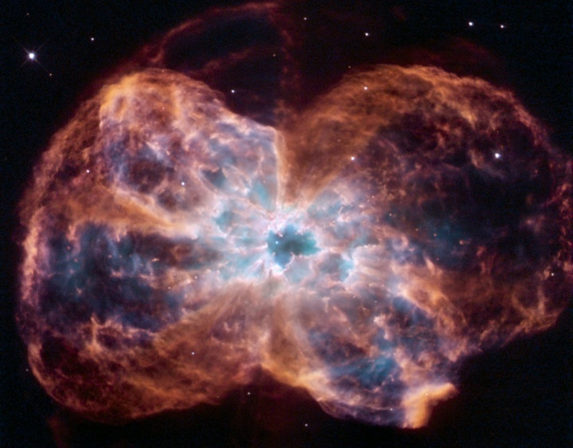
THE BIG BANG?
DID IT HAPPEN?
IS IT EVOLUTION?
PLANETARY NEBULA NGC 2440: Credit-NASA, ESA K. Noll (STScI), Acknowledgement – Hubble Heritage Team (STScI, AURA)

Slide 47
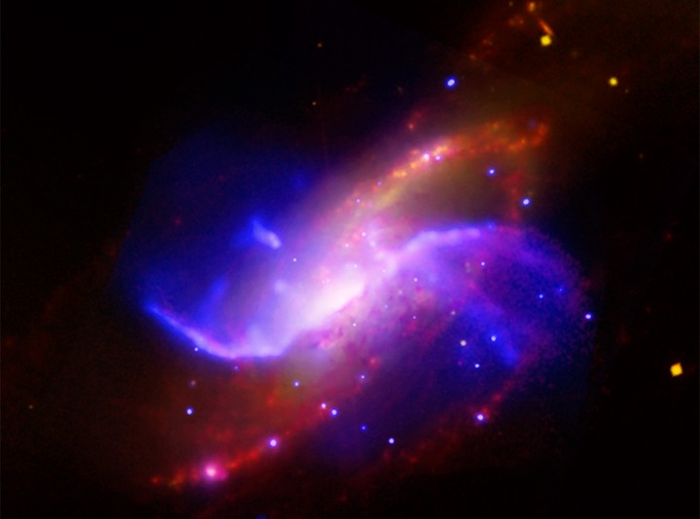
THE BIBLE & THE BIG BANG:
HOW DO THEY COMPARE?
ARMS OF NGC 4258 GALAXY: Credit-X-Ray, Yuxuan Yang (UMCP) et al, NASA, CXC, Optical-DSS, IR-NASA, JPL-Caltech & Radio NRAQ, AUI, NSF

Slide 48
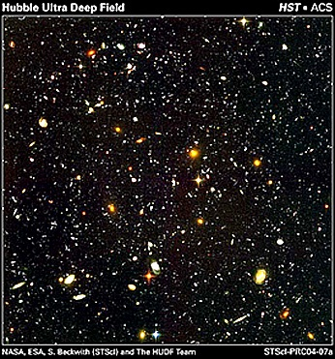
BIG BANG DEFINITION
“A precisely designed creation & expansion (not a random explosion!) of space, time, energy, and matter (STEM) under God’s direction & control”
Therefore, it is not a random and self-evolving process.
HUBBLE ULTRA DEEP FIELD: NASA, ESA, S. Beckwith (STScI) & the HUDF Team

Slide 49
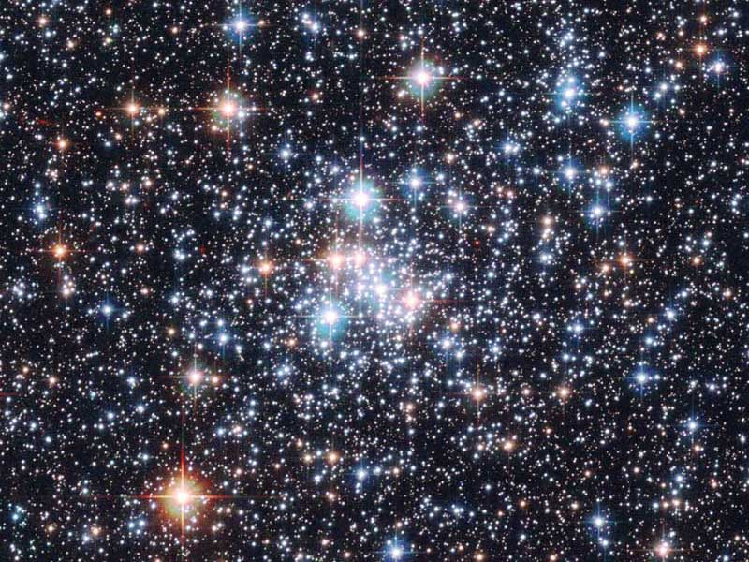
STAR CLUSTER NGC 290: Credit – ESA, NASA; Acknowledgement – E. Olzjewski (U. of Arizona), NST

Slide 50
BIG BANG BASIC #1
The universe (all space, time, energy, and matter) had a beginning!
Therefore, the universe had to have a pre-existing “causing agent” that brought the universe into being.

Slide 51
THE HUBBLE SWEEP SEARCHING FOR OTHER PLANETS: Credit – NASA, ESA, K. Sahu (STScI) & the SWEEPS Science Team

Slide 52
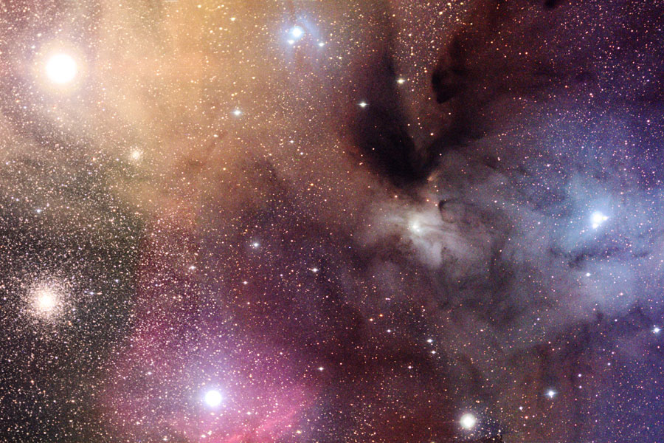
BIG BANG BASIC #1
Universe’s beginning supported by:
  Einstein’s General Theory of Relativity (some of it proven to a 99.999999999999999% certainty!!!)
CLOUDS OF RHO OPHIUCHI - Credit – Adam Block, KPNO Visitor Program, NOAO, AURA, NSF

Slide 53
BIG BANG BASIC #1
Universe’s beginning supported by:
  Second Law of Thermodynamics:
  “everything wears out.” If universe was infinitely old, it would have “died” an infinitely long time ago.
CLOUDS OF RHO OPHIUCHI - Credit – Adam Block, KPNO Visitor Program, NOAO, AURA, NSF

Slide 54
BIG BANG BASIC #1
Beginning of the universe
Supported by (continued):
  Numerous scientific observations and
  experiments
CLOUDS OF RHO OPHIUCHI - Credit – Adam Block, KPNO Visitor Program, NOAO, AURA, NSF

Slide 55
BIG BANG BASIC #1
World famous Physicist Stephen Hawking has stated: “So long as the Universe had a beginning, we could suppose it had a creator.”
The majority of scientists in the hard sciences are now theists (believe in a creator God)
ORION NEBULA - Credit – NASA, ESA, M. Robberto (STScI, ESA), The Hubble Space Telescope Orion Treasury project Team

Slide 56
BIG BANG BASIC #2
The Universe has been expanding since its creation & will continue to expand
Past expansion proven by
photographic observations
Future expansion - not enough
matter to stop it & is speeding up

Slide 57
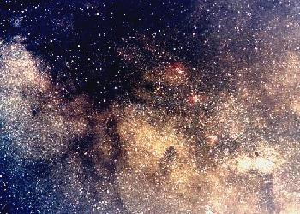
BIG BANG BASIC #3
The Universe is wearing out, growing old, and it will die:
  “Die” = heat death - increasing
  entrophy, resulting in no more
  usable energy & death of all life
  Second Law of Thermodynamics
  (defined earlier) requires the
  universe’s death.
CONSTELLATION SAGISTARIUS

Slide 58
BIBLE BASIC #1
The universe (all space, time, energy and matter) had a beginning!
God, Who has always existed, is the “causing agent” Who created the universe
BIBLE BASIC #1
VELA SUPERNOVA REMNANT: Credit-Digitized Sky Survey, ESA, ESO, NASA, FITS Liberator; Color Composite-David De Martin (Skyfactory)

Slide 59

GENESIS 1:1 - In the beginning, God created (“bara”) the heavens and the earth (“hashamayin we ha `erets”) …
Gen. 2:3, 2:4; Psalm 148:5; Isaiah 40:26, 42:5 & 45:18 – each say God created (began) the universe.

Slide 60
“Time” had a beginning!
II Timothy 1:9 – “… before the beginning of time,…”
Titus 1:2 – “…promised before the beginning of time,…”

Slide 61
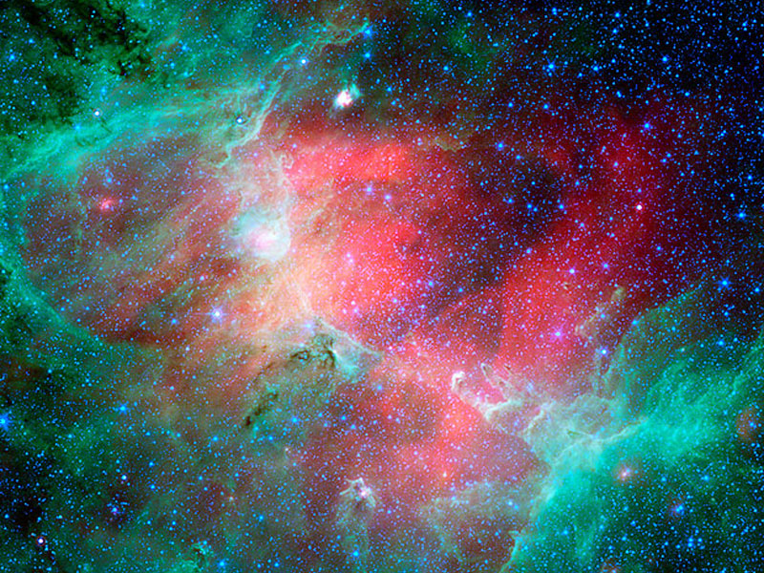
BIBLE BASIC #2
The universe has been expanding since its creation and is continuing to expand
EAGLE NEBULA IN INFRARED: Credit-NASA, JPL-Caltech, N. Flagey (IAS, SSC) & A. Noriega-Crespo (SSC, Caltech)

Slide 62

The next five verses state that God stretched out the heavens, past tense, a completed action, using the Qal perfect form:
Is. 45:12 – …I…stretched out the heavens…
Is.48:13 – …my right hand spread out the heavens.

Slide 63

Isa 44:24 – …I…the Lord… stretched out the heavens,…
Isa 51:13 – …the LORD…who stretched out the heavens…
Jeremiah 51:15 – He…stretched out the heavens…

Slide 64

The next four verses say that God is currently stretching out (present tense) the heavens by using the “Qal Active participle” form of the
Hebrew verb “natah,” which implies ongoing stretching.
Job 9:8 – He alone stretches out the heavens…

Slide 65
Is. 40:22 – …He stretches out the heavens like a canopy…
Ps. 104:2 - …he stretches out the heavens like a tent
Zechariah 12:1 - …The Lord, who stretches out the heavens,…

Slide 66
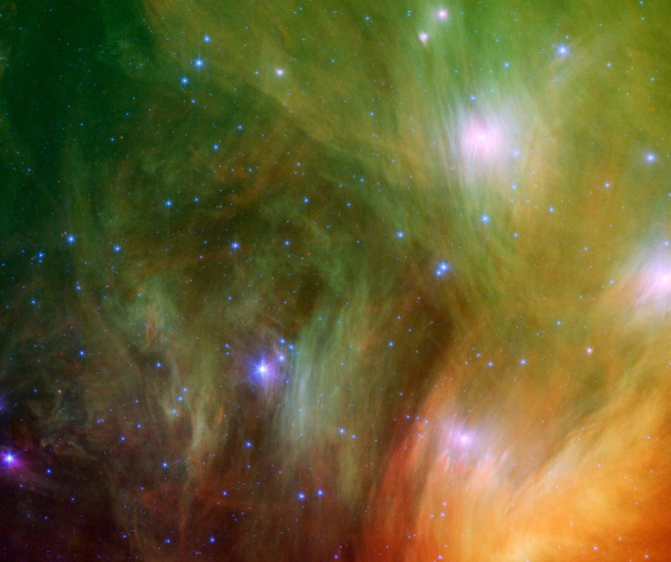
BIBLE BASIC #3
The universe is growing old, wearing out, and it will die.
SEVEN DUSTY SISTERS: Credit-NASA, JPL-Caltech, J. Stauffer (SSC, Caltech)

Slide 67
Verses in Support of Bible Basic #3:
Psalm 102:26 – “…They [the heavens] will perish,…they will all wear out like a garment…”
Hebrews 11:10b – 11: “..the heavens are the work of your hands. They will perish,…they will all wear out like a garment.”

Slide 68

Romans 8:19-21 – “For the creation was subjected to frustration,…that the creation itself will be liberated from its bondage to decay…”

Slide 69

SUMMARY OF BIBLE & BIG BANG
The Bible | The Big Bang | Conclusion
The universe (all space, time, energy & matter) had a beginning | The universe (all space, time, energy & matter) had a beginning | Agreement
A pre-existing agent brought the universe into being – this is God | Conclusion: a pre-existing agent had to bring the universe into being | Agreement
The universe was and is expanding | The universe was and is expanding | Agreement
The universe is growing old & will die | The universe is growing old & will die | Agreement

Slide 70
Before DAY 1: v.2
(2) Now the earth was formless and empty, darkness was over the surface of the deep, and the Spirit of God was hovering over the waters.
Extremely Important Point Here: In v. 1 the point of view (POV) is from outer space. In v. 2 the POV changes to the position of being on earth’s surface!
  “Surface of the Deep” & “hovering over the waters”
POV is critical; it affects the events of Days 1 and 4. Just as in ideology and philosophy, POV can totally change the interpretation of the subject matter.

Slide 71
Before DAY 1: v. 2
The Bible
The Record of Nature
“Formless” – earth was a sphere, but on the surface everything was dark and empty – forms could not be seen.
Remember: POV is from earth’s surface!
In a planet’s infancy there can be so much debris in its atmosphere that it will block all light from getting to the surface. This is known as an “opaque atmosphere.”

Slide 72
Before DAY 1: v. 2
The Bible
The Record of Nature
So, for all practical purposes, one’s view from the surface was “no view at all” – total darkness; therefore, reality was “shapeless,” could not see forms.
The initial earth had a thick, noxious Venus-like atmosphere trapping heat. On Venus it is hot enough on the surface to melt lead (over 800° F).
Before Day 1: The Bible and Record of Nature Agree

Slide 73
DAY 1: vs. 3-5
3 > And God said, "Let there be light,” and there was light.
4 > God saw that the light was good, and he separated the light from the darkness.
5 > God called the light “day,”and the darkness he called “night.” And there was evening, and there was morning — the first day.

Slide 74
Day 1: (3): And God said, “Let there be light,” and there was light.
The Bible
Record of Nature
Remember, the POV is from the earth’s surface.
Therefore, from the surface, light is seen for the first time
Next a planet’s opaque atmosphere can become “translucent” (like a cloudy day) as the debris thins. Light can now reach the surface.

Slide 75
Day 1: (4) God saw that the light was good, and he separated the light from the darkness.
The Bible
Record of Nature
In. v. 4 “light” from “darkness” can now be seen
When light can penetrate the atmosphere, from the POV of the surface one would see light or darkness depending on time of day

Slide 76
Day 1: (5) God called the light “day,” and the darkness he called “night.”
The Bible
Record of Nature
God calls the light “day” and the darkness “night” (v. 5)
Sun created in Gen. 1:1.
All of God’s laws of physics show that a planet will not exist without a parent star
To say the sun was created after the earth is so wrong on so many levels!
The Bible and Record of Nature Agree

Slide 77
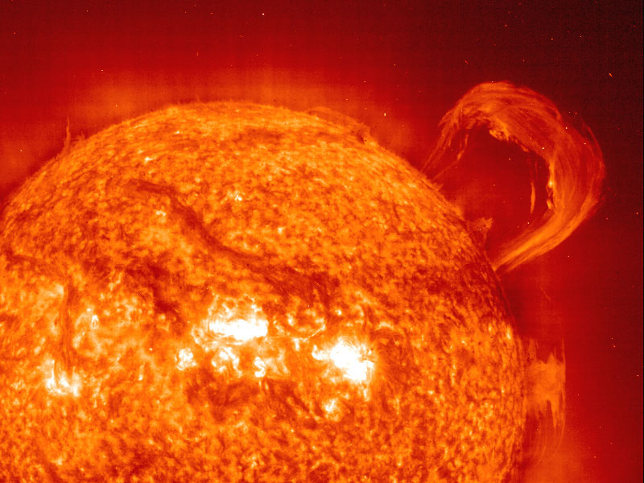
Size of earth
(1,400,000 earths can fit inside the sun)

Slide 78
Day 1: (5). God called the light "day," and the darkness he called “night.”
The Bible
Record of Nature
V. 5 supports the sun’s creation in Gen. 1:1 - to have night & day on earth (a sphere) on the first day the light must come from a single point; i.e., THE SUN!
If God created the earth first (which he could) then the laws of nature would show that happened! He would also had to have overriden all his laws of physics to do so.
The Bible and Record of Nature Agree

Slide 79
Record of Nature
It is during this time when our atmosphere became translucent. The cause of this change MAY have been the result of what we now know was a Mars-size object that collided with earth at just the right time (4.45 bya), at just the right angle (45°), at just the right speed which ripped away most of earth’s “way-too-thick-for-life” atmosphere and also formed the moon.
It is also possible this translucent atmosphere came about later, but no later ~ 3.9 bya.

Slide 80
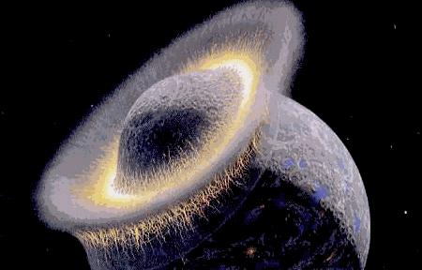
44.45 bya: the collision that creation earth’s moon and changed our atmosphere to one that could support life! In fact, 99% of our atmosphere was ripped away.
Google Images

Slide 81
DAY 2: vs. 6-8
6 > And God said, “Let there be an expanse between the waters to separate water from water.”
7 > So God made the expanse and separated the water under the expanse from the water above it. And it was so.
8 > God called the expanse “sky.” And there was evening, and there was morning — the second day.

Slide 82
Day 2 - Key Verse: (6) And God said, “Let there be an expanse [v. 8 – called sky] between the waters to separate water from water.
The Bible
Record of Nature
God separates the waters on the surface from waters above the surface by creating a more arid atmosphere above the surface
This is the next stage: the initiation of a more arid, gaseous atmosphere above the earth’s surface.
Day 2: The Bible and Record of Nature Agree

Slide 83
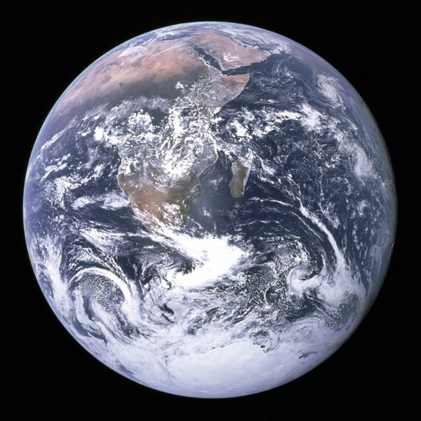
DAY 3: vs. 9-13
9 > And God said, "Let the water under the sky be gathered to one place, and let dry ground appear." And it was so.
10 > God called the dry ground "land," and the gathered waters he called "seas." And God saw that it was good.

Slide 84
Day 3: (9) And God said, "Let the water [v. 10 – oceans] under the sky be gathered to one place, and let dry ground [v. 10 – land] appear.“
The Bible
Record of Nature
After a more arid, gaseous atmosphere is created, God brings forth dry land on earth, which prior to
this point has been a water world.
Dry land came after the creation of an arid, gaseous atmosphere, just like the Bible says.
Most significant land continental creation took place between 3.5 – 2.5 bya.

Slide 85
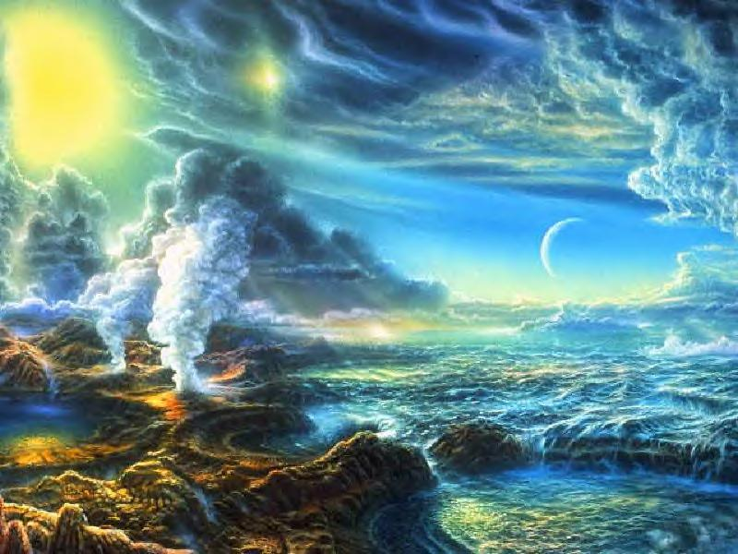
Early land masses – artistic rendition
Growth of Land Mass as Percentage
of Surface by billions of years ago:
4.5 – 3.5: Vascilates between 0-1%
3.0: 6%
2.5: 19%
2.0: 22%
1.5: 24%
1.0: 25+%
0.5: 27+%
Today: 29%
“Early earth” – Google Images-3

Slide 86

DAY 3: vs. 9-11
11 > Then God said, "Let the land produce vegetation: seed-bearing plants and trees on the land that bear fruit with seed in it, according to their various kinds." And it was so.
12 > The land produced vegetation: plants bearing seed according to their kinds and trees bearing fruit with seed in it according to their kinds. And God saw that it was good.

Slide 87
DAY 3: vs. 9-11
13 > And there was evening, and there was morning — the third day.

Slide 88
Day 3: (11). Then God said, "Let the land produce vegetation: seed-bearing plants and trees on the land that bear fruit with seed in it, according to their various kinds." And it was so.
The Bible
Record of Nature
Land vegetation appears after the first land appears
Concurs with the Bible.

Slide 89
Day 3: (11). Then God said, "Let the land produce vegetation: seed- [“zera”] bearing plants [’es] and trees on the land that bear fruit [“peri”] with seed in it…(12). The land produced vegetation: plants bearing seed according to their kinds and trees bearing fruit with seed according to their kinds.
The Bible
zera’ – semen or the embryos of any plant species. Could refer to any plant species that ever existed.*
(*R. Laird Harris, Gleason L. Archer, and Bruce K. Waltke, Theological Wordbook of the Old Testament, Vol. I (Chicago: Moody press, 1980), pg. 252-253)

Slide 90
Day 3: (11). Then God said, "Let the land produce vegetation: seed- bearing plants [’es] and trees on the land that bear fruit with seed in it…(12). The land produced vegetation: plants bearing seed according to their kinds and trees bearing fruit with seed according to their kinds.
The Bible
‘es – any large plant containing woody fiber. (Harris, Archer, Walkte, Ibid., Vol. I, 688-689)
‘es – includes all large plants containing cellulose, and possibly could refer to all larger than microscopic plants whose fibers provide a measure of stiffness (Hugh Ross, The Genesis Question, p. 39)

Slide 91
Day 3: (11). Then God said, "Let the land produce vegetation: seed- bearing plants and trees on the land that bear fruit [peri] with seed in it…(12). The land produced vegetation: plants bearing seed according to their kinds and trees bearing fruit with seed according to their kinds.
The Bible
peri – the food and/or embryos produced by any living thing. (Harris, Archer, Walkte, Ibid., Vol. 2, pg. 734)

Slide 92
Record of Nature
Date of earliest vegetation is actually unknown.
Plants do not fossilize as well as animals
Research has emphasized animal fossils over plant fossil study
If cryptogamic colonies can be considered plants, plants go back to about 2 bya.
Chemical evidence found of photosynthetic, fibrous plants back to as early as 1.2 bya

Slide 93
Record of Nature
Molecular clocks show more “plant-like” land plants may date to 750 mya to 1 bya.
Have found plant spores in Cambrian, which may indicate “more typical” vegetation occurred even before 543 mya.
We have actual evidence that:
  Fruit Bearing Trees start at 450-475 mya
  Vascular plants start at about 430 mya
  Seed Bearing Plants start at about 370 mya

Slide 94
The Bible
The vegetation references of Day 3 in the Hebrew language could include practically any type of vegetation, regardless of what our English translations state, which is “seed-bearing plants” & “fruit bearing trees.
The Hebrew language in Day 3 could refer to the earliest cryptogamic colonies/cyanobacteria AND/OR could refer to the more familiar seed bearing plants and fruit bearing trees.

Slide 95
The Bible
Four legitimate scenarios are possible that show The Bible and the Record of Nature Agree:
If Day 3’s vegetation only occurs after the Cambrian Explosion, Day 3 overlaps Days 4 & 5.
If Day (or “Period” or “Phase”) 3 continues into Day 4 or even into Day 5, the start of any given day in the Genesis account must commence before the start of a subsequent day (i.e., Day 3 must start before the start of Day 4, and so on) in order to stay true to the textual logic.

Slide 96
The Bible
(2) If Day 3 is really referring to just the very early types of vegetation, such as cryptogamic colonies of 2 bya, then Day 3 does not overlap any succeeding days. Future research may find additional early plant types
(3) Or a combination of (1) and (2).
(4) The evidence of photosynthetic, fiberous plants dating back to 1.2 bya could by itself harmonize the Bible and current findings.

Slide 97
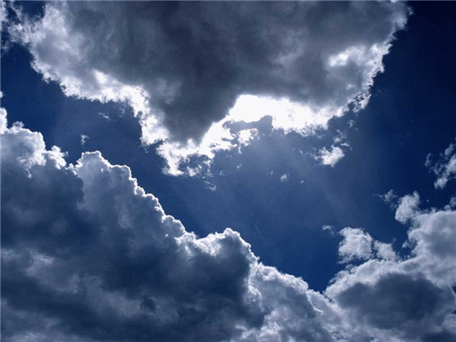
DAY 4: vs. 14 - 19
14 > And God said, "Let there be lights in the expanse of the sky to separate the day from the night, and let them serve as signs to mark seasons and days and years,
15 > and let them be lights in the expanse of the sky to give light on the earth." And it was so.
16 > God made two great lights — the greater light to govern the day and the lesser light to govern the night. He also made the stars.

Slide 98
DAY 4: vs. 14 - 19
17 > God set them in the expanse of the sky to give light on the earth,
18 > to govern the day and the night, and to separate light from darkness. And God saw that it was good.
19 > And there was evening, and there was morning — the fourth day.

Slide 99
Record of Nature
At this point in earth’s history, its translucent atmosphere (like a cloudy day) became transparent. Now can see the sun, moon, stars from the earth’s surface.
This is necessary to prepare the right conditions for the animals that start in the subsequent time frame of Day 5 (part of which is the Cambrian Explosion). Many of these animals must see the heavenly bodies to help regulate their biological clocks.

Slide 100
Day 4: (14). And God said, “Let there be lights in the expanse of the sky to separate the day from the night, and let them serve as signs to mark seasons and days and years.
The Bible
Remember, POV is from earth’s surface!
So, for the first time, from the surface one can see the sun, moon & stars just like the facts of nature would indicate.

Slide 101
Day 4: (14). And God said, “Let there be lights in the expanse of the sky to separate the day from the night, and let them serve as signs to mark seasons and days and years.
The Bible
V. 14 does NOT say God “created” the lights at this point!!! (see Gen. 1:1). He said “Let there be lights” (like “Let there appear”)
This accurately portrays what would happen when the atmosphere became a clear one revealing the sun, moon, and stars from the earth’s surface POV.

Slide 102
Day 4: (14). And God said, “Let there be lights in the expanse of the sky to separate the day from the night, and let them serve as signs to mark seasons and days and years.
The Bible
V. 14 states the purpose of the lights:
  (i) to separate the day from the night
  (ii) to serve as signs to mark seasons, days, & years

Slide 103
Day 4: (15). And let there be lights in the expanse of the sky to give light on the earth,” and it was so.
The Bible
V. 15 states the purpose of the lights: to give light on the earth.

Slide 104
Day 4: (16). God made [‘asa] two great lights — the greater light to govern the day and the lesser light to govern the night. He also made [‘asa] the stars.
The Bible
Hebrew word for “made” in v. 16 is “ ‘asa.”
“ ‘asa” is a verb; in v. 16 it is in the tense of a “completed action.”
V. 16 states the purpose of the two great lights (i.e., sun & moon):
  To govern the day…to govern the night

Slide 105
Day 4: (17). God set them in the expanse of the sky to give light on the earth,
(18). to govern the day and the night, and to separate light from darkness. And God saw that it was good.
The Bible
V. 17 is a reiteration of v. 14 – 16.

Slide 106
The Bible
Putting it All Together (v. 14 – 17):
  V. 14 said that the light that separated light from darkness was NOT created, but that it was made to appear, or literally “Let there be…”
  V. 14 said the purpose of the lights were to:
    separate light from darkness,
    day from night, and
    to mark the seasons, days, and years.

Slide 107
The Bible
Putting it All Together (v. 14 – 17):
  V. 16 said that the making of the lights that separated light from darkness, and day from night was a past, completed action (“asa”).
  That completed action was back in Day 1 in Gen. 1:3-5!! This is because 1:3-5 states, “Let there be light, and there was light…and he separated the light from the darkness. God called the light “day,” and the darkness he called “night.”

Slide 108
The Bible
Below helps illustrate how most of Day 4 (Genesis 1:14 – 17) references back to Day 1 (Genesis 1:3-5.)
Day 1 Verses |  | Day 4 Verses
3 | Let there be light | 15, 17
4 | Separate light from dark, day from night | 14
5 | The light was called “day” and the darkness was called “night” | 16, 18
 | Stars were made (to appear) | 16
 | Lights to mark the days, the years, the seasons | 14
Day 4’s “Light vs. Dark” already occurred in Day 1

Slide 109
The Bible
Since on Day 1 the atmosphere became translucent, only the light of the sun, and perhaps to a much lesser extent, the moon’s light (it was much closer to earth at that point), could penetrate the atmosphere.
The light of the stars could only be seen once the atmosphere became transparent; now can mark the days, years, seasons.

Slide 110
The Bible
THEREFORE, THE BIBLE HAS THE SUN, MOON, AND STARS CREATED ON DAY 1

Slide 111
The Bible
Recall Gen. 1:1 wherein the “heavens” included all that is in them – the sun, moon, and STARS, etc.
So, if one wishes to maintain the sun and moon in vs. 14 – 17 were created on the fourth day, they would have to say the same thing for the stars (v. 16)!
That would mean that nothing but the vacuum of space and one singular planet (earth) was created in Gen. 1:1!

Slide 112
The Bible
That would violate the clear meaning of “heavens and the earth” (“hashamayim we ha’ erets”) in Gen. 1:1 as previously discussed.
Such a position ignores the context of Day 1 as discussed above.
Such a position ignores the “completed” or “past tense” verb tense (“asa”) of Gen. 1:16 (Day 4).

Slide 113
Record of Nature
According to all the physical laws God created, the earth was not the first “thing” created in the entire universe!
According to all the physical laws God created, the earth did not precede the sun, and could not precede the sun.
Unless God overrode his physics, the vegetation of Day 3 could not survive without the particular kind of light the sun gave and at just the right time in the sun’s life span.

Slide 114
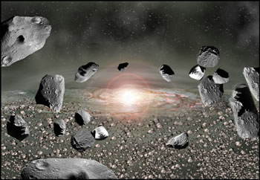
Proto-planets

Slide 115
Record of Nature
Unless God violated every law of physics he created, events of Gen. 1:1 – 15 simply could not have occurred if earth was the only created thing up to v. 16!

Slide 116
The Bible
Record of Nature
DAY 4, when carefully read and correctly interpreted in its proper context, Gen. 1 clearly supports the Record of Nature’s requirement for the sun to be created in Gen. 1:1 and not later on Day 4.
The atmospheric phases of opaque (Gen. 1:1), then translucent (Day 1), and then transparent (Day 4) is fully supported by the body of scientific literature.
Hence, Bible and Record of Nature Agree!

Slide 117
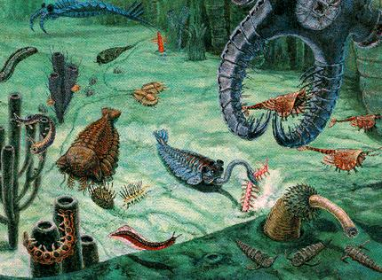
Day 5: Gen. 20 - 23
20 > And God said, "Let the water teem [“sheres”] with living creatures [“nephesh”], and let birds fly above the earth across the expanse of the sky."
21 > So God created [“bara”] the great creatures of the sea and every living and moving thing [nephesh”] with which the water teems [“sheres”], according to their kinds, and every winged bird according to its kind. And God saw that it was good.
icamera.as.arizona.edu

Slide 118
Day 5: Gen. 20 - 23
22 > God blessed them and said, "Be fruitful and increase in number and fill the water in the seas, and let the birds increase on the earth."
23 > And there was evening, and there was morning — the fifth day.
icamera.as.arizona.edu

Slide 119
Day 5: (20). And God said, "Let the water teem [“sheres”] with living creatures [“nephesh”], and let birds fly above the earth across the expanse of the sky.” (21). So God created [“bara”] the great creatures of the sea and every living and moving thing [“nephesh”] with which the water teems [“sheres”], according to their kinds,
The Bible
God creates in the oceans their variety of life forms plus the birds.

Slide 120
Day 5: (20). And God said, "Let the water teem [“sheres”] with living creatures [“nephesh”], and let birds fly above the earth across the expanse of the sky.” (21). So God created [“bara”] the great creatures of the sea and every living and moving thing [“nephesh”] with which the water teems [“sheres”], according to their kinds,
The Bible
“Nephesh” occurs 754 times in Old Testament:
  63% (472 times) of them translated as “soul” (of man)

Slide 121
The Bible
  34% (282 times) of occurrences to other references (most involve human personhood, will, emotions, life and death)
  3% (about 22 times) to lower animals: Of these:
    In Genesis, 6-7 times “nephesh” is used to refer to mammals;
    In Genesis, 2-3 times “nephesh” is not limited to mammals.

Slide 122
The Bible
In Gen. 1:20 & 21 nephesh is not limited to mammals, as:
  In v. 21 (clarifying v. 20) it says that the animals created were “every living and moving thing with which the water teems…”
  The above statement refers to life in general in the ocean – a lot more than just sea mammals;

Slide 123
The Bible
  The word “teems” (“sheres” in Hebrew) is typically used in connection with smaller life forms as fish, etc. and not larger-bodied sea mammals.
  In v. 21 it states that “the great creatures of the sea” were created; this includes the whales, and quite likely dolphins, porpoises, etc., which are mammals.

Slide 124
The Bible
Record of Nature
Possible life (bacteria) started in Gen. 1:2 where the Spirit is hovering over the surface of the oceans, as the Hebrew word for “hovering” is also used for a bird “brooding” over her nest.
First life is in the oceans: evidence of bacteria life to 3.83 bya. (due to the sun’s highly intense flaring before this time, no life could have existed).

Slide 125
The Bible
Record of Nature
Whether or not Gen. 1:2 is indicative of life’s first appearance, does not change Genesis’ agreement with the Record of Nature: Day 5 has the first appearance of major life forms in the ocean.
Cambrian Period starts at about 543 mya, and is called the “Big Bang” of biology! Suddenly, 50 - 85% of all animal phyla on this planet are created in a geological instant (~3 million yrs)!

Slide 126
The Bible
Record of Nature
Based on record of nature, Day 5 starts no later than Cambrian Explosion (543 mya), and ends no sooner than the advent of whales, or around 50 mya
Whales first appear 50 mya

Slide 127
The Bible
Record of Nature
Day 5: The Bible and the Record of Nature agree!
  If Gen. 1:3 is referring to first life in the oceans, it agrees with the Record of Nature of bacteria life going back to at least 3.83 bya
  Genesis’ Day 5 definitely concurs with the Record of Nature in that the major life forms suddenly appear in the oceans when they do in the Cambrian Explosion.
  Sequence of events of Day 5 compared to Days 4 & 6.

Slide 128

Day 6: Gen. 24 - 27
1:24 > And God said, "Let the land produce living creatures [“nephesh”] according to their kinds: livestock, creatures that move along the ground, and wild animals, each according to its kind." And it was so.
1:25 > God made the wild animals according to their kinds, the livestock according to their kinds, and all the creatures that move along the ground according to their kinds. And God saw that it was good.

Slide 129
Day 6: Gen. 24 - 27
1:26 > Then God said, "Let us make man in our image, in our likeness, and let them rule over the fish of the sea and the birds of the air, over the livestock, over all the earth, and over all the creatures that move along the ground."
1:27 > So God created man in his own image,
  in the image of God he created him; male and female he created them.

Slide 130
Day 6: (24). And God said, "Let the land produce living creatures [“nephesh”] according to their kinds: livestock [mammals], creatures [“remes”] that move along the ground, and wild animals [mammals], each according to its kind." And it was so.
Some have criticized the Bible for having land mammals being created after the sea mammals of Day 5.
The mammals of Day 6 are only certain types, which indeed came after the sea mammals of Day 5.

Slide 131
The Bible
Some debate whether the “creatures [Hebrew – “remes”] that move along the ground” are mammals; perhaps they are reptiles. The evidence that they are short legged mammals (such as squirrels, rodents, etc.) is as follows:
  Hebrew “nephesh” most of the time, when referring to animals, refers to birds and mammals in Genesis and the Old Testament

Slide 132
The Bible
  Hebrew “nephesh” most of the time, when referring to animals, refers to birds and mammals in Genesis and the Old Testament

Slide 133
The Bible
  V. 24 starts: “Let the land produce living creatures [‘nephesh’]:” Therefore the subsequent three types of animals in v. 24 are only types of nephesh, and therefore are mammals.

Slide 134
The Bible
  Further, the fact that two of the three types of animals described in v. 24 (i.e., “livestock” and “wild animals”) are mammals, the context requires that “the creatures [“remes’] that move along the ground” listed between them are also mammals.

Slide 135
The Bible
  These animals and man are created on Day 6. Genesis’ author, Moses, most likely had a knowledge of the Book of Job, which was written about 6-800 years prior to Moses.

Slide 136
The Bible
  In Job 38, God uses the mammals that are associated with man/who help man/are used by man to show Job the wonders of God’s creation.
  One reasonable deduction would be that Moses is therefore talking only about mammals here in Genesis as well since Day 6 involves the creation of man and of those types of mammals.

Slide 137
The Bible
Is there evidence to support that the “creatures that move along the ground” could be “non-mammals,” or in other words “reptiles?”
None, other than some reptiles also are short legged animals that move along the ground.

Slide 138
The Bible
If Moses intended reptiles to be included here, it would be reasonable to conclude he was referring to modern reptiles, and certainly not the big reptiles or dinosaurs that started about 260 mya and became extinct 65 mya.

Slide 139
The Bible
Record of Nature
Most likely it is only mammals being described in Day 6 (v. 24-25. IF reptiles are to be included, it is almost certain the modern variety are referred to since that is the case of the mammals.
The types of mammals described in Gen. 1:24-25 came AFTER the sea life of Day 5. Except for crocodiles and alligators, most/almost all/all reptiles existing today also came into being after the sea life of Day 5.

Slide 140
The Bible
Record of Nature
Vs. 26-27 talk about creation of man. He is the last of God’s creative activity.
Man alone is created in the image of God.
The verb for “created” in relation to man is “bara,” which means something brand new.
Man is the last new animal type to appear in the fossil record.
Date of modern man most likely 40 – 60,000 ya, when the first appearance of culture, art, jewelry, and evidence of a spiritual nature appears

Slide 141
The Bible
Record of Nature
Image of God includes things like possessing a spiritual nature, knowledge of existence of God, knowledge of life after death, right vs. wrong, ability to do calculus, etc.
Bi-pedal primates (Neanderthal, Homo heildbergensis, Homo erectus, etc.) preceding man show no evidence of the culture, art, jewelry, and spiritual nature like that of modern man (i.e., Cro-Magnon Man/Homo sapiens sapiens).

Slide 142
Record of Nature
Not purpose here to discuss in detail each of the various bi-pedal primates appearing in the fossil record prior to modern man (analyzed in detail in another presentation).
Bottom line, it is getting more difficult for evolutionists to make a case for an evolutionary development leading to modern man.

Slide 143
Record of Nature
On the contrary, as the genetic and fossil evidence has accumulated, the scientific case for the special creation of man is becoming stronger and stronger.

Slide 144
The Bible
Some maintain that the genealogies in the Bible show the advent of man to be about 6,000 years ago.
In 1642 Cambridge University Vice-Chancellor John Lightfoot published his date for creation of the universe at September 17, 3928 B.C.
In 1650 Anglican archbishop of Ireland, James Ussher used these genealogies to calculate a date of October 3, 4004 for Adam’s creation.

Slide 145
The Bible
Lightfoot later adjusted Ussher’s date of Adam’s creation on October 23, 9:00 A.M.!!!
From turn of 18th Century, King James Ver. included Ussher’s chronology as margin notes or even as headings in the text of its various editions. Some people believed it was part of the inspired text!
This has helped many in the Church get to where it is today on the six 24-hr. day creation week paradigm.

Slide 146
The Bible
Those who rely on these dates have utilized two false assumptions:
  That the genealogies are complete
  That the genealogies are contiguous (no gaps)
Comparing the genealogies of Gen. 5 , 11, Matthew 1, and Luke 3, one finds some names in some of the genealogies that are not in one or more of the others. In other words, they are not intended to be complete, and there are intended gaps; some have groupings of 10 names, others 14, etc.

Slide 147
The Bible
Many consider Genesis 5’s genealogies as continguous. A careful reading shows this is not required. Plus, Luke 3 inserts an additional name here.
Bottom line is this: they are not intended to be complete by any means; there are intended gaps depending on the intent of the writer. Some have groupings of 10 names, some 14, and so on.

Slide 148
The Bible
Also the Hebrew names for father and son, ’ab and be n, have much broader definitions than in English.
For example, if you (we will call you “John”) today, were a direct descendent of George Washington, the Hebrew language would allow ol’ George to be called your father, or ‘ab, and for you to be called his son, or be n.

Slide 149
The Bible
And if George has his first son at the age of 25, the Hebrew would allow for this statement: “George at the age of 25 became the father of John” (that’s you!), since that is when George’s lineage began.
Therefore, the thinking that the “father” and “son” had to be contiguous is simply incorrect.

Slide 150
The Bible
According to Dr. Hugh Ross the most reliable and conservative Hebrew scholarship he has studied places the biblical date for Adam’s creation sometime between 10,000 – 60,000 years ago (with an outside limit of about 7,000 – 100,000 years ago) (A Matter of Days, p. 224).

Slide 151
The Bible
Record of Nature
Good biblical scholarship allows, if not infers, that Adam was most likely created between 10,000 – 60,000 years ago, with an outside possibility of 7,000 – 100,000 years ago.
As explained earlier, the origin of modern man, or homo sapiens sapiens, was about 40,000 – 60,000 ya. Modern field of genetics has traced the possible advent of modern man to a recent a period of 50,000 – 100,000 ya.

Slide 152
The Bible
Record of Nature
The Bible has the human race starting with two human beings, from a single location (possibly northeast Africa, while region of Iraq cannot be discounted).
Modern genetics indicates the human race began from a small population of humans from a single local area, most likely in Africa (called “out of Africa hypothesis”).

Slide 153
The Bible
Record of Nature
The Bible has the human race starting with two human beings, from a single location (possibly northeast Africa, while region of Iraq cannot be discounted).
Modern genetics indicates the human race began from a small population of humans (two or more) from a single local area, most likely in Africa (called “out of Africa hypothesis”).

Slide 154
The Bible
Record of Nature
Day 6: The Bible and the Record of Nature agree!
  Much evidence shows an agreement on the timing of Adam and Eve (or the first humans) and their possible location

Slide 155
The Bible
Record of Nature
Day 6: The Bible and the Record of Nature Agree!
  On sequence of appearance of the types of mammals Genesis describes (and of the modern reptiles, if relevant) in relation to Day 5.
  That modern man’s appearance is the last new life form to appear in the fossil record.
  That modern man is very distinct and mentally different from any previous bi-pedal primates.

