Slide 1
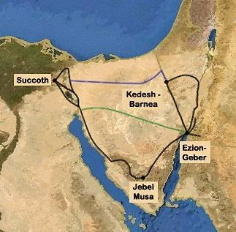
Exodus & Moses
Notes:
Goshen in Egypt
According to the Joseph narrative in the Book of Genesis, the sons of Israel who were living in Hebron, experienced a severe famine that lasted seven years. Since word was that Egypt was the only kingdom able to supply food, the sons of Israel journeyed there to buy goods. In the second year of famine, the Vizier of Egypt, Joseph, invited the sons of Israel to live in Egyptian territory. They settled in the country of Goshen. Goshen is described as the best land in Egypt, suitable for both crops and livestock. It has been suggested that this location may have been somewhat apart from Egypt, because Genesis 46:34 states, "Ye may dwell in the land of Goshen; for every shepherd is an abomination unto the Egyptians." After the death of Joseph and those of his generation, the following generations of Israelites had become populous in number. The Egyptians feared potential integration or takeover, so they enslaved the Israelites and took away their privileges. The Egyptians forced them to build store-cities at Pithom, Raamses and Heliopolis (On).
Centuries later, Moses was called to lead the Israelites out of Egypt, from the Goshen to Succoth, the first waypoint of the Exodus. They pitched at 41 locations crossing the Nile Delta, to the last station being the plains of Moab.
Some favor that if there was an exodus, it was related to expulsion of the Hyksos, a Semitic people that came to power in Egypt about 1600 BC and left in approximately 1450 BC. The Jewish Semites went along with them… Rameses (Ex 12:37; Nm 33:3) was the starting point of the Exodus. There is no reason to doubt that Biblical Rameses is the same as Pi-Rameses in Egyptian texts (Kitchen 2003: 255; Wood 2004; Hoffmeier 2005: 53, 55). The city, whose full hieroglyphic name was “House of Ramesses, Beloved of Amun, Great of Victories,” was originally built on the eastern bank of the Pelusiac, the easternmost of the Nile’s five ancient distributary branches.
First Stop along the Exodus path: Succoth.

Slide 2
Exodus & Moses
No substantial evidence other than Bible.
Documentarians, Liberals and Minimalists agree that it’s a hoax.
Exciting New Discoveries await publication…

Slide 3
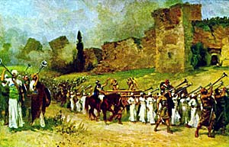
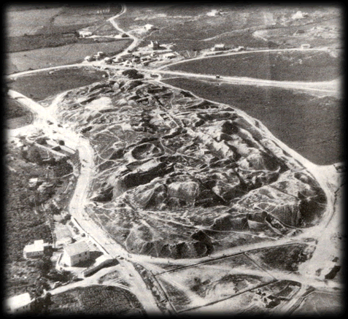
Jericho
Notes:
Described in the Old Testament as the "City of Palm Trees", copious springs in and around Jericho have made it an attractive site for human habitation for thousands of years. It is known in Judeo-Christian tradition as the place of the Israelites' return from bondage in Egypt, led by Joshua (Joshua 6:1-27), the successor to Moses. Archaeologists have unearthed the remains of more than 20 successive settlements in Jericho, the first of which dates back 11,000 years (9000 BCE), almost to the very beginning of the Holocene epoch of the Earth's history; i.e., end of the last Ice Age. Bronze age
Archaeological evidence indicates that in the latter half of the Middle Bronze Age (circa 1700 BCE) the city enjoyed some prosperity, its walls having been strengthened and expanded.^{[17]} According to carbon dating the Canaanite city (Jericho City IV) was destroyed between 1617 and 1530 BCE, but rounded at c.1550 BCE. Some scholars, who favor the early exodus theory, relate the destruction of Jericho in 16th century BCE with the conquest by Joshua. The site remained uninhabited until the city was refounded in the 9th century BCE. Bronze age
The first excavations of the site were made by Charles Warren in 1868. Ernst Sellin and Carl Watzinger excavated Tell es-Sultan and Tulul Abu el-'Alayiq between 1907–1909 and in 1911, and John Garstang excavated between 1930 and 1936. Key events (after the advances made by William F. Albright at Tel Beit Mirsim in the 1920s) brought about our modern understanding of pottery in the southern Levant: Extensive investigations using more modern techniques were made by Albright ‘s protégée Kathleen Kenyon between 1952 and 1958. Lorenzo Nigro and Nicolo Marchetti conducted excavations in 1997-2000. Since 2009 the Italian-Palestinian archaeological project of excavation and restoration was resumed.
Bryant Wood has shown that a destruction date of ~1400 BC is confirmed by pottery remains (Cypriot facsimile), agreeing with 1930’s excavator John Garstang, but disagreeing with 1950’s excavator Kathleen Kenyan.

Slide 4
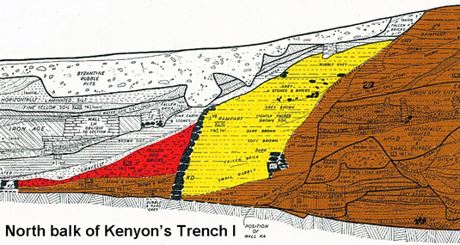
Jericho:
Kathleen Kenyon’s drawing of outwardly fallen wall
Notes:
Critical issue regarding authenticity of Bible: Chronology! Ruins should show evidence of Joshua’s conquest, but noted archaeologist Kathleen Kenyon reported in early 1980’s that the site was destroyed during Bronze age in ~1550 BC instead of expected 1400 BC. She determined this based upon the lack of imported pottery for that year. However, she overlooked earlier finds of her predecessor John Garstang, who found the precise 1400 BC pottery in another, more affluent, section of the city… Additionally, radiocarbon (C-14) of burnt wood and other organics shows age of 1500 BC or older, but Bryant Wood points out that tested wood may have been well over 100 years old…

Slide 5
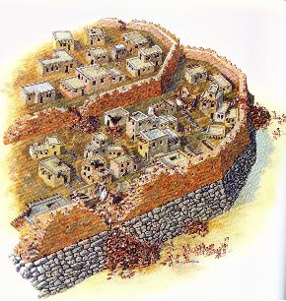
Jericho
Notes:
Fallen portions of red-brick rampart that Kathleen Kenyon found.

Slide 6
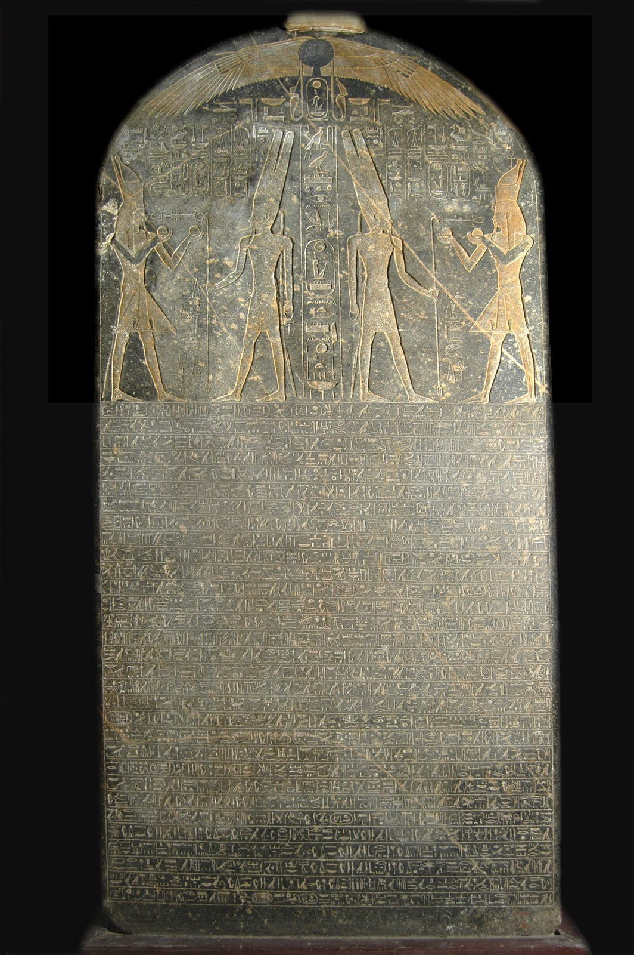
Merneptah
Victory Stela
This engraved slab of granite is more than seven feet tall and was found in Western Thebes, Egypt. It contains the first mention of “Israel” outside of the Bible: “Israel is laid waste, his seed is not.” It was carved c. 1208 BC and is now located in the Egyptian Museum, Cairo.
PHOTO: ©Greg Gulbrandsen
Notes:
Described destruction of Israel by Egyptian forces. Merneptah was the son and successor of Ramesses II. This reference suggest that by 1208 (when inscription carved) the Israelites were already in the land of Canaan. Regarding the exodus, two possible dates emerge: 1250-1270 BC and 1446/7 BC.

Slide 7
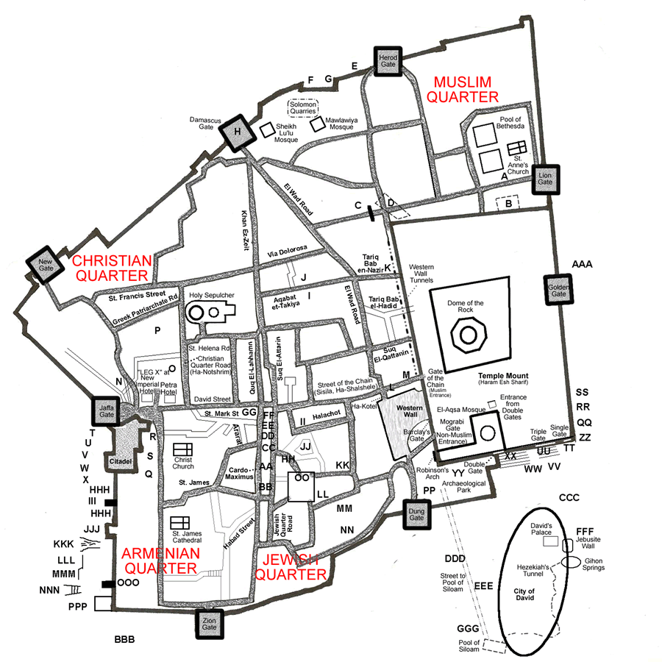
JERUSALEM TODAY
Tem
Temple
Mount
City of
David
Notes:
Temple Mount: Where 1st (Solomon’s) and 2nd Hebrew Temples stood, now under Muslim administrative control. Dome of the Rock (Mohammad prayed there), several other Domes, and the 3rd most holy Muslim site (Al-Aqsa Mosque—where Mohammad landed on horse) now exist.
The Western Wall (or Wailing Wall), the Kotel, is the most significant site in the world for the Jewish people. It is considered the last remnant of the Temple. Jews from around the world gather here to pray. People write notes to God and place them between the ancient stones of the Wall.
City of David Ophel: oldest settled neighborhood of Jerusalem and a major archaeological site due to recognition as biblical Jerusalem. It is a narrow ridge running south from the Temple Mount. Not yet recognized as authentic by some scholars.
Biblical Archaeology Chronology
1.1 Chalcolithic (4500–3500 BCE)
1.2 Early Bronze Age (3500–2350 BCE)
1.3 Middle Bronze Age (2000–1550 BCE)
1.4 Late Bronze Age (1550–1200 BCE)
1.5 Iron Age I (1200–980/70 BCE)
1.6 Iron Age IIa (1000–900 BCE)
1.6.1 Necropolis
1.7 Iron Age IIIb (8th century – 586 BCE)
1.8 Babylonian and Persian periods (586–322 BCE)
1.9 Hasmonean and Herodian periods (167 BCE – 70 CE)
1.10 New Testament references for the City of David being Bethlehem
1.11 Byzantine and early Islamic Periods (324–1099 AD)

Slide 8
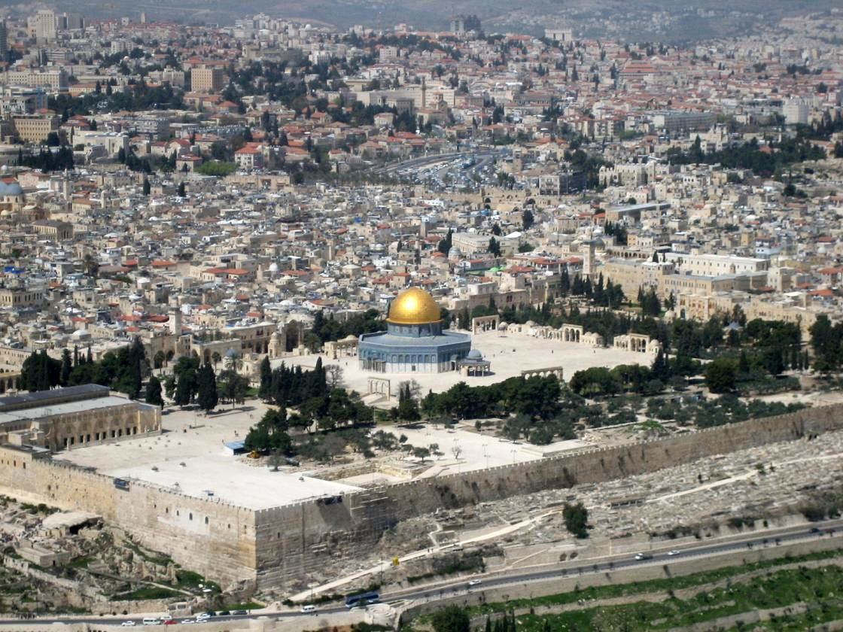
Temple Mount
Notes:
The most important religious sites in the Old City of Jerusalem. It has been used as a religious site for thousands of years by at least four religions: Judaism, Islam, Christianity, and Roman paganism. Israel allotted Muslims religions control of mount. What political challenges do the Muslims present to Israel regarding the Temple Mount, Jerusalem, Israel? E.g., Most countries of Muslim faith want Israel/Judaism out of the land and political authority given to the Palestinian Arabs. Religious Jews want a new temple built on the Mount…
al-Aqsa Mosque and Dome of the Rock on the site

Slide 9
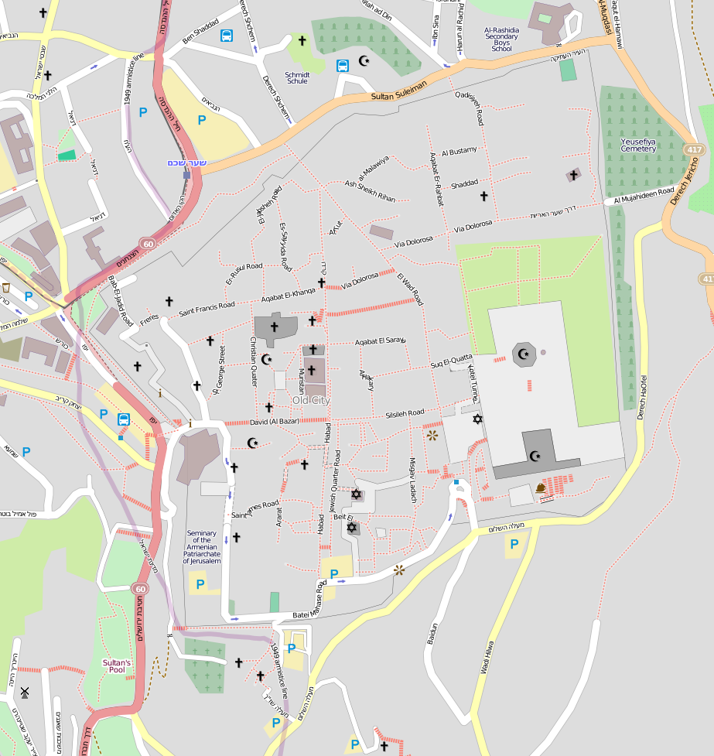
Temple Mount
Dome of the Rock
al-Aqsa Mosque

Slide 10
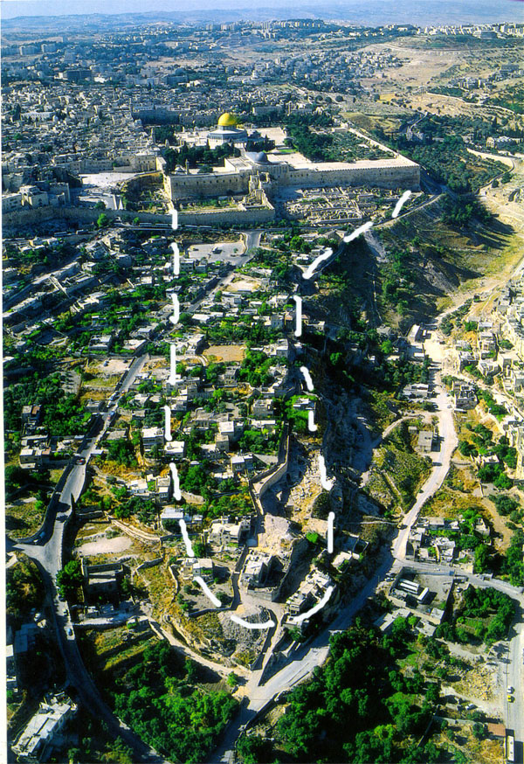
King David in Archaeology: City of David
Notes:
Ariel view of the modern location of the City of David – Looking from South to North. The white broken-line is where the ancient city of David was located (which is outside the city wall today)

Slide 11
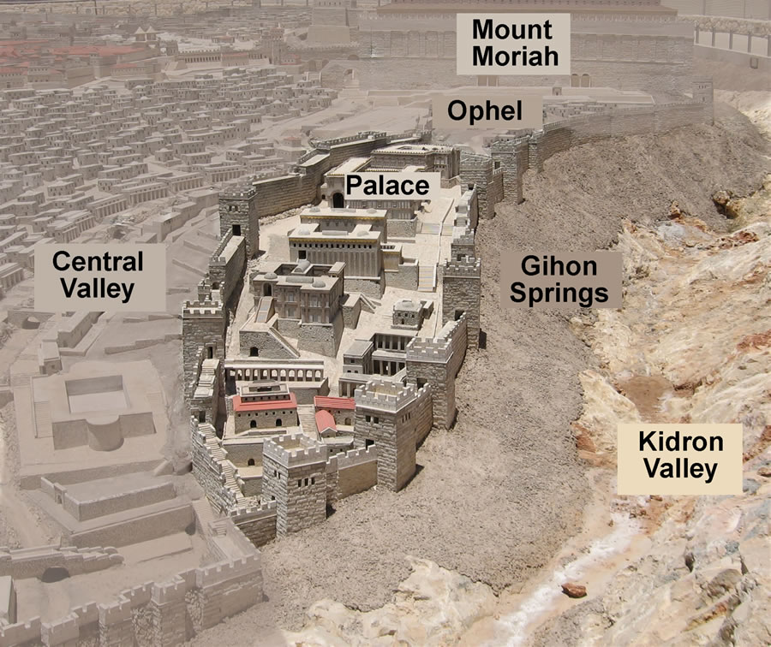
King David in Archaeology: City of David
Notes:
City of David, from Holyland Model of Jerusalem. (Ophel = meaning fortified hill or risen area). Mount Moriah = Temple Mount area and site where Abraham went to sacrifice his son Isaac.

Slide 12
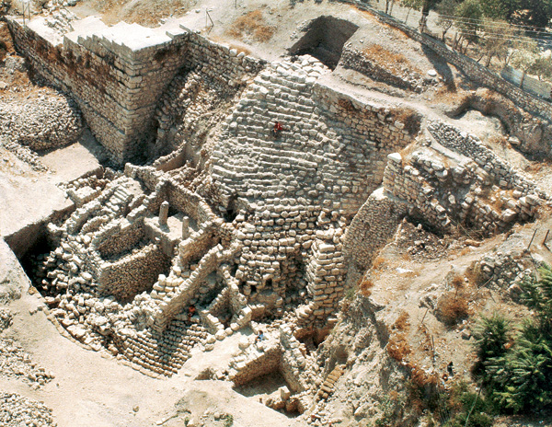
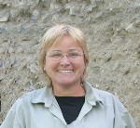
King David in Archaeology
Eilat Mazar
King David’s Palace..?
Notes:
Israeli archaeologist Eilat Mazar (daughter of Benjamin Mazar’s, “Dean” of Israel archaeology) believes the evidence she has uncovered during months of excavation and biblical comparison points to an extraordinary discovery.
She believes she has found the palace of King David, the poet-warrior who the Bible says consolidated the ancient Jewish kingdom around the 10th century B.C. and expanded its borders to encompass the Land of Israel. Only a small fraction of the structure has been exposed. Some archaeologists believe Jerusalem was no more than a tiny hilltop village when it served as David's capital. The discovery of a palace or other large public building from David's time would strengthen the opposing view that he and his son, Solomon, presided over a civilization grander than the collection of rural clans some historians say made up the Jewish kingdom. Whether David was a tribal chieftain or visionary monarch matters deeply to the Jewish historical narrative. Why would confirmatin of a discovery of this magnitude be so politically important?

Slide 13
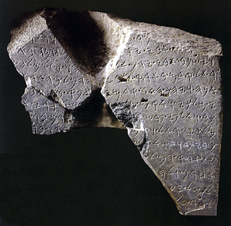
King David in Archaeology
TELL DAN STELA
This Inscribed monument contains the oldest known reference to King "David" outside of the Bible. 800-845 BC
Notes:
TELL DAN STELA: As stated earlier, Minimalists claimed that if David and Solomon existed, they were simply pastoralist chieftains from the hills of Judea, and thus their military exploits were gross exaggerations from later times (somewhat supported because their names are not found in in Egyptian texts). In 1993 however this view was challenged with this find. This fragment was a statement by King Hazael, who claims to have defeated “Jehoram king of Israel and killed Ahaz son of /// I overthrew the house of David.” These two ruled from 852 to 841BC, and 841 BC. Both killed by usurper general Jehu, who became king of Israel.

Slide 14
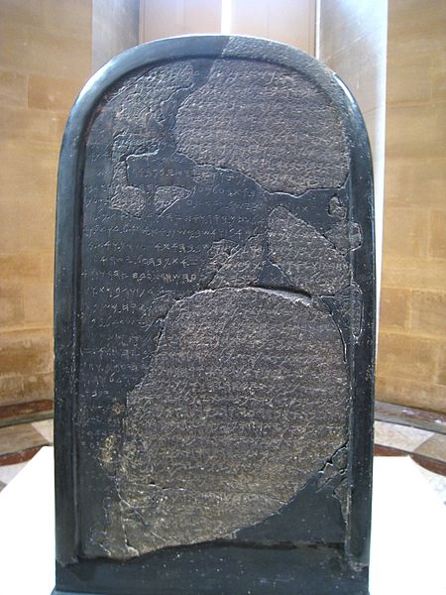
King David in Archaeology
Mesha Stela
Refers to the “Kingdom of Israel” and “House of David.
~840 BC
Notes:
Another find, the Mesha Stela mentions that King Mesha of Moab in 850 and 840 BC attached Ataroth in Gad in Trans-Jordan. The alter hearth of YHWWH mentioned clear reference to God of Israel. Towards end of stela he mentions earlier occupation of one of his cities by “the house of David.”
Mesha of Moab (a kingdom located in modern Jordan). Mesha tells how Kemosh, the God of Moab, had been angry with his people and had allowed them to be subjugated to Israel, but at length Kemosh returned and assisted Mesha to throw off the yoke of Israel and restore the lands of Moab. Mesha Stele in the Louvre Museum.

Slide 15
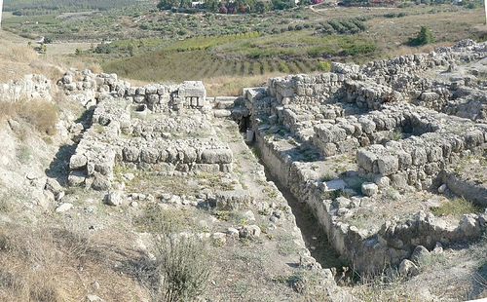
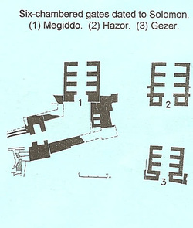
King Solomon’s Defense Gates
1st Kings 9:15
Notes:
Architectural evidence of ancient Israel lends support for important biblical characters. King Solomon is known as a great builder for such structures as the Temple, but he also built the defense and trade-route cities of Hazor, Mediddo and Gezer between 970 and 950 BC., where six-chambered gate systems were his forte. Note that Gezar is in the southern kingdom (Judah) whereas Hazor and Megiddo are in Israel, which is in disagreement with Minimalists’ claim that the southern kingdom was never developed and is thus indicative that Judah was nothing but frontier, and that David and Solomon either were myth or they were small-town chieftains and not monarchs…
Dated to 10th century BC… Destruction tied to Pharaoh Shishak’s campaign in 926 BC for Gezer and Megiddo. Solomon’s building period reported to be mainly 970 to 950 BC. An additional 6-chambered gate found at Tel “Ira in the south near Beer-Sheba.
The gate at Megiddo includes a courtyard in front which is created by heavy, angular walls. A heavy, angular wall was discovered in front of the eastern gate of the Temple Mount in Jerusalem by Charles Warren in the late 19th century.
I Kings 9: 15 “Here is the account of the forced labor Solomon conscripted to build the Lord’s temple, his own palace, the supporting terraces, the wall of Jerusalem, and Hazor, Megiddo and Gezer.”

Slide 16
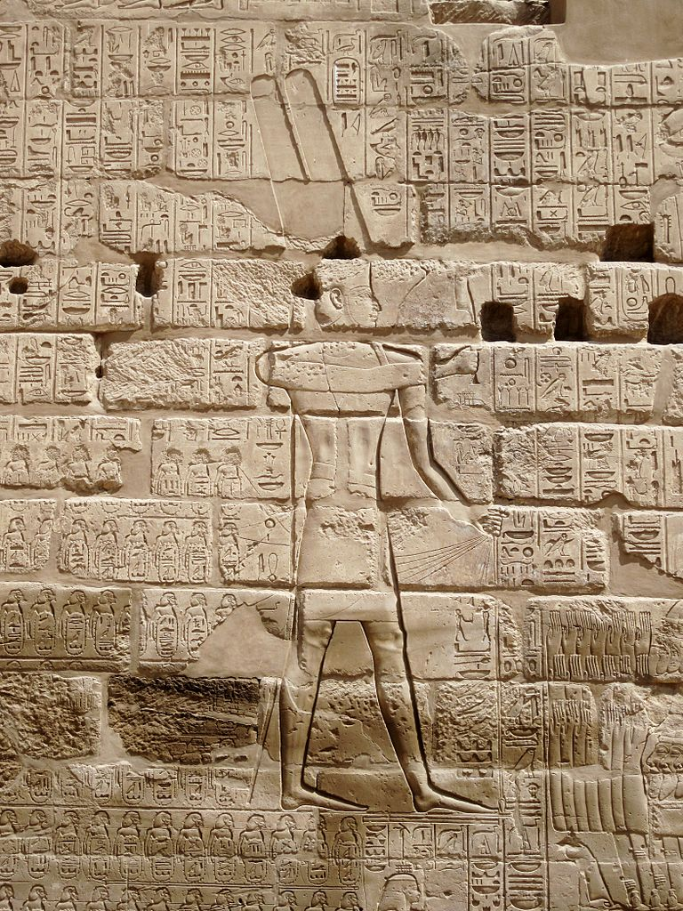
Egyptian invasion into Israel
This wall carving within the Karnak Temple complex in Egypt commemorates Pharaoh Shishak's invasion into Israel, c. 925 BC.
Notes:
Shishank (Shoshenq I): 1st Egyptian Pharaoh mentioned by name in Bible (1st Kings 14:25, and 2 Chron 12:1-12). Invaded in 5th year of King Rohoboam (Solomon’s son ruled 926 – 917 BC), Egypt swept thru Judah and took royal treasures from Jerusalem. However, no mention on Karnack Temple wall, which list most or all of Shishak’s military campaigns (claims all were won…). Minimalists credit this as proof there was no Davidic line of kings… Note; this was likely more of a large raid as Shishank had to deal with more powerful Assyrians in Nineveh. Also, many of the cartouche’ have been worn off the wall…

Slide 17
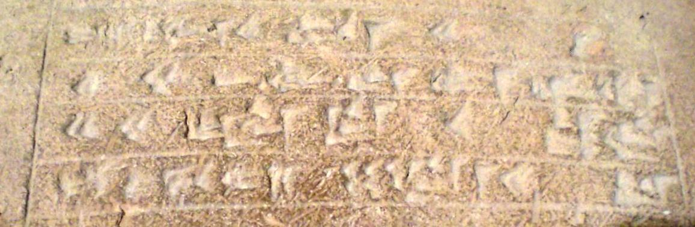
Brick from Assyrian Ruler Sargon II
Notes:
This inscribed portion of a brick now located in the Oriental Institute Museum at the University of Chicago refers to the Assyrian King Sargon II who reigned from 721 to 705 BC. The brick was found in the ancient Assyrian city of Khorsabad during excavations that took place from 1929 to 1935. Sargon is also referred to in the Bible in Isaiah 20:1.

Slide 18
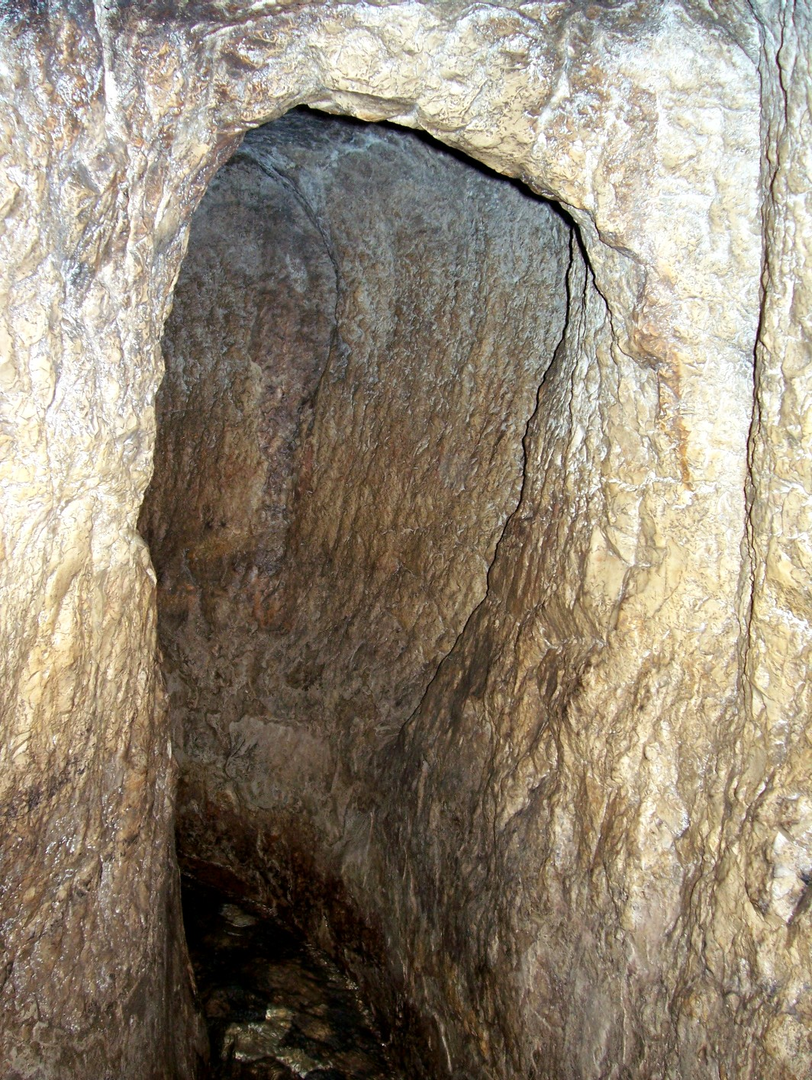
Hezekiah's tunnel
In the Biblical passage found in 2 Kings 20:20 there is a reference to a "tunnel" built by King Hezekiah in Jerusalem to channel water into the city, c. 700 BC. The tunnel is still open, and visitors can walk through it. It is about 1/3 of a mile long, and the water is roughly knee deep.
PHOTO: ©Greg Gulbrandsen
Notes:
Judah’s King Hezekiah (late eighth century B.C., & 13 kingships removed from David) anticipated a siege against Jerusalem by the Assyrian monarch Sennacherib (son of Sargon II), especially due to the siege and destruction/massacre at Judah’s largest city of Lachish.
To protect the city’s water supply during the siege, Hezekiah undertook a strategic engineering project that would be an impressive feat in any age: He ordered the digging of a 1,750-foot tunnel under the City of David to bring water from the Gihon Spring, which lay outside the city wall, inside the city to a pool (to bescome known as the Siloam Pool) on the opposite side of the ridge. In the years that followed, “Hezekiah’s Tunnel” continued to carry fresh water to this section of Jerusalem, and different pools were built here over the centuries, including the Second Temple pool that Jesus knew. Hezekiah’s commemorating plaque was taken to Turkey during Ottoman reign and is on display there.
While the tunneling in Jerusalem was proceeding,King Sennacherib was attacking the City of Lachish: Judah’s largest city guarded the region from 10th -6th century BC (Bronze and Iron ages). Presently the city site called Tell ed-Duwier. 30 miles SW of Jerusalem. Represented by King Sennacherib’s base relief in Assyrian city of Nineveh, depicting destruction and slaughter of city and occupants. In 701 BC Sennacherib attacked Judah for reneging on taxes (Israel already fully occupied for 30 years). However, later, King Hezekiah and Israel prayed to God for help and in the night 185K Assyrian soldiers died in their sleep. Sennacherib’s own sons afterwards killed him with their swords. No mention of Jerusalem found on base relief. Lachish is only known Assyrian siege ramp. All this represents a great convergence of the Bible, extra-biblical text, archaeology and iconology. More on Lachish to follow…
Note: Joshua concurred per Jos 10:23, 31-33. King Nebuchadnezzar of Babylon captured Lachish in 587 BC for 2nd exile; Jews resettled afterwards—pottery found.

Slide 19
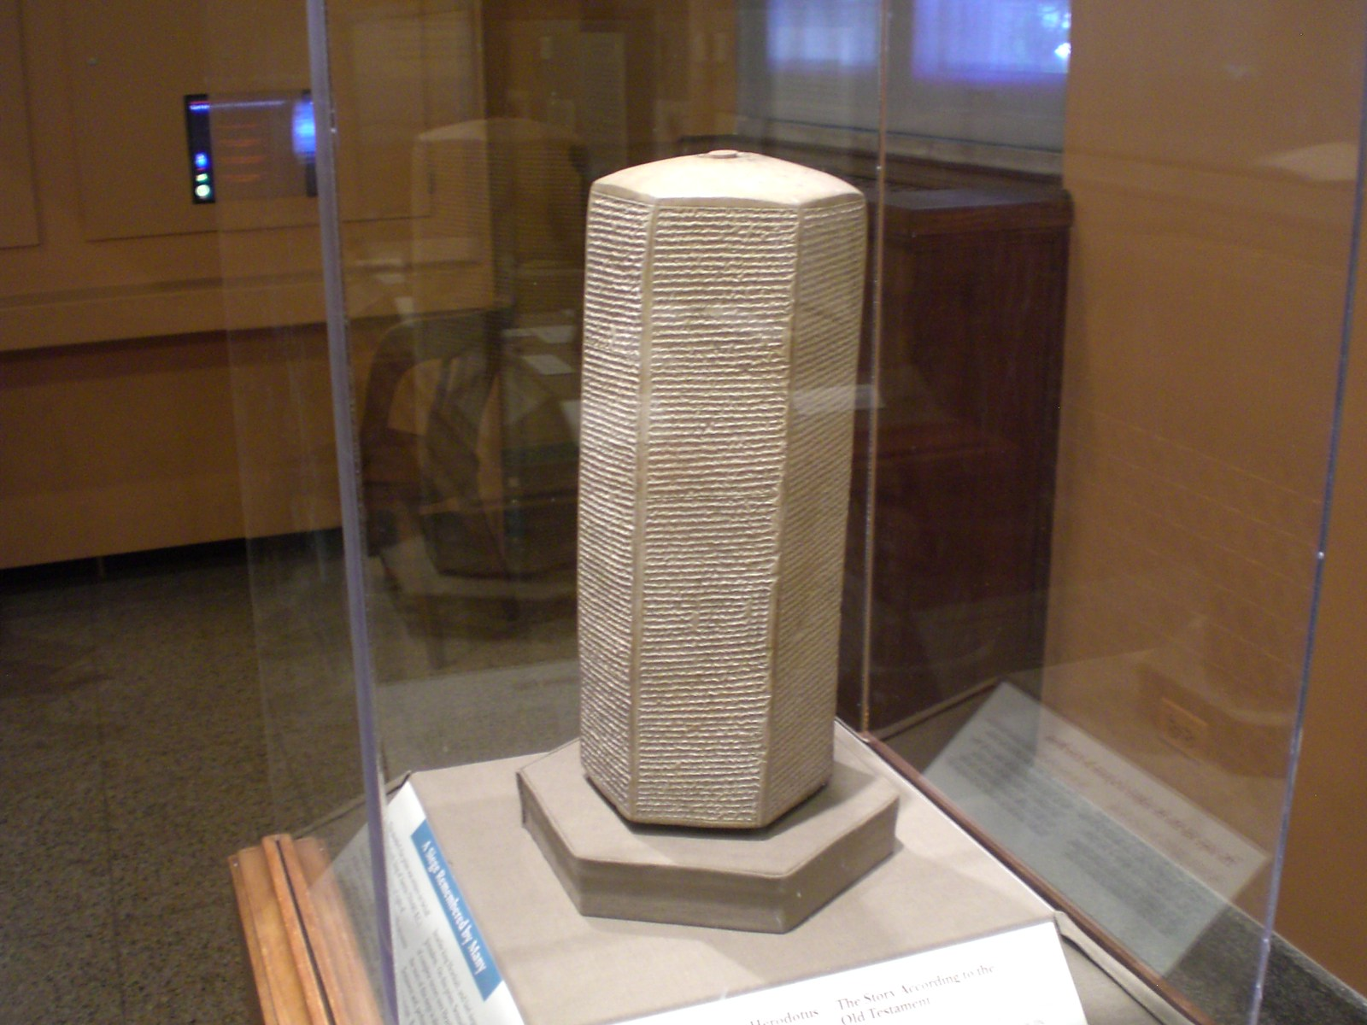
Ancient record of Biblical King
This artifact is known as the "Prism of Sennacherib,“ made in ancient Assyria, c. 700 BC.
Has written text that refers to Biblical King Hezekiah.
Notes:
It is a six-sided object approximately 15" tall made of baked clay. It is now located in the Oriental Institute Museum at the University of Chicago.

Slide 20
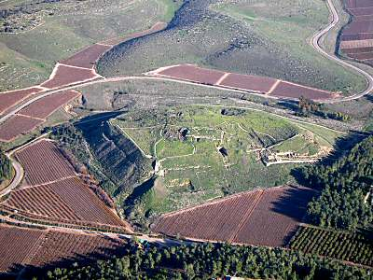
Tel Lachish
Identified first as Lachish by Albright in 1929. Lachish is generally regarded as the second most important city in the southern kingdom of Judah. It enters the biblical narrative in the battle accounts of Joshua, Sennacherib and later, Nebuchadnezzar.

Slide 21
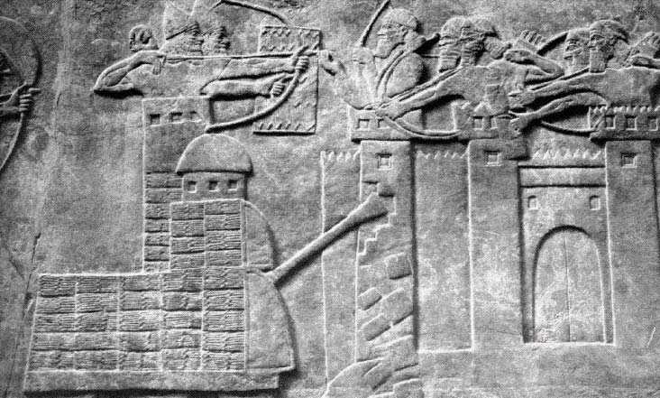
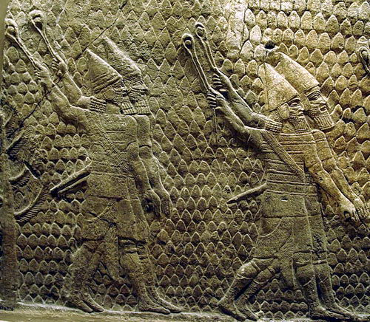
Battle of Lachish
This wall relief carving was created in c. 700 BC and was rediscovered in the 1850's in the ancient city of Nineveh, Assyria. It depicts the siege of Lachish by King Sennacherib, telling the story from the Assyrian point of view. The events are also recorded in the Bible in 2 Kings 18-19.
Notes:
King Sennacherib & city of Lachish: Judah’s largest city guarded the region 10th -6th century BC (Bronze and Iron ages). Presently city site called Tell ed-Duwier. 30 miles SW of Jerusalem. Represented by King Sennacherib’s base relief in Assyrian city of Nineveh, depicting destruction and slaughter of city and occupants. In 701 BC Sennacherib attacked Judah for reneging on taxes (Israel already fully occupied for 30 years). It now resides in the London Museum.
While Lachish being destroyed, King Hezekiah built “Hezekiah’s Tunnel” for water security (Gihon Springs to city) for expected siege of Jerusalem. However, later, King Hezekiah and Israel prayed to God for help and in the night 185K Assyrian soldiers died in their sleep. Sennacherib’s own sons afterwards killed him with their swords. No mention of Jerusalem found on base relief. Lachish is only known Assyrian siege ramp. All this represents a great convergence of the Bible, extra-biblical text, archaeology and iconology.
Note: Joshua concurred per Jos 10:23, 31-33. King Nebuchadnezzar of Babylon captured Lachish in 587 BC for 2nd exile; Jews resettled afterwards—pottery found.

Slide 22
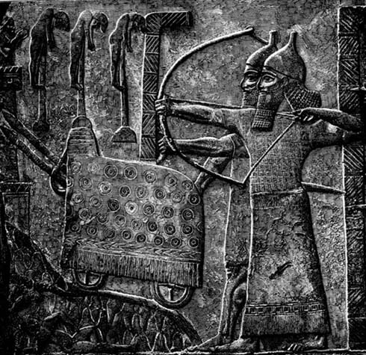
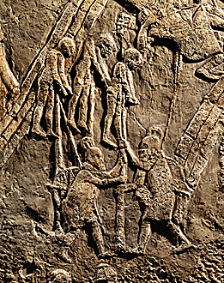
Battle of Lachish
Images of battering ram and archers. Terror was also a potent weapon - see the impaled captives at top left of image.
Notes:
WHO The Assyrian king Sennacherib conquered it with terrible carnage - archaeologists discovered a mass grave with 1,500 human skeletons, mostly of women and children. Pictures show some of the gruesome ways he killed them. WHAT Lachish was a fortified town with a history of violence: despite its massive walls and six-chambered gates it was conquered several times, most notably by Sennacherib. WHEN In 701 BC Sennacherib attacked Judah for reneging on taxes. It was already a fortified city in 16th century BC. Only a small settlement was rebuilt after the Exile in Babylon
WHERE It lay in low hills about 48km/30miles SW of Jerusalem.

Slide 23
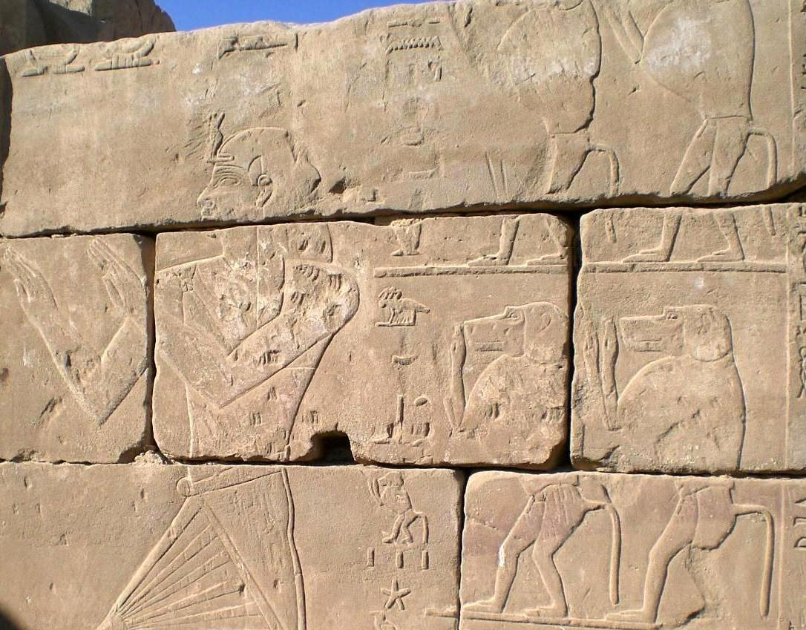
Carved Image of Egyptian pharaoh
This wall carving is from the Edifice of Tirhakah in the Karnak Temple in Luxor, Egypt (7th century BC). Pharaoh Tirhakah, originally from the Kingdom of Cush, is referred to in the Bible in both 2 Kings 19:9 and Isaiah 37:9.
PHOTO: © Michael J. Caba
Notes:
It shows Pharaoh Tirhakah on the left and baboons on the right worshipping the Egyptian god Re (sun god, evolved into different forms over time).

Slide 24
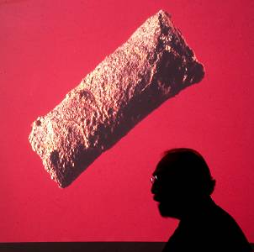
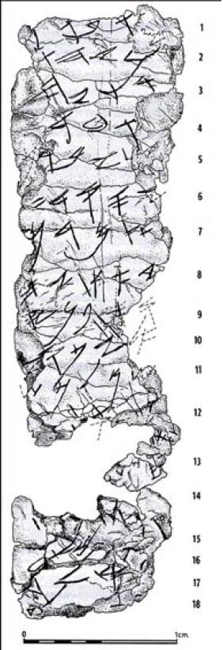
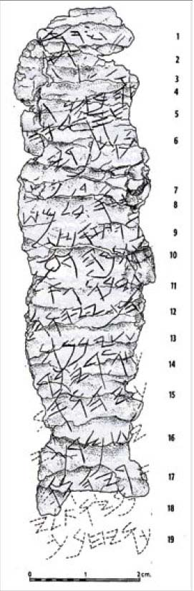
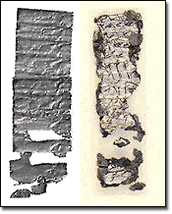
7th Century BC Silver Amulet Scrolls
Inscribed with Numbers 6:24-26. “The LORD bless you and keep you; The LORD make His face shine upon you, And be gracious to you; The LORD lift up His countenance upon you, And give you peace.”
Notes:
Upper left is one of the silver scrolls looked shortly after it was removed from the tomb at Ketef Hinnom by Gabriel Barkay. Scholars determined that the scrolls were inscribed with the ‘priestly blessing’ found in Numbers 6:24-26. While excavating a burial tomb near Jerusalem in 1979, Barkay uncovered the oldest known copy of Old Testament scripture,. dated to the 7th century B.C. Much to Minimalist's chagrin, this pre-dates the Babylonian Captivity, and thus refutes their claim that the bible was written after this event…
“This was a discovery of utmost importance,” said Barkay, professor of archaeology at Bar Ilan University near Tel Aviv. “These verses pre-date the famous Dead Sea Scrolls by approximately four centuries. They are the only biblical verses we have from the time of the First Temple [period].” The two silver scrolls were discovered by Barkay’s team in a rock-hewn burial cave southwest of the ancient city of Jerusalem. The structure of the tomb was of interest to Barkay because it dated to the First Temple period, but it appeared that over centuries looters had taken all the artifacts. The tomb had last been used for storing Turkish army rifles during the Ottoman period. At some point a layer of the repository’s ceiling broke lose and covered the collected bones and personal items. Barkay said that the piece of ceiling appeared to be nothing more than the repository floor. An Israeli schoolboy helping clean the repository during excavations accidentally broke through the layer, revealing many bones and artifacts below.
As the team sifted through the items in repository, they discovered the two scrolls. After the initial discovery in 1979, scholars had the daunting task of unrolling and deciphering the text. They had no idea how important the find would be.
“It took us three years to unroll it [the larger scroll],” Barkay said. “When unrolled, it was covered with very delicately scratched characters. The first word we could decipher was the ‘YHWH’ . This is the name of the Lord in the Hebrew Bible.”
Until this time no inscriptions with the name of God had been found in Jerusalem. The larger of the two scrolls was only about three inches long when it was unrolled. The smaller one was just over two inches long. Barkay said the thin fragile silver of each scroll was etched with 19 lines of tiny, Hebrew script. It was years before researchers realized that the inscription was an almost exact representation of the priestly blessing found in Numbers. Careful study revealed that the Hebrew characters used were distinctive of the 7th century B.C.
In English the verses read: “The LORD bless you and keep you; The LORD make His face shine upon you, And be gracious to you; The LORD lift up His countenance upon you, And give you peace.”
The find is significant because it helps establish the historicity and the age of Old Testament scripture. In the late 1800s German higher critics began questioning the date the Pentateuch (the first five books of the Old Testament) was composed in written form. Many of these critics argued that this section of scripture was written some time after the Babylonian exile.
According to Barkay, the discovery of this early biblical inscription is an important part of the argument for an early dating of the Old Testament. He acknowledges that the find does not prove that the Pentateuch was written by the 7th century. However, it is strong evidence for that position.
“I can at least say that these verses existed in the 7th century ... the time of the prophet Jeremiah and the time of King Josiah,” Barkay said.
Barkay published a book about the find in 1986, but recent advances in computer technology have helped researchers discover additional verses on the silver scrolls. The new research technique revealed that the scroll contains other verses from the Pentateuch.

Slide 25
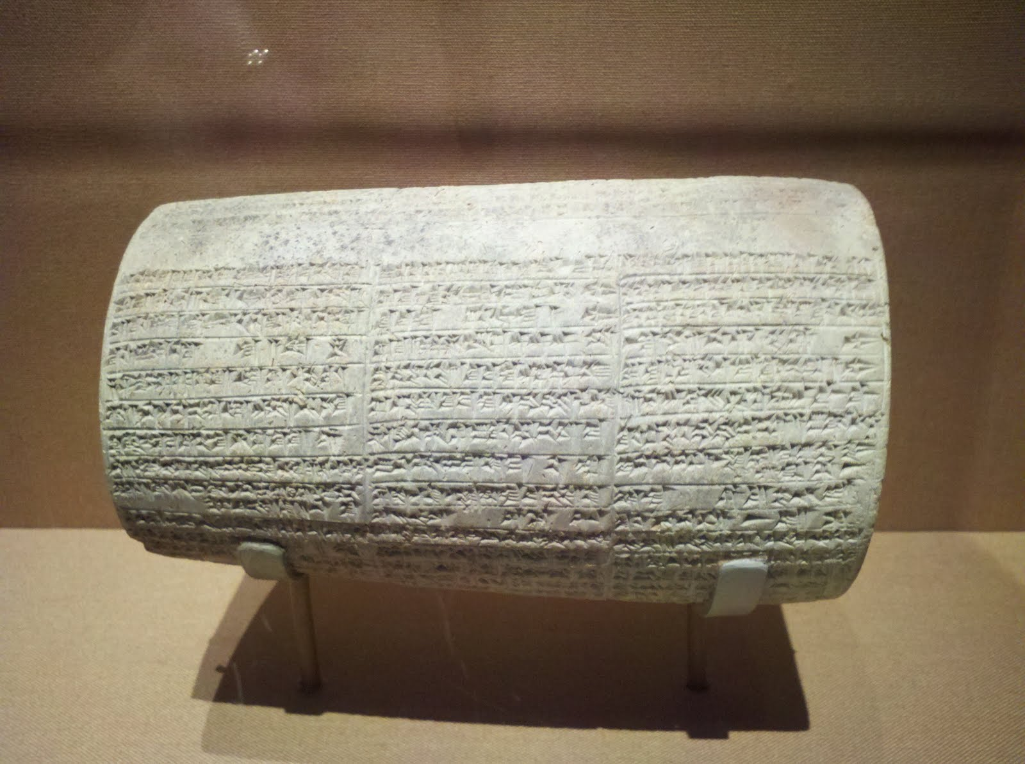
Nebuchadnezzar named on cylinder
This cylinder is inscribed with the name of Babylon’s King Nebuchadnezzar (reigned 604-566 BC) , who is referred to in the Bible more than any other foreign king:
PHOTO: © Michael J. Caba
Notes:
It is located in The Metropolitan Museum of Art in New York, and refers to the king's building projects. This clay cylinder was found in the ruins of the city of Babylon. The cuneiform text describes the three palaces which Nebuchadnezzar II (reigned 604-562 BC) built for himself in Babylon. Cylinders of this type were buried in the corners of all large buildings by Nebuchadnezzar and his successors. They were meant to be found and read by future kings whenever the buildings had to be repaired.

Slide 26
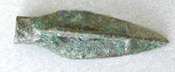
Babylonian arrowhead
This arrowhead was recently found in Jerusalem in material retrieved from the Temple Mount. It is of the type used by the Babylonian army that destroyed the Temple in Jerusalem in 586 BC. The attack is recorded in the Bible in 2 Kings 24:10.
Notes:
Ask about Temple Mount politics; e.g., why was this found in “material retrieved” from there, and not excavated in a bona fide archaeological dig..?

Slide 27
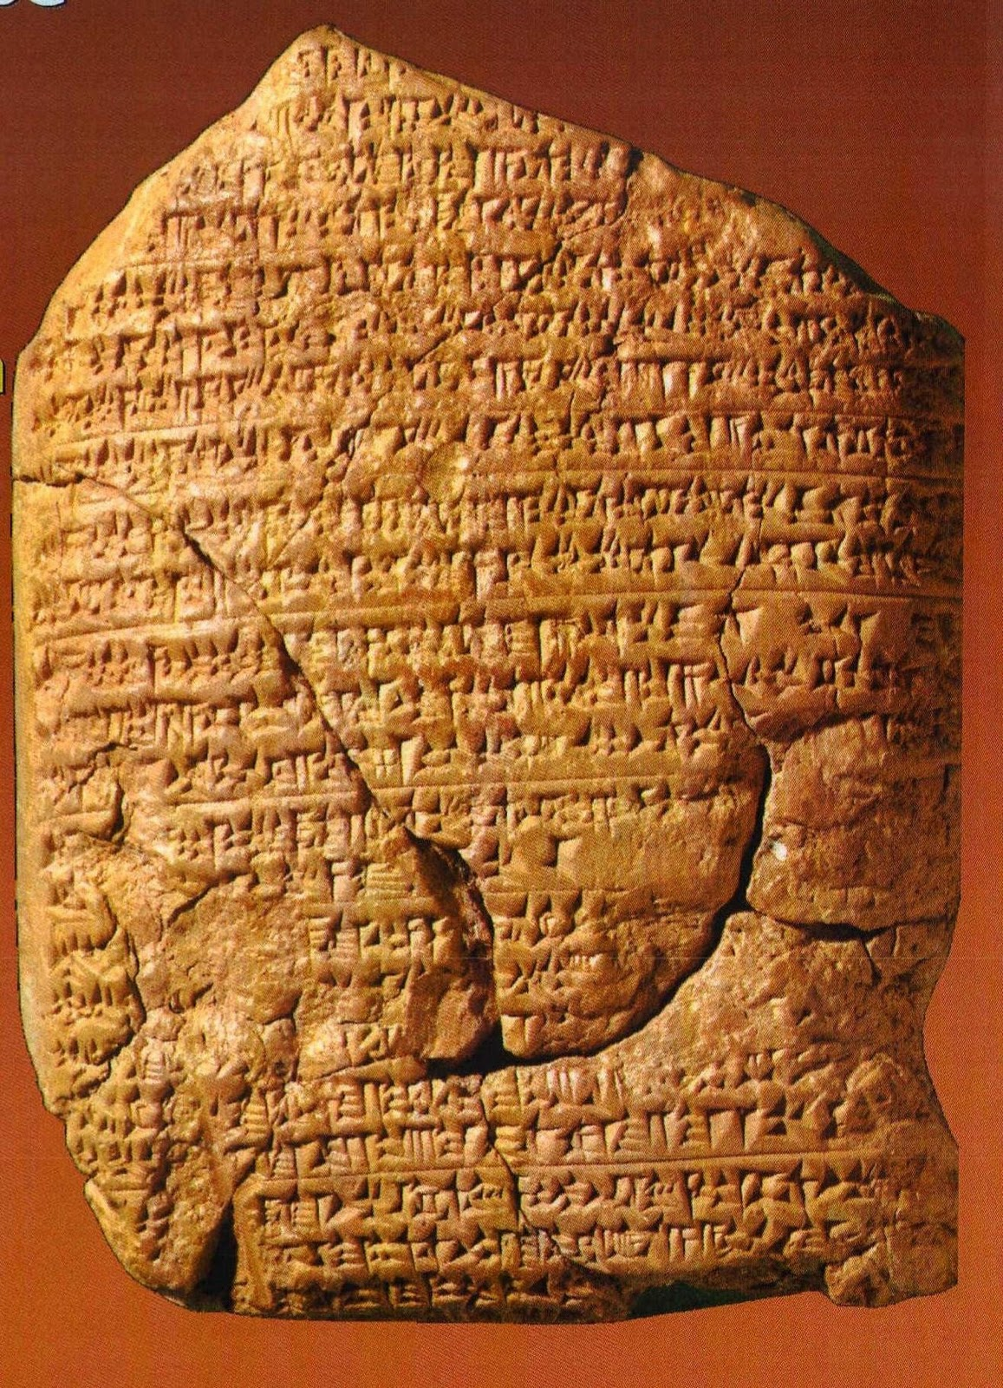
Babylonian Chronicles
This ancient clay tablet is part of the Babylonian Chronicles, which records the capture of Jerusalem by the Babylonians in 597 BC.
The event is also recorded in the Bible in 2 Kings 25.
Notes:
The Assyrian and Babylonian chronicles (or Mesopotamian Chronicles) are historiographical texts from ancient Mesopotamia. They are many series of tablets recording major events. Although they contain references to the earliest times, they deal especially with the second half of the second and the entire first millennium down to the first century BCE. This tablet was discovered in the late 1800s and is now located in the Brtitish Museum.

Slide 28
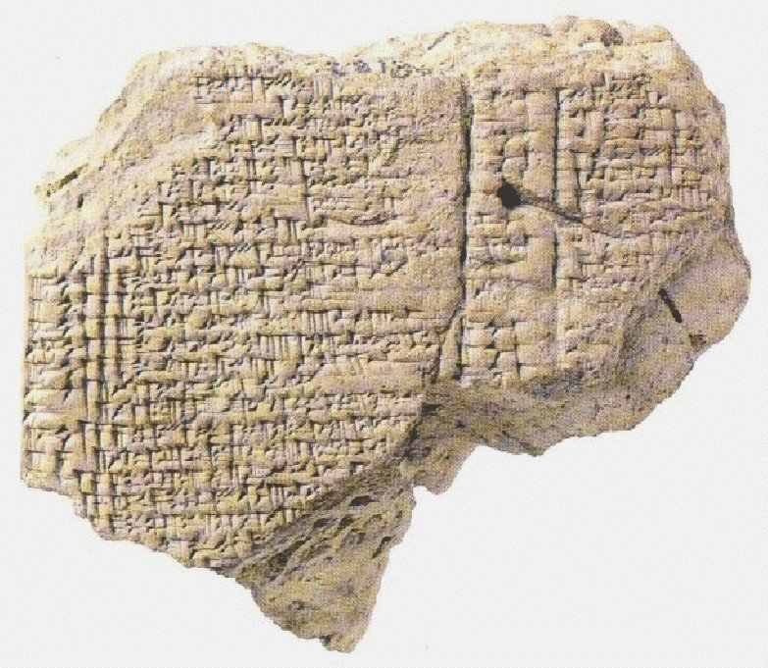
King Jehoiachin mentioned by Babylonians
This 3" tall tablet from ancient Babylon describes the captured Jewish king.
2 Kings 25:29-30, states that he received a "regular allowance" from the king of Babylon. The tablet was made in c. 595-570 BC, was discovered 1900.
Notes:
He was a king of Judah who was dethroned by the King Nebuchadnezzar of Babylon in the 6th Century BCE and was taken into captivity. Excavated near the Ishtar Gate in Babylon and have been dated to c. 592 BC. Written in Cuneiform, they mention Jeconiah ("Ia-'-ú-kinu") and his five sons as recipients of food ration in Babylon.[Jeremiah (22:28-30) cursed Jeconiah that none of his descendants would ever sit on the throne of Israel:
Thus says the LORD: 'Write this man down as childless, A man who shall not prosper in his days; For none of his descendants shall prosper, Sitting on the throne of David, And ruling anymore in Judah.'"
It is now located in the Museum of the Ancient Near East, Pergamum Museum, Berlin.

Slide 29
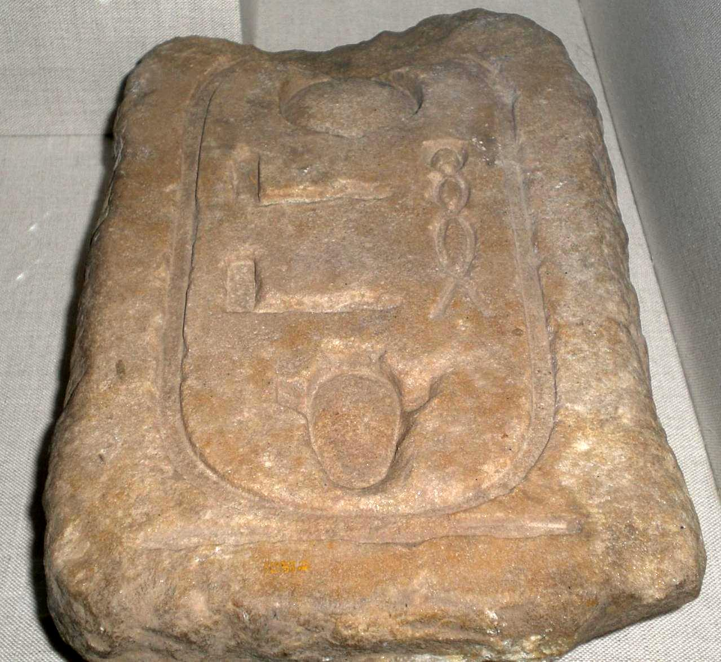
A Pharaoh recorded in the Biblical text and archaeological record
This sandstone block is on display in the Oriental Institute Museum at the University of Chicago. The name (cartouche) on the artifact is "Haaibra," the throne name of Pharaoh Hophra who is referred to in the Bible in Jeremiah 44:30.
Notes:
This Pharaoh, called Apries Ouaphres in Greek, is mentioned in Jeremiah 44:30 as Pharaoh Hophra king of Egypt who reigned 589-570 BC. Jeremiah mentions him in the same context as Nebuchadnezzar, and predicts that the Pharaoh will fall to his enemies. This particular pharaoh, ruling at the time of this Jewish flight into Egypt, was later assassinated by his own enemies in the palace, with the resulting turmoil giving Nebuchadnezzar and his armies occasion and opportunity to invade and subjugate Egypt.

Slide 30
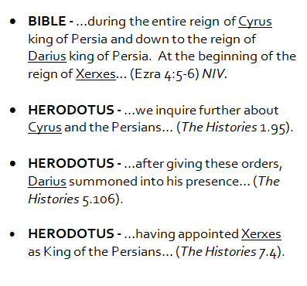
Persian kings recorded by both the Bible and the Greek historian Herodotus
Both the Bible and the Greek historian Herodotus speak about the same Persian kings: Cyrus, Darius and Xerxes. In the quotes shown to the left, the Bible is given first, followed by three quotes from Herodotus.
Notes:
Herodotus lived in the 5th century BC. (c.484 – 425 BC). He has been called the "Father of History", and was the first historian known to collect his materials systematically, test their accuracy to a certain extent and arrange them in a well-constructed and vivid narrative. The Histories—his masterpiece and the only work he is known to have produced—is a record of his "inquiry" (or ἱστορία historía, a word that passed into Latin and acquired its modern meaning of "history"), being an investigation of the origins of the Greco-Persian Wars and including a wealth of geographical and ethnographical information. Although some of his stories were fanciful, he claimed he was reporting only what had been told to him. Little is known of his personal history.

Slide 31
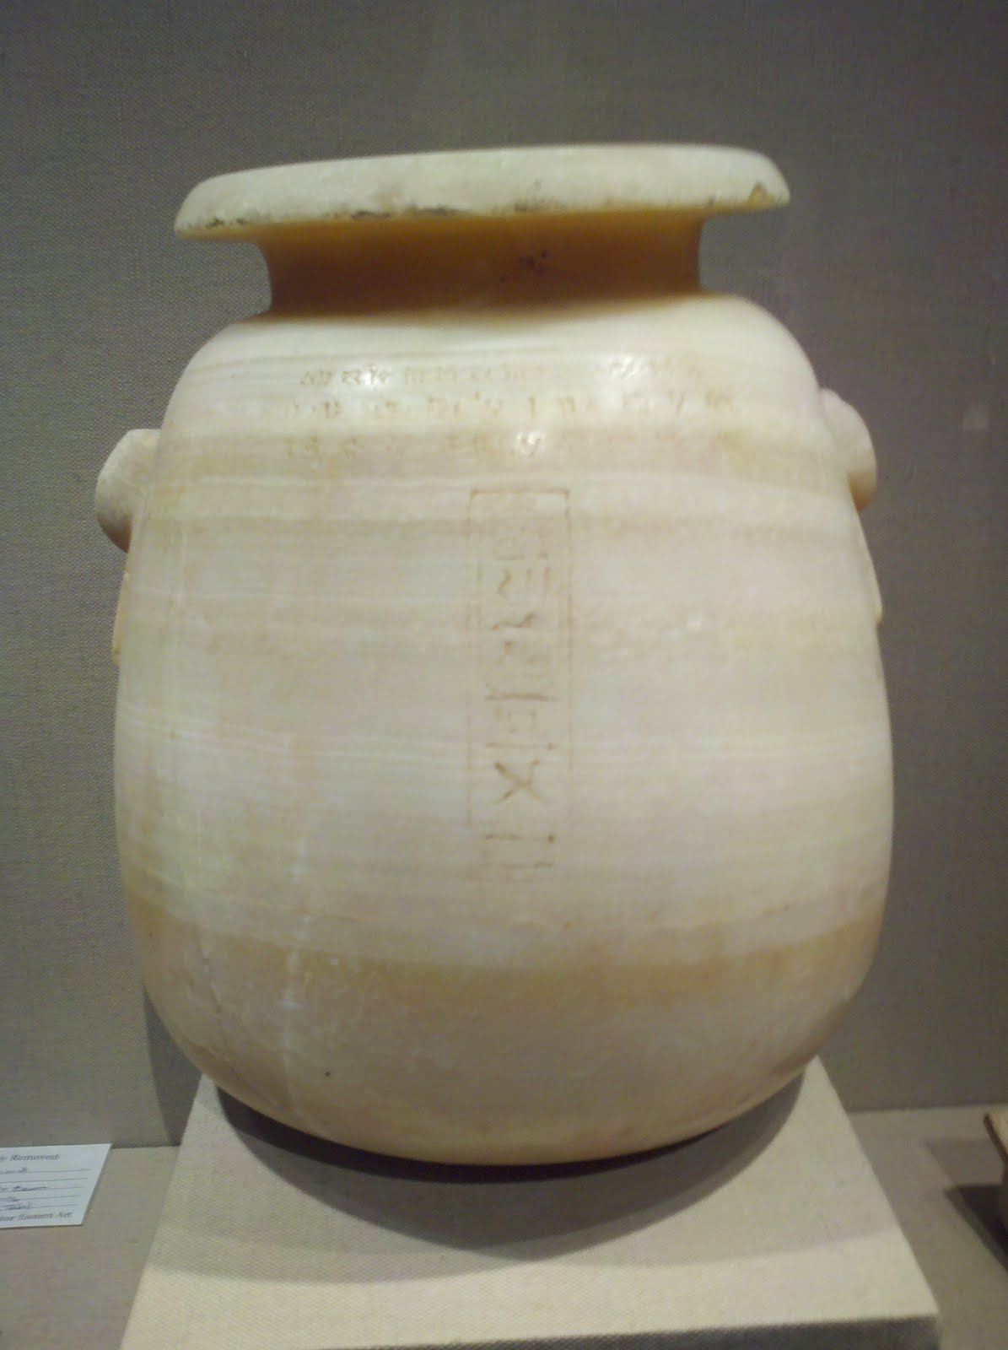
Persian King Xerxes
This alabaster jug comes from 5th century BC, and is inscribed with the name of the Persian king Xerxes–sometimes called Ahasuerus–who is referred to often in the Bible, particularly in the book of Esther.
Notes:
Persian conqueror and ruler. Emperor of Persia 486 BC-465 BC. Won battle of Thermopylae 480b. Lost battle of Salamis 480b. Assassinated. He was the grandson of Cyrus and the son of Darius. Ester According to the Bible, was a Jewish queen of the Persian king Ahasuerus. Ahasuerus is traditionally identified with Xerxes I during the time of the Achaemenid empire. Her story is the basis for the celebration of Purim in Jewish tradition.
It is inscribed in both cuneiform and hieroglyphs, and is about ten inches high. The object is located in The Metropolitan Museum of Art in New York.

Slide 32
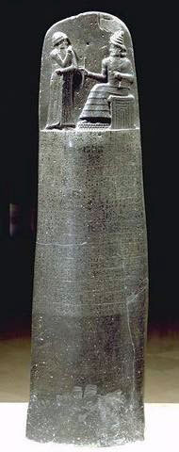
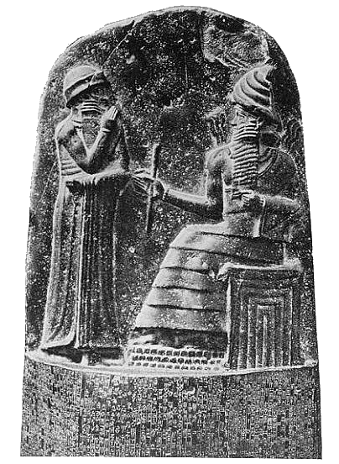
Code of Hammurabi, Stela
Notes:
Hammurabi, Code of: King Hammurabi was of 1st Babylonian Dynasty (6th king ~1780 BC). The stela had 282 laws and rules for society including crime punishments (“eye-for-an-eye) as well as methods for contracts and day-to-day living. The 6’ tall diorite stela is carved in the shape of a finger, with his figure carved on the nail. Its laws & rules are similar to some of Exodus, Leviticus and Numbers but the differences much greater than similarities. Written in Akkadien cuneiform (city of Akkad in 2334 – 2154 BC), an ancient Semitic language. Louvre Museum, Paris.

Slide 33
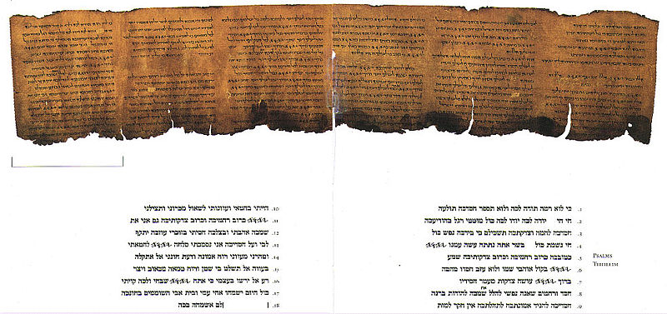
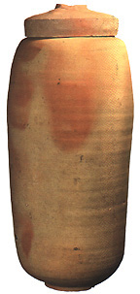
Dead Sea Scrolls
Found 1947 – 1956 at Khirbet Qumran adjacent to Dead Sea.
972 2nd Temple & other texts.
Date from 150 BC to 70 AD.
Great religious & historic significance .
Notes:
The Dead Sea Scrolls are a collection of 972 texts from the Hebrew Bible and extra-biblical documents found between 1947 and 1956 at Khirbet Qumran on the northwest shore of the Dead Sea from which it derives its name. Note, Khirbet is Arab for ruin discovery. This is an arid region 13 miles east of Jerusalem and 1,300 feet below sea level. Narrative: “Juma was beginning to get nervous. Some of his goats were climbing too high up the cliffs. He decided to climb the face of the cliff himself to bring them back. The story of how those scrolls traveled from the hands of young Bedouin goat herders to be under the scrutinous eyes of international scholars is stranger than fiction. Although all the details of the next few years will probably never be known for sure, this much is clear. After hanging from a pole in a Bedouin tent for a period of time, the seven original scrolls were sold to two separate Arab antiquities dealers in Bethlehem. From there, four were sold (for a small amount) to Athanasius Samuel, Syrian Orthodox Metropolitan at St. Mark's Monastery in the Old City of Jerusalem. Scholars at the American School of Oriental Research, who examined them, were the first to realize their antiquity. John Trever photographed them in detail, and the great archaeologist William F. Albright soon announced that the scrolls were from the period between 200 BC and AD 200. The initial announcements were then made that the oldest manuscripts ever discovered had been found in the Judean desert! All of the scrolls finally came together at Hebrew University under another strange set of circumstances. After touring the U.S. with his four scrolls and not being able to find an interested buyer, Metropolitan Samuel placed an ad in the Wall Street Journal. By coincidence (or divine providence?) Yigal Yadin happened to be lecturing in New York and saw the advertisement. Through intermediaries, he was able to purchase these priceless scrolls for around $250,000. In February of 1955, the Prime Minister of Israel announced that the State of Israel had purchased the scrolls, and all seven (including the three purchased earlier by Professor Sukenik) were to be housed in a special museum at Hebrew University named the Shrine of the Book, where they can be seen today. Needless to say, the initial announcement about the scrolls prompted feverish searches in the area of the original discoveries. An official archaeological expedition was begun in 1949 which eventually resulted in the discovery of ten additional caves in the surrounding area also containing scrolls. The archaeologists then directed their attention to a small ruin nearby called "Khirbet Qumran," which had been thought of as the remains of an old Roman fortress. After six seasons of intensive excavation, the scholars were sure beyond any reasonable doubt that the scrolls found their origin in this community which flourished between 125 BC and AD 68. The scrolls had been stored in haste in the caves as the community fled the encroaching Roman army, which was in Judea to put down the Jewish Revolt of AD 66-70. Fragments of every Biblical book except Esther have been found, as well as many other non-Biblical texts.
Three of the other original scrolls found by the Bedouin boys were sold to E. L. Sukenik, archaeologist at Hebrew University and father of Yigal Yadin (a general in the Israeli army who later became a famous archaeologist and excavator of Masada and Hazor). It should be noted that the drama of these events was heightened because these were the last days of the British Mandate period in Palestine, and tensions between the Arab and Jewish population were great. This made examination of the scrolls by scholars extremely dangerous.
The texts are of great religious and historical significance, as they include the oldest known surviving copies of Biblical and extra-biblical documents and preserve evidence of great diversity in late Second Temple Judaism. They are written in Hebrew, Aramaic and Greek, mostly on parchment, but with some written on papyrus.[1] These manuscripts generally date between 150 BCE and 70 CE.[2] The scrolls are traditionally identified with the ancient Jewish sect called the Essenes, though some recent interpretations have challenged this association and argue that the scrolls were penned by priests in Jerusalem, Zadokites, or other unknown Jewish groups.[3][4]
The Dead Sea Scrolls are traditionally divided into three groups: "Biblical" manuscripts (copies of texts from the Hebrew Bible), which comprise roughly 40% of the identified scrolls; "Apocryphal" or "Pseudepigraphical" manuscripts (known documents from the Second Temple Period like Enoch, Jubilees, Tobit, Sirach, non-canonical psalms, etc., that were not ultimately canonized in the Hebrew Bible), which comprise roughly 30% of the identified scrolls; and "Sectarian" manuscripts (previously unknown documents that speak to the rules and beliefs of a particular group or groups within greater Judaism) like the Community Rule, War Scroll, Pesher on Habakkuk (Hebrew pesher פשר = "Commentary"), and the Rule of the Blessing, which comprise roughly 30% of the identified scrolls.[5]
SIGNIFICANCE: Such was the discovery of a group of manuscripts which were a thousand years older than the then-oldest-known Hebrew texts of the Bible (manuscripts, many of which were written more than 100 years before the birth of Jesus). One of the most important contributions of the Dead Sea Scrolls is the numerous Biblical manuscripts which have been discovered. Until those discoveries at Qumran, the oldest manuscripts of the Hebrew Scriptures were copies from the 9th and 10th centuries AD by a group of Jewish scribes called the Messoretes. Now we have manuscripts around a thousand years older than those. The amazing truth is that these manuscripts are almost identical! Here is a strong example of the tender care which the Jewish scribes down through the centuries took in an effort to accurately copy the sacred Scriptures. We can have confidence that our Old Testament Scriptures faithfully represent the words given to Moses, David and the prophets. This is dramatic, because we now have absolute evidence that Messianic prophecies contained in today’s Old Testament (both Jewish and Christian) are the same Messianic prophecies that existed prior to the time Jesus walked on this earth. Dead Sea Scrolls - Isaiah 53: The Dead Sea Scrolls have provided phenomenal evidence for the credibility of biblical scripture. Specifically, the nearly intact Great Isaiah Scroll is almost identical to the most recent manuscript version of the Masoretic text from the 900's AD. Translation of the actual Great Isaiah Scroll (Isaiah 53), beginning with line 5 of Column 44:
5. Who has believed our report and the arm of YHWH to whom has it been revealed And he shall come up like a suckling before him
6. and as a root from dry ground there is no form to him and no beauty [+to him+] and in his being seen and there is no appearance
7. that we should desire him. He is despised and rejected of men, a man of sorrows and knowing grief
8. and as though hiding faces from him he was despised and we did not esteem him. Surely our griefs he
9. is bearing and our sorrows he carried them and we esteemed him beaten and struck by God
10. and afflicted. and he is wounded for our transgressions, and crushed for our iniquities, the correction
11. of our peace was upon him and by his wounds he has healed us. All of us like sheep have wandered each man to his own way
12. we have turned and YHWH has caused to light on him the iniquity of all of us He was oppressed and he was afflicted and he did not
13. open his mouth, as a lamb to the slaughter he is brought and as a ewe before her shearers is made dumb he did not open
14. his mouth. From prison and from judgment he was taken and his generation who shall discuss it because he was cut off from the land of
15. the living. Because from the transgressions of his people a wound was to him
16. And they gave wicked ones to be his grave and [a scribbled word probably accusative sign "eth"] rich ones in his death
17. although he worked no violence neither deceit in his mouth And YHWH was pleased to crush him and He has caused him grief.
18. If you will appoint his soul a sin offering he will see his seed and he will lengthen his days and the pleasure of YHWH
19. in his hand will advance. Of the toil of his soul he shall see {+light+} and he shall be satisfied and by his knowledge shall he make righteous
20. even my righteous servant for many and their iniquities he will bear. Therefore I will apportion to him among the great ones
21. and with the mighty ones he shall divide the spoil because he laid bare to death his soul and with the transgressors
22. he was numbered, and he, the sins of many, he bore, and for their transgressions he entreated.

Slide 34
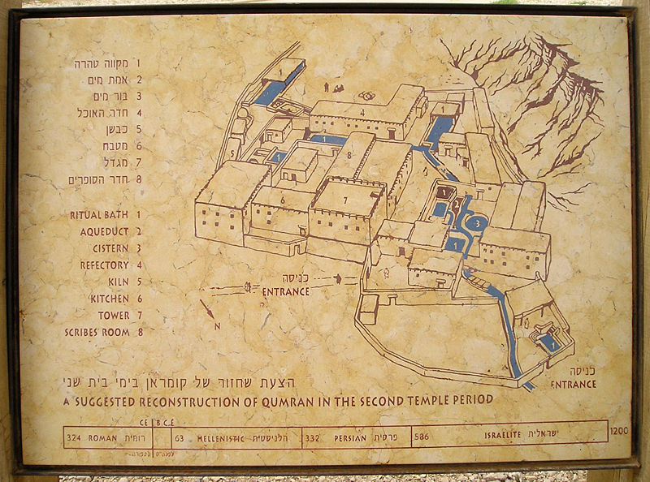
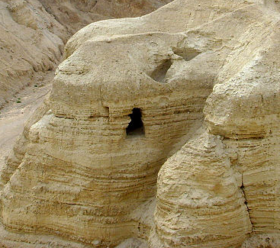
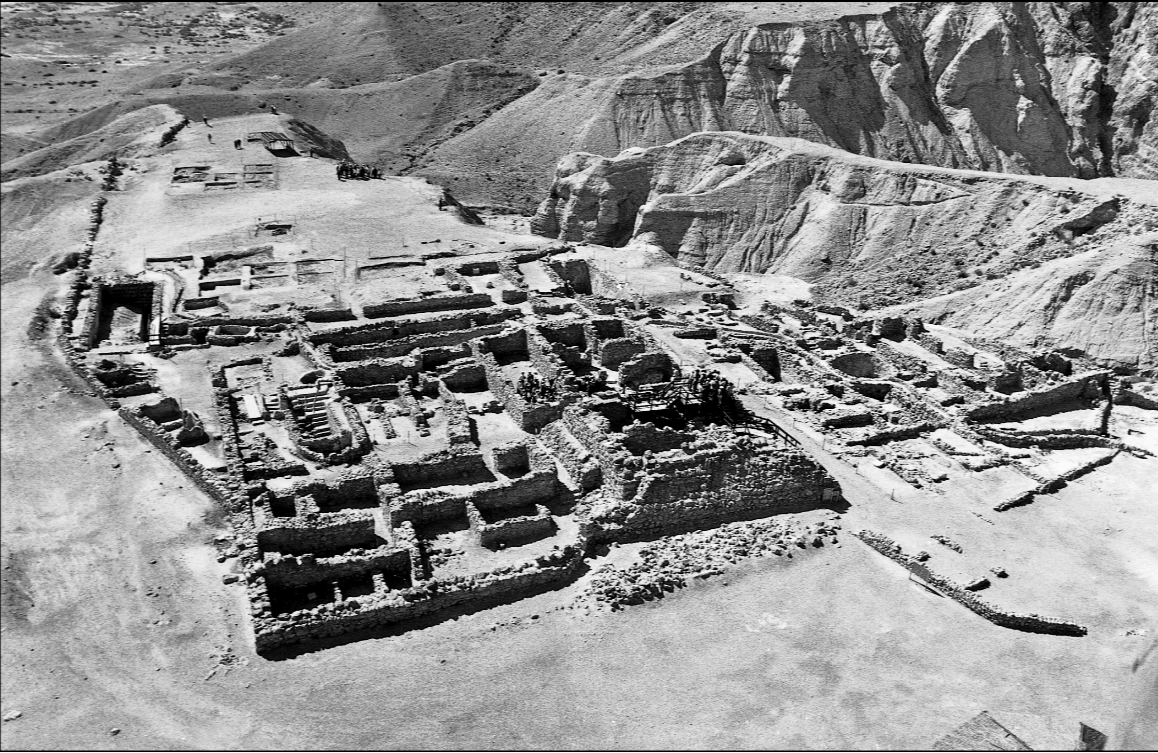
Dead Sea Scrolls
Cumran & adjacent caves with scrolls
Notes:
Khirbet Cumran is believed to have been populated by the Jewish sect Essenes, a break-away religious group that advocated voluntary poverty, daily immersion, abstinence from pleasures and to help the sick and dejected of society. There were far fewer Essene priests than Pharisees and Sadducees. The brotherhood/sisterhood combed the countryside attired in white robes.

Slide 35
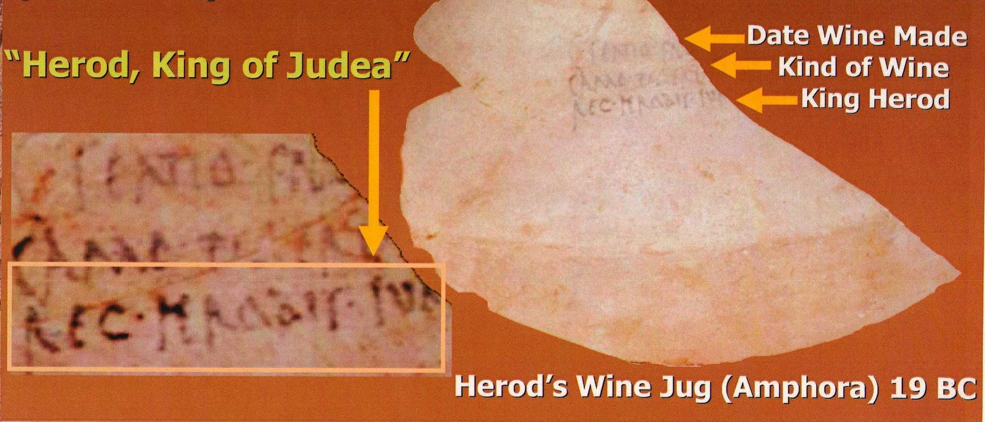
King Herod's wine jug
This piece of a wine jug was found in 1996 at Masada in Israel. It refers to King Herod The Great, who is noted in the Bible as having killed the babies of Bethlehem near the time of Christ's birth.
Notes:
He was a Roman client king of Judea. His epithet of "the Great" is widely disputed as he is described as "a madman who murdered his own family and a great many rabbis." He is also known for his colossal building projects in Jerusalem and elsewhere, including his expansion of the Second Temple in Jerusalem (sometimes referred to as Herod's Temple) and the construction of the port at Caesarea Maritima. Important details of his biography are gleaned from the works of the 1st century CE Roman-Jewish historian Josephus Flavius.
The Romans made Herod's son Herod Archelaus ethnarch of Judea, Samaria, and Idumea (biblical Edom) from 4 BCE to 6 CE, referred to as the tetrarchy of Judea. Archelaus was judged incompetent by the Roman emperor Augustus who then combined Samaria, Judea proper and Idumea into Iudaea province under rule of a prefect until 41.
Herod's other son Herod Antipas was tetrarch of Galilee from 4 BCE – 39 CE. Born Before 20 BCE Died After 39 CE. Place of death Gaul.
Herodian Dynasty. Mother Malthace. Herod Antipater, known by the nickname Antipas, was a 1st-century CE ruler of Galilee and Perea, who bore the title of tetrarch ("ruler of a quarter"). He is best known today for accounts in the New Testament of his role in events that led to the executions of John the Baptist and Jesus of Nazareth.

Slide 36
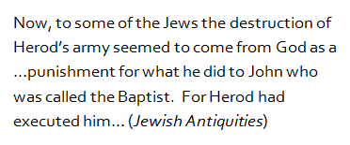
John the Baptist referred to by ancient historian
Notes:
This quote, from the 1st century AD Jewish writer Josephus, references the execution of John the Baptist, recorded in Mathew 14.
Josehus Flavius was a 1st century Romano-Jewish historian AD 37 – 100. He was born in Jerusalem. His father was of priestly descent, and his mother claimed to be of Roman Royal Ancestry. He was employed by Rome as a historic writer after he had been captured in the “Great Revolt” of AD 66 – 73 where he had been a Jewish general. He had convinced his men to commit suicide when the Roman army approached his hideout, but he reneged on suicide himself only to switch sides.

Slide 37
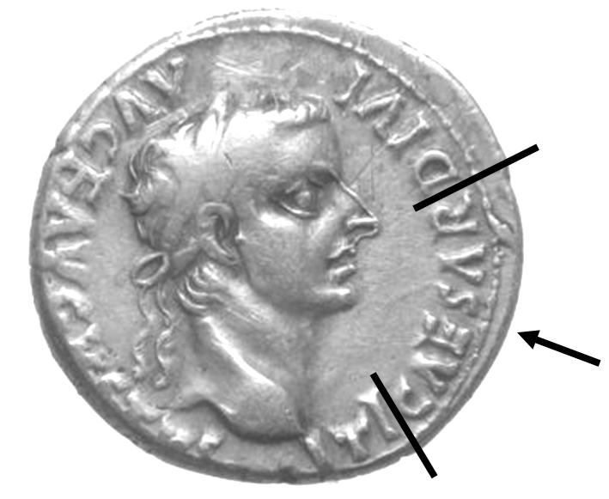
Coin with image of Caeser
This picture shows a coin with the image of Tiberius Caesar, Roman Emperor from 14-37 AD, & during Christ’s ministry. In Luke 20:23-25 Jesus requested a coin and then asked the crowd whose image was on it. They replied that it was “Caesar’s.”
Notes:
Does anybody know of another famous verse where Jesus refers to this coin? (Matthew 22:15-22; “…’Show me the coin used for paying the tax’. They brought him a denarius. He asked them ‘Whose portrait is this? And whose inscription?’ ‘Cesar’s’ they said. Then he said to them ‘Give to Caesar what is Caesar’s and to God what is God’s.”).
Several types of coins were in circulation at that time that showed an image of Caesar, with the one displayed here being a typical example. The text on the silver platted coin is written in Latin, and the coin itself is now in a private collection.

Slide 38
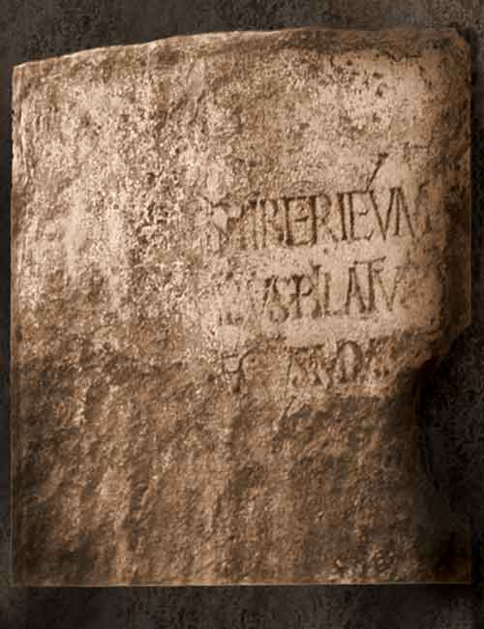
Pontius Pilate Stone Inscription
Pontius Pilate, the procurator (Roman governor) who ordered Jesus' crucifixion was believed to be a fictional biblical character until one inscribed stone was discovered in 1961
Read “PONTIUS IILATUS PREFECTUS IUDAEAE” (Pontius Pilate, Prefect [governor] of Judea.
Notes:
Pontius Pilate, the procurator under Tiberius, 26 - 36 A.D., ordered Jesus' crucifixion. A handful of small coins and one inscribed stone are the only physical evidence that Pilate existed. It is likely that Pontius Pilate made his base at Caesarea Maritima where the stone was discovered, and occasionally went to Jerusalem when needed. His presence in Jerusalem at the time of Jesus crucifixion was likely due to Passover. Israel Museum in Jerusalem.

Slide 39
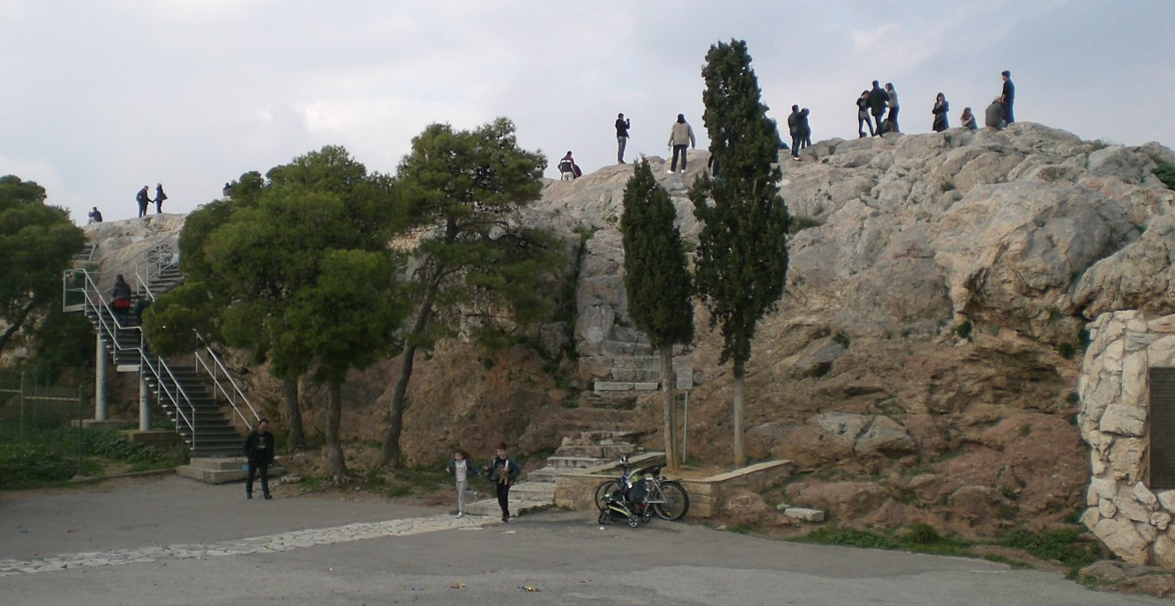
Mars Hill in Athens
View of Mars Hill, also called the "Areopagus," in Athens, Greece. The Bible reads, "Paul then stood up in the meeting of the Areopagus and said: “People of Athens! I see that in every way you are very religious...." (Acts 17:22 NIV).
Notes:
Areopagus in classical times functioned as the high Court of Appeal for criminal and civil cases in Athens. Later, the Romans referred to the rocky hill as "Mars Hill", after Mars, the Roman God of War. Paul addressed the crowds congregating at the Athenian altar.

Slide 40

Ephesian Theater where Paul appeared
View of theater in ancient Ephesus. In Acts 19:29 reference is made to this theater in which a crowd gathered to protest the ministry of the Apostle Paul.
Notes:
Acts 19 tells of Paul’s ventures in Ephesus where goddess Artemis was worshipped. Those who made their livings producing and selling silver shrines of Artemis became incensed towards Paul and his companions because they feared losing their livelihoods.

Slide 41

Erastus Inscription in Corinth.
The inscription shown was discovered in 1924 at the location of ancient Corinth in Greece. It reads, "Erastus...bore the expenses of this pavement." This is likely a reference to the same "Erastus" referred to in Romans 16:23 as a city official.

Slide 42

Roman Historian records the crucifixion of Christ
Notes:
The Roman historian Tacitus wrote his book, The Annals of Imperial Rome, in c. 110 AD, roughly a decade after the death of the last apostle, John. Tacitus is one of the earliest non-Christian sources to discuss Jesus and the manner of his death.

Slide 43

House of Caiaphas Ossuary
Ossuaries are limestone boxes for storing family bones taken after the flesh-rotting process is completed in a tomb (thus making room for subsequent family bodies). Above bears an inscription with the name "Miriam daughter of Yeshua son of Caiapha..” Israeli scholars have confirmed its authenticity and age of approximately 2,000 years.
Notes:
Typically measured 20”l X 12”h X 10”w. This "second-burial" system first interred the deceased in sepulchers to decompose for a couple of years. Then the bones that remained were gathered and put into stone boxes or "ossuaries. The High Priest known as Caiaphas was an adversary of Jesus (Yeshua) and played a key role in his crucifixion, according to the bible. Israeli scholars have confirmed the authenticity of a 2,000-year-old burial ossuary bearing the name of a relative of the high priest Caiaphas. The Israel Antiquities Authority says the ossuary was seized from tomb robbers a few years ago. It is believed to have been taken from a burial site in the Valley of Ela in Judea. The IAA says that microscopic tests have confirmed the inscription is "genuine and ancient." The two scientists used ESEM/EDS (Environmental Scanning Electron Microscope / Energy-Dispersive Spectrometer) technology to verify the ossuary’s authenticity.

Slide 44


The James Ossuary
Has elements of truth and forgery, which is a common difficulty in Bib. Arch.
Significant if genuine—could provide oldest archaeological record of Jesus of Nazareth.
Notes:
Authenticity somewhat speculative and controversial, but with some merit. The inscription is significant because, if genuine, it might provide the oldest archeological record of Jesus of Nazareth.
The James ossuary came from the Silwan area in the Kidron Valley, southeast of the Temple Mount. The bones originally inside the ossuary had been dumped out somewhere, which is the case in nearly all ossuaries not discovered by archaeologists. The first-century origin of the ossuary is not in question, since the only time Jews buried in that fashion was from approximately 20 BC/BCE to the destruction of Jerusalem in 70AD/CE. The dispute centers on the date of origin of the inscription, which is not customary. The owner of the ossuary is Oded Golan, an Israeli engineer and antiquities collector, but has a reputation for forgery. The Israeli Antiquities Authority determined in 2003 that the inscriptions were forged at a much later date. The IAA determination has not been universally accepted by scholars. Oded Golan was charged with 44 counts of forgery, fraud and deception in December of 2004 including that he faked the Ossuary inscription. Numerous expert witnesses were subpoenaed to court with contrasting viewpoints.
Court proceedings for the trial of Golan and a co-defendant rendered a final decision on June 13, 2012: BAR reports “After a 5-year trial, Jerusalem judge Aharon Farkash recently acquitted the defendants of all charges of forgery. But his verdict doesn’t mean the Aramaic inscription on the bone box, “James, son of Joseph, brother of Jesus,” is authentic. It only means that the prosecution failed to present evidence beyond a reasonable doubt that the inscription is a forgery. The State of Israel says they will appeal the verdict.
On another note, some in the field of BA go to not ends to reach notoriety, as is the case for “The Tomb of Jesus”. A Discovery Channel program (“The Naked Archaeologist”) with Simcha Jocobvici and James Cameron made claims the tomb of Jesus had been discovered in Jerusalem with one ossuary inscribed with “Jesus son of Joseph and Mary.” Announced that the remains of Jesus and his wife Mary Magdalene had been discovered. Arguments against authenticity include: expect family burial in Nazareth; tomb too expensive for Mary and Joseph; reading of names on ossuaries not settled; typically names are X son of Y in Jerusalem, and X of town for outsiders; very surprising that tomb went unfound considering that early Christians identified so many sites and built over with churches or martyriums.

Slide 45

Apostle Philip’s Tomb found in Turkey…
Italian Arcaeologists found a few months ago.
located in a smaller church less than 150 feet away from the martyrium
No scientific report released yet, giving skeptics reason to doubt.
Notes:
An Italian professor has announced the apparent discovery of the tomb of St. Philip, one of Jesus Christ’s apostles, at the ancient city of Hierapolis in the Aegean province of Denizli.
Philip was born in Bethsaida on the northern shore of the Sea of Galilee (John 1:44, 12:21). The discovery of the grave of the biblical saint, who was killed by the Romans 2,000 years ago, will attract immense attention around the world, said Francesco D’Andria. St. Philip, one of the 12 apostles, came to Hierapolis 2,000 years ago to spread Christianity before being killed by the Romans, the professor said.
D’Andria has been leading archeological excavations at the ancient city for 32 years.
“Until recently, we thought the grave of St. Philip was on Martyrs’ Hill, but we discovered no traces of him in the geophysical research conducted in that area. A month ago, we discovered the remnants of an unknown church, 40 meters away from the St. Philip Church on Martyrs’ Hill. And in that church we discovered the grave of St. Philip,” said D’Andria.

Slide 46


The Siloam Pool
Where Jesus Healed the Blind Mand
The stepped remains of the ancient Siloam Pool, long thought to be located elsewhere, were uncovered in 2004 near the City of David. John’s gospel tells us that it was at this sacred Christian site that Jesus healed the blind man.
Notes:
Traditionally, the Christian site of the Siloam Pool was the pool and church that were built by the Byzantine empress Eudocia (c. 400–460 A.D.). During construction work to repair a large water pipe south of Jerusalem’s Temple Mount, at the southern end of the ridge known as the City of David, archaeologists Ronny Reich and Eli Shukron identified two ancient stone steps. Further excavation revealed that they were part of a monumental pool from the Second Temple period, the period in which Jesus lived. The structure Reich and Shukron discovered was 225 feet long, with corners that are slightly greater than 90 degrees, indicating a trapezoidal shape, with the widening end oriented toward Tyropoeon valley.
The Siloam pool is adjacent to the area in the ancient City of David known as the King’s Garden and is just southeast of the remains of the fifth-century church and pool traditionally believed to be the sacred Christian site.
What was the function of the Siloam pool during Jesus’ time? Because the pool is fed by waters from the Gihon Spring, via Hezekiah's Tunnel, located in the Kidron Valley, the naturally flowing spring water would have qualified the pool for use as a mikveh for ritual bathing. However, it could also have been an important source of fresh water for the inhabitants on that part of the city. One scholar has even suggested that it was a Roman-style swimming pool. Whatever its original purpose, the Siloam pool where Jesus healed the blind man is an important Christian site, and its discovery represents a watershed moment in the field of Biblical archaeology.
As with many sites in the Holy Land, the origins of the Siloam Pool reach back even further in history—at least seven centuries before the time of Jesus. Judah’s King Hezekiah (late eighth century B.C.) correctly anticipated a siege against Jerusalem by the Assyrian monarch Sennacherib.
To protect the city’s water supply during the siege, Hezekiah undertook a strategic engineering project that would be an impressive feat in any age: He ordered the digging of a 1,750-foot tunnel under the City of David to bring water from the Gihon Spring, which lay outside the city wall, inside the city to a pool on the opposite side of the ridge. In the years that followed, “Hezekiah’s Tunnel” continued to carry fresh water to this section of Jerusalem, and different pools were built here over the centuries, including the Second Temple pool that Jesus knew.

Slide 47

Gospel of John Fragment
Found in Egypt in 1920 by John Ryland
John 18:37-38 one side horizontal, & 18:37-38 on other side vertical
~125 A.D. per handwriting style
Trash heaps in dry desert preserved some papyrus text

Slide 48


Forgeries: plague of the Israeli Antiquities Authority
“Ivory” Pomegranate, a Solomon relic
Lettering added much later per IAA
Now (inscription) must be declared a fake and relic w/o value
Notes:
JERUSALEM — An ivory pomegranate long touted by scholars as the only relic from Solomon’s Temple is a forgery, per the IAA, as investigators said they had broken up several fake antiquity rings in a wide-ranging investigation. Indictments in that investigation were handed down. Among those to be indicted is Israeli collector Oded Golan, the Justice Ministry confirmed.
The Ivory Pomegranate is a thumb-sized ornament acquired by the Israel Museum. It is not actually made of ivory, but of Hippopotamus bone and bears an inscription Holy (Sacred) to the Priest of the House of God (YHWH). At the time of its discovery, it was thought to have adorned the High Priest's sceptre within the Holy of Holies and was once considered a genuine artifact proving the existence of Solomon's Temple, though some argue it pre-dates the first temple by 300 to 400 years; however, the Hebraic inscription has been dismissed as a modern forgery, added long after the item had been broken in antiquity. Proof of guilt or innocents would be seen in how the lettering did or didn’t mesh into the broken part of the pomegranate—if fake, the letters would stop short and not mesh into the break…
News Update: On March 14, 2012 Oded Golan was acquitted of all charges of forgery after the judge found that police had failed to prove forgery beyond all reasonable doubt. It was not included in the individual counts against Golan; i.e., the judge did not consider its authenticity in his findings. Judge Aharon Farkash stated that the acquittal did not mean that the objects were "true and authentic.” (once again…)

Slide 49


Shroud of Turin: Real or Fake?
Linen cloth thought to have covered Jesus after his death.
Highly controversial: C-14 dates to 13th century; fabric weave too complex for 1st century.
Notes:
The Shroud of Turin or Turin Shroud (Italian: Sindone di Torino, Sacra Sindone) is a linen cloth bearing the image of a man who appears to have suffered physical trauma in a manner consistent with crucifixion. It is kept in the royal chapel of the Cathedral of Saint John the Baptist in Turin, northern Italy. The image on the shroud is commonly associated with Jesus Christ, his crucifixion and burial. It is much clearer in black-and-white negative than in its natural sepia color. The shroud is owned by the Vatican, although the Catholic church has never taken an official position on the cloth’s authenticity.
In the 19th century, and not long after the popularization of flash photography, a man named Segundo Pia took pictures of the Shroud of Turin, alleged to be the burial shroud of Jesus. He could not have anticipated what he would find when he went into his darkroom. When he took his photographic negatives in for processing, and before he printed up the positive images of the Shroud, he examined the negatives in the dim light of the darkroom. What he saw astounded him. It was the positive image of a badly beaten or crucified man. But the positive image was found on the negative! This caused something of a sensation at the time and led to over a century of study and examination (at various points) of the Shroud. Could it really be the image of Jesus? Do we finally have a clue what he looked like? This possibility seemed to have been ruled out when the Shroud was allowed to be carbon dated in the late '80s, and the date that came to light from the testing was from the early Middle Ages. But wait. We know the Shroud was scorched in a fire in the early Middle Ages, and it appears that the carbon 14 testing may have been skewed because a scorched part of the cloth was tested, and also because the microbiotic coating on the Shroud was not cleaned off before testing. Even careful scientific testing does not always produce indisputable results. Naturally, finding an image of Jesus would be the biggest find of any sort relating to the New Testament. But the jury is still out on the Shroud.
Favoring its authenticity: In 2009 a Vatican researcher said she had found the words ‘Jesus Nazarene’ on the cloth, while two years later Italian government researchers claimed the image of a man had been caused by a supernatural ‘flash of light’. Supporters also claim that with all of today's technology we cannot duplicate it. The Shroud of Turin had been mended in the area from which the carbon 14 samples had been taken. The shroud of Turin is contaminated with the C14 containing bioplastic varnish of microorganisms still multiplying and present on the artifact.
Proponents to Authenticity: In 1988, radiocarbon tests on samples of the shroud at the University of Oxford, the University of Arizona, and the Swiss Federal Institute of Technology dated the cloth to the Middle Ages, between 1260 and 1390. Carbon-14 testing in 1980’s indicate origin of 13th – 14th (medieval) century. Texture weave complex as after 1000 AD, not simple double weave of (one) finding of 1st century. Many (now destroyed) other fakes from 13th – 14th century.

