Slide 1
Origins of Humans & Hominids
1 Feb 2015_Mark Durham
Notes:
Vocabulary Handouts….

Slide 2
Reasons To Believe Related Materials
Advanced Seminar on Human Origins
15 week Reasons Institute course presented by RTB scholar Dr. Fuz Rana. It includes viewpoints from secular scientists, young earth creationists, evolutionary creationists (TE), and how RTB’s model is able to address the challenges that these other viewpoints present. Fuz originally taught this course at Biola University and it can be taken as an audit or as a “for credit” course. It is a great course to include when working toward an Intermediate or Advanced Certificate.
Book: “Who was Adam?” by RTB Scholar Dr. Fuzale Rana
Notes:
Started 26 January 2015…

Slide 3
Relationship Between Science & Christianity
Does Methodological Naturalism (MN) give the answers to all that was, is, or ever will be?
MN Employs the Scientific Method to help understand phenomena
Makes no truth (absolute) claims when used properly
Often used as Philosophical Naturalism argument for atheistic claims
Helps develop models. Continual testing makes confirmable and falsifiable predictions
Scripture establishes framework for Scientific Method: Identify, Interpret, and Integrate
Why is the question of humanity’s origin critical to Christian the faith?
What does God’s Word, the Bible Say?
Genesis 1:25 “And God made the beast of the earth after their kind…”
Genesis 1:26 “Then God said, “Let Us make man in Our image, according to Our likeness…”
Genesis 1:27 And God created man in His own image, in the image of God He created him, male and female he created them…”
Notes:
Methodological naturalism (MN) is a manner of doing scientific research using the scientific method. MN is a good tool to understand natural phenomena in an empirical and naturalistic, methodical way. It makes no truth claims (absolutes) but deals in likelihood or statistical probability.
MN is the label for the required tool of philosophical naturalism when working with the scientific method. Methodological naturalists limit their scientific research to the study of natural causes, because any attempts to define causal relationships with the supernatural are never fruitful, and result in the creation of scientific "dead ends" and God of the gaps-type hypotheses. To avoid these traps scientists assume that all causes are empirical and naturalistic; which means they can be measured, quantified and studied methodically.
However, this assumption of naturalism need not extend beyond an assumption of methodology. This is what separates methodological naturalism from philosophical naturalism - the former is merely a tool and makes no truth claim; while the latter makes the philosophical - essentially atheistic - claim that only natural causes exist.
MN makes confirmable and falsifiable predictions, spawns new questions , guides advancement, provides framework for data interpretations, leads to universal enterprise.
Genesis 1:25, “made”=asah: to make, in a general sense, as from preexisting.
Genesis 1:26, “make”=asah
Genesis 1:27, “created”=bara: to create (2X) something absolutely new

Slide 4
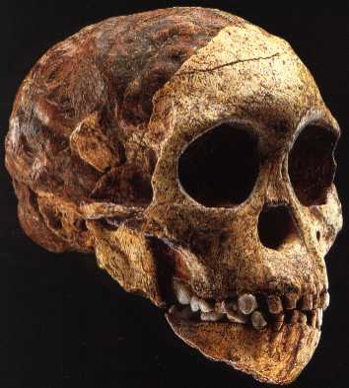
Background & History
1859: “Origins of Species…” by Charles Darwin
1856: Neanderthal skeleton discovered
1868: Cro-Magnon
1887: Java Man
1912: Piltdown Man
1924: Taung Child (photo)
1927: Peking Man
1930’s: Homo habilis (“Handy Man”)
1953: Piltdown Man discovered a fraud
1959: Zinj Man (“Nutcracker Man”)
1974: Lucy
Notes:
1859: “Origins of Species…” by Charles Darwin, didn’t mention humans but said all species result of natural selection. His later book “Descent of Man” in 1871…
1856 Neanderthal skeleton first discovered about 12 km (7.5 mi) east of Düsseldorf, Germany, in the Feldhofer Cave in the river Düssel's Neander valley named after Joachim Neander, a 17th-century German pastor and hymnist.
1868 Cro-Magnon skeleton used to describe the first early modern humans (early Homo sapiens sapiens) of the European Upper Paleolithic (10KY – 50 KY ago). The name comes from the location of Abri de Cro-Magnon (abri is French for rock shelter, cro is Occitan for hole or cavity, and Magnon is said to be the name of the owner of the land) in southwestern France
1887: Java Man discovered. Homo erectus (formerly Pithecanthropus erectus)
1912: Piltdown Man, Eoanthropus dowsonii in a gravel pit at Piltdown, East Sussex, England. Shown to be hoax in 1953.
1924: Taung Child, Australopithecus africanus, Robert Dart
1927: Peking Man, Homo erectus (was Sinanthropus pekingensis)
1930’s: Homo habalis (“handy man”). Louis Leaky, pebble tools, Olduvai Gorge Africa. Type I tools or Oldawan tools
1953: Piltdown Man discovered a fraud
1959: Zinj Man (“Nutcracker Man”—robust jaw..), Australopithecus (Paranthropus) boisei. found by Mary Leakey at Olduvai Gorge, Tanzania. First radiometric dating of hominids, which led to paleoanthropology becoming a real science
1974: Lucy, Australopithecus afarensis. Lucy is the common name of AL 288-1, several hundred pieces of bone representing about 40% of the skeleton of a female found in Ethiopia by Mary Leaky, Donald Johanson, et cet. 3.2 MYA and early bipedalist (falcultative)

Slide 5
Human Evolutionary Models
MULTIREGIONAL
Races resulted from three hominid (“archaic humans”) origins of modern man, with some crossbreeding along the way
Africans from Homo ergaster
Europeans from Neanderthal
Asiatics from Homo erectus
A primitive Homo erectus thought to be ancestral to all
No longer accepted as most reliable evolutionary model
Notes:
MULTIREGIONAL: some X-breeding. H ergaster now considered an early version of H erectus

Slide 6
Human Evolutionary Models
OUT OF AFRICA
Humanity originated as one species in Africa
Homo erectus thought to be ancestral
Spread throughout Old World
Races evolved along the way
Most popular evolutionary model
Supported by genetic studies

Slide 7
Christian Origin of Humanity Models
Day Age Creation (AKA Progressive or Old Earth Creation)
Bible Inerrant
Days (Hebrew “yom”) are literal with 5 meanings including long periods of time per Hebrew scholars
Fossil Record real
Rejects Macroevolution
Accepts scientific data but distinguishes between data and interpretation
RTB follows Day Age Creation. Supplements with:
Humans created physically and spiritually in Image of God at a single location in the Middle East
Humans created 10,000 – 100,000 years ago
Adam and Eve were 1st humans. Females trace back to Eve, and Males to Noah bottleneck
Human behavior explosively unique
Universal/Worldwide/Regional Flood (opposed to Global)
Humans spread around World after Noah’s time
Hominids were created but are not human, bipedal primates, spiritless, limited intelligence & emotions, biologically and behaviorally distinct
Notes:
YOM: "It can denote: 1. the period of light (as contrasted with the period of darkness), 2. the period of twenty-four hours, 3. a general vague "time," 4. a point of time, 5. a year (in the plural; I Sam 27:7; Ex 13:10, etc.)." - See more at: http://www.oldearth.org/word_study_yom.htm#sthash.qo4xF0GR.dpuf

Slide 8
Christian Origin of Humanity Models
Calendar Day Creation (AKA Young Earth Creation, or YEC)
Bible Inerrant
Days (Hebrew “yom”) are literal, but only one period of time accepted: 24 hours
Creation occurred in six consecutive 24 hour days
Reject macroevolution
Skeptical of science and geological ages; believe Earth ~6,000 years old
1st humans Adam & Eve; Garden of Eve covered entire Earth surface
Garden was perfect
Global Flood
Hominids descendants of Adam & Eve but were diseased, old or with developmental pressures
No death (of any life forms) before Fall
Notes:
NO death before Fall: counter to Romans 5:13-19… YEC interprets “Sin entered thru Adam” that no death of anything before Adam…
YEC belief that hominids look as they do developmentally is from cold climate and other difficult living conditions.

Slide 9
Christian Origin of Humanity Models
Theistic Evolution Creation (AKA Evolutionary Creationism)
Creation is a process, not an event
God uses laws of nature (evolution) to create in two ways
1. Deistic: God “hands off” after Creation
2. Theistic: God gives some continual guidance, but relies mostly on evolution
Bible/Genesis 1 is poetic, mythical
False historically but true theologically
Creation Days are non-literal, snapshots in time
Adam & Eve and Original sin concepts are mythical
Notes:
Theistic evolution is not a scientific theory, but a range of views about how the science of evolution relates to religious beliefs.
Francis Collins (famous TE) describes theistic evolution as the position that "evolution is real, but that it was set in motion by God“.
The framework hypothesis interpretation is held by many theistic evolutionists. Genesis 1 creation days divided into two triads: Days 1 to 3 are creation of universe and earth, and Days 4 to 6 are creation of life (day 4 being luminaries, sun and moon).

Slide 10
Hominid Classification Difficulties
Hominids are classified in the Primate Family Hominidae
Hominin is another term sometimes used
Hominids are bipedal primates, including genera Australopithecus and Homo
RTB considers humans to not be hominids due to great spiritual and cultural differences compared to hominids
Great apes sometimes added to hominid classification, which causes classification turmoil
Much variation in hominid fossils
Can’t tell species apart very well; two reported species may be male and female of same species; few samples
At least 12 variations phylogenetically
Kenyanthropus and H. floresiensis are spoilers; Mauve Leaky wants all Australopithecines changed to Kenyanthropus
Many theories produced without conclusive scientific evidence
Notes:
Hominids: Created but are not human. Spiritless, limited intelligence, emotions, society. Expected to be biologically and behaviorally distinct from humans. Whereas Human behavior explosively unique.
Hominin sometimes used, but is actually a subfamily tribe of Hominidae…
Primate is an Order of Class Mammalia
Variations/confusions: just as people look different from one another today, so did early hominids look different from one another, and the dissimilarity of the bones they left behind may have fooled scientists into thinking they came from different species.

Slide 11
Hominid Classification Difficulties
Phylogeny: Taxonomy based on physical features. Can mislead
Dmanisi discovery, a site in Republic of Georgia
5 individuals 1.8-million-year-old living at same time/place showed great skull diversity for same species (Homo erectus)
May need to rewrite the evolutionary history of our human genus Homo.
Notes:
Phylogeny = Evolutionary historic relationships of taxonomic groups based on physical features.
Described in a publication in October 2013
An analysis of a complete 1.8-million-year-old hominid skull found at the archaeological site of Dmanisi in Georgia suggests the earliest Homo species – Homo habilis, Homo rudolfensis, Homo erectus and so forth – actually belonged to the same species.
Dr David Lordkipanidze from the Georgian National Museum in Tbilisi, a lead author of a paper in the journal Science and co-author of a paper published in the Proceedings of the National Academy of Sciences.

Slide 12
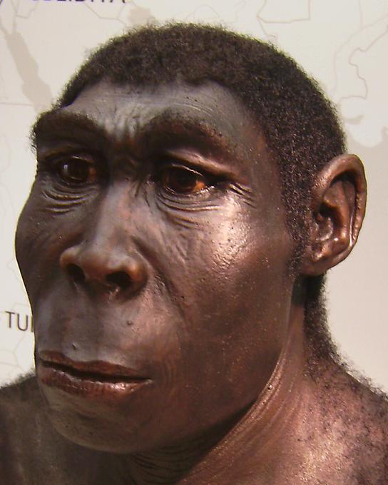
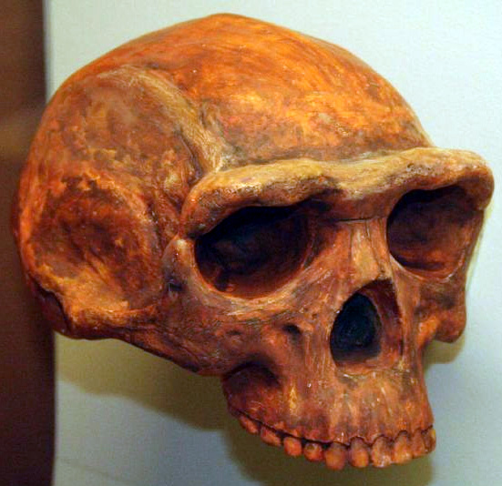
Hominid Classification Difficulties Homo erectus
Notes:
Skull and fleshed in model. Dmanisi 5 H. erectus vary so greatly as to include H. habilis and H. rudolfensis.. All may be same species..!
Compare and contrast HOMO SKULL SAMPLES

Slide 13
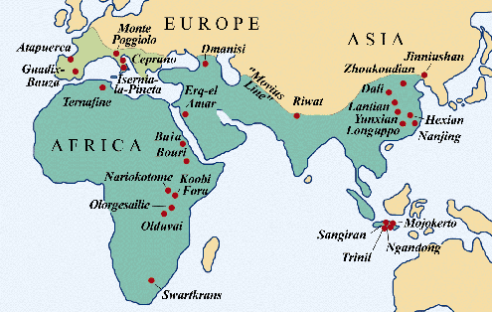
Hominid Classification Difficulties Geographical Spread of Homo erectus
Maps shows Homo erectus habitat as estimated from fossils and radiometric measurements. Difficult to determine routes of spread
Phylogenetic (DNA mutations) analysis of timing of spread not available
Notes:
Homo erectus existed from about 1.9 -0.1 MYA. Genetic material for Phylogenetic comparisons are available due to oldness of fossil finds. Other dating techniques show H erectus appeared about the same time in Africa, Europe, Java and China (1.9 MYA).

Slide 14
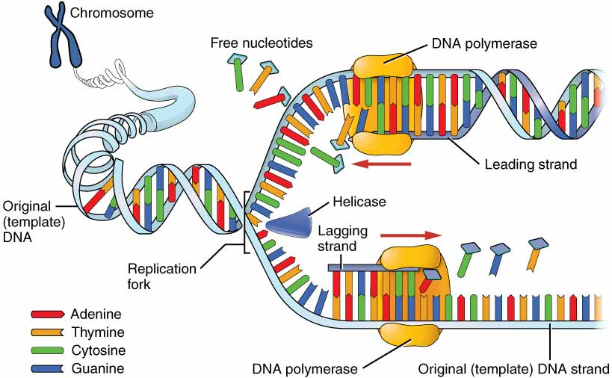
Hominid Classification & Molecular Anthropology Phylogenetics To The Rescue..?
Phylogenetics: Taxonomic relationship of organismal groups based on genetic differences and similarities
Deals with DNA nucleotide changes in cell nuclei and mitochondria
DNA composed of four nucleotide bases : A, T, G, C
DNA composed of two long antiparallel wound strands (double helix) that unwind for chromosome duplication or for transcription (leads to protein production)
Sequencing is determining the order of nucleotide base pairs (A-T & G-C) in DNA
DNA Replication
Notes:
DNA Nucleotide Bases: A=Adenine, T=Thymine, G=Guanine, C=Cytosine

Slide 15
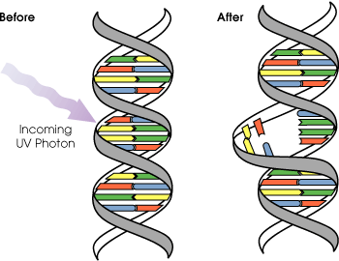
Hominid Classification & Molecular Anthropology Phylogenetics
Genic DNA is a nucleotide sequence that codes for a protein
Mutations are nucleotide errors that are usually harmful to genic DNA, but likely not harmful in non-genic DNA. Common causes are radiation and chemical disruptions
Nucleotide base bonds are broken
Bases can be deleted, added, switched individually or in groups
Large segments of chromosomal DNA may undergo such changes too
DNA Mutation

Slide 16
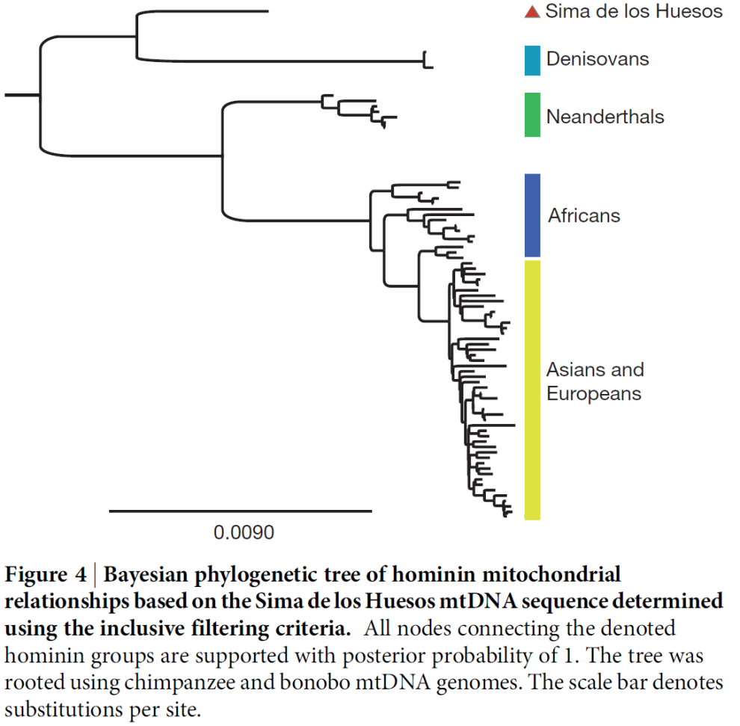
Hominid Classification & Molecular Anthropology Phylogenetic Analysis
DNA analysis offer a helpful method to study genetic closeness of humans to apes, Neanderthal, and other life forms
Mapping Mutations of non-genic DNA offer a helpful method to compare people-groups around the world, both for geographic and temporal origins and spread
Figure from Nature 16 Jan 2014 depicts hominid genetic relations
Notes:
Sima de los Huesos is a site in Spain: It contains several caves, where fossils and stone tools of the earliest known Hominins in West Europe have been found, belonging to the species Homo antecessor (or Homo erectus antecessor) and Homo heidelbergensis. The earliest hominids may have dated to 1.2 million years ago, representing the first in Western Europe. Mitochondrial DNA (mtDNA) from a 400,000 year old femur has been sequenced, the oldest hominin mtDNA recovered as of 2013. The mtDNA was found to be closer to the mtDNA from Denisova hominins than to the mtDNA from Neanderthals

Slide 17
Hominid Classification & Molecular Anthropology Phylogenetic Analysis
Most Recent Common Ancestor (MRCA) is traceable back in time (coalescence)
Coalescent theory seeks to predict the amount of time elapsed between the introduction of a mutation and the arising of a particular allele or gene distribution in a population. This time period is equal to how long ago the most recent common ancestor existed
Notes:
MRCA traceable back in time: P = probability, t = time, N = Population size. Time to coalescent theory seeks to predict the amount of time elapsed between the introduction of a mutation and the arising of a particular allele or gene distribution in a population. This time period is equal to how long ago the most recent common ancestor existed.

Slide 18
Hominid Classification & Molecular Anthropology Phylogenetic Analysis
For example if there are 5 major DNA sequences of interest, and groups vary from 5 to 1 mutated sequences, this gives basis for Gene Genealogies
Formulas exist for location & geographic spread of MRCA
Formulas are useful but some view them as “wild guesses”.

Slide 19
Genetic Techniques
Genetic Diversity: Mutations having occurred in the human genome indicates
Recent origin for humanity
Expanded from a small population
Out Of Africa origin
Human genic DNA is only 3% mutated
Surprising because in one tribe of Mountain Gorillas there is a genic variance of 18%
Highest genic DNA variance occurs in Africans—not surprising because they are oldest human group
Second highest genic DNA variance in Mid-East, which give credence to Eden’s Biblical location in Mesopotamian Plane.

Slide 20
Genetic Techniques
Chromosome 21: has 32.4 million base pairs
Found 36,000 SNPs
Only three haplotypes (SNP clusters) describe 80% of humans
Yet there are a possible 2E36,000 haplotypes (2 to power of 36,000!)
Indicates humans had a very recent origin
Notes:
SNP = Single Nucleotide Polymorphism (substitution for one DNA nucleotide base). Recall that Genetic Code allows for substitution of some nucleotide bases without effecting a change in amino acid (peptide, protein) order…

Slide 21
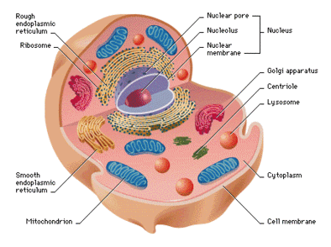
Genetic Techniques
Mitochondria can be useful phylogenetic tools for determining origin of humanity in terms of
Time of beginning
Location of beginning
Population size
Spread patterns
Notes:
Eukaryotic cell with mitochondria. Next slide has mitochondrial details.

Slide 22
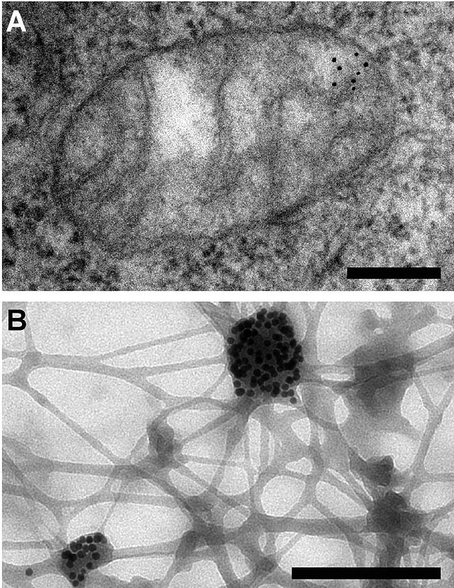
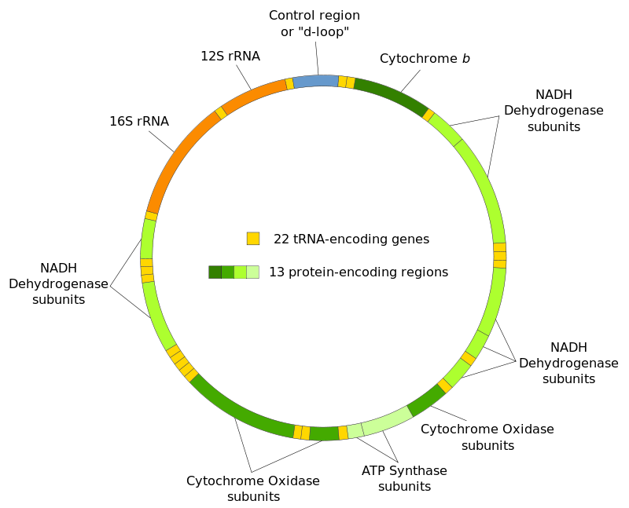
Genetic Techniques
Mitochondria are microscopic cellular (eukaryotic) inclusions that have their own DNA. Better known as MtDNA
Circular DNA (unlike chromosomes in nucleus) that clumps (see Fig. B, Au stain)
Powerhouses of cells: download energy from sugars to make ATP
Inherited almost exclusively from maternal line (mother) and so have valuable phylogenetic properties (both genic and non-genic mutations are used)
Molecular Clock, tracing humans back 150K – 260K years old
Small population (“Mitochondria Eve”)
Single location of origin (Africa)
Some Problems:
Variable mutation rates over time
Harmful mutations may be selected away
Recombinant
Leakage during fertilization, as from sperm cells (up to 20% have two types)
Notes:
Figures A & B = mitochondrion and gold stained clumps of DNA
Recombinant: Recombinant DNA is the general name for taking a piece of one DNA, and combining it with another strand of DNA. Occurs naturally or may be induced in the lab. Good uses: make GMO’s (genetically modified organism) for better Ag products, Better Crops (drought & heat resistance), Recombinant Vaccines (ie. Hepatitis B), Prevention and cure of sickle cell anemia, Prevention and cure of cystic fibrosis, Production of clotting factors, Production of insulin, Production of recombinant pharmaceuticals, Plants that produce their own insecticides, Germ line and somatic gene therapy. Bad Safety concerns (viruses developing antibiotic resistance)
Environmental concerns (developing resistance to fungi)
Ethical dilemmas over human treatment (i.e. are we playing God?)
Potential for Experimental abuse (doctors using patients as test subjects)
Germline treatment going from treating diseases to a method for picking the traits you want in a child (i.e. specifying hair and eye color)
Germ Warfare
All Figures: "Electron microscopy reveals mitochondrial DNA in discrete foci" by Francisco J Iborra1 , Hiroshi Kimura2 and Peter R Cook - The functional organization of mitochondrial genomes in human cells. Licensed under CC BY 2.0 via Wikimedia Commons -
"Mitochondrial DNA en" by derivative work: Shanel (talk)Mitochondrial_DNA_de.svg: translation by Knopfkind; layout by jhc - Mitochondrial_DNA_de.svg. Licensed under CC BY-SA 3.0 via Wikimedia Commons -

Slide 23
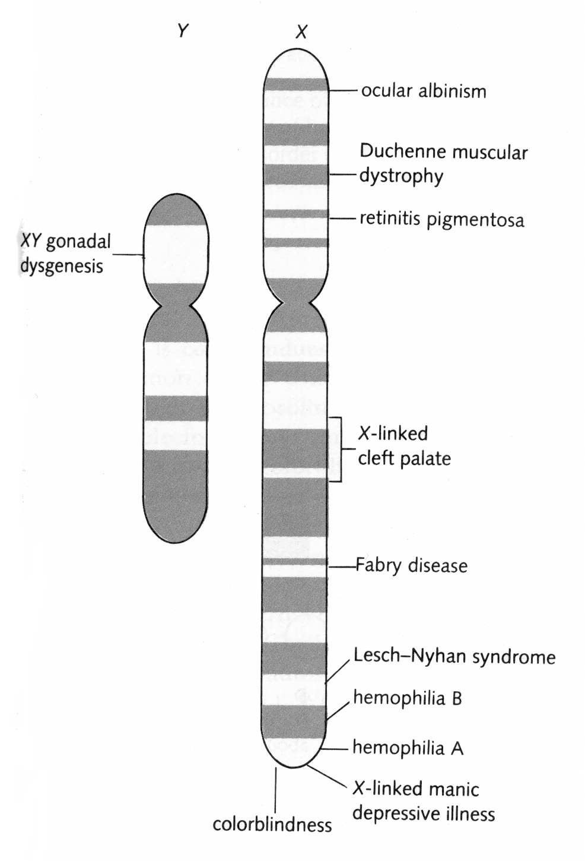
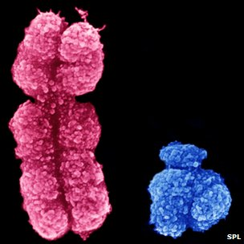
Genetic Techniques: Y-Chromosome
The Paternal (male) chromosome (#23) is an excellent candidate for phylogenetics: “Y-Chromosome Adam”
Inherited exclusively from fathers
Accrued mutations useful in determining:
Molecular clock: originated ~50KYA
Place of origin: Out of Africa
Small population
Spread of humanity (next slide)
Notes:
Detailed microscopic studies of the human X and Y chromosomes have confirmed the color tones of pink for X and blue for Y…
Indicates origin of humanity to only ~50KYA…RTB posits this is due to “genetic bottleneck” of Flood, when only Noah and his 3 sons survived—all had identical Y chromosome and so genetic clock was restarted, from Adam’s time. This was not so for X chromosome as Noah had three daughter-in-laws, all likely with genetic variation in their X chromosomes.

Slide 24
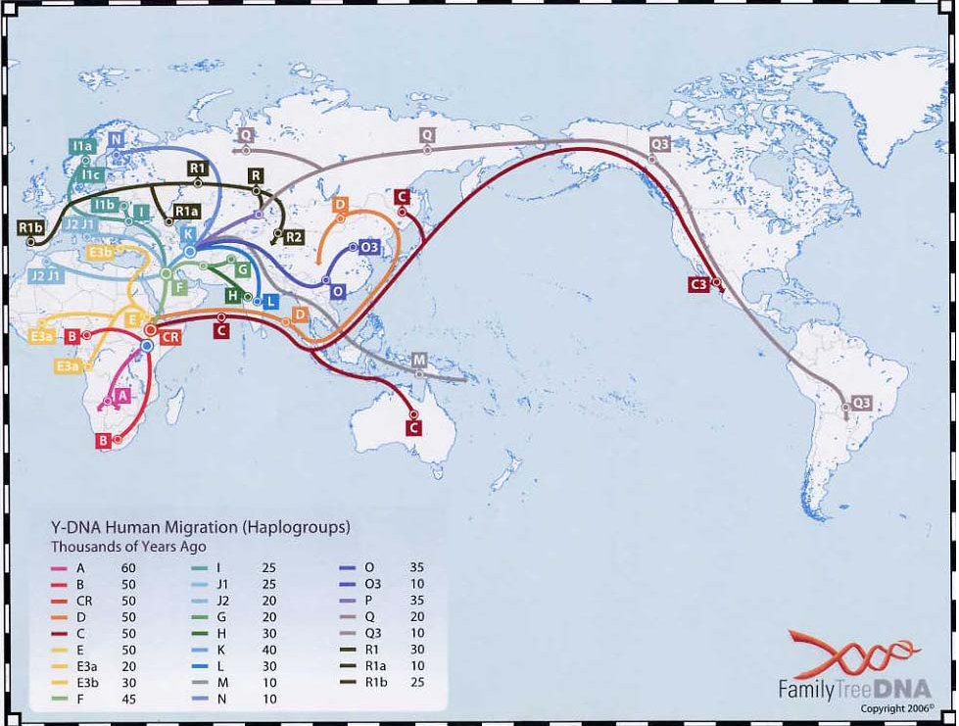
Genetic Techniques: Y-Chromosome Spread of Humanity
Notes:
Haplogroup: In molecular evolution, a haplogroup is a group of similar haplotypes that share a common ancestor having the same single nucleotide polymorphism (SNP) mutation in all haplotypes.

Slide 25
Genetic Techniques, Continued
Introns: Sections of genic DNA that are non-coding (coding = Exons)
Area where exons are sliced out
Can accrue mutations without harm
Good candidate for genetic clocks because no natural selection occurs
Indicate humanity 200K – 240K years old
Indigenous Retroviruses: Thought to be non-functional virus DNA (from RNA) incorporated into human genome
Can accrue mutations without harm
Shows recent origin, Out of Africa

Slide 26
Genetic Techniques, Continued
Alu Elements (a SINE: short interspersed nuclear element)
Microsatellite DNA: are repeating sequences of 2-5 base pairs of DNA
Minisatellite DNA: is a section of DNA that consists of a short series of nucleobases (10–60 base pairs)
Genetic studies of these and other types of DNA show
Recent origin (70K- 240K years ago)
Out of Africa
Small population
Notes:
An Alu element is a short stretch of DNA originally characterized by the action of the Alu (Arthrobacter luteus) restriction endonuclease. Alu elements probably arose from a gene that encodes the RNA component of the signal recognition particle, which labels proteins for export from the cell.
Alu is an example of a so-called "jumping gene" – a transposable DNA sequence that "reproduces" by copying itself and inserting into new chromosome locations.
The Alu family is a family of repetitive elements in the human genome. Modern Alu elements are about 300 base pairs long and are therefore classified as short interspersed elements (SINEs) among the class of repetitive DNA elements. The study of Alu elements has also been important in elucidating human population genetics and the evolution of primates’. There are over one million Alu elements interspersed throughout the human genome, and it is estimated that about 10.7% of the human genome consists of Alu sequences.
Alu elements in primates form a fossil record that is relatively easy to decipher because Alu elements insertion events have a characteristic signature that is both easy to read and faithfully recorded in the genome from generation to generation. The study of Alu elements thus reveals details of ancestry because individuals will only share a particular Alu element insertion if they have a common ancestor. Some diseases associated with (cancers mostly).

Slide 27
Genetic Techniques, Continued
Tapeworm Origin: 160 KYA
Malaria Parasite Origin: 120 KYA
Helicobacter pylori (H. pylori) Origin: Out of Africa, then to Europe/Asia and then Americas. Related to stomach ulcers
J.C. Virus: Human Papovavirus, Out of Africa, then to Europe/Asia and then to Americas
Body Lice Origin: 70KYA. Needs clothing
Notes:
J.C. Virus: a type of human polyomavirus (formerly known as papovavirus). The initial site of infection may be the tonsils, or possibly the gastrointestinal tract. The virus then remains latent in the gastrointestinal tract and can also infect the tubular epithelial cells in the kidneys, where it continues to reproduce, shedding virus particles in the urine.~70% of human population carries, but it only becomes pathogenic when immune system is jeopardized (as with AIDS).

Slide 28
Genetic Techniques: Conclusions
Genetic and Phylogenetic Studies all support:
Out of Africa
Recent origin
Single origin
Single location
Genetic bottleneck (fits Noah & family genetic predictions)
Genetic and Phylogenetic Studies agree with RTB Model
Eden possible origin site
Biblical Dating of Humanity Origin
Adequate but incomplete genealogies)
(ben & yalad mean give birth to a lineage, thus Bible characters existed 10K – 100K years ago
Genetics “discrepancy” of Y-Chromosome Adam and MtDNA Eve due to Flood bottleneck for Y-chromosome (all males were Noah’s direct relatives)
Notes:
Eden possible origin site because invalid assumption that today’s people groups are located where they were then. Eden might have extended to NE Africa.

Slide 29
Genetic Techniques: Conclusions
YEC Model
Disagree on age of human origin (6 KYA)
Agree all humanity from Adam and Eve
Disagree on Garden of Eden location (whole Earth)
Reject MtDNA studies (remain focused only on earliest inaccurate studies)

Slide 30
Finis

Slide 31
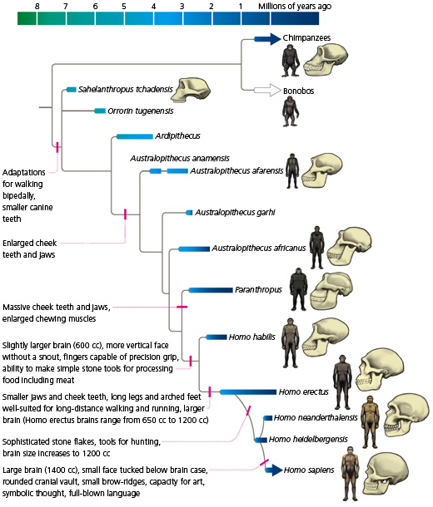
HANDOUT ON HOMINID/HUMAN TAXONOMIC TREE, 1 OF 2

Slide 32
HANDOUT 2 OF 2, VOCABULARY
ORIGIN OF HUMANS & HOMINIDS Vocabulary Paradoxes Sunday School Class 1 Feb 2015
Methodological Naturalism (MN): |  |  |  | A manner of doing scientific research only through the use of the scientific method.
asah: |  |  |  | (Hebrew) to make, in a general sense, as from preexisting
bara: |  |  |  | (Hebrew) to create something absolutely new
Multiregional Model: |  |  |  | A human evolutionary model positing that the races resulted from crossbreeding of hominids with humans
Out Of Africa Model: |  |  |  | A human evolutionary model positing that humanity originated in Africa and races evolved later
Day Age Creation |  |  |  | Old Earth Creationism (aka Progressive), belief that the Days of Genesis 1 are correctly interpreted as long periods of time
yom: |  |  |  | (Hebrew) a period of time with 5 meanings: 1. the period of daylight , 2. the period of twenty-four hours, 3. a general vague "time," 4. a point of time, 5. a year
Macroevolution |  |  |  | Belief that life evolves through stages above the species level, indicating large-scale genetic changes
Microevolution |  |  |  | Belief that life evolves through stages only at or below the species level primarily through gene frequency change
Hominid |  |  |  | Several species of bipedal primates that resemble humans. Family Hominidae. Order Primates
Theistic Evolution |  |  |  | AKA Evolutionary Creationism. Belief that macro-evolution is real, but that it was set in motion by God
Phylogeny |  |  |  | Taxonomy (evolutionary relationships) based on physical features of bones and fossils
Homo erectus |  |  |  | A geographically widespread hominid existing from 1.9M to 0.2M years ago that may have originated in Africa
Phylogenetics |  |  |  | Taxonomy (evolutionary relationships) based on genetic differences and similarities of organisms
Molecular Anthropology |  |  |  | Taxonomy (evolutionary relationships) based on genetic differences and similarities of hominids and humans
DNA |  |  |  | Cellular molecules of nucleotide bases containing hereditary information
Sequencing |  |  |  | Determining the order of nucleotide base pairs (A-T & G-C) in DNA
Genic DNA |  |  |  | A nucleotide sequence that codes for a protein
Mutations |  |  |  | DNA nucleotide errors
MtDNA |  |  |  | Mitochondrion DNA, circular instead of chromosomal
SNP |  |  |  | Single Nucleotide Polymorphism (substitution for one DNA nucleotide base)
Haplotype |  |  |  | SNP clusters in groups of humans
Mitochondria Eve |  |  |  | First human female as determined by genetic studies of mitochondria. 150K - 260K years ago
Y-Chromosome Adam |  |  |  | First human male as determined by genetic studies of Y-chromosome. ~50K years ago
ben & yalad |  |  |  | (Hebrew) to give birth to a lineage, to father

