Slide 1
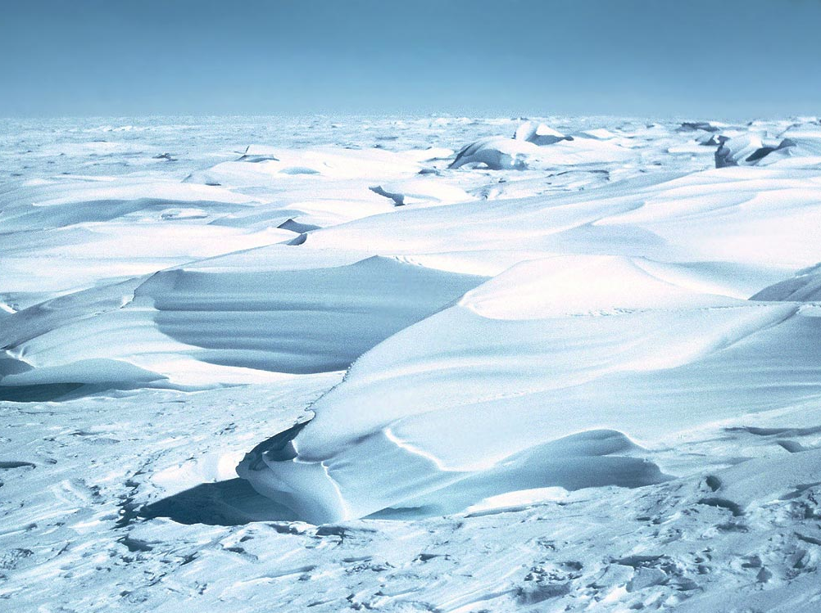

Slide 2
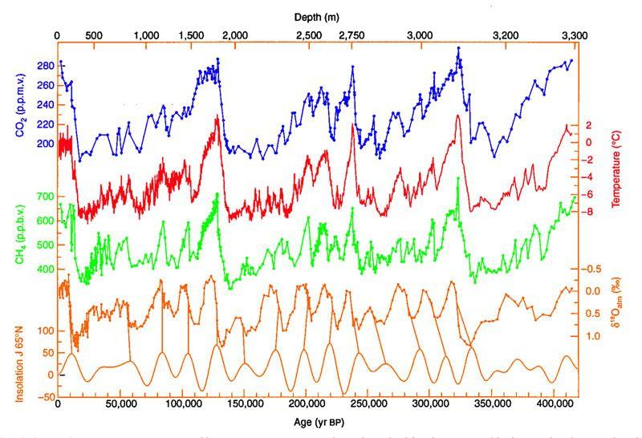
Notes:
Vostok (720,000 years)
red line is temperature

Slide 3
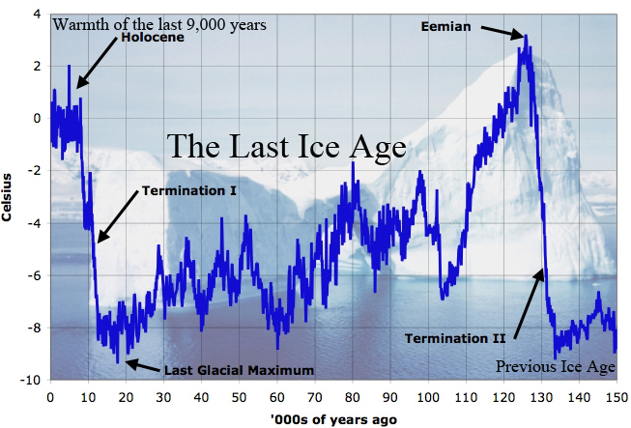
Notes:
NEEM (150,000 years)

Slide 4
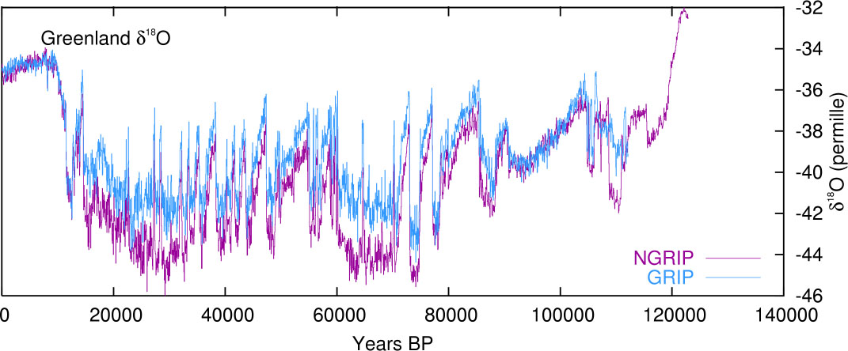
The Long Summer
The Long Summer

Slide 5
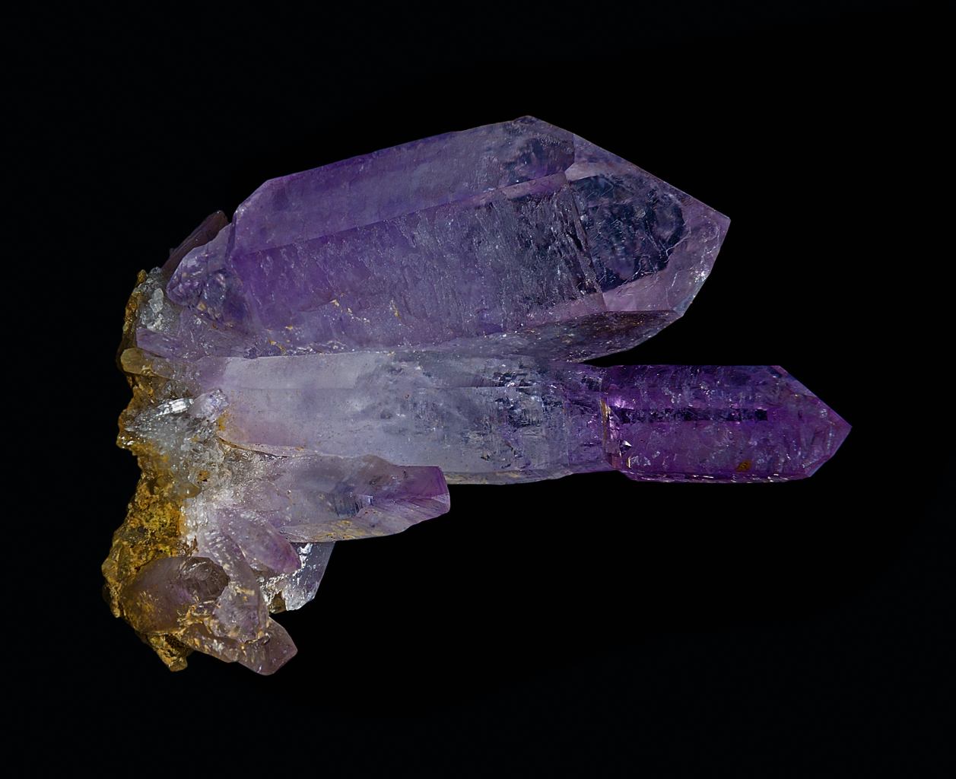
Mineral Growth History
Giant molecular clouds 12
Primitive meteorite formation 60
Achondritic formation 250
Life-initiated tectonics 1,500
Biology, GOEs, and ice ages 4,300

