Slide 1
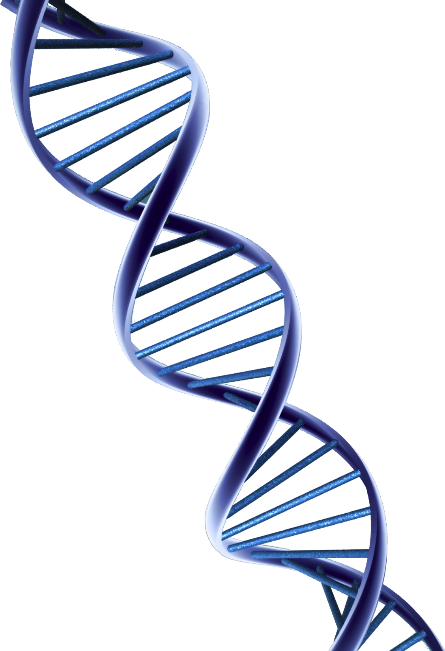
Designs in Gene Regulation
Richard Deem,
Paradoxes Class, November 9, 2014
Notes:
How many were here last time when we discussed designs in DNA? In that class, we looked at some remarkable ways in which DNA was designed. However, the reason why you are not a chimpanzee have little to do with the sequence of your genes, but rather, how those genes are regulated and expressed. If you are listening online, you must download the slides and follow along or you will get lost. For you in class, you don’t need to take notes, since everything you need to know is summarized in the one-page handout. The slides, handout, and audio will be available on the Paradoxes.org website. So, sit back and relax and focus on the big picture. 

Slide 2

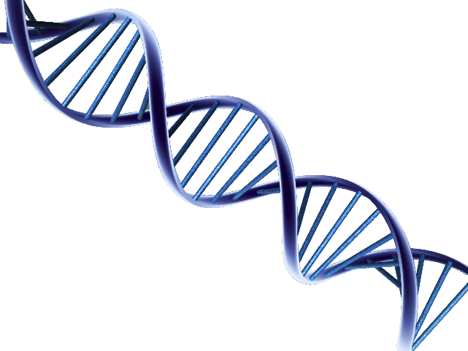


Central Dogma of Biology
Nucleus
DNA
T
T
T
C
T
C
A
C
A
C
A
A
G
A
A
G
A
G
G
G
G
T
C
T
C
T
C
C
A
A
G
C
T
C
T
T
A
G
T
A
T
A
T
G
G
A
Transcription
mRNA
G
A
A
U
U
G
A
U
C
G
A
C
G
U
A
A
U
G
U
G
A
U
C
A
A
A
C
A
G
G
C
A
C
U
U
U
G
G
A
A
A
A
C
C
U
U
ER
G
A
A
U
U
G
A
U
C
G
A
C
U
G
A
A
G
A
A
C
C
U
U
Translation
Protein
Notes:
Everybody remembers the central dogma of biology right? DNA is transcribed into RNA, then translated into protein. The expression of genes is controlled at each of these levels in multiple ways.

Slide 3
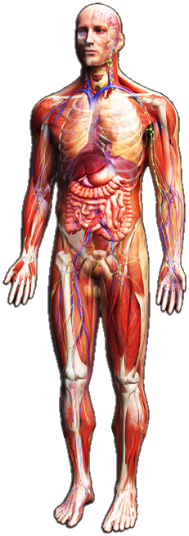
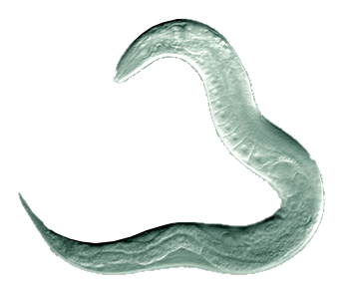
Genes vs. Function
 | Caenorhabditis elegans (Nematode) | Homo sapiens (Human)
Genes | 20,517 | 20,848
Notes:
The number of genes in the genome of a human being is only about 300 genes more than that of a roundworm.  So, do 300 genes turn a 1000 cell roundworm  into a 40 trillion cell human being? 

Slide 4
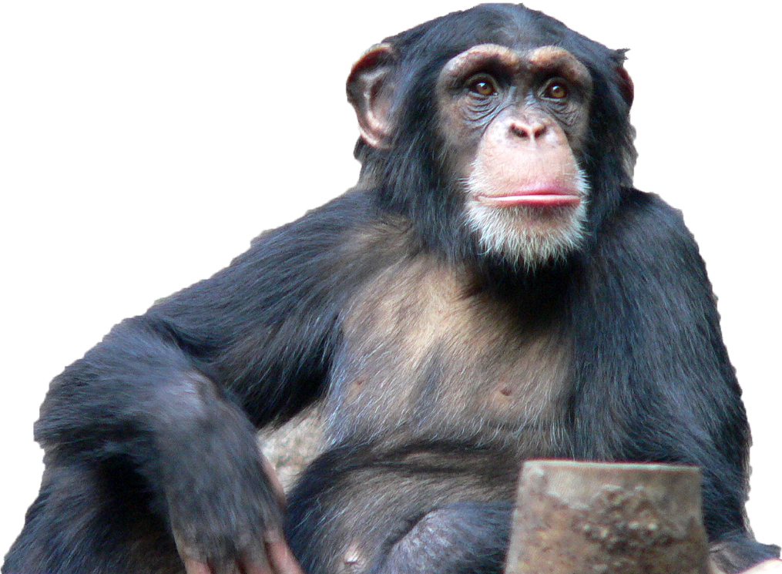

Protein Coding Differences in Apes
Chimp
Human
98.7%
Identical
Images adapted from Wikipedia
Notes:
You say the comparison is unfair, since the sequences of those genes in nematodes and human beings are vastly different. So, let’s look at two species whose genes are not very different. Sequencing of both human and chimpanzee genomes show that those genes are 98.7% identical. The question is, can a 1.3% difference in gene sequence  turn this  into this? 

Slide 5
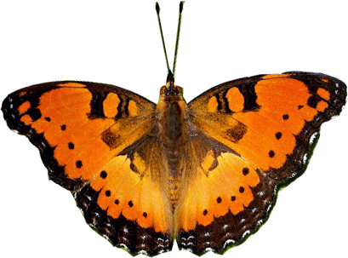
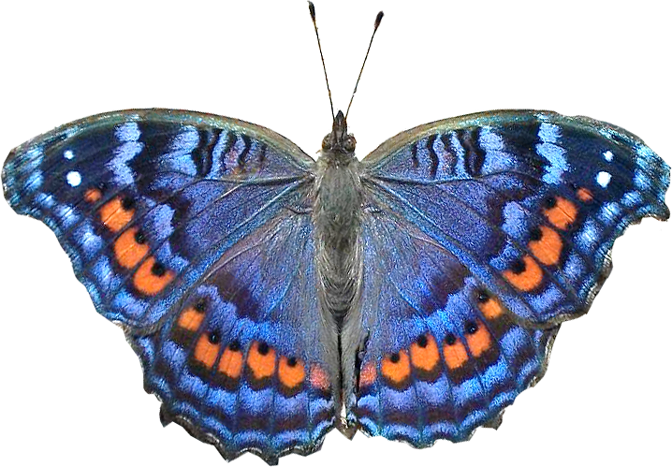
Butterfly Precis octavia
Summer
Winter
Images adapted from Wikipedia
Notes:
Here are two butterflies. How many of you think they are related species? How many of you think they are the same species?  They are both Precis octavia! The one on the left develops in Summer and the one on right develops in Winter. The species actually lives in Kenya, near the equator and the differences in wing patterning are due to temperature, even though the temperature near the equator is only marginally different in summer and winter months. 

Slide 6
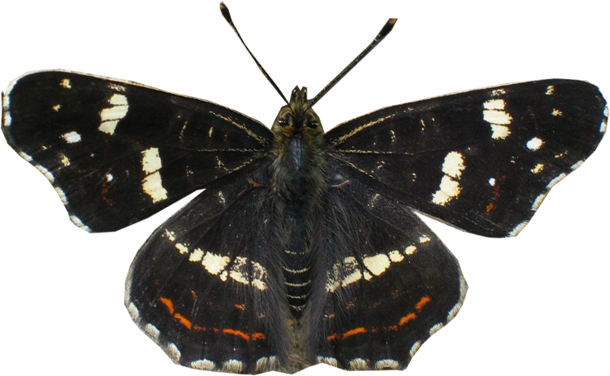
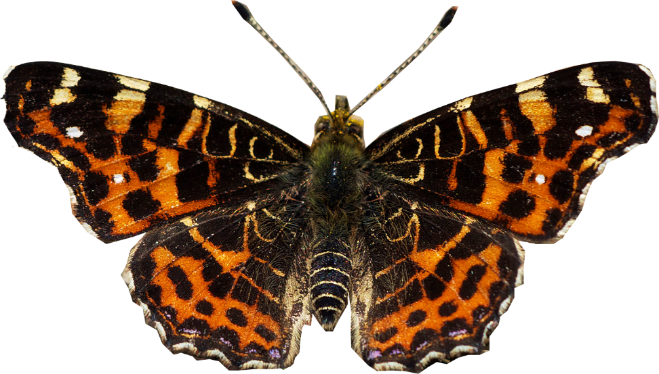
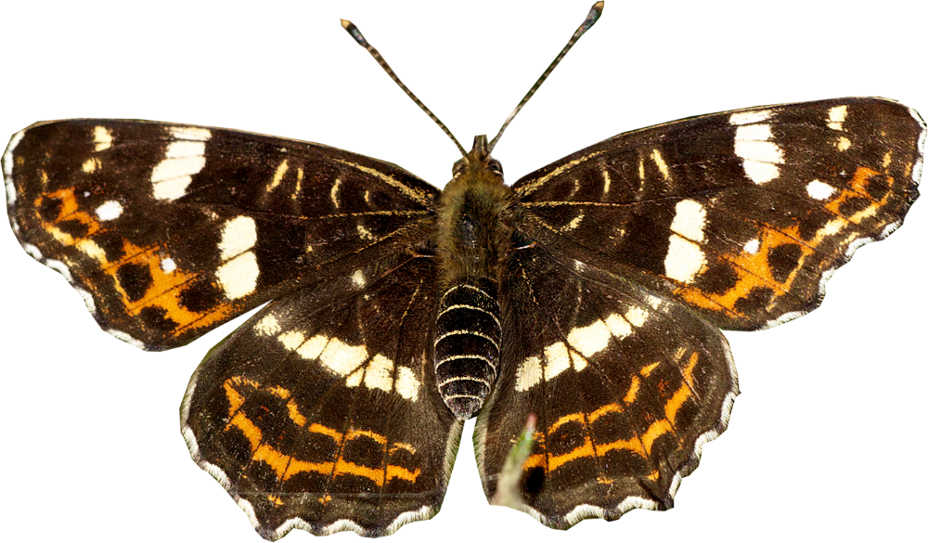
Butterfly Araschnia levana
Summer
Spring
Images adapted from Wikipedia
Notes:
Here are three butterflies. Are these the same species or different species?  This is Araschnia levana, with summer spring and intermediate wing patterning. So, its pretty clear from these examples that genetic sequence alone does not determine phenotype. 

Slide 7
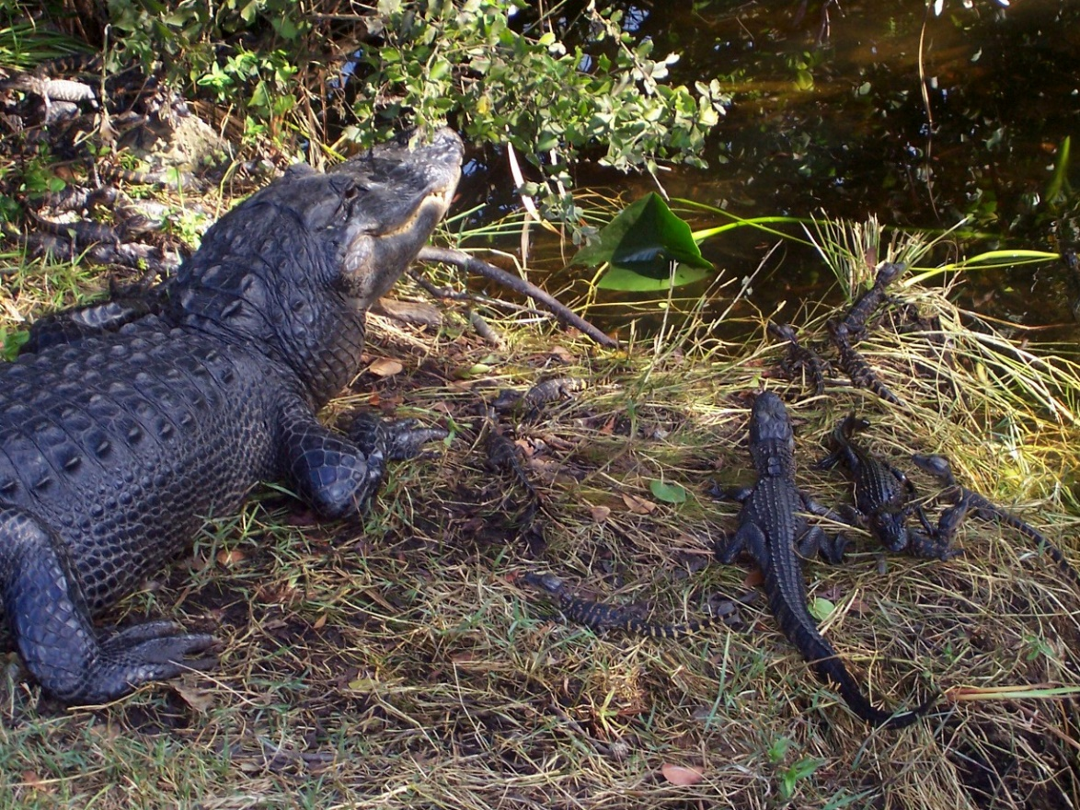
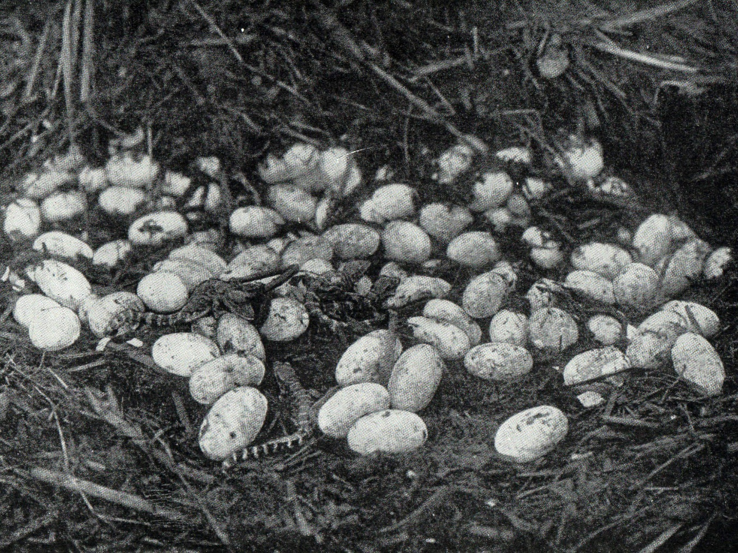
Sexual Determination in Alligators
F
C
120
50
100
40
♂
30
♀
80
20
60
10
40
0
20
-10
0
-20
-20
-30
-40
-40
Images adapted from Wikipedia
Notes:
Everybody recognizes these creatures. This is an alligator and its young. How many people think the sex of an alligator is determined by its chromosomal complement?  It turns out that the process is completely temperature dependent.  Alligator eggs that develop at a temperature of 86 degrees and  below all develop into females. Those eggs that  develop at 93 degrees and above  all become males. Male and female alligators have identical genetic sequences! 

Slide 8
Genotype is Not Everything!
Genotype
Phenotype
The genetic sequence
GACTTTCGAATGGCCAAAA
Some observed characteristic
Amount of gene product expressed
Notes:
So, it is clear from the preceding slides that the genotype of an individual is not the complete picture of what makes up a biological entity. So, there are two terms you need to know.  One is genotype, and the other is  phenotype. The genotype  is the genetic sequence –  the base pairs in your DNA. The phenotype  is an observed characteristic, which is often dependent not only upon the genetic sequence, but also  the amount of a gene that is expressed. 

Slide 9
Encyclopedia Of DNA Elements (ENCODE)
Begun September, 2003
Identify all functional elements in the human genome sequence
  1,600 experiments
  147 cell types
  450 authors (30 institutions)
  15 TB data
Notes:
The Encyclopedia Of DNA Elements (ENCODE) was  launched September 2003, to carry out a  project to identify all functional elements in the human genome sequence space. Results published in 2012 involved  1,600 experiments using  147 cell types, authored  by 450 investigators at 30 institutions.  More than 15 TB of data was collected. 

Slide 10
ENCODE Results
74.7% of the genome is transcribed
56.1% associated with modified histones
15.2% is in open-chromatin areas
8.5% binds transcription factors
4.6% methylated CpG dinucleotides
Notes:
Even though only two percent of the human genome codes for proteins,  about three quarters of the entire human sequence is transcribed into RNA. What is all that RNA doing?  More than half the genome is associated with modified histones, which tend to control gene expression.  15% of the genome is in open-chromatin areas. These DNA areas are noted for high transcription rates.  8.5% of the genome binds transcription factors, which also control gene expression. And 4.6% of all nucleotides are CpG sites – the methylation of which turns off gene expression. You can see that these totals add up to more than 100%. However, many of these sites are actually overlapping. Ultimately, ENCODE found that 80% of the human genome was functional. 

Slide 11
How Much Function in DNA?
“There is not a single place in the genome that doesn't have something that you might think could be controlling something else.”
Ewan Birney, Associate Director EMBL-EBI
“Very little of our genomes are junk.”
  Michael Pazin, Director, Functional Genomics
Notes:
What do the scientists have to say about their data?  Ewan Birney said, “There is not a single place in the genome that doesn't have something that you might think could be controlling something else.”  Michael Pazin said, “Very little of our genomes are junk.” 

Slide 12
Evolutionary Definition of “Function”
“…only sequences that can be shown to be under selection can be claimed with any degree of confidence to be functional.”
“We have already seen that ENCODE uses an evolution-free definition of ‘functionality.’”
Dan Graur
Dan Graur, et al. On the Immortality of Television Sets: “Function” in the Human Genome According to the Evolution-Free Gospel of ENCODE. Genome Biol Evol (2013) 5: 578-590.
Notes:
Not everybody was happy with the ENCODE results.  Dan Graur, in a scientific commentary from last year, said, “…only sequences that can be shown to be under selection can be claimed with any degree of confidence to be functional.” What is wrong with this definition of function? Does anybody know what the percentage of the human genome that has been shown to be under selection?  He went on to say, “We have already seen that ENCODE uses an evolution-free definition of ‘functionality.’” In the subtitle of his article, he calls it, “the Evolution-Free Gospel of ENCODE.” So, it’s pretty clear Graur recognizes that if the ENCODE definition of function is true, then evolution is false. 

Slide 13
RNA Transcription (74.7%)
If most of this RNA does not code for proteins, what does it do?
Notes:
So, we are going to take a whirlwind tour of functional elements in the human genome. First we’re going to look at RNA transcription. We know that only 2% of the DNA codes for proteins, so what is the other 73% doing that it needs to be transcribed. Is it just a case of bad design? 

Slide 14
Alternative Splicing of RNA
Exon2
Exon2
Exon2
Exon4
Exon4
Exon1
Exon4
Exon5
Exon1
Exon1
Exon3
Exon3
Exon5
Int1
Int2
Int3
Int4
Exon5
Pre-mRNA
mRNA
Protein isoform A
Protein isoform B
Notes:
Last time, we went over the idea of alternative splicing. In nearly all genes that contain multiple exons, the pre-mRNA is spliced in alternative ways.  Sometimes, all the exons are included in the final mRNA transcript.  At other times, only a select set of exons are included in the mRNA and the other exons are spliced out. In this way,  two different proteins can be produced from the same gene. It turns out that the introns in these genes code for how these genes are spliced. So, these non-coding sequences are not just passive bystanders, but function to control gene expression. 

Slide 15
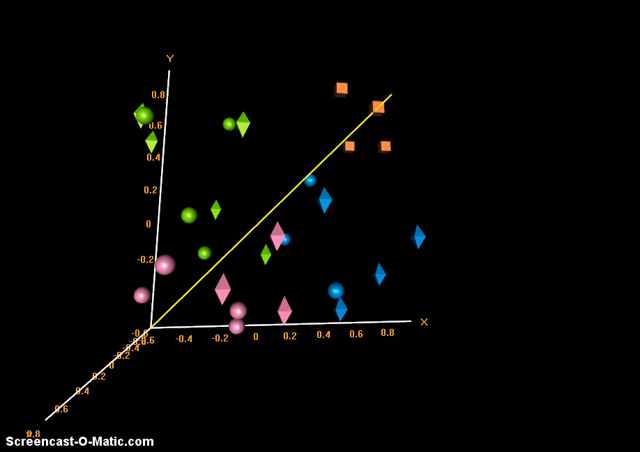
Principal component analysis (PCA)
Group 1 (NL)
Group 4 (IBD)
23% of variance
Group 2 (IBD)
Group 3 (IBD)
2%
75% of variance
Notes:
We are going to look at some data in a moment, but first we need to go over how some of this data is analyzed. Principal component analysis (PCA) is a statistical procedure that uses an orthogonal transformation of data points to determine how closely related samples might be.  In a plot of principle components, the x-axis represents about 75% of variance between samples  and the y-axis represent about 23%.  The third dimension represents much more subtle differences between groups. This is an example of PCA using gene expression data for 17,000 transcripts. Each point represents one individual.  The four orange cubes are normal controls.  Group 2 are patients with IBD that are most similar to controls.  Groups 3 and  4 are IBD patients that demonstrate a more severe phenotype than those in Group 2. And here is the plot rotated, showing the points in three dimensions. 

Slide 16




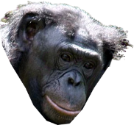
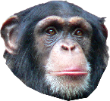
Alternative Transcripts in Apes
Brain
Cerebellum
30
30
20
20
10
10
PC2
0
0
-10
-10
-20
-20
-30
-20
-10
-30
-20
-10
PC1
PC1
Reyes A et al. Drift and conservation of differential exon usage
across tissues in primate species. PNAS 2013;110:15377-15382
Notes:
 Here are the two dimensional principle components of 6 ape species within the brain. As can be seen, alternative transcripts from humans are different from each of the ape species.  If we look at the cerebellum, which is primarily involved in motor control, we find less variance, in principle components, as expected. 

Slide 17

Alternative Transcripts in Apes
Heart
Liver
30
30
20
20
10
10
PC2
0
0
-10
-10
-20
-20
0
10
20
0
10
20
PC1
PC1
Reyes A et al. Drift and conservation of differential exon usage
across tissues in primate species. PNAS 2013;110:15377-15382
Notes:
 A heart merely pumps blood, so we find less variance in principle components than for the brain. Likewise for the liver, which primarily filters blood. Why the Rhesus macaque is up there, I don’t know. So, this data shows that alternative transcripts are different between humans and apes, especially in the brain. 

Slide 18

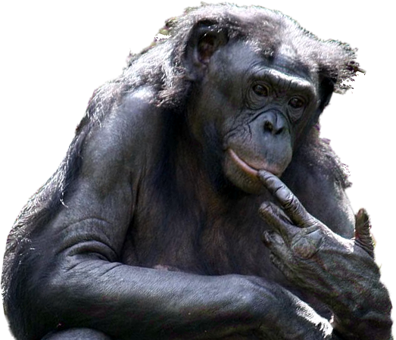
Differential Gene Expression in Apes
Human
11,391
Chimp
Human
11,586
Bonobo
1,446
1,124
1,369
975
Chimp
13,267
Bonobo
279
88
Maria C. N. Marchetto et al., Differential L1 Regulation in Pluripotent Stem Cells of Humans and Apes, Nature 503:525-532.
Notes:
Scientists have examined the expression of genes in human vs. ape iPSC. My guess is that scientists used iPSC instead of embryonic stem cells to eliminate the moral questions involved in using human embryos. So,  for example, over 1,400 genes are overexpressed in humans and  over 1,100 are overexpressed in chimpanzees.  Similar results are found comparing humans to Bonobos.  However, when we compare gene expression in chimpanzees compared to Bonobos, there are very few differences in gene expression. So, even though human and chimpanzee genes are nearly identical, their expression in the developing embryo are quite different.

Slide 19
Micro RNA (miRNA)
Ubiquitous small RNAs that control the expression of many genes
Notes:
Now, we are going to look at a few classes of non-coding RNAs that control gene expression. Our first example is micro RNA, as the name suggests are small RNA molecules, usually about 22 base pairs in length. Even though they are small, they have a big impact on the expression of protein coding genes, since about half the genes in the human genome are controlled by miRNAs. 

Slide 20
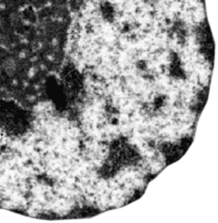

MicroRNA Regulatory Functions
Nucleus
Exportin-5
Argonaute Proteins
G
C
C
A
U
G
U
A
G
U
A
C
C
A
U
A
G
G
U
C
A
A
C
A
C
A
U
G
U
G
A
C
U
C
A
U
G
G
U
A
U
C
C
C
G
U
U
G
U
G
U
A
C
A
G
A
A
C
C
U
G
Ribosome
Dicer
U
U
G
C
C
C
U
A
U
G
G
U
A
C
C
A
U
G
G
U
A
U
C
C
C
G
U
U
G
U
G
U
A
C
A
G
G
A
C
A
U
G
U
G
U
U
G
C
C
C
U
A
A
A
A
A
A
A
A
A
mRNA
Notes:
Micro RNAs, like all other RNAs are made in the nucleus.  The original double-stranded pre-micro RNA molecule is transported out of the nucleus by a molecule called exportin-5. This pre-micro RNA molecule is nonfunctional and must be processed in order to perform its function. Once out of the nucleus,  it is joined by argonaute proteins. Nearly all miRNAs have a mismatched hairpin loop at one end.  This loop is sliced off by a protein called dicer. In addition, one of the strands,  called the passenger strand, is discarded. The mature miRNA is then free to do its work. The miRNA is complementary to a specific sequence found in the  mRNA of a specific protein-coding gene. When the  miRNA binds to the mRNA, it blocks protein translation, shutting off gene expression. The binding of the miRNA also destabilizes the mRNA molecule,  resulting in its hastened degradation. 

Slide 21
Human Micro RNAs in Common
29%
16%
26%
29%
Hisakazu Iwama, H. et al. 2013. Human MicroRNAs Originated from Two Periods... Mol Biol Evol 30: 613-626.
Notes:
Even though humans have genes that are nearly identical with other mammals, their miRNAs are not.  29% of miRNAs are specific for hominoids.  Another 26% are common between hominoids and monkeys.  Less than a third are in common with other mammals,  and only 16% are in common with non-mammalian vertebrates. So, miRNA regulation of gene expression is a large part of what makes human beings unique. 

Slide 22
Long Noncoding RNA (lncRNA)
A regulatory force in gene expression
Notes:
Long noncoding RNAs are a relatively recent discovery in the study of gene regulation. In contrast to miRNAs, these transcripts are greater than 200 base pairs long. Many of these RNAs have powerful regulatory effects on the genes they control. 

Slide 23
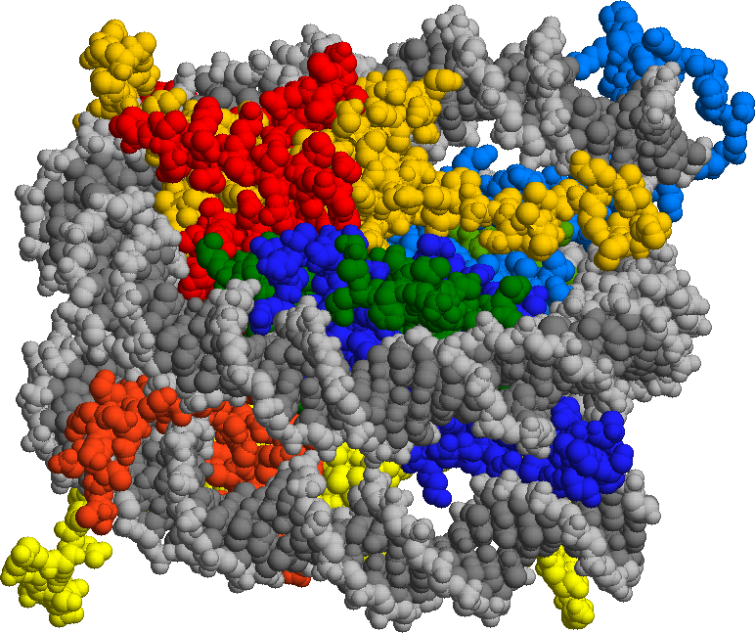
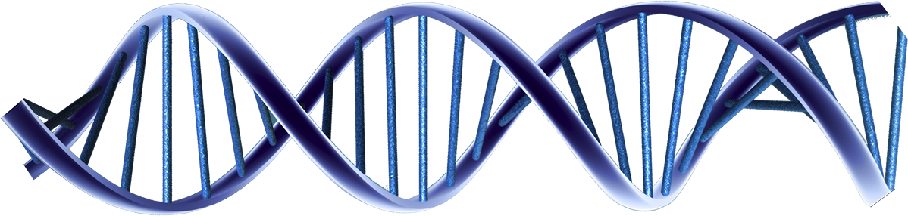
lncRNA Regulatory Functions
U
A
protein
mRNA
A
microRNA
C
A
G
G
U
U
G
U
G
A
A
A
C
A
C
U
C
A
G
U
C
U
G
A
A
C
U
A
A
U
A
A
G
A
U
U
G
C
C
G
ribosomes
lncRNA
G
C
C
U
A
microRNA
U
A
G
U
C
Transcription factors
U
A
A
G
U
Inr
A
G
U
C
G
A
A
C
U
U
C
DNA
A
A
A
U
G
G
C
Notes:
lncRNA can be involved in a any of a number of different regulatory functions. For example,  lncRNA can be designed so that it binds complementary mRNA, regulating translation by blocking ribosome access.  It can also bind proteins, regulating transport or co-activation signals.  Some lncRNAs are complementary to microRNAs, acting as a sponge to bind them preventing their inhibitory function.  Other lncRNAs can recruit transcription factors, forming complexes that bind genes in DNA to regulate their transcription.  Still other lncRNAs bind to mRNA causing them to be alternatively spliced or degraded. So, lncRNA can regulate gene expression in quite a number of ways. 

Slide 24
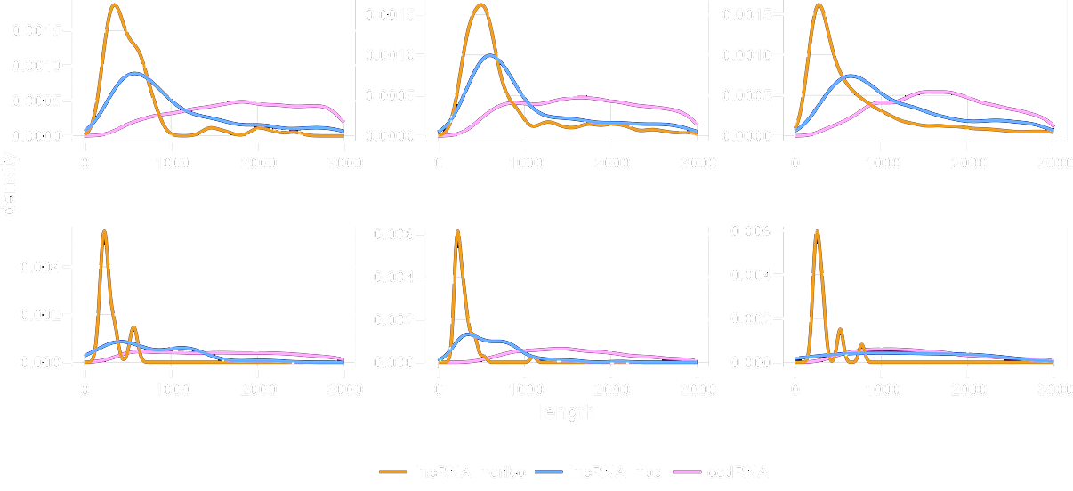
Transcript Length of lncRNA
Mouse
Human
Zebrafish
Fruit Fly
Arabidopsis
Yeast
Ruiz-Orera J et al. eLife Sciences 2014;3:e03523
Notes:
Now, we are going to compare lncRNAs from different species of animals and plants. These are density plots on the y-axis vs. transcript length for different RNAs.  The orange lines represent the density of lncRNAs not associated with ribosomes and are found in all species.  The blue lines represent the density of lncRNAs associated with ribosomes. You can see that in primitive species of animals and plants, not many lncRNAs are associated with ribosomes. It is only in higher animals, and especially humans where these RNA exert their regulatory effects. 

Slide 25
lncRNA Loci Matched to Other Species
Species | mRNA | lncRNA | Random
Chimp | 99% | 98% | 96%
Rhesus | 98% | 93% | 86%
Cow | 97% | 73% | 51%
Mouse | 96% | 58% | 36%
Rat | 93% | 54% | 32%
Considered “matched” if >30% of bases could be mapped from human to the other species.
Stefan Washietl, et al. Evolutionary dynamics and tissue specificity
of human long noncoding RNAs in six mammals. Genome Res. 2014 24: 616-628.
Notes:
This table represents a comparison of the lncRNAs compared to mRNAs for different mammalian species. As can be  seen in the first column, the mRNA bases of humans matches pretty well with most mammalian species – even cows and mice. However,  the second column shows that lncRNAs from humans don’t match well with most other mammals, and is, in fact, pretty close to that  expected with random sequences. So, this data shows that genetic differences that make humans unique are found in the lncRNAs rather than the coding sequences.

Slide 26
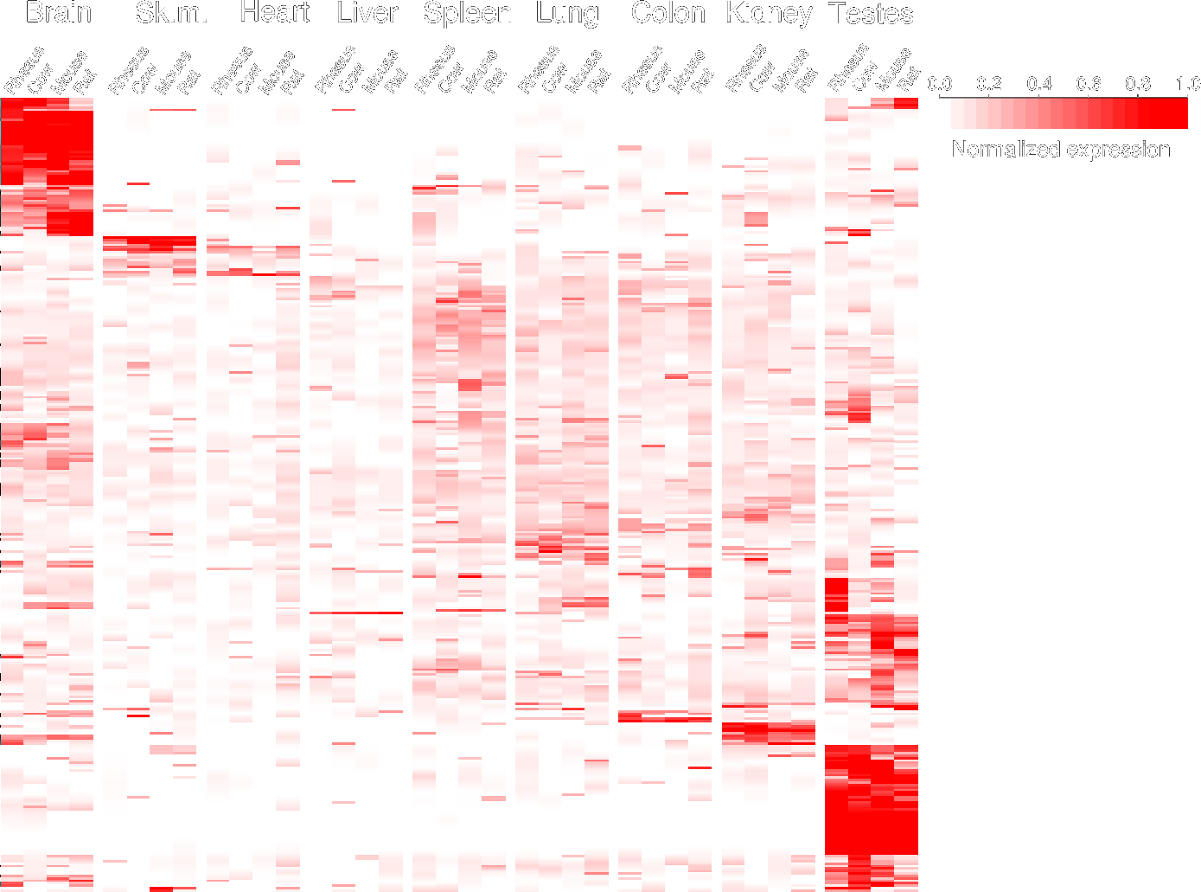
Heatmap of lncRNA Expression
Stefan Washietl, et al.
Evolutionary dynamics and tissue specificity of human long noncoding RNAs in six mammals. Genome Res. 2014 24: 616-628.
Notes:
This is a heatmap of lncRNA expression comparing humans to Rhesus macaques, cows, mice, and rats  for different organs. Each line, going across the heatmap represents one lncRNA, with the  red ones being differentially expressed. The data shows that these lncRNAs are differentially expressed mostly in  human brains  and testes. So, lncRNAs are one of the design features that make humans unique from other animals.  Sk.m.=Skeletal muscle.

Slide 27
Pseudogenes: Evolutionary Relics?
Are pseudogenes just duplicated copies of functional genes?
Notes:
For many years, pseudogenes were evolutionists great apologetic for the veracity of neo-Darwinian evolution, since they claimed that these sequences were merely evolutionary relics. 

Slide 28
Pseudogene Formation: Duplication
5’
UTR
Exon
1
Intron
1
Exon
2
Intron
2
Exon
3
3’
UTR
DNA
Duplication
5’
UTR
Exon
1
Intron
1
Exon
2
Intron
2
Exon
3
3’
UTR
DNA
Mutation
5’
UTR
Exon
1
Intron
1
Exon
2
Intron
2
Exon
3
3’
UTR
DNA
Notes:
There are two naturalistic theories of how pseudogenes form. In the first scenario,  a gene is duplicated, then  suffers a mutation that results in the gene no longer being translated into protein. 

Slide 29
Pseudogene Formation: Retrovirus
5’
UTR
Exon
1
Intron
1
Exon
2
Intron
2
Exon
3
3’
UTR
DNA
Transcription
5’
UTR
Exon
1
Intron
1
Exon
2
Intron
2
Exon
3
3’
UTR
RNA
Reverse transcription
5’
UTR
Exon
1
Exon
2
Exon
3
3’
UTR
DNA
Notes:
In the second scenario,  a gene is transcribed into RNA, and the  RNA is processed to remove the introns. At this point, a retrovirus (whose genetic material is RNA instead of DNA) attacks the cell. The retrovirus produces an enzyme called reverse transcriptase that normally synthesizes DNA from the viral RNA. Once the retroviral DNA is produced, that DNA is processed by the host cell to produce retroviral RNA to make more viruses. However,  sometimes the reverse transcriptase turns host RNA into DNA, which gets incorporated into the host’s DNA. In this case, the processed RNA gets incorporated into the host DNA as a processed pseudogene. Since it doesn’t have any of the gene’s promoter sequence, the pseudogene usually doesn’t get transcribed. Of course, the non-evolutionary explanation for pseudogenes is that they were designed to mimic the gene whose expression they control. 

Slide 30
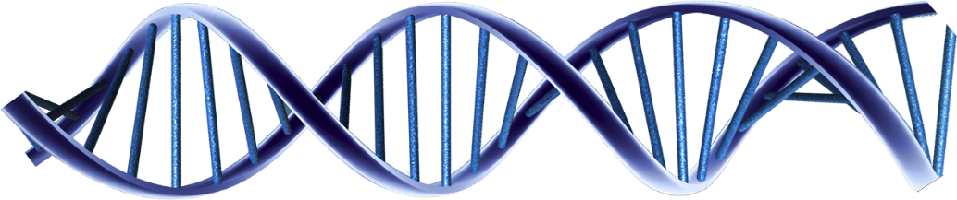

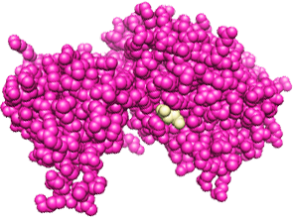
Pseudogene RNA Prevents Cancer
Inr
Inr
PTEN
miRNA
PTENPG1
A
U
C
C
G
U
A
G
U
U
A
U
A
G
U
U
C
C
G
A
U
C
C
G
A
A
G
U
A
A
G
A
A
A
G
A
A
C
G
C
U
G
C
U
U
A
G
U
U
C
C
G
A
A
G
A
A
G
C
U
Phosphatase
(Tumor-suppressor protein)
Notes:
I am going to give you some examples of psuedogene function.  Phosphatase and tensin homolog (PTEN) gene codes for a  phosphatase protein that regulates cell division to prevent cells from dividing too rapidly. Mutations of this PTEN gene are responsible for the development of many cancers.  The expression of the PTEN gene is controlled by miRNA that  binds to the mRNA preventing it from being translated. However, the pseudogene of PTEN,  PTEN pseduogene 1, produces a similar RNA transcript. This transcript has the same miRNA binding sequence, so the pseudogene binds the inhibitory miRNA, allowing the tumor-suppressor protein to be translated. In this way, the pseudogene prevents cancer. 

Slide 31
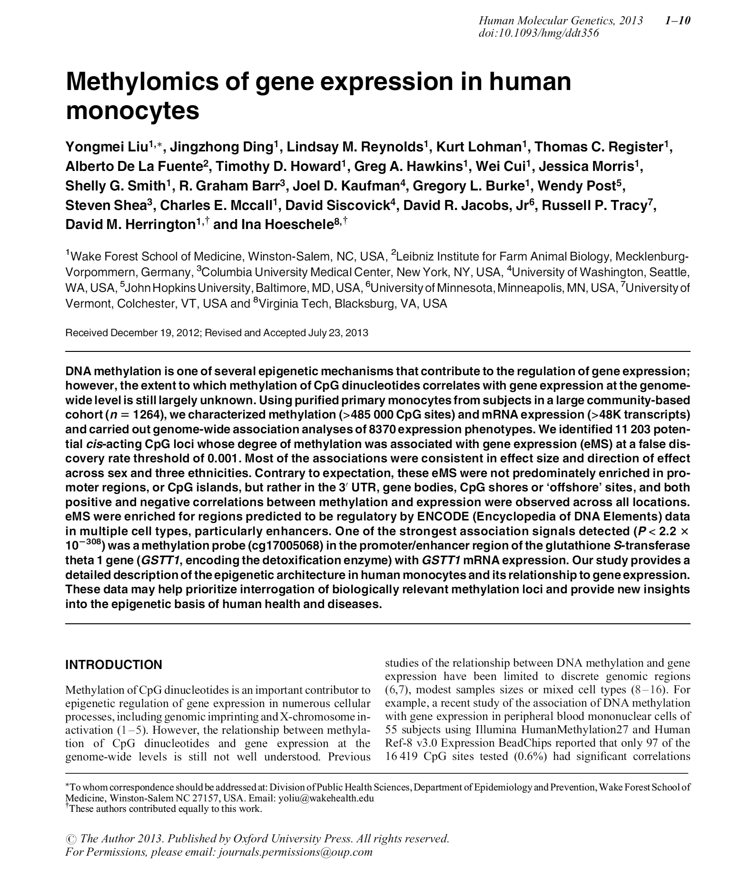
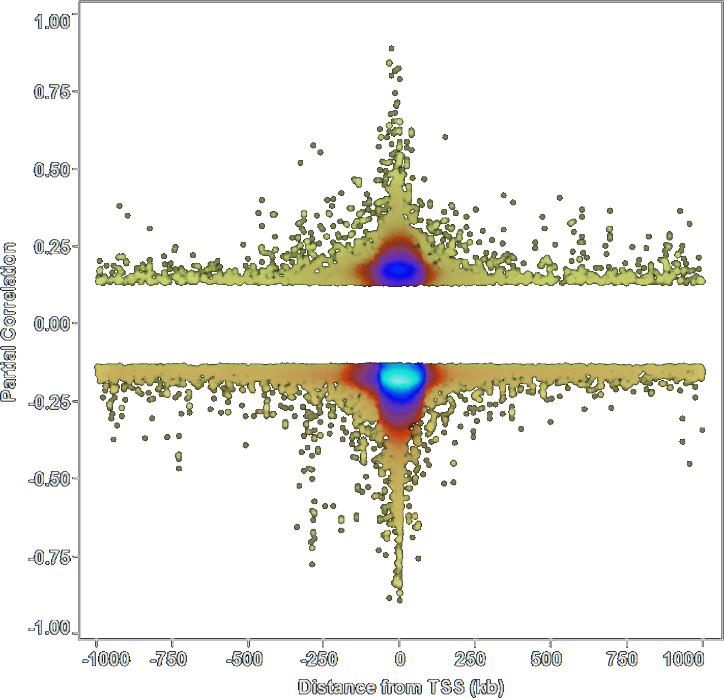
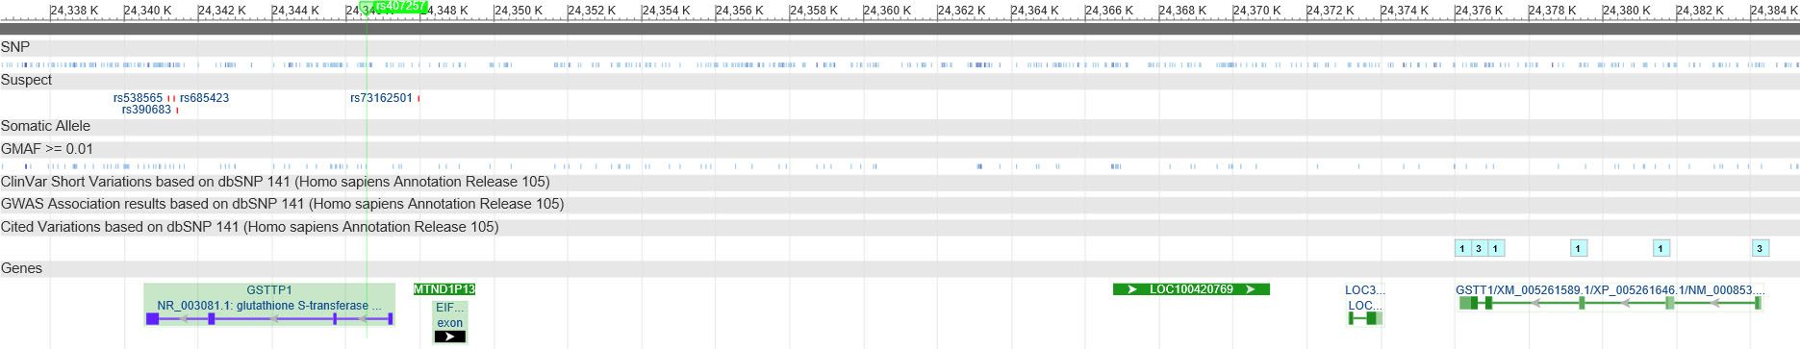
“Undiscovered” Pseudogenes Function
rs407257
GSTTP1
(pseudogene)
GSTT1
28 Kb
Liu, Y, et al. 2013. Methylomics of gene expression in human monocytes Hum. Mol. Genet. doi: 10.1093/hmg/ddt356.
Notes:
 A paper was published last year looking at the methylomics of monocytes. One expects CpG sites to affect gene expression when located near the  gene’s transcriptional start site, which is what they showed.  However, this paper found a particular SNP that affected a gene, GSTT1, 28 KB away. The authors never identified the reason for the long range effect. However, when I looked up the SNP in the NCBI database (National Center for Biotechnology Information),  it was clear that the SNP was in the GSTT1 pseudogene. So, it’s likely that the pseudogene is controlling expression of the expressed gene. 

Slide 32
HLA-H Pseudogene
HLA region is associated with IBD
Notes:
This is an unpublished example from my own research. As most of you know, I am involved in research of inflammatory bowel disease at Cedars-Sinai Medical Center. Research in patient genetics has shown a strong association with disease in the HLA region, which is involved in host defense mechanisms and antigen recognition. HLA-H is a transcribed pseduogene, although it produces no protein product. This is a graph of the expression of the gene vs. methylation of one of its CpG sites, showing a clear negative correlation.

Slide 33
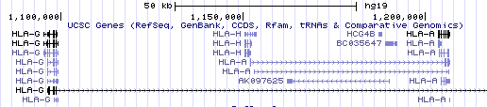
HLA-H Correlations
HLA-G
HLA-H
HLA-A
TSS
Notes:
This is a graph of correlations of expression and methylation over the length of the gene. As expected, CpG methylation is most correlated with expression  near the TSS. However, there are two addition peaks of correlation located on either side of the HLA-H gene. NCBI shows these locations to be the  genes HLA-G  and HLA-A–two translated genes. It turns out that the sequence of the HLA-H gene has a 93% homology, or identity, with that of HLA-G. So, it is likely that the transcript of HLA-H is somehow regulating expression of its two neighboring genes. We have plans to look into the mechanism of this association in future studies. So, pseudogenes produce transcripts that regulate genes and are not just evolutionary relics. 

Slide 34
Histone Modification (56%)
The structure of DNA regulates the expression of its genes
Notes:
Histones are proteins that form the structure of DNA within a cell. They can be specifically modified to control the expression of the genes they are associated with. 

Slide 35
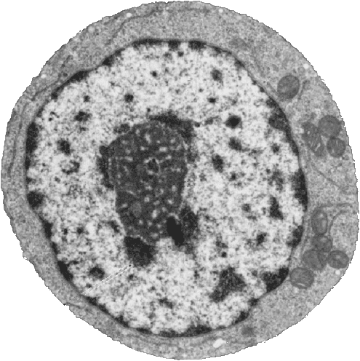
DNA Structure: Chromatin
Nucleus
Heterochromatin
(condensed DNA)
Euchromatin
(actively transcribed DNA)
Notes:
Those of you who were here last time will probably remember this slide. It shows the  nucleus, the  dark heterochromatin, which is condensed DNA, and the  light euchromatin, which is the actively transcribed DNA. Let’s look at how this DNA is organized. 

Slide 36
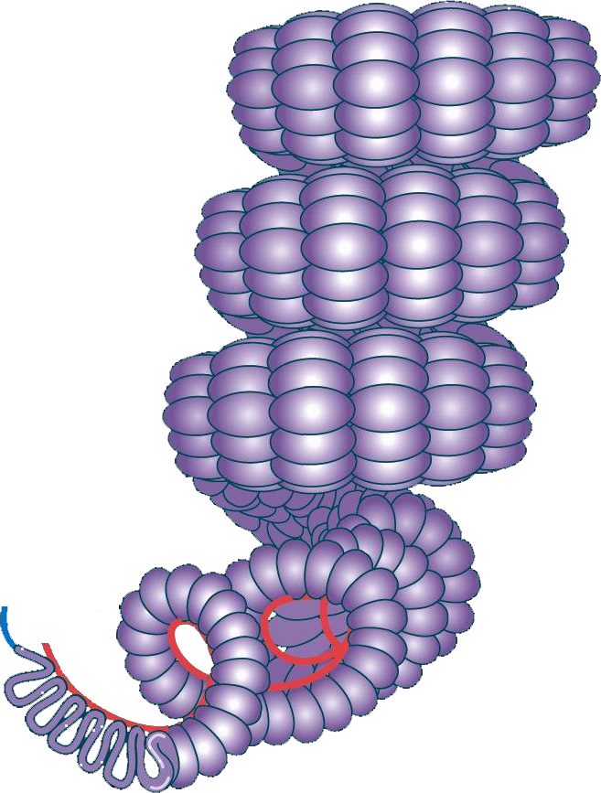
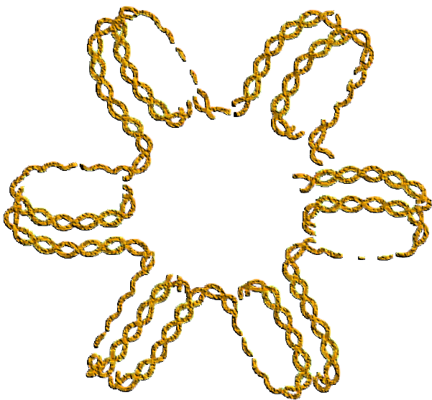
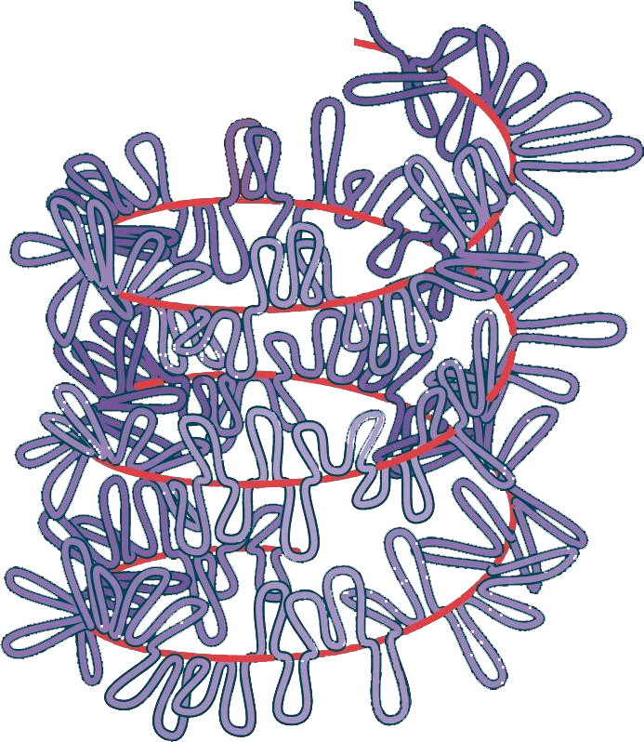
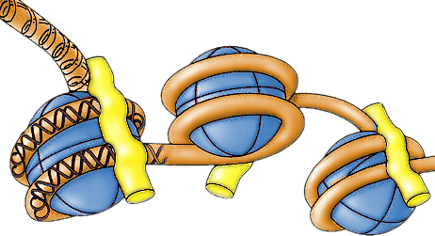
DNA Coiling and Supercoiling
4 Histone protein pairs
Histone H1
DNA
Nucleosome
Notes:
The fundamental organization of eukaryotic DNA is the nucleosome. It consists of a core of 4 pairs of histone proteins (represented in blue) around which the DNA (orange) is wrapped. Histone H1 is on one end and controls how the nucleosomes are organized.  This is a representation of how the nucleosomes are organized together, making this flower-like arrangement.  These “flowers” are stacked on top of each other to form long threads. The threads are coiled and the coils are  further coiled, in what is called supercoiling,  producing the chromosome. Why is all this structure necessary? 

Slide 37
Length of Human DNA
Measurement
Number
Units
Base Pairs (BP)
6.40
#
9
Length BP
3.40
Meters
-10
DNA length/cell
2.18
Meters
# cells
3.70
#
13
Total length
8.05
Meters
13
Distance to Pluto
3.67
Miles
Meters
to Pluto
5.91
Meters
09
12
Times to Pluto
13.63
#
Meters/mile
1.61
Conversion
3
Notes:
There are 3.2 billion base pairs in one set of human DNA. Since each cell is diploid (two copies of DNA), this means that  each cell has 6.4 billion base pairs of DNA.  Each base pair is 3.4 x 10⁻¹⁰ meters long. This means that the  DNA in one cell is over 2 meters long – taller than anybody in this room!  The average human being has 37 trillion cells in their body. So taken together, this means that  there are 80 trillion meters of DNA in your body.  It’s only about 6 trillion meters to Pluto, which means there is enough  DNA in your body to extend to Pluto and back over 6 times. 

Slide 38
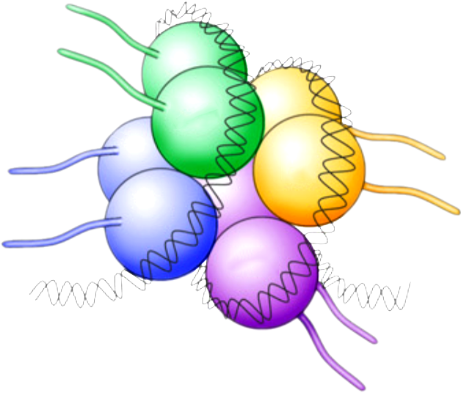
Histone Tails
H2B
H4
H3
H2A
Notes:
This is a closer look at the nucleosome. As can be seen, the histone proteins have tails. Let’s look at what these tails are doing. 

Slide 39
Chromatin Remodeling (Histone Code)
A
Acetylation
P
H2A
U
P
M
Methylation
P
Phosphorylation
A
A
A
U
Ubiquitination
P
H2B
U
A
A
A
A
M
M
M
P
H3
P
M
P
M
P
M
M
P
M
A
A
A
A
A
P
M
H4
M
M
A
A
A
A
A
Adapted from Gräff and Mansuy. 2008. Epigenetic codes in cognition and behavior. Behav Brain Res. 192: 70–87.
Notes:
These are the four core histone proteins. Sites on the protein tails can be modified in four different ways.  For example, acetylation of the histones turns on gene expression.  Methylation of the histones turns off gene expression.  Phosphorylation in histone H2 is used as a marker of broken DNA. So, the phosphorylation signals the cells’ DNA repair machinery to excise the region and repair it.  Ubiquitin is a small regulatory protein. Ubiquitination of histones H2A and H2B  regulates methylation of histone H3. And, finally,  these regulatory sites interact with each other to control gene expression. This complex regulatory mechanism has been called the histone code. 

Slide 40

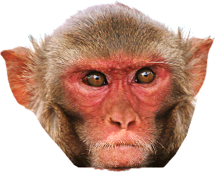
H3K4me3 Modifications Near TSS
Cain C E et al. Gene Expression Differences Among Primates Are Associated With Changes in a Histone Epigenetic Modification. Genetics 2011;187:1225-1234
Notes:
These graphs are histograms of the distance from modified histone regions to the nearest TSS in humans, chimpanzees, and rhesus macaques. If these modified histone a re involved in gene regulation, we would expect to find them near the TSS, which they are. 

Slide 41



Overlap of H3K4me3⁺ Genes
457
163
209
9026
300
438
339
Cain C E et al. Gene Expression Differences Among Primates Are Associated With Changes in a Histone Epigenetic Modification. Genetics 2011;187:1225-1234
Notes:
This is a comparison of histone modifications for  humans, chimpanzees, and  macaque. It shows that a significant number of histone sites are differentially regulated in each species. So, histone modification is one mechanism by which humans are unique from other apes. 

Slide 42
Transcription Factors (8.5%)
Binding of transcription factors regulates gene expression
Notes:
8.5% of human DNA consists of short sequences that bind transcription factors. These factors regulate gene expression, usually by increasing the rate of transcription for the particular gene with which they are associated. 

Slide 43

Transcription Factor Regulation
Enhancer
C
C
U
C
A
G
G
A
C
A
U
G
U
G
U
U
G
C
C
C
U
A
U
G
G
U
A
C
C
A
U
G
G
U
A
U
C
C
C
G
U
U
G
C
Transcription
Factors
A
U
G
G
G
A
Inr
U
A
C
C
U
U
U
G
C
C
C
U
A
U
G
G
U
A
C
C
A
U
G
G
U
A
U
C
C
C
G
U
U
G
U
G
U
A
C
A
G
G
A
C
A
U
G
U
G
U
U
G
C
C
C
U
G
G
A
C
A
U
G
U
G
C
Enhancer
Promoter
TSS
Notes:
We usually think of a gene within DNA as being a linear sequence of bases, containing a  transcriptional start site,  a promoter, and maybe  some enhancer elements. How can an enhancer so far from the TSS affect gene transcription? The reality is that DNA is not flat, but as shown previously,  bends and curves. So,  enhancer elements can bind transcription factors, promoting the binding of RNA polymerase complexes to enhance gene transcription. 

Slide 44

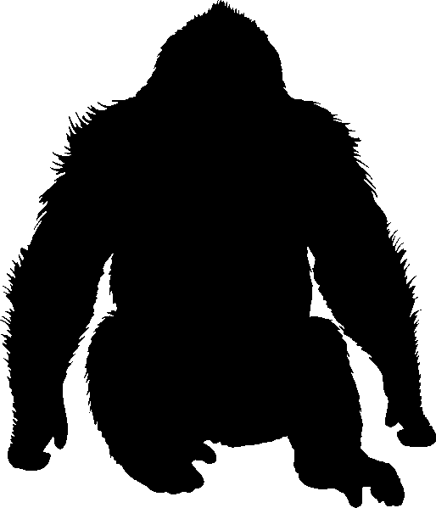
CTCF Transcription Factor Binding Sites in Apes
Human
Gorilla
24,370
19,451
5,228
A. Scally et al. Insights into hominid evolution from the gorilla genome sequence. Nature 483, 169-175 (2012).
Notes:
This is a figure of CTCF transcription factor binding sites that are unique in humans vs. gorillas for iPSC. So, humans have many more CTFC transcription factor binding sites and over half of those sites are unique to each species, even though our coding sequences are nearly identical. 

Slide 45
DNA Methylation (4.6%)
Methylation of CpG sites downregulates RNA expression
Notes:
DNA methylation sites, called CpG sites, account for 4.6% of the human genome. Methylation of some of these sites downregulates gene expression. 

Slide 46
DNA Methylation Alters Gene Expression
RNA polymerase
U
A
A
G
U
Me
Me
Me
Me
Me
A
G
U
C
G
A
A
C
Inr
U
U
CpG Island
Gene
C
A
A
A
U
G
G
C
Promoter
Unmethylated
Methylated
Notes:
Often, these CpG sites are located in the promoter part of a gene. If the CpG sites are  unmethylated, the gene is expressed and mRNA is produced. However, if the promoter CpG sites are  methylated, RNA polymerase is blocked and the gene is not expressed. So, methylation of CpG sites is an important epigenetic regulator of gene expression. 

Slide 47
CpG Methylation vs. Expression
Notes:
The relationship between methylation and expression can be seen in this graph, where less methylated CpG sites have greater gene expression. 

Slide 48
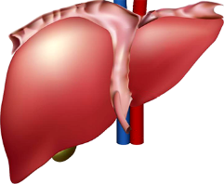




CpG Methylation Sites in Apes
603
367
470
129
85
127
282
112
240
Pai AA, et al. (2011) A Genome-Wide Study of DNA Methylation Patterns and Gene Expression Levels in Multiple Human and Chimpanzee Tissues. PLoS Genet 7: e1001316.
Notes:
A 2011 study examined genome-wide methylation and gene expression in multiple human and chimpanzee tissues. The results showed that the vast number of CpG methylation sites were differentially methylated between humans and chimps. 

Slide 49
Why Evolution by Natural Selection is False
80% of genome shows function
10% of genome is evolutionarily conserved
∴ Evolution (selection) does not explain 70% of genome function
∴ Most of genome is designed
Notes:
So, scientists have found  that 80% of the human genome has some function.  However, only 10% of genome is evolutionarily conserved.  Therefore, evolution (specifically natural selection) does not explain 70% of genome function.  If natural selection is the driving factor of evolution, most of genome has not evolved, but is designed. 

Slide 50
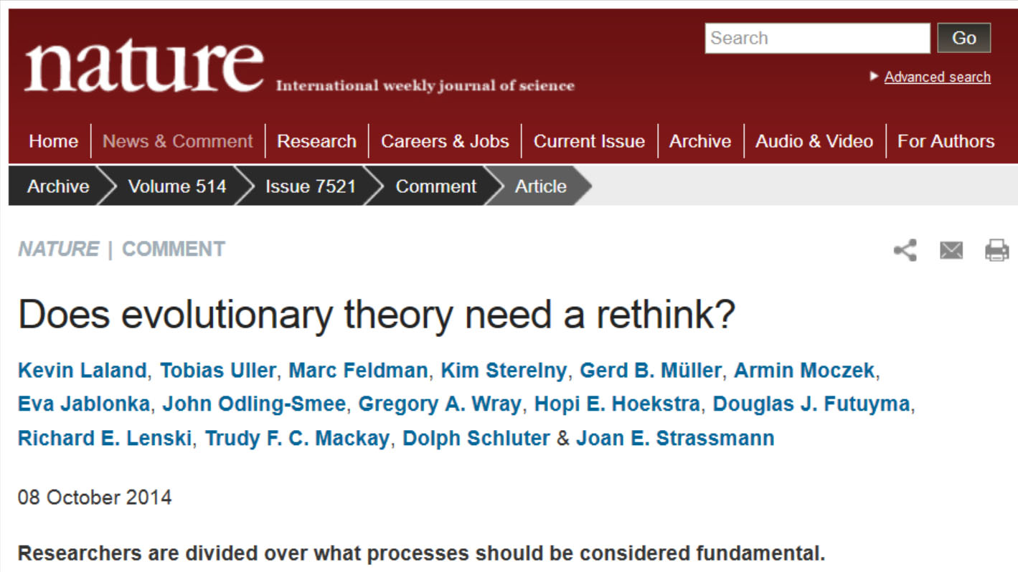
Standard Evolutionary Theory?
Notes:
 This article came out a little over a month ago, asking if standard evolutionary theory needed to be modified. Of course, since it was in the journal Nature, it had both supporters and detractors. One fear, mentioned in the article was that “Perhaps haunted by the spectre of intelligent design, evolutionary biologists wish to show a united front to those hostile to science.” The main thrust of the article was what to do with the many of the examples of gene regulation and how to incorporate those concepts into standard evolutionary theory. Some scientists advocated a new evolutionary paradigm whereas others thought they could just incorporate the complications of genetic control mechanisms into standard evolutionary theory. 

Slide 51
SET vs. EES
Standard Evolutionary Theory (SET)
Extended Evolutionary Synthesis (EES)
A theory of genes
Genetic mutation
Natural selection
Gene fixation
A theory of forms
Environmental influence
Developmental plasticity
Developmental bias
Genetic change
Notes:
This is a comparison of  standard evolutionary theory to the new extended evolutionary synthesis. Standard evolutionary theory has become  a theory of genes, where  random genetic mutation is acted on by  natural selection, resulting in the eventual  fixation of advantageous genes into the genomes of populations of species. The extended evolutionary synthesis is a  new theory of forms, where  environmental influences,  developmental plasticity, and  developmental bias lead to phenotypic changes in species, in the absence of genetic changes. Eventually, those phenotypic changes get  hard-wired into the genetic sequences of populations. 

