Slide 1
THERE IS ONE EVENT IN ALL OF HISTORY, IF TRUE, REVOLUTIONIZES ALL OF HISTORY… and YOUR LIFE

Slide 2
THE PHYSICAL RESURRECTION
OF
JESUS CHRIST

Slide 3
WHY???
Will discuss later
First, must determine if evidence shows Jesus Christ physically rose from the dead

Slide 4
PART ONE: THE EVIDENCE

Slide 5
TYPES OF EVIDENCE
Type 1: Scientific Evidence
“Scientific Method” conducts repeated experiments under controlled conditions, recording the results;
No historical event can be proven by the “scientific method”

Slide 6
TYPES OF EVIDENCE
Findings of scientific evidence (fingerprints, carbon 14 dating methods, chemistry, biology, etc.) can be applied to historical data

Slide 7
TYPES OF EVIDENCE
Type 2: Legal/Historical
Used to examine historical facts
Based on viable written/verbal documentation or artifacts
And what sound conclusions can be drawn from these sources

Slide 8
TYPES OF EVIDENCE
Legal/historical evidence almost the entire basis of determining truth in courts of law for thousands of years
Bible utilizes this type of evidence

Slide 9
Legal/historical evidence will be used to examine the historicity of
THE
RESURRECTION OF
JESUS CHRIST

Slide 10
LEGAL/HISTORICAL EVIDENCE
Must examine the viability of relevant documents:
New Testament (NT) Books, especially the four Gospels
Documents outside the NT

Slide 11
LEGAL/HISTORICAL EVIDENCE
Conduct sound logic of facts, establish viable conclusions, or, as the legal system would say, conclusions “beyond a reasonable doubt.”

Slide 12
MANUSCRIPT EVIDENCE
FIVE SIGNIFICANT FACTORS
THAT VERIFY
A DOCUMENT’S RELIABILITY:

Slide 13
MANUSCRIPT EVIDENCE
NUMBER - of copies, the more the better –can crosscheck for consistency and accuracy
OLD – How old is the manuscript(s) compared to the original version; generally, the younger the better.

Slide 14
MANUSCRIPT EVIDENCE
TIME – between the event and:
Existing document
Information source in the document
EYEWITNESSES – best kind of testimony is by eyewitnesses
SUPPORTING DATA – from other sources

Slide 15
MANUSCRIPT EVIDENCE
MEMORY TRICK:
THIS IS THE “NOTES” THEOREM OF DOCUMENTATION
NUMBER
OLD (how old compared to original)
TIME
EYEWITNESSES
SUPPORTING DATA

Slide 16
MANUSCRIPT EVIDENCE
Ancient literature outside the NT:
Typical surviving no. of manuscripts are 10 or less (No.)
The earliest being 400 – 1400 years from the original (Old). Numerous ancient manuscripts determined reliable based on above numbers and age; just a few…..

Slide 17
AUTHOR | BOOK | DATE WRITTEN | EARLIEST COPIES | HOW OLD? | NO. OF COPIES
Homer | Illiad | 800 B.C. | c. 400 B.C. | c. 400 yrs. | 643
Herodotus | History | 480-425 B.C. | c. A.D. 900 | c. 1,350 yrs | 8
Thucydides | History | 460-400 B.C. | c. A.D. 900 | c. 1,300 yrs | 8
Plato |  | 400 B.C. | c. A.D. 900 | c. 1,300 yrs | 7
Demosthenes |  | 300 B.C. | c. A.D. 1100 | c. 1,400 yrs | 200
Ceasar | Gallic Wars | 100-44 B.C. | c. A.D. 900 | c. 1,000 yrs | 10
Livy | History of Rome | 59 B.C. – A.D. 17 | 4th C. (partial) Mostly 10th C. | c. 400 yrs c. 1,000 yrs | 1 partial 19 copies
Tacitus | Annals | A.D. 100 | c. A.D. 1100 | c. 1,000 yrs | 20
Pliny Secundus | Natural History | A.D. 61 – 113 | c. A.D. 850 | c. 750 yrs. | 7
From Josh McDowell’s The New Evidence that Demands a Verdict, p. 38

Slide 18
EXAMINATION OF
THE RELIABILITY OF THE NEW TESTAMENT (NT) MANUSCRIPTS

Slide 19
NEW TESTAMENT RELIABILITY
NUMBER: No. of NT Manuscripts:
About 25,000 in many languages
This includes over 5,000 Greek copies!
The multiple languages helps to cross check consistency of the data.

Slide 20
NEW TESTAMENT RELIABILITY
OLD: How old are existing NT Manuscripts compared to their originals:
Earliest is within 25-35 years of original (“John Rylands” fragment of Gospel of John found in Egypt)!
Possibly a Mark fragment dating to 68 AD (Mark written in 50s – 60s)
Many copies in 2nd & 3rd Centuries
Exponential growth after that

Slide 21
NEW TESTAMENT RELIABILITY
All NT likely by ~70 AD, excluding Revelation and other books by John.
Incredible short time span of when the NT books were written compared to their originals is relatively unique for ancient literature

Slide 22
NEW TESTAMENT RELIABILITY
TIME: NT Books written VERY early after actual events of the early thirties AD:
Matthew: 50s – 60s
Mark: 50s – 60s
Luke: 60
John: 85 - 90
I Cor.: 55
Galations: 48 - 49
All of Paul’s Epistles from ~48 AD – 64/68 AD

Slide 23
NEW TESTAMENT RELIABILITY
Further analysis of the TIME issue: Consider time interval between the origin of the information contained in the NT and the events themselves!

Slide 24
NEW TESTAMENT RELIABILITY
Following is the dating of the resurrection story (This helps further prove how close the written information in the NT is to the original event, and thereby substantiating its veracity per the “TIME” factor for showing document reliability):
NT has resurrection creeds going back to the mid-30s, and likely to the resurrection itself!!!

Slide 25
NEW TESTAMENT RELIABILITY
NT has Creeds in it which Pre-Date the times of the writing of the NT books Themselves!
Even radical NT critical scholars agree I Cor. was written about 55 A.D. and accept it as a legitimate letter from Paul
In I Cor. Paul references a previous time of presenting the Gospel to the Corinthians; scholars generally feel this is about 51 A.D.

Slide 26
Crucifixion is often dated in 30 A.D. However should be in 33 A.D. based on the prophecy chronology of Daniel 7.
AT THIS POINT WE ARE
WITHIN ABOUT 20 YEARS
OF THE RESURRECTION ITSELF!

Slide 27
NEW TESTAMENT RELIABILITY
I Cor. 15:3-7 considered by conservative & liberal critics a quotation by Paul of a previous Christian creed:
“For what I received I passed on to you as of first importance: that Christ died for our sins according to the Scriptures, that he was buried, that he was raised on the third day according to the Scriptures, and that he appeared to Peter, and then to the Twelve.

Slide 28
NEW TESTAMENT RELIABILITY
“After that, he appeared to more than five hundred of the brothers at the same time, most of whom are still living, though some have fallen asleep. Then he appeared to James, then to all the apostles,…”
Paul then adds in verse 8, “and last of all he appeared to me last to one abnormally born.”

Slide 29
NEW TESTAMENT RELIABILITY
Due to stylistic and vocabulary characteristics, etc. this creed, a stylized hymn, is thought by most scholars to have originated by 35 – 38 A.D. Some contend it goes back to the resurrection itself!

Slide 30
NEW TESTAMENT RELIABILITY
Conservative & liberal scholars generally accept Paul’s conversion was 1-3 yrs. after the crucifixion.
Even liberal critics accept Galations as a genuine letter of Paul
In Gal. 1:13-17, Paul, after his conversion, went to Damascus for three years of personal study, consulting with no one.

Slide 31
NEW TESTAMENT RELIABILITY
In Gal. 1:18-20, Paul then visited Peter and James, confirming with them the Gospel. This visit was about 4 - 6 years after the resurrection.
Thus, the creed of I Cor. 15:3-7, which Paul said he received earlier, undoubtedly was received by him by no later than his visit with Peter and John (they surely did not just talk about the weather!!!)

Slide 32
NEW TESTAMENT RELIABILITY
Therefore, this creed was transmitted to Paul by no later than 35 – 37 AD (assuming a 30 A.D. crucifixion date, rather than a 33 A.D. date).
Vast majority of liberal and conservative scholars accept the above dates.

Slide 33
NEW TESTAMENT RELIABILITY
Since this creed existed at the time of Paul’s visit to Peter and James (34 – 36 AD), it originated before that point.
Some well-known critical scholars feel it goes all the way back to the year of the proclaimed resurrection!

Slide 34
NEW TESTAMENT RELIABILITY
German theologian Walter Kasper states,
“We have here therefore an ancient text, perhaps in use by the end of 30 AD….” (Jesus the Christ, new ed., trans. V. Green (Mahweh, N.J.: Paulist, 1976), p. 125)

Slide 35
NEW TESTAMENT RELIABILITY
Reginald Fuller proclaims about the disciples belief in the resurrection
“as one of the indisputable facts of history…a fact upon which both believer and unbeliever may agree.” (The Foundations of New Testament Christology, p. 142)

Slide 36
NEW TESTAMENT RELIABILITY
Atheist writer, Bart Ehrman, even states:
“Historians, of course, have no difficulty whatsoever speaking about the belief in Jesus’ resurrection, since this is a matter of public record. For it is a historical fact that some of Jesus’ followers came to believe that he had been raised from the dead soon after his execution.” (Jesus: An apocalyptic Prophet of the New Millennium (New York: Oxford University Press, 1999), p. 231)

Slide 37
NEW TESTAMENT RELIABILITY
Ulrich Wilckens declares that the material in this creed
“indubitably goes back to the oldest phase of all in the history of primitive Christianity.” (Resurrection: Biblical Testimony to the Resurrection: An Historical Examination and Explanation, trans. A.M. Stewart (Edinburgh: Saint Andrew, 1977), p. 2)

Slide 38
NEW TESTAMENT RELIABILITY
Most scholars feel that in the Book of Acts there is encased in the material sermons from the earliest Christian preaching, which talk about the death and resurrection of Jesus.

Slide 39
NEW TESTAMENT RELIABILITY
Scholar Gerald O’Collins states that the sermon content in Acts:
“…incorporates resurrection formulae which stem from the thirties.” (Interpreting Jesus (London: Geoffrey Chapman, 1983), 109-110.

Slide 40
NEW TESTAMENT RELIABILITY
Scholar John Drane adds:
“The earliest evidence we have for the resurrection almost certainly goes back to the time immediately after the resurrection event is alleged to have taken place. This is the evidence contained in the earlier sermons in the Acts of the Apostles.” (Introducing the New Testament (San Francisco: Harper and Row, 1986), p. 99)

Slide 41
NEW TESTAMENT RELIABILITY
Gary Habermas is one of the most, if not the most, authoritative scholar on the resurrection of Jesus Christ.
Since 1975 he has read more than 1400 scholarly publications on the death, burial, and resurrection of Jesus, which have appeared in German, French, and English.

Slide 42
NEW TESTAMENT RELIABILITY
He reports that almost all of the critical scholars (liberal or conservative) agree that:
The resurrection story goes back to just after the crucifixion
Early Christians believed they had experiences of the risen Lord Jesus Christ.
He includes scholars who deny the literal physical resurrection of Jesus.

Slide 43
NEW TESTAMENT RELIABILITY
All this indicates very early information that is datable from just after the crucifixion.
Clearly indicates the resurrection story is not a “legend,” as legends need time (usually at least two generations to 200 years) to develop.
The theory that the Church later developed a “resurrection legend” does not correspond to the historical data, nor the biblical data.

Slide 44
NEW TESTAMENT RELIABILITY
EYEWITNESSES:
Most of NT by eyewitnesses! Such accounts are better than second-hand information.
Eyewitness accounts are rare in ancient literature.
Eyewitness accounts that are written down provide powerful evidence for the truth of the document

Slide 45
NEW TESTAMENT RELIABILITY
Eyewitnesses wrote most of the NT:
Luke 1:1-4 “Many have undertaken to draw up an account of the things that have been fulfilled among us, just as they were handed down to us by those who from the first were eyewitnesses and servants of the word. Therefore, since I myself have carefully investigated everything from the beginning, it seemed good also to me to write an orderly account for you, most excellent Theophilus, so that you may know the certainty of the things you have been taught.”

Slide 46
NEW TESTAMENT RELIABILITY
I John 1:1: “That which was from the beginning, which we have heard, which we have seen with our eyes, which we have looked at and our hands have touched – this we proclaim concerning the Word of life. The life appeared; we have seen it and testify to it….We proclaim to you what we have seen and heard, so that you may have fellowship with us.”

Slide 47
NEW TESTAMENT RELIABILITY
II Peter 1:16 – “We did not follow cleverly invented stories when we told you about the power and coming of our Lord Jesus Christ, but we were eyewitnesses of his majesty.”
Polycarp (b. 69)an actual disciple of John, the Apostle. Stated that John was an eyewitness and that he wrote the book of John

Slide 48
NEW TESTAMENT RELIABILITY
Eye-witnesses of Jesus’ life & resurrection: Matthew, John, & Peter, plus two half-brothers of Jesus – James & Jude; and Paul (saw Jesus after his resurrection).
People very close to the eye-witnesses: this includes Mark (under Peter) & Luke (under Paul).

Slide 49
NEW TESTAMENT RELIABILITY
SUPPORTING DATA:
Documentation outside the NT books
Total of over 31,000 existing quotes of NT by early church fathers by 254 AD, & all of NT by 299 AD except for about 11 versus. The following illustrates….

Slide 50
 | Name of Writer |  | NT Quotes | Existing Quotes of the following NT Books
 | Clement of Rome (??-97) (a disciple of the Apostles) |  | >6 | Quotes/paraphrases: I Cor., Eph., Heb., I Peter, James.
 | Ignatius (70-110) (knew Apostles) |  | >15 | Matt., Luke, John, Acts, Romans, I Cor., Gal., Eph., Phil., Col., I & II Thess., I & II Tim., Jam., I Pet.
 | Polycarp (70-156) (Disciple of John) |  | 40 | All (except John, Col., Jam., II Pet., Tit., II John, Jude, Rev.)
 | Just Martyr (100-165) |  | 330 | Four Gospels, Rev.
 | Iraneus (130-202) |  | 1,819 | Each NT book except Phil, II Peter, III John, Jude

Slide 51
Clement of Alexandria (150-212) |  | 2,406 | Each NT book except for three (II Peter, III John & ?).
Tertullian (160-220) |  | 7,258 | Each NT book except James, II Peter, II/III John
Hippolytus (170-235) |  | 1,378
Origin (185-254) |  | 18,ooo+ | Each NT book

Slide 52
NEW TESTAMENT RELIABILITY
Summary: Abundant proof for the viability of the NT because of:
NUMBERS: Huge no. of manuscripts
OLD: Relatively young manuscripts; short time between the originals & their copies
TIME: The short time interval of the NT books compared to the events themselves AND the incredible early dates of information in the NT that can be traced to just after the resurrection itself
EYEWITNESSES: Most of the NT was written by eyewitness accounts of people who knew Jesus and the events personally.
SUPPORT: Information from outside sources.

Slide 53
NEW TESTAMENT RELIABILITY
Regarding the
supporting information
from outside the NT,
additional evidence will be provided later in our discussion from
NON-CHRISTIAN sources

Slide 54
CONCERNING NT MANUSCRIPTS
Sir Frederic G. Kenyon states:
“The interval then between the dates of original composition and the earliest extant evidence becomes so small as to be in fact negligible, and the last foundation for an doubt that the Scriptures have come down to us substantially as they were written has now been removed. Both the authenticity and the general integrity of the books of the New Testament may be regarded as finally established.” (The Bible and Archaeology, New York; Harper & Rowe, 1940, p. 288)

Slide 55
CONCERNING NT MANUSCRIPTS
Norman L. Geisler & William E. Nix:
“…only about one-eight of all the variants had any weight, as most of them are merely mechanical matters such as spelling or style. Of the whole, then, only about one-sixtieth rise above ‘trivialities,’ or can in any sense be called ‘substantial variations.’ Mathematically this would compute to a text that is 98.33 percent pure.” (A General Introduction to the Bible, Chicago: Moody Press, 1968, p. 365)

Slide 56
CONCERNING NT MANUSCRIPTS
Benjamin Warfield:
“…has been transmitted to us with no, or next to no, variation; and even in the most corrupt form in which it has ever appeared, to use the oft-quoted words of Richard Bentley, ‘the real text of the sacred writers is competently exact;….nor is the article of faith or moral precept either perverted or lost….chose as awkwardly as you will, choose the worst by design, out of the whole lump of readings.” (Introduction to Textual Criticism of the New Testament, 7th Ed., 1907, p. 14, & John H. Skilton, “The Transmission of the Scripture,” The Infallible Word, 1946, p. 163)

Slide 57
NT RELIABILITY SUMMARY
The NT is the same as it was originally written is overwhelming because of:
NUMBER
OLD
TIME
EYEWITNESSES
SUPPORTING DOCUMENTATION

Slide 58
NT RELIABILITY SUMMARY
If we cast doubt on NT viability, we have to “throw out” all other literature of antiquity!!!

Slide 59
NT RELIABILITY SUMMARY
What was originally written would be accurate if the writers were honest men with integrity because they were eyewitnesses or knew eyewitnesses.
Simply put, they were in a position to know if what they wrote was correct or not.

Slide 60
EXISTENCE & DEATH OF JESUS
NEXT STEP IS TO EXAMINE THE LEGAL & HISTORICAL EVIDENCE FOR TWO ISSUES:
DID JESUS CHRIST REALLY EXIST?
IF HE DID EXIST, WAS HE CRUCIFIED AS DESCRIBED IN THE NT?
(in order to have a possible resurrection, Christ would have to have existed and then died)

Slide 61
EXISTENCE & DEATH OF JESUS
NT, which has been shown to be authoritative and reliable, clearly attests to the existence of Jesus Christ as a historical figure and that he died from crucifixion.
Literature outside the NT also documents the above two historical facts. Aside from the early church fathers, there are about 17 secular, historical references to Jesus and/or his crucifixion. We will reference 10 of those:

Slide 62
Author (all dates are AD) | Document | Nature of Reference/Quote
Cornelius Tacitus (55-120 AD) Greatest Roman Historian | Annals 15.44 | Refers to Christ, plus his crucifixion under Pontius Pilatus
Suetonius Roman Historian; chief secretary to Emperor Hadrian (117-135) | Claudius 25 | Refers to Jewish disruptions in Rome (AD 49) due to Christ
Flavius Josephus (37/38 – 97) | Antiquities (circa 95) 20:9 | Refers to James, “the brother Jesus, who was called the Christ.”
Flavius Josephus (37/38 – 97) | Antiquities 18:3 | Parts are debated, but that Christ is truly referenced is not debated
Pliny the Younger Roman author, Governor | Letters, V. II, X:96 (circa 112) | Persecuted Christians. States Christians worship Christ as deity
Jewish oral traditions, compiled by 135, revised 200 | The Babylon-ian Talmud, V. III, Sanhedrin 43a | From portion of 70 – 200, “On the eve of the Passover Yeshu [Jesus] was hanged” [i.e., crucified; Gal. 3:13 equates hanging w/crucifixion]
Lucian (Greek satirist), 2nd C. | The Death of Peregrine, 11-13 | “The Christians…worship a man to this day…who introduced their novel rites, and was crucified…”

Slide 63
Author (all dates are AD) | Document | Nature of Reference/Quote
Phlegon (b. 80), freedman of the Emperor Hadrian as quoted by Origen, an early church Father in the 4th C. | Quoting Phlegon’s work, Chronicles (no longer available), Origen in Contra Celsum XIV in the Anti-Nicene Fathers | “Now Phlegon, in the thirteenth or fourteenth book…of his Chronicles, not only ascribed to Jesus a knowledge of future events…but also testified that the result corresponded to His predictions.”
Mara Bar-Serapion (a Syrian, between late 1st – 3rd C) | Letter from Mara to his Son Serapion, British Museum, Syriac Manuscript, Additional 14,358 | “…What advantage did the Jews gain from executing their wise King? [only Jesus could fit this] It was just after that that their kingdom was abolished. …” [i.e., 70 AD, fall of Jerusalem]

Slide 64
EXISTENCE & DEATH OF JESUS
Justin Martyr, around 150 AD in his First Apology, XXXV, to the Emperor Tiberius, stated, “And the expression, ‘They pierced my hands and my feet,’ was used in reference to the nails of the cross which were fixed in His hands and feet. And after He was crucified, they cast lots upon His vesture, and they that crucified Him parted it among them. And that these things did happen you can ascertain in the ‘Acts of Pontius Pilate.’”

Slide 65
EXISTENCE & DEATH OF JESUS
NOTE: adding veracity to this document of Pilate is the fact “Why would Justin Martyr write to the emperor and tell him to reference a non-existent document in support of his (Justin’s) argument?

Slide 66
EXISTENCE & DEATH OF JESUS
Justin Martyr, again to the Emperor, in regard to Christ performing miracles stated, “And that He did those things, you can learn from the ‘Acts of Pontius Pilate.’” (Justin Martyr, First Apology, XLVIII)
Tertullian (an early church Father) stated that Tiberius acted on the above report: “Tiberius, accordingly, having himself received intelligence from Palestine of events which had clearly shown the truth of Christ’s divinity, brought the matter before the senate, with his own decision in favor of Christ.” (Tertullian, Apology, V)

Slide 67
DEATH OF JESUS BY CRUCIFIXION
Some (very few in history) try to say “Maybe Christ only fainted when he was crucified; therefore he did not resurrect from the dead.”
Arguments in support of Christ’s death:
The NT books, shown to be reliable documents, clearly proclaim Christ died by crucifixion.

Slide 68
DEATH OF JESUS BY CRUCIFIXION
Documents outside the NT support Christ’s death by crucifixion (referenced earlier)
Christ’s opponents and later Jewish sources believed Christ died by crucifixion. Jewish historical sources confirm this (to be provided later)
Crucifixion is one of the worst tortures, and if crucified, one would die.

Slide 69
DEATH OF JESUS BY CRUCIFIXION
Before being crucified, Christ was subjected to the Roman flagrum (whipping)(Matt. 27:26; Mark 15:15, John 19:1). The whip had leather “strings” which had hard balls of lead and sharp pieces of metal at the ends
History bears out that many people died just from the Roman flagrum. It was so severe that often the victim’s inner organs would be exposed as the whipping would tear the flesh and muscles away.

Slide 70
DEATH OF JESUS BY CRUCIFIXION
While on the cross, John 19:34 reports that a Roman soldier pierced Christ’s right side with a spear and blood and water came out.
John did not understand the medical significance of this symptom, but we now know it means that Christ had a ruptured heart, and this is certain death.
Romans were experts in death.

Slide 71
DEATH OF JESUS BY CRUCIFIXION
Simple to tell if a person on a cross is dead: they need to raise themselves every few seconds in order to breath in air. When they stop this process, they quickly suffocate to death.
Typical Roman practice to have 3 coroners check a crucified person to be sure he was dead; more likely than not that Christ was examined by three coroners.

Slide 72
DEATH OF JESUS BY CRUCIFIXION
Josephus got three crucified associates off of the cross within about 3 hours. Two died.
When Christ’s body was prepared for burial, if he was still alive he would have been breathing, which certainly would have been noted by his burial caregivers.
John 19:40 states Jesus was buried according to Jewish burial customs.

Slide 73
DEATH OF JESUS BY CRUCIFIXION
Burial custom of Jews: winding the body up in thin linen strips of about 2 inches wide; the legs would be individual wrapped and bound together, as where the arms which were then bound to the body.
Between each strip would be applied a glue like substance of myrrh and aloes (John 19:39 says about 75 lbs. worth).

Slide 74
DEATH OF JESUS BY CRUCIFIXION
Proponents of the fainting theory believe Jesus:
Survived the Roman flagrum
Then the horrors of crucifixion,
Did not die from a ruptured heart, did not breath during the entire (close to 3 hrs.!) burial process,
Was revived by the cold, dark tomb,
Moved a 1.5 – 2 ton stone all by himself,
Single-handedly conquered the Roman guards, and
Went on to impress the Disciples with his new-found vitality, which invigorated the entire world!

Slide 75
NOT!

Slide 76
SUMMARY OF PROOF FOR
JESUS’ DEATH AND CRUCIFIXION
From what has been presented, the proof for Jesus’ existence and death by crucifixion is compelling.

Slide 77
ESTABLISHED FACTS SO FAR
Based on the aforementioned documented facts in the NT and in literature outside the NT, it is clearly established that:
Christ existed as a historical figure
Christ died by crucifixion
The resurrection story can be traced back within about 4-6 yrs., and probably all the way back, to the resurrection itself, thereby negating the “legend theory.”

Slide 78
EVEN THE CRITICS AGREE
It has been shown that:
Virtually every liberal scholar (& all conservative ones) of the NT agree that Christ existed & died by crucifixion
Almost all liberal scholars (& all conservative ones) believe that the disciples, women, etc. believed they had experiences they thought were of the risen Lord Jesus Christ.

Slide 79
CHRIST’S EMPTY TOMB
Next fact to establish is that Christ’s tomb was found empty after his crucifixion.
The Bible clearly attests to his empty tomb: Matthew 28:1-15, Mark 16:1-8, Luke 24:1-12 John 20:1-9, etc., etc.

Slide 80
CHRIST’S EMPTY TOMB
If tomb was not empty:
Certainly the Pharisees (and maybe even the Romans) would have dragged out Christ’s body to disprove the resurrection.
The fact they did not, proves all by itself that the tomb was empty.

Slide 81
THE EMPTY TOMB
Jewish history states the tomb was empty!
Justin Martyr, around 165 AD, in his Dialogue with Trypho, at the beginning of Chapter 108, records a Jewish community letter about the empty tomb:
“[A] godless and lawless heresy had sprung from one Jesus, a Galilean deceiver, whom we crucified, but his disciples stole him by night from the tomb, where he was laid….”

Slide 82
THE EMPTY TOMB
In the Jewish Toledoth Yeshu, which describes Christ as a disrespectful deceiver, etc., written around the 6th Century, in the Jewish community stated:
“Diligent search was made and he [Jesus] was not found in the grave where he had been buried….

Slide 83
THE EMPTY TOMB
These “empty tomb” statements mean the tomb location was known.
No one at the time tried to say the tomb location was unknown, since that would have been ridiculous.
Additionally, consider the following…

Slide 84
THE EMPTY TOMB
The Bible States that (see Matt. 27:57-61, Mark 16:1-8, Luke 23:50-55 & John 19:38-42):
Joseph & Nicodemus wrapped the body according to the burial custom of the Jews
They put Jesus into a nearby tomb of rock, which was Joseph of Aramethia’s tomb, and sealed it with a large rock (1.5 – 2 tons)
They were followed by the women from Galilee who accompanied Jesus (at least Mary Magdalene & the other Mary)

Slide 85
THE EMPTY TOMB
Joseph of Aramethia successfully asked Pilate for Jesus’ dead body; he was accompanied by Nicodemus.
Joseph was a rich man, and a good and upright person, a member of the Sanhedrin, and thus was a well-known member of the community
Nicodemus was a Pharisee, a member of the Ruling Council (John 3:1), and thus was a well-known member of the community.

Slide 86
THE EMPTY TOMB
If the previous account was not true as to WHO did WHAT and WHERE:
It would have foolishness for the Bible to state Christ’s body was laid in Joseph’s tomb by Joseph and Nicodemus with the women as witnesses;
People could have easily checked the story out with the purported eye-witnesses - Joseph, Nicodemus, or the women.

Slide 87
THE EMPTY TOMB
Some try to say everyone went to the wrong tomb; the previous information refutes that thoroughly, but more will be added later.
So, the problem is not whether the tomb was empty, or where it was, BUT:
HOW DID THE TOMB GET EMPTY??!!

Slide 88
ESTABLISHED FACTS
So far, four facts have been firmly established that would hold up in any court of law, and are agreed upon by almost every one of the critics of the resurrection story (except the empty tomb, which gets 75% agreement among the critical scholars, 100% among conservative scholars):
1. Christ existed
2. Christ died by crucifixion

Slide 89
ESTABLISHED FACTS
3. The resurrection story can be traced back to just after the crucifixion, admitted by even almost every one of the strongest critics
4. Christ’s tomb was empty after his body was put into it

Slide 90
MORE EVIDENCE!
The rest of this examination will analyze which explanation best explains:
The four established facts just stated; AND
The other 9 facts to be discussed, which even the most liberal critics of the NT agree upon as true. Almost every single critic, including the most radical/liberal (i.e., Jesus Seminar, etc.) ones, agree on the following facts, except for one as noted (and this one has about 75% of the liberal critics in agreement, as discussed earlier)

Slide 91
MORE EVIDENCE!
The twelve facts listed on the next page are the result of Gary Habermas’ review of over 1400 scholarly treatments of Christ’s death, burial and resurrection published since 1975 in English, German and French.

Slide 92
EVIDENCE AGREED UPON BY CRITICS & SUPPORTERS OF RESURRECTION
1. Jesus died by crucifixion
2. Jesus was buried
3. Disciples lost hope, were in despair
4. Tomb was empty a few days later (75% agree)
5. The disciples had real experiences causing them to believe he was risen
6. Disciples changed from timid, fearful individuals to bold proclaimers willing to die for proclaiming the resurrection

Slide 93
EVIDENCE AGREED UPON BY CRITICS & SUPPORTERS OF RESURRECTION
7. Resurrection was center of early Church
8. Message proclaimed in Jerusalem, amidst eyewitnesses
9. Resurrection caused birth of Church
10. Sunday became main day of worship
11. James converted from skepticism to belief when he believed he saw the risen Christ
12. Paul converted from skepticism to belief when he believed he saw the risen Christ

Slide 94
ADDITIONAL EVIDENCE
About 18 facts majority of critics agree on, but will limit here to the 11 that almost every critic agrees to, plus the 75% regarding the empty tomb.
Additionally, there are even more facts than these which conservative scholars would agree to.

Slide 95
ALTERNATE THEORIES
Various explanations offered in an attempt to explain away Christ’s physical resurrection
The following pages show these various explanations, and how well or poorly they can “potentially” or “theoretically” explain the 12 historical facts previously established.

Slide 96
ALMOST EVERY SINGLE CRITIC AGAINST JESUS’ RESURRECTION AGREES ON 11 OF THE 12 BELOW FACTS, & 75% ON POINT NO. 4 (“x” means the theory in question could “possibly” meet the below historical fact) | RESURRECTION | THEORIES THAT TRY TO REFUTE THE RESURRECTION
 |  | ONLY FAINTED | LEGEND | BODY STOLEN | WRONG TOMB | HALLUCINATIONS | USED A TWIN | ROSE A SPIRIT
1. Jesus died by crucifixion | X |  |  | X | X | X | X | X
2. Jesus was buried | X | ? |  | X | X | X | X | X
3. Disciples lost hope, were in despair | X | X |  | X | X | X | X | X
4. The tomb was empty a few days later | X | X |  | X
5. The disciples believed he was the risen | X
6. Disciples changed to bold proclaimers | X
7. Resurrection center of early Church | X
8. Message proclaimed amidst eyewitnesses | X
9. Resurrection caused birth of Church | X
10. Sunday became main day of worship | X
11. James converted from skepticism | X
12. Paul converted from skepticism | X

Slide 97
THEORY: JESUS ONLY FAINTED
This dealt with earlier in discussion of the proofs for Jesus dying on the cross.
As shown, not even the most radical critics try to promote this one.
It is interesting to note that not even the Pharisees or Romans tried to claim Jesus’ did not die. Why? It was absurd.

Slide 98
ONLY FAINTED VS. THE FACTS (Green means theory cannot explain the fact, even theoretically; orange means “not likely”)
1. Jesus died by crucifixion
2. Jesus was buried (unlikely to bury a live person – they need to breath!)
3. Disciples lost hope, were in despair
4. The tomb was empty a few days later
5. The disciples believed he was the risen
6. Disciples changed to bold proclaimers
7. Resurrection center of early Church
8. Message proclaimed amidst eyewitnesses
9. Resurrection caused birth of Church
10. Sunday became main day of worship
11. James converted from skepticism
12. Paul converted from skepticism

Slide 99
THEORY: ONLY LEGEND?
The theory that Christ’s resurrection was only a fictitious legend later created by the early Church was shown to be unacceptable for the reasons discussed earlier in the treatise on the evidence of the early date of the resurrection stories, in front of eyewitnesses, which occurred before any legend could occur!
The next page further exemplifies:

Slide 100
LEGEND VS. THE FACTS (Green means theory cannot explain the fact)
1. Jesus died by crucifixion
2. Jesus was buried
3. Disciples lost hope, were in despair
4. The tomb was empty a few days later
5. The disciples believed he was the risen
6. Disciples changed to bold proclaimers
7. Resurrection center of early Church
8. Message proclaimed amidst eyewitnesses
9. Resurrection caused birth of Church
10. Sunday became main day of worship
11. James converted from skepticism
12. Paul converted from skepticism

Slide 101
THEORY: DISCIPLES STOLE BODY
Matthew 28:11-15 states the Jewish authorities bribed the Roman Custodian that guarded Jesus’ tomb to spread the rumor that the body of Jesus was stolen by his disciples while they (the guards) were asleep in an attempt to explain the absence of Jesus’ body.
Two Jewish sources were previously referenced which stated that Jesus was crucified and that his disciples stole his body by night.

Slide 102
THEORY: DISCIPLES STOLE BODY
Arguments against the theory:
According to Matthew 27:62-66, a Roman Custodian was placed in front of the tomb to protect it. The tomb was sealed with the Roman seal.
A Roman Custodian was a group of 4 – 16 men, and were the equivalent of today’s “Rambo,” based on Roman military historical data.
Anyone who broke that seal (it was a Roman Seal) was hunted down and killed by the Romans.

Slide 103
THEORY: DISCIPLES STOLE BODY
Penalty for a Roman Custodian falling asleep at his post was DEATH!
Chances of all 4 – 16 men falling asleep at once is extremely minute; not believable. Plus historical fact reveals they took shifts in sleeping, so all would not sleep at once.
Chances of the Disciples rolling away a 1.5 – 2 ton stone (the kind of stones used to seal a 1st Century Jewish tomb), which would take up to 20 men to move it uphill out of its groove, and not wake up any of the nearby guards is totally unrealistic.

Slide 104
THEORY: DISCIPLES STOLE BODY
How could anybody testify to anything happening when they are asleep??!! Such a poor theory shows how desperate the Pharisees were.
Theory assumes all the Disciples were liars and hypocrites, denying all that Jesus taught them about honesty and integrity. If history has taught us anything about the Disciples after the resurrection, they had integrity and honesty.

Slide 105
THEORY: DISCIPLES STOLE BODY
11 of the 12 Disciples died for proclaiming the resurrection.
Falsely assuming for the moment the resurrection was a lie promoted by the Disciples, one has major problems:

Slide 106
THEORY: DISCIPLES STOLE BODY
It would mean the disciples died for what they knew to be a lie (if the resurrection did not happen, and they said it did, they knew their proclamations that it did happen were lies).
No one dies for what they know to be a lie. People may die for what they THINK is true (when it turns out it isn’t), but people do not die for what they know to be a lie.

Slide 107
THEORY: DISCIPLES STOLE BODY
Luke 1:1-4 “Many have undertaken to draw up an account of the things that have been fulfilled among us, just as they were handed down to us by those who from the first were eyewitnesses and servants of the word. Therefore, since I myself have carefully investigated everything from the beginning, it seemed good also to me to write an orderly account for you, most excellent Theophilus, so that you may know the certainty of the things you have been taught.”

Slide 108
THEORY: DISCIPLES STOLE BODY
I John 1:1 “That which was from the beginning, which we have heard, which we have seen with our eyes, which we have looked at and our hands have touched – this we proclaim concerning the Word of life. The life appeared; we have seen it and testify to it….We proclaim to you what we have seen and heard, so that you may have fellowship with us.”

Slide 109
THEORY: DISCIPLES STOLE BODY
II Peter1:16 – “We did not follow cleverly invented stories when we told you about the power and coming of our Lord Jesus Christ, but we were eyewitnesses of his majesty.”
The Bible is clear that the women and disciples touched Jesus, talked with him, ate with him, etc. after he died and was proclaimed risen (Matt. 28:8-9, 16; Luke 24:13-45, John, Chapters 20-21

Slide 110
THEORY: DISCIPLES STOLE BODY
CONSEQENTLY, THE “DISCIPLES STOLE THE BODY” DOES NOT MAKE SENSE, WITH OR WITHOUT A ROMAN GUARD. IN SUMMARY:
1. Does not make sense logically or historically
2. Contradicts the biblical record
3. Contradicts the available historical record outside the Bible, and the logic of the historical record of the Disciple’s behavior and human psychology.

Slide 111
THEORY: DISCIPLES STOLE BODY
4. Jesus, the ultimate moral/ethical teacher of all time, taught his follows accordingly. It would be unreasonable to assume that the Disciples, etc. would try to foist on the world the biggest lie possible (assuming, for the moment, the resurrection was not true)
5. The Disciples, etc. had nothing to gain, in a material sense, for proclaiming the resurrection.

Slide 112
THEORY: DISCIPLES STOLE BODY
6. The Disciples, etc. were deeply religious Jews. Their eternal destinies were at stake: to proclaim a heretical, false teaching would damn them for eternity. Therefore, they must have been utterly convinced of the Resurrection.

Slide 113
THEORY: DISCIPLES STOLE BODY
7. The changed lives of those proclaiming the resurrection.
The Disciples were frightened, hiding from the authorities after the crucifixion.
James, half-brother of Jesus, thought Jesus was crazy.
When known as Saul, Paul persecuted Christians.

Slide 114
THEORY: DISCIPLES STOLE BODY
AND YET in each case they did a 180 degree change and became bold proclaimers of the resurrected Jesus; this change is even attested to by almost every single liberal critic, and, of course, by all conservative ones
SOMETHING BIG must have happened to cause that kind of change!

Slide 115
STOLEN BODY VS. THE FACTS (Green means theory cannot explain the fact)
1. Jesus died by crucifixion
2. Jesus was buried
3. Disciples lost hope, were in despair
4. The tomb was empty a few days later
5. The disciples believed he was the risen
6. Disciples changed to bold proclaimers
7. Resurrection center of early Church
8. Message proclaimed amidst eyewitnesses
9. Resurrection caused birth of Church
10. Sunday became main day of worship
11. James converted from skepticism
12. Paul converted from skepticism

Slide 116
STOLEN BODY VS. THE FACTS
So, the above reasons are why even the most liberal scholars, who deny Jesus’ deity, miracles, etc., accept the proposition that the Disciples, etc. really believed they saw the Resurrected Jesus.

Slide 117
THEORY: WRONG TOMB?
This claims everyone went to the wrong tomb! This means:
Roman guard went to the wrong tomb
Pharisees went to the wrong tomb
Joseph of Arimethea did not know where his own tomb was and went to the wrong tomb
The women, who saw the tomb, then went to the wrong tomb
Disciples went to the wrong tomb
(maybe they all had frontal lobotomies!)

Slide 118
THEORY: WRONG TOMB
A variation of this “wrong tomb” theory theory, not really promoted by hardly even the most liberal critics, is that Jesus’ body was put into another tomb unknown by others, such as a common, poor-man’s tomb:
Denies the biblical account
There is zero evidence for a different tomb,
Negated by arguments given earlier on the “wrong tomb” and “disciples stole the body” theories.

Slide 119
WRONG TOMB VS. THE FACTS (Green means theory cannot explain the fact)
1. Jesus died by crucifixion
2. Jesus was buried
3. Disciples lost hope, were in despair
4. The tomb was empty a few days later
5. The disciples believed he was the risen
6. Disciples changed to bold proclaimers
7. Resurrection center of early Church
8. Message proclaimed amidst eyewitnesses
9. Resurrection caused birth of Church
10. Sunday became main day of worship
11. James converted from skepticism
12. Paul converted from skepticism

Slide 120
THEORY: HALLUCINATIONS
Proposes everyone had hallucinations of the risen Jesus.
Popular in critical circles, which do accept the fact that the disciples and Paul really felt they experienced a resurrected Jesus
Such liberal critics refuse to accept any miracles as even possible, including the resurrection.

Slide 121
THEORY: HALLUCINATIONS
This theory has the following problems:
If hallucinations occur, they are usually indicative of the mind set of the one having the hallucinations
The mind set of the disciples and the women was one NOT of resurrection:
Jesus was dead
Plus the Jews did not believe in a resurrection of the dead until the end of the world

Slide 122
THEORY: HALLUCINATIONS
The mind set of the disciples and the women was one of despair and fear, surely not anticipating any resurrection by Jesus
Hallucinations are very “individualistic,” are unique to the individual.

Slide 123
THEORY: HALLUCINATIONS
All the disciples and women, under various emotional states, under different situations and locations, ALL SAW THE SAME THING: THE RISEN LORD JESUS.
In I Cor. 15 Paul states that over 500 “brethren” saw the risen Lord at one time! Paul had the attitude “if you don’t believe me talk to them!”

Slide 124
THEORY: HALLUCINATIONS?
Further mitigating the hallucination theory is the biblical account of the disciples eating with Christ, touching him, talking with him.

Slide 125
HALLUNICATIONS VS. THE FACTS (Green means theory cannot explain the fact)
1. Jesus died by crucifixion
2. Jesus was buried
3. Disciples lost hope, were in despair
4. The tomb was empty a few days later
5. The disciples believed he was the risen
6. Disciples changed to bold proclaimers
7. Resurrection center of early Church
8. Message proclaimed amidst eyewitnesses
9. Resurrection caused birth of Church
10. Sunday became main day of worship
11. James converted from skepticism
12. Paul converted from skepticism

Slide 126
THEORY: USED A TWIN
Suggests it was not Jesus himself that was crucified but a twin. So, when Jesus appeared alive it was the real Jesus, but the twin was still dead; or some say vice versa.
This theory involves deception and collusion on the part of Jesus (& the disciples), who let a “double” be crucified
The twin could be either a twin brother or someone unrelated.

Slide 127
THEORY: USED A TWIN
This not proposed by anyone of reputable credentials.
Major flaw: Jesus accused of being a liar, a hypocrite, and being diabolical, to pretend it was him on the cross and then foisted the resurrection on the world, while teaching integrity and honesty.
If the disciples used a “duplicate” after the real Jesus died, then they are guilty of the biggest lie foisted on mankind. History’s record of their integrity shows this option to be a major flaw. This also negated by the arguments against “disciples stole the body” theory.

Slide 128
THEORY: USED A TWIN
Another major flaw is that someone would volunteer for such an assignment where a horrible death is the result with no viable motive.
Still another major flaw is that Mary, Jesus’ mother, and others close to Jesus would not recognize the deception…to get someone so identical is not likely. There is no historical record of a twin brother.
Meanwhile, under this theory, the real (albiet lying, deceptive, hypocritical, diabolical, etc.) Jesus has no wounds. Ummmm

Slide 129
USED A TWIN VS. THE FACTS (Green means theory cannot explain the fact, orange means it is not likely)
1. Jesus died by crucifixion
2. Jesus was buried
3. Disciples lost hope, were in despair
4. The tomb was empty a few days later
5. The disciples believed he was the risen
6. Disciples changed to bold proclaimers
7. Resurrection center of early Church
8. Message proclaimed amidst eyewitnesses
9. Resurrection caused birth of Church
10. Sunday became main day of worship
11. James converted from skepticism
12. Paul converted from skepticism

Slide 130
THEORY: RAISED A SPIRIT
Proposes the resurrection of Jesus was a spiritual, not a (physical) bodily one.
The Jehovah’s Witnesses propose this theory.

Slide 131
THEORY: RAISED A SPIRIT
Flaws in this theory include:
Jesus predicted his physical death and resurrection in John 2:19-22, when he stated that in three days he would raise his body (“soma” in Greek).
The Jews did not believe in only a spiritual resurrection, but a physical one, albeit at the end of the age.

Slide 132
THEORY: RAISED A SPIRIT
Jews believed, as does the Bible, that the spirit continues to exist after physical death, so to talk about a “spiritual resurrection” makes no sense whatsoever.
Why would the angel at the tomb point to the lack of a physical body in the tomb to prove a nonphysical resurrection??!!

Slide 133
THEORY: RAISED A SPIRIT
In Luke 24:39 Jesus said, “Look at my hands and feet. It is I myself! Touch me and see; a ghost does not have flesh and bones, as you see I have.”
Jesus said to Thomas, “See, it is me, feel my wounds on my hands, stick your hand into my side.” (John 20:27)

Slide 134
THEORY: RAISED A SPIRIT
The ability of Jesus to pass through walls (such as when the Disciples were in a locked room, Luke 24, referenced earlier) does not mean he was a spirit, but demonstrated his new immortal, physical body, could transcend the limitations of three dimensional space.
In I Peter 3:18 it states Christ was physically buried but was made alive in the spirit. This is obviously meant to refer to spiritual issues; it does NOT say “he was raised AS a spirit.”

Slide 135
RAISED A SPIRIT VS. THE FACTS (red means theory cannot explain the fact)
1. Jesus died by crucifixion
2. Jesus was buried
3. Disciples lost hope, were in despair
4. The tomb was empty a few days later
5. The disciples believed he was the risen
6. Disciples changed to bold proclaimers
7. Resurrection center of early Church
8. Message proclaimed amidst eyewitnesses
9. Resurrection caused birth of Church
10. Sunday became main day of worship
11. James converted from skepticism
12. Paul converted from skepticism

Slide 136
WHAT SAITH THOU?
Simon Greenleaf:
one of America’s top lawyers
with one other helped establish Harvard Law School.

Slide 137
WHAT SAITH THOU?
He wrote A Treatise on the Law of Evidence (1842), which is still considered “the greatest single authority on evidence in the entire literature of legal procedure.”

Slide 138
WHAT SAITH THOU?
He wrote the rules of evidence for the U.S. legal system.
Once an atheist Jew, then when he examined the evidence for Christ’s resurrection he became a Christian.

Slide 139
WHAT SAITH THOU?
Lionel Lucklou:
Recorded in Guinness Book of World Records as the “World’s Most Successful Advocate,” with 245 consecutive murder acquittals; twice knighted by Queen Elizabeth, stated:

Slide 140
“…I say unequivocally the evidence for the Resurrection of Jesus Christ is so overwhelming that it compels acceptance by proof which leaves absolutely no room for doubt.” (Sir Lionel Luckhoo, The Question Answered: Did Jesus Rise from the Dead?, Luckhoo Booklets, back page)

Slide 141
WHAT SAITH THOU?
Lord Lyndhurst:
One of greatest legal minds in British history stated:
“I know pretty well what evidence is, and I tell you, such evidence as that for the resurrection has never broken down yet.”

Slide 142
WHAT SAITH THOU?
Josh McDowell, one of Christianity’s leading apologists, when in college was challenged by Christians to examine the Resurrection. He was definitely anti-Christian. However, he spent two years, 900 hrs. of research in the great libraries of the world. He became a Christian.

Slide 143
WHAT SAITH THOU?
Lee Strobel, a leading Christian apologist, once an atheist. Has a Master of Studies in Law degree from Yale Law School, and was an award-winning journalist for 13 years.

Slide 144
WHAT SAITH THOU?
When his wife became a Christian, he was really upset. He reluctantly examined the evidence for the Resurrection and the life of Christ. He became a Christian.

Slide 145
WHAT SAITH THOU?

Slide 146
PART II:
HOW DOES
ALL THIS AFFECT
MY LIFE???

Slide 147
HOW DOES THIS AFFECT MY LIFE?
God’s LOVE for us is “so big” that we cannot comprehend it:
Rom. 8: For I am convinced, that neither death nor life, neither angels or demons, neither the present or the future, nor any powers, neither height or depth, neither anything else in all creation, will be able to separate us from the love of God that is in Christ Jesus our Lord.

Slide 148
HOW DOES THIS AFFECT MY LIFE?
God is intensely interested in each one of us & is easily capable of knowing all the details & thoughts of our lives.
Matt. 10:30 – “And even the very hairs of your head are numbered.”
Mark 10:27 – “…all things are possible with God.”

Slide 149
Next…
JUSTICE

Slide 150
HOW DOES THIS AFFECT MY LIFE?
How would you feel if a man:
Goes on a killing rampage, or attacks crippled children, or
Slowly tortures victims
AND THEN THE COURT LETS HIM OFF FREE BECAUSE: (i) HE SAYS HE IS SORRY OR (ii) DUE TO SOME MINOR LEGAL ISSUE

Slide 151
HOW DOES THIS AFFECT MY LIFE?
Would you feel outrage? Disgust? Horror? Or how about a feeling that JUSTICE has not been accomplished?
Probably all of the above plus more.

Slide 152
HOW DOES THIS AFFECT MY LIFE?
Well, as imperfect as we human beings are, if we feel that way about INJUSTICE, don’t you think that…
…God, being perfect, and therefore perfectly just, would have even more of a sense of outrage, etc. against the injustice?

Slide 153
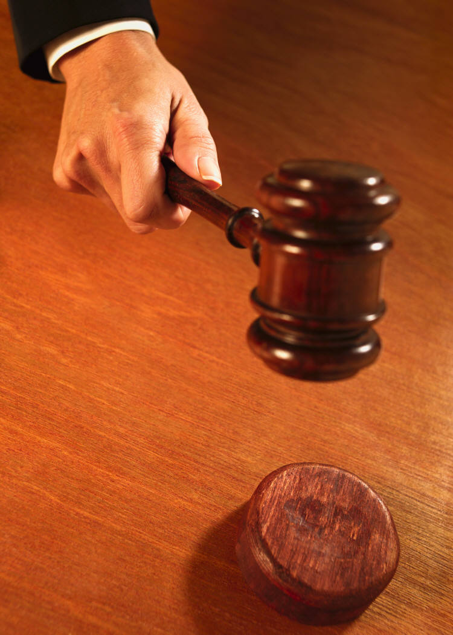
HOW DOES THIS AFFECT MY LIFE?
A PERFECT GOD…..
LOVES PERFECTLY &….
PRACTICES PERFECT JUSTICE

Slide 154
God’s Nature
Perfect Justice
Next…
WHY GOD MUST PUNISH INJUSTICE

Slide 155
HOW DOES THIS AFFECT MY LIFE?
A perfect and holy God must, by his nature, punish sin (which is injustice or violation against God & his laws).
For example, if a mother never punished her child for ongoing steeling, she would, in effect, be condoning that steeling.

Slide 156
HOW DOES THIS AFFECT MY LIFE?
If God did not decree an appropriate punishment for our sins, he would be condoning our sins, like the above-referenced mother with her child.
Therefore, due to his perfect, holy & just nature God must punish sin/injustice.

Slide 157
We have discussed:
God’s Nature
Perfect Justice
God Must Punish Injustice
Next…
ARE YOU PERFECT?

Slide 158
HOW DOES THIS AFFECT MY LIFE?
QUESTION:
Can you stand in front of God and claim you have never disobeyed any of his laws? Can you claim perfection?
Hint…can you walk on water?

Slide 159
HOW DOES THIS AFFECT MY LIFE?
For example:
God’s two greatest commands are to love God with all your heart, mind & strength and to love your neighbor as yourself.
Everyone messes up on those two each day!

Slide 160
HOW DOES THIS AFFECT MY LIFE?
More examples:
Ever lied? Ever commit sexual lust?
Ever been rude? Selfish? Unkind?
How about unforgiving? Prideful?
Less than loving?

Slide 161
HOW DOES THIS AFFECT MY LIFE?
Well, so far, it has been established that you are a:
lying, adulterous, rude, selfish, unkind, unforgiving, prideful, and often an unloving person!!!
Shall we proceed with more proof?

Slide 162
HOW DOES THIS AFFECT MY LIFE?
On a human level, you may be a very nice, “together” person.
However, it is God’s perspective that counts here. He evaluates human behavior based on PERFECT justice, based on his perfect laws. He can do no other.

Slide 163
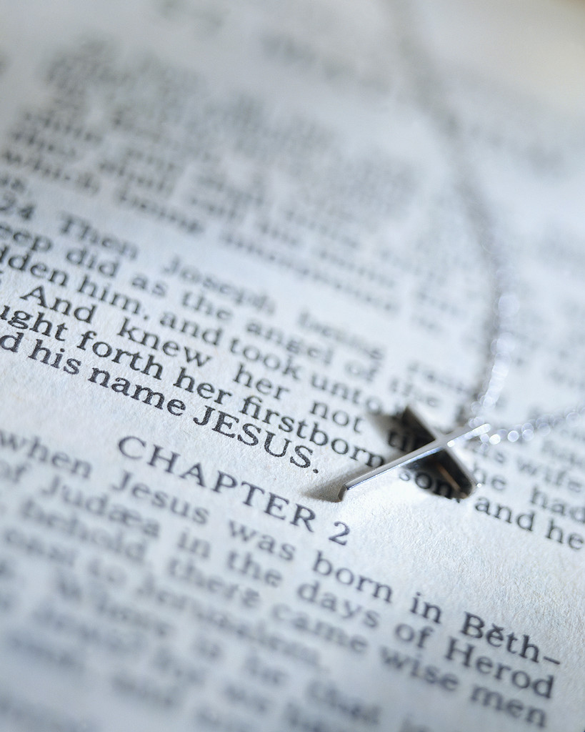
HOW DOES THIS AFFECT MY LIFE?
The Bible says all have sinned:
Rom. 3:10, 12 - “…There is no one that is righteous, not even one….All have turned away.”
Rom. 3:23 – “…for all have sinned, and fall short of the Glory of God,”
I John 1:9 – “If we claim we have not sinned, we make him [God]) out to be a liar,…”

Slide 164
HOW DOES THIS AFFECT MY LIFE?
SO FAR, IT HAS BEEN ESTABLISHED:
That God practices perfect justice
He must punish sin or injustice
Each of us is guilty of sin or injustice

Slide 165
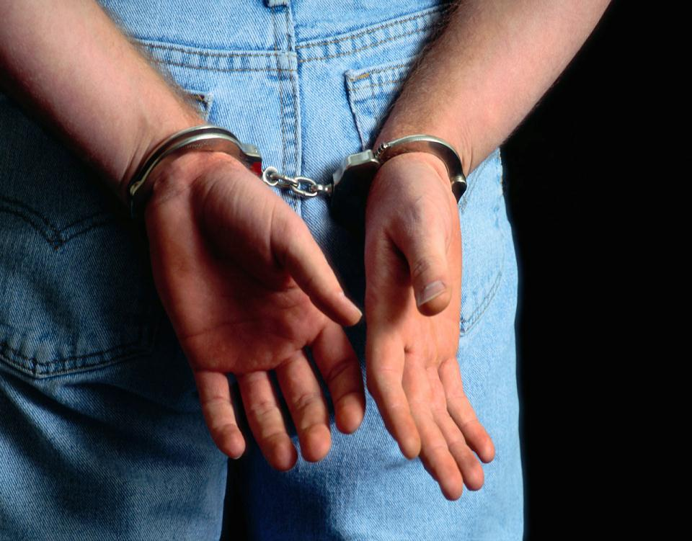
HOW DOES THIS AFFECT MY LIFE?
Therefore,
each of us stands guilty of sin in front of the Throne of God

Slide 166
We have discussed:
God’s Nature
Perfect Justice
God Must Punish Injustice
Are You Perfect? NOOO!
Next…
JUSTICE REQUIRES AN
APPROPRIATE PUNISHMENT OF INJUSTICE

Slide 167
HOW DOES THIS AFFECT MY LIFE?
Since each of us is guilty before God, each of us is subject to the result of perfect justice. Perfect justice, of course, requires the appropriate punishment

Slide 168
We have discussed:
God’s Nature
Justice
God Must Punish Injustice
Are You Perfect?
Justice & Punishment
Next…
WHAT IS THE APPROPRIATE PUNISHMENT FOR OUR SIN/INJUSTICE?

Slide 169
HOW DOES THIS AFFECT MY LIFE?
The Bible states that the appropriate punishment for sin is spiritual death:
Rom. 6:23 – “For the wages of sin is death,…”
Spiritual death is the only appropriate punishment for our sins!

Slide 170
HOW DOES THIS AFFECT MY LIFE?
Spiritual death = eternal separation from God.
Since God is the ultimate source of all love, care, hope, peace, joy, & all the positive aspects of creation, separation from God also means separation from all these things, too.

Slide 171
HOW DOES THIS AFFECT MY LIFE?
Eternal separation from God involves even more than this.
Suffice it to say, it is called “Hell” for a very good reason!

Slide 172
HOW DOES THIS AFFECT MY LIFE?
“But wait a minute!” you might say, “Isn’t that punishment by a loving God too harsh for the crime of our sins?”

Slide 173
HOW DOES THIS AFFECT MY LIFE?
Isn’t it usually the perpetrator of the crime who usually thinks his punishment is too severe?
While the symptoms of sin are selfishness, rudeness, unkindness, lying, lust, etc., the overall cause of sin is………

Slide 174
HOW DOES THIS AFFECT MY LIFE?
TREASON/REBELLION AGAINST GOD CAUSED BY HUMAN PRIDE:
It is man’s attempt to overthrow God, rule his own life, & become his own “god”
Remember Satan’s original lie to Eve, “You shall become as gods?”
Mankind has been falling for that one ever since!!!

Slide 175
HOW DOES THIS AFFECT MY LIFE?
Eternal separation from God is also God saying, in effect:
“If you do not want me in your life, then I will grant you your wish. You can rule over your own little ‘universe’ forever.”
Talk about loneliness!

Slide 176
HOW DOES THIS AFFECT MY LIFE?
A judge does not send a murderer (etc.) to prison; the guilty party’s actions sends him or her to prison.
Similarly, God does not SEND people to hell; people without forgiven sin send themselves there.
It saddens God immensely.

Slide 177
HELP!
Or to put it another way…
“How do we get out of this mess?”

Slide 178
HOW DOES THIS AFFECT MY LIFE?
If there is a solution, it can only be by one or two methods:
By man’s efforts and/or
By God’s efforts

Slide 179
We have discussed:
God’s Nature
Justice
God Must Punish Injustice
Are You Perfect?
Justice & Punishment
Punishment for Our Injustice
Next…
CAN MAN SAVE HIMSELF
BY HUMAN EFFORT???

Slide 180
HOW DOES THIS AFFECT MY LIFE?
Suppose you hit a friend, destroying that relationship. Then in an effort to heal it you go off and do all sorts of good deeds (giving money to charity, helping other people, etc.).

Slide 181
HOW DOES THIS AFFECT MY LIFE?
QUESTION:
Do those good works
heal your relationship with
your friend whom you hit?

Slide 182
HOW DOES THIS AFFECT MY LIFE?
“OF COURSE NOT!”
you may reply, thinking the answer is obvious.

Slide 183
HOW DOES THIS AFFECT MY LIFE?
You are right!
What is the obvious true answer?
Duh!...You go back to your friend and ask him for forgiveness and depend on his love to forgive you.

Slide 184
Forgiveness is a free gift,
and is definitely not earned!
Obvious!

Slide 185
HOW DOES THIS AFFECT MY LIFE?
The Bible is clear: human effort has nothing to do with salvation and those who try to do so will not have their sins forgiven:
Eph. 2:8-9 – “For it is by grace [undeserved merit] you have been saved, through faith – and this not from yourselves, it is the Gift of God – not by works, so that no one can boast.”

Slide 186
Gal. 3:16 – “We….know that a man is not justified by observing the law [doing good deeds], but by faith in Jesus Christ. So we too, have put our faith in Jesus Christ that we might be justified by faith in Christ and not by observing the law, because by observing the law no one will be justified.
Rom. 2 – 3, 10; John 3:16-18, etc.

Slide 187
HOW DOES THIS AFFECT MY LIFE?
Of all the religions, only Christianity says works have nothing to do with salvation, or healing your relationship with God, who you have sinned against (according to the Bible sin separates us from God, it is like spiritual treason, much worse than “hitting him in the face”).

Slide 188
HOW DOES THIS AFFECT MY LIFE?
So, logic, common sense and the Bible agree:
A person cannot obtain God’s forgiveness by human effort.
So, that brings us to the second, and last possible, question….

Slide 189
We have discussed:
God’s Nature
Justice
God Must Punish Injustice
Are You Perfect?
Justice & Punishment
Punishment for Our Injustice
Can Man Save Himself?
Next…
CAN GOD SAVE US?

Slide 190
HOW DOES THIS AFFECT MY LIFE?
All religions (except Christianity) teach salvation by human effort, and it has been shown that “works for salvation” makes no sense.
This leaves us with Biblical Christianity which says human effort has nothing to do with getting God’s forgiveness.
STAR CLUSTERS OF NEGC 1313: Credit – NASA, ESA, Anne Pellerin (STScI)

Slide 191
HOW DOES THIS AFFECT MY LIFE?
Only the Bible gives us our obvious answer: you go back to God and ask him to forgive you of your sins against him & depend on his love to forgive you.
However, this is only possible because of what Jesus (God) did.
STAR CLUSTERS OF NEGC 1313: Credit–NASA, ESA, Anne Pellerin (STScI)

Slide 192
JESUS CHRIST
IS
THE MEANS OF OUR SALVATION

Slide 193
Jesus Christ (who is Creator God) demonstrated his love by taking on human flesh:
“In the beginning, was the Word [Jesus] and the Word was with God, and the Word was God,…The Word became flesh and made his dwelling among among us.” (John 1:1, 12)

Slide 194
He knew we could not save ourselves, and because God (Jesus) loves us so much, he took our sins and their penalty (death) on himself by dying on the Cross. He rose from the dead 3 days later to prove his victory over sin and death.

Slide 195
By doing so, God’s punishment of sin has been accomplished. Justice is satisfied! It is sort of like a Judge who pronounces sentence on his daughter in a courtroom by fining her $500 for a traffic violation. He then takes off his judge’s robe and then pays her fine.

Slide 196
NOW, it is possible to go back to God, whom you have sinned against, to ask for forgiveness. He can forgive you because the crime of your sins has been paid for by Jesus. Justice is kept intact.
God wants a personal relationship with each one of his human creations.

Slide 197
Jesus is calling on you to be sorry for your sins, to ask him to forgive you of all your sins, and for you to depend on Him, his death for you, and his resurrection as the means of your salvation, and to make Him God, Lord (& friend) of your life.
Are you ready to walk the walk?

